Slide 1
National Executive Council Members
What do they do?
Virtual Meeting
February 12, 2025

Slide 2
Purpose of this gathering:
Share ins and outs of serving on the OFS USA National Executive Council
Qualifications, General Duties, Skills, Expectations
Specifics from each current member
Share how to submit nominations and general process
Answer questions

Slide 3
Opening Prayer
https://themodernpsalmist.com/songs/servant-song/

Slide 4
National Elective Chapter:
September 9-14, 2025
Elections – Saturday, September 13, 2025
Nominations Committee created
Theresa Pratt, OFS (St. Elizabeth of Hungary Region)
Gigi Gregory, OFS (Our Lady of Guadalupe – Empress of the Americas Region)
Need a slate 60 days prior.
Need nominations

Slide 5
Applicable Citations
Look to legislative documents:
OFS General Constitutions
Articles 51, 52, 65-68, 75
International Statutes
Articles 8, 25-27, 46-49
National Statutes
Articles 5, 6, 11, 13

Slide 6
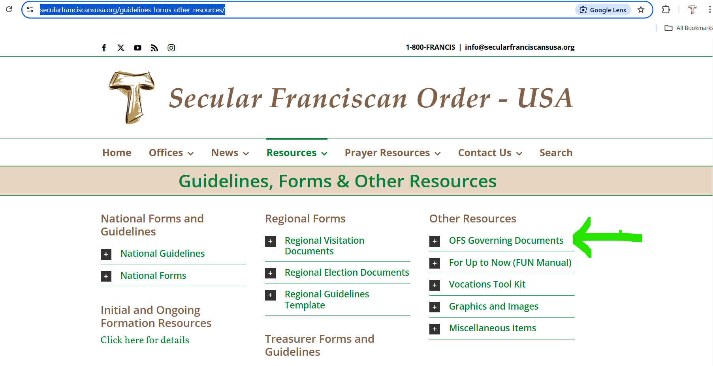
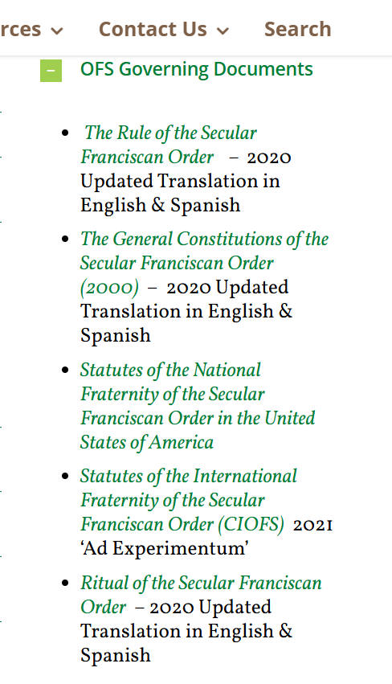
https://www.secularfranciscansusa.org/guidelines-forms-other-resources/

Slide 7
Qualifications:
International Statutes Article 8 (adopted Nov 2024)
perpetual Profession for at least 2 years;
experience of animation/leadership in an OFS Council;
no civil or ecclesiastical incompatibility;
active participation in one's local Fraternity;
not holding a leadership position in political parties

Slide 8
Skills
Proficient with MS Word, virtual meeting and email technology
Ability to travel (physically and time)
Familiarity with OFS legislative documents
And much more….
Passionate about OFS vocation
Collaborative in nature
Organized
Able to communicate in writing and orally
Responds to emails and phone calls in a timely manner

Slide 9
Positions of the National Executive Council
National Minister
National Vice-Minister
National Secretary
National Treasurer
International Councilor
National Councilor (three positions)

Slide 10
Positions of the National Executive Council
National Minister
National Vice-Minister
National Secretary
National Treasurer
International Councilor
National Councilor (three positions)

Slide 11
Positions of the National Executive Council
National Minister
National Vice-Minister
National Secretary
National Treasurer
International Councilor
National Councilor (three positions)

Slide 12
Positions of the National Executive Council
National Minister
National Vice-Minister
National Secretary
National Treasurer
International Councilor
National Councilor (three positions)

Slide 13
Positions of the National Executive Council
National Minister
National Vice-Minister
National Secretary
National Treasurer
International Councilor
National Councilor (three positions)

Slide 14
Positions of the National Executive Council
National Minister
National Vice-Minister
National Secretary
National Treasurer
International Councilor
National Councilor (three positions)

Slide 15
Nominations Process
Nominations are open until April 30, 2025
Two ways to submit nominations:
Submit through Google Link
email Theresa and Gigi
Committee will check nominees meet qualifications and then contact nominees to confirm acceptance of nomination
Slate will be shared by early July 2025
Of course, nominations will be accepted from floor

Slide 16
Questions?
Raise Hand through Zoom
Nominations Process
Qualifications
Enter question in Chat
If we run out of time, you can reach out to members individually after this meeting
Pray as we prepare for the election

Slide 17
Almighty, most high and supreme God, Father, holy and just, Lord, King of heaven and earth: we give you thanks for yourself.
We ask you to inspire members to respond to the call for service to the National Council.
Inspire those who are able to animate and guide us by their example, their virtues and prudent decisions so that the gospel of Jesus in the spirit of St. Francis may come alive in our community.
We ask this through Christ our Lord.
Prayer based on Ritual Secular Franciscan Order (CIOFS) 2020

Slide 18
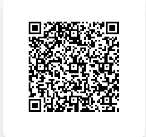
Nominations Form

