Slide 1
State of the Order 2025
OFS-USA Chapter
Bons Secours Retreat Center
Marriottsville, Maryland
September 10, 2025
Jane DeRose-Bamman OFS
National Minister, OFS-USA
on behalf of the National Executive Council (NEC)
Notes:
Slide 1: Good Morning Sisters and Brothers!
Praise be Jesus Christ. Now and Forever!

Slide 2
Our goal is to become holy, to show God’s love to the world, to make the life of others better, to get closer to God and to bring others closer to God.
Tibor Kauser, OFS
Letter of the Minister General
June 24, 2018

Slide 3
Overview
The facts and figures
The priorities and accomplishments
Who we are as an Order in the United States –
are we making a difference?
how are we transformed?
What’s next?
Notes:
Slide 2:

Slide 4


Slide 5
Facts and Figures
Our ever-improving tool – the database –
is a gift to the OFS-USA.
details of our order that we really didn’t have access to before.
make sure data is entered and accurate.

Slide 6
Observe the Rule, that helps you to follow Christ in every moment of your life, in all the aspects of your life.
Tibor Kauser, OFS
Letter of the Minister General
June 24, 2018

Slide 7
Total Active professed

Slide 8
Key Factors – Fraternities
Vocations are cultivated by good fraternities – the privileged place. OFS Art 22
Regions and the CNSA have been working to “prune” our fraternities.
20 fraternities have been deactivated in the last few months.

Slide 9
Breakdown of regions by fraternities
4 Regions with
< 7 Fraternities
6 Regions with
25-32 Fraternities
9 Regions with
8-15 Fraternities
11 Regions with
16-24 Fraternities

Slide 10
Breakdown of regions by fraternities
≤ 7 Fraternities (4 Regions) | 8- 15 Fraternities (9 Regions) | 16 – 24 Fraternities (11 Regions) | 25 – 32 Fraternities (6 Regions)
Franciscans of the Prairie Our Lady of the Rockies Ohana O’ Ke Anuenue Saint Clare | Holy Trinity Juan de Padilla Our Lady of Guadalupe – EOA Our Lady of Indiana Saint Joan of Arc Saint Maximilian Kolbe Saint Thomas More Santa Maria de Las Montanas Troubadours of Peace | Divine Mercy Lady Poverty La Verna Los Tres Companeros Mother Cabrini Queen of Peace Saint Elizabeth of Hungary Saint Frances Saint Junipero Serra Saint Kateri Tekakwitha Tau Cross | Blessed Solanus Casey Brothers and Sisters of St. Francis Five Franciscan Martyrs Our Lady of the Angels Saint Katharine Drexel Saint Margaret of Cortona
Notes:
Here’s the breakdown of small and large regional fraternities by # of fraternities.

Slide 11
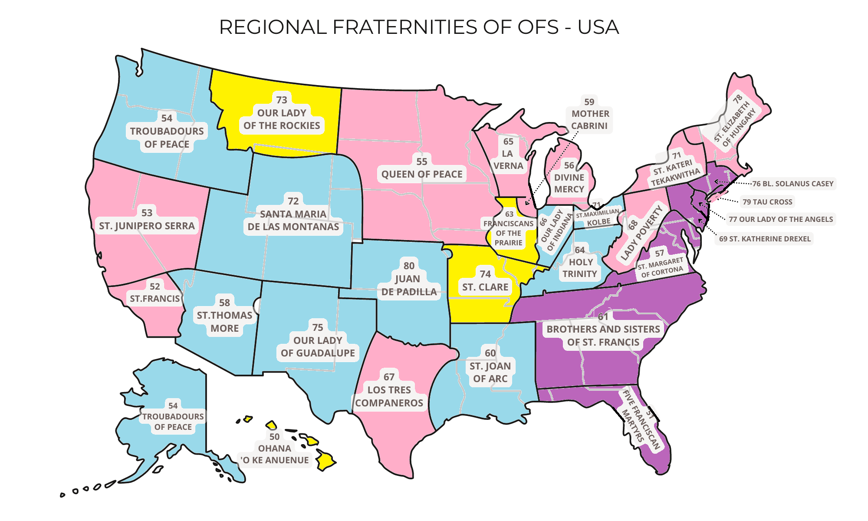

Slide 12
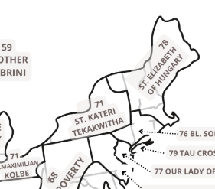
Breakdown of Fraternities by age
Which is the oldest fraternity in the United States? (according to the database)
Saint Joseph- Utica-NY
Saint Kateri Tekakwitha Region
Established 4/1/1859
166 years

Slide 15
We do not have a sewn and tailored habit…
We have a habit…of the way we live our life…
Our habit is our prayer, our sacramental life, our commitment to the Order, and thus to the fraternity. Our habit is our Franciscan way of life, that we live “going from gospel to life and life to gospel.”
Tibor Kauser, OFS
Letter of the Minister General
June 24, 2018

Slide 16

Breakdown of Age of Members
What’s the age of our
oldest member in the
United States?

Slide 17
Knowing our members help us to serve them better

Slide 18
Generational Categories
1925-1945 | Greatest Generation or older
1946-1964 | Baby Boomers
1965-1980 | Gen X
1981-1996 | Millennials
1997-2012 | Gen Z

Slide 20
Bottomline
Membership declining
Members are aging
Consistent numbers in the last 50 years in fraternity establishment
Emphasis on strong fraternities will help to boost vocations
Need to make sure we are using appropriate means of outreach for various generational groups

Slide 21
Notes:
Slide 3: Our priorities are VCR – vocations, communications, relationships.
How are we doing as an Order?

Slide 22
The Rule is an empty text if we do not turn it into life.
Tibor Kauser, OFS
Letter of the Minister General
June 24, 2018

Slide 23
National Fraternity
Commissions
(consultative role)
Formation Commission
Justice, Peace and Integrity of Creation Commission
Youth/Young Adult Commission
National Executive Council
Minister International Councilor
Vice Minister National Councilor
Secretary National Councilor
Treasurer National Councilor
Committees and Individual Appointments
Accessibility, Database, Archivist, Bookstore, Historian, 1-800-Francis, E/I, Multicultural, Tau-USA, Duns Scotus, Q, Centenaries
30 Regional Ministers
Conference of National Spiritual Assistants
President In Turn (serves on NEC) +3 other Friars

Slide 24
Accomplishments
Action Plan –
16 Goals – to achieve improved Vocations/Communications/Relationships
Workshops
JPIC – 2025 retreat
CNSA/NFC – 2024 Retreat
Database/Website/Tau-USA
Participation in the OLG Synod
Response to appeals for Leprosy Center/Floods in TX

Slide 25
Accomplishments
Relationships with our National Fraternity Council
Fraternal Visitations – 7 since last Chapter, 26 over 3 years
Regional Elections – 15 since last Chapter, 32 over 3 years
Virtual Meetings with the National Fraternity Council
Meet and Greets - virtually

Slide 26
Accomplishments
Guidelines
Review of International Statutes
participation at CIOFS General Chapter (Nov 2024)

Slide 27
The Rule does not want us to be uniform, but to unite us in diversity.
Tibor Kauser, OFS
Letter of the Minister General
June 24, 2018

Slide 28
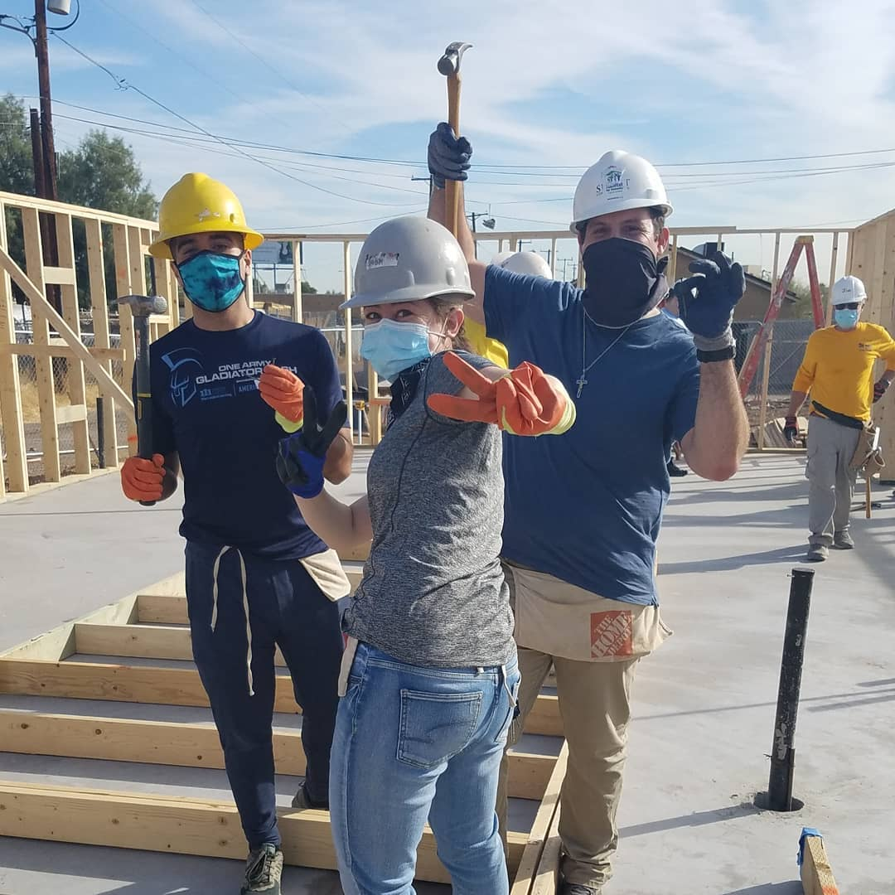
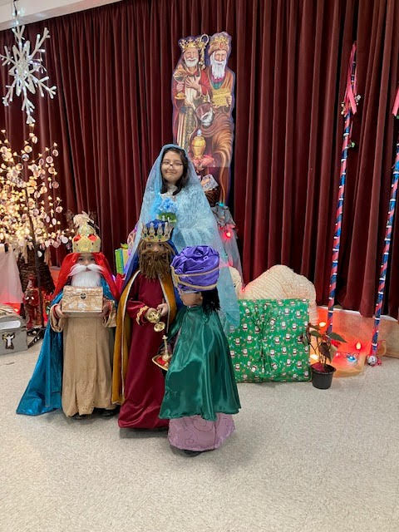
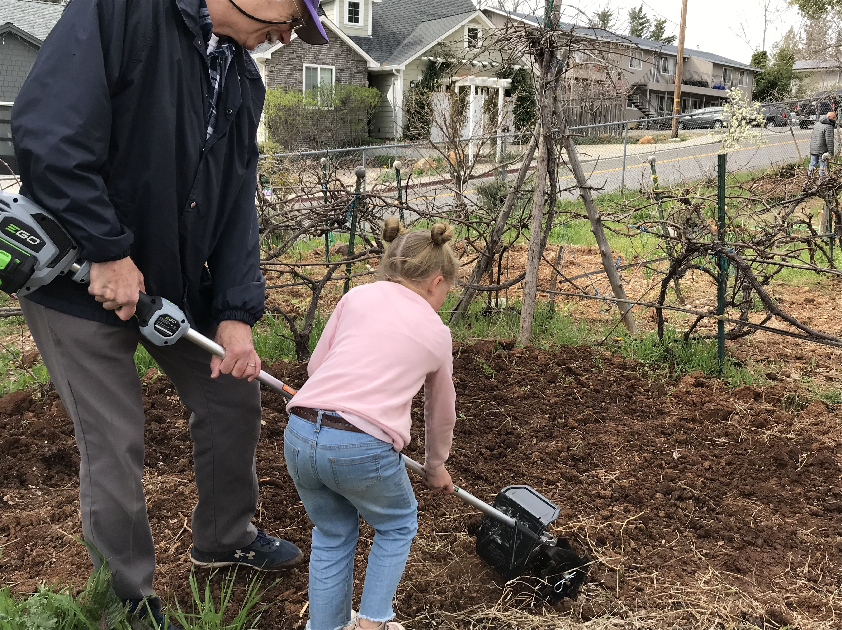
Who We Are

Slide 29
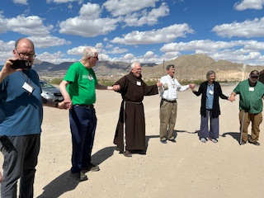
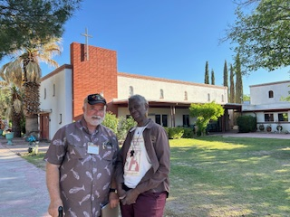
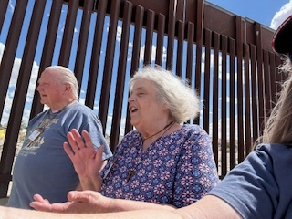
Who We Are

Slide 30
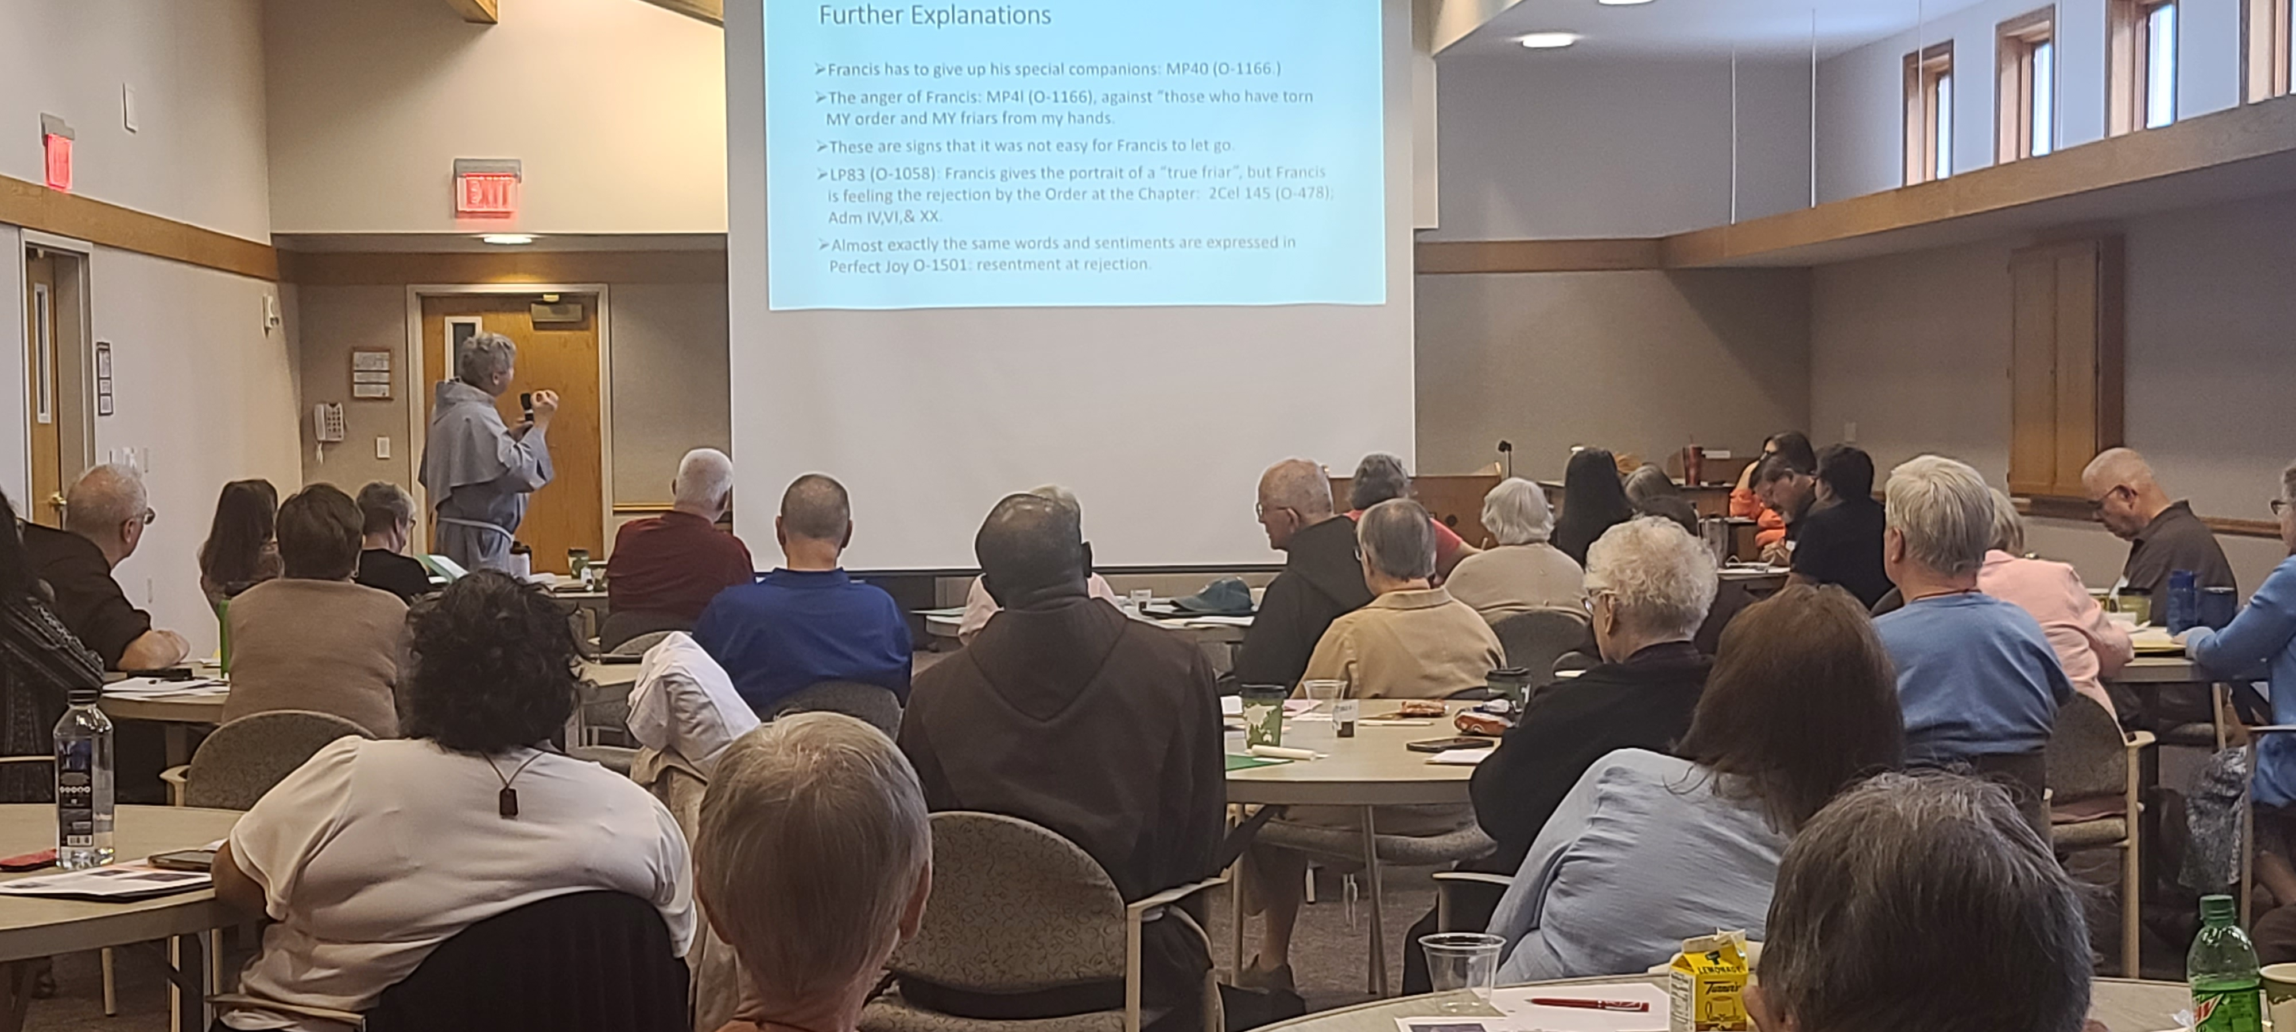
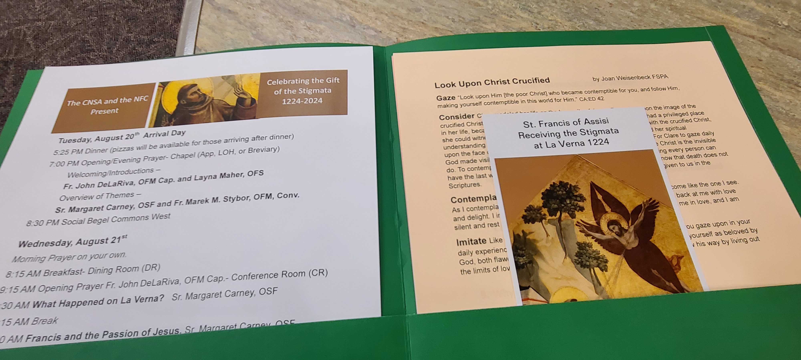
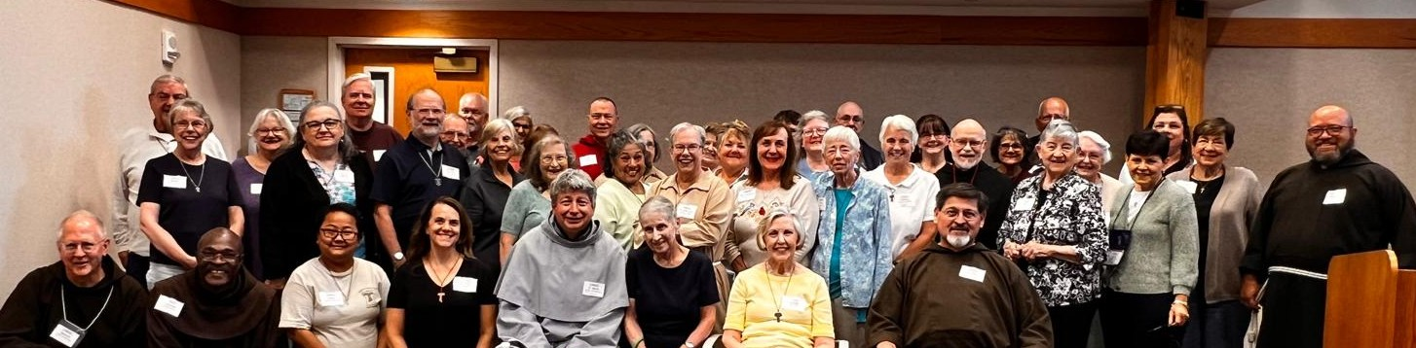
Who We Are

Slide 31
Who We Are
Shelters for those without homes
Pregnancy Centers/Pro-Life Ministry
Evangelization
Ministry to Poor (domestically and internationally)
Care for Creation
Education
Care for the Elderly and orphaned
Assistance to Refugees/Immigrants
St Vincent De Paul Services/food/clothing
Formation
Legislative Advocacy
Advocate against Human Trafficking
Food Pantries

Slide 32
What’s next?
National Statutes Revision
Communications Manual roll out
Branding/Vocational Materials
Guidelines
Translations
TAU-USA
2031 Q
Action Plan for new priorities
Review Appointments
Celebration of the 50th Anniversary of OFS Rule (2028)
Youth/Young Adult
Transitioning of Responsibilities
Management of the Bequest
And more……

Slide 33
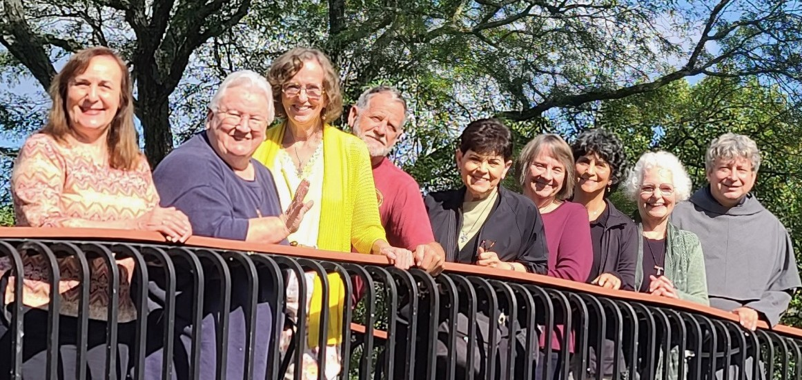
We were honored to care for you on our journey.
OFS-USA National Executive Council (2022-2025)
Mary Frances Charsky OFS, Cherryle Fruge OFS, Donna Hollis OFS, Joshua Molidor OFS
Diane Menditto OFS Claudia Kauzlarich OFS, Jane DeRose-Bamman OFS
Susan Ronan OFS, Fr. Marek Stybor, OFM Conv (CNSA President-In-Turn)
Notes:
Slide 34: It’s been a busy period so far….and we are still smiling!
We’d like to commend the Regional Ministers (and your executive councils) for the times you’ve grappled with issues on your own and acknowledge the times you brought issues to us so we can collaborate to resolve them early on.
Thank you for your support and quick responses to our requests for information and feedback..

Slide 34
Our goal is to become holy, to show God’s love to the world, to make the life of others better, to get closer to God and to bring others closer to God.
Tibor Kauser, OFS
Letter of the Minister General
June 24, 2018

Slide 35
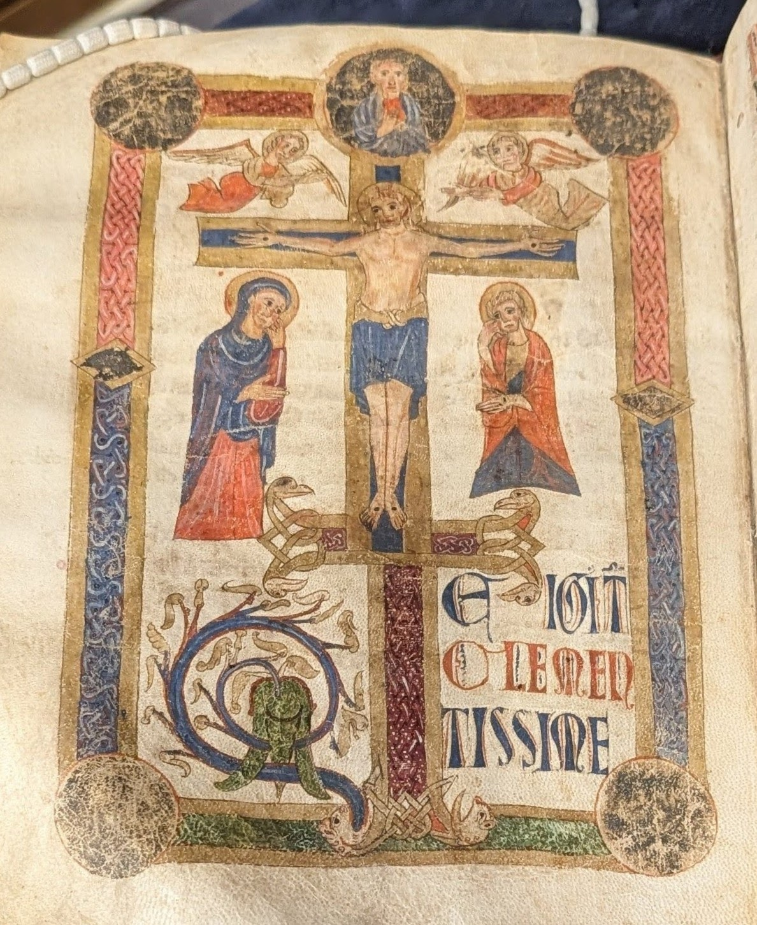
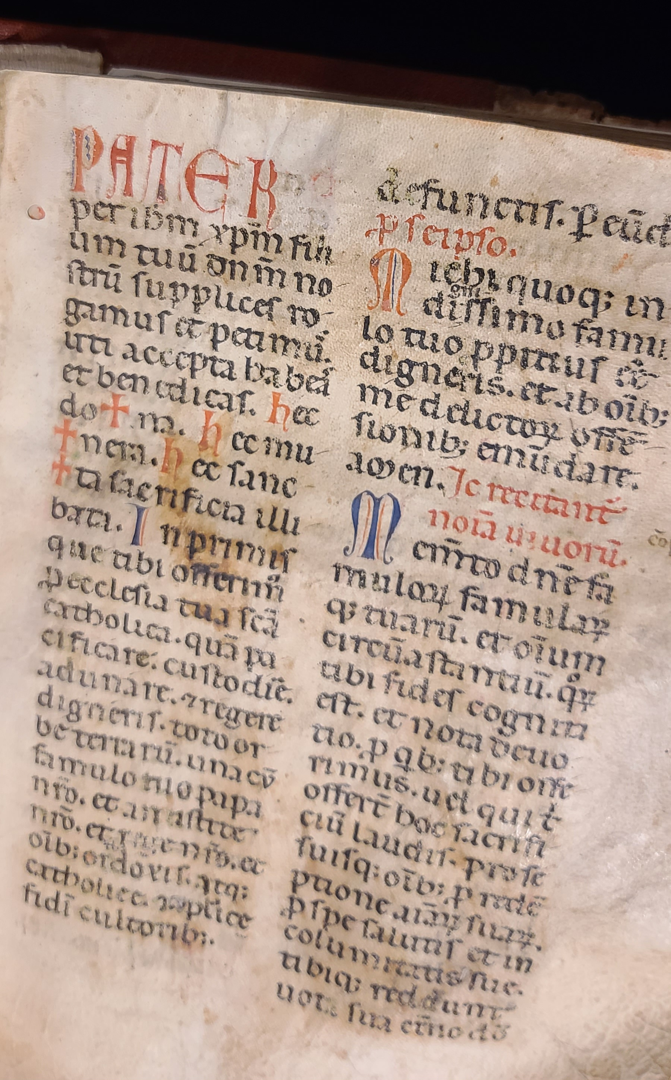

Slide 36
