Slide 1
State of the Order
Secular Franciscan Order in the United States
OFS-USA Chapter
Spiritual Life Center
Bel Aire, Kansas
October 14, 2026
Jane DeRose-Bamman OFS
National Minister, OFS-USA
on behalf of the National Executive Council (NEC)
Notes:
Slide 1: Good Morning Sisters and Brothers!
Praise be Jesus Christ. Now and Forever!

Slide 2
National Fraternity Council
Commissions
(consultative role)
Formation
Justice, Peace and Integrity of Creation
Vocations and Communications*
Youth/Young Adult
National Executive Council (NEC)
Minister International Councilor
Vice Minister National Councilor
Secretary National Councilor
Treasurer National Councilor
Committees and Individual Appointments
Accessibility, Archivist, Communications/PR, Database, Bookstore, Historian, 1-800-Francis, E/I, Multicultural, Tau-USA, Duns Scotus, Quinquennial, Centenaries
30 Regional
Ministers
Conference of National Spiritual Assistants
President In Turn (serves on NEC) +3 other Friars
*Vocations and Communications Commission (VCC) created in 2026. Not specified in National Statutes yet.

Slide 3

Notes:
Slide 2:

Slide 4
Last’s year’s “What’s next?”
National Statutes Revision
Communications Manual roll out
Branding/Vocational Materials
Guidelines
Translations
TAU-USA
2031 Q
Action Plan for new priorities
Review Appointments
Celebration of the 50th Anniversary of OFS Rule (2028)
Youth/Young Adult
Transitioning of Responsibilities
Management of the Bequest
And more……

Slide 5
Overview
Facts and figures
  Membership
Accomplishments
What does Living the Gospel look like
What’s next?
Notes:
Slide 2:

Slide 6
Total Professed Members of OFS-USA (Active and Excused)
5% decrease from 2024

Slide 7
What Happened in 2025?
797 deaths, withdrawals, lapsed, suspended
341 professions

Slide 8
Category of Membership | Total 2023 | Total 2024 | Total 2025 |  | 2026 (thru 9/9) |  | Variance 2025 and 2026
total professed (active + excused) | 9,052 | 9,277 | 8,826 |  | 8,829 |  | 3
total active candidates | 649 | 701 | 749 |  | 706 |  | -43
total active aspirants inquirers |  |  | 288 |  | 265 |  | -23
total active aspirants orientees |  |  | 103 |  | 92 |  | -11
about 1,000 in formation

Slide 9
315 SAs

Slide 10
Good News…..
Number of Local Spiritual Assistants – increased by 3% in 2025 over 2024

Slide 11
Knowing our Membership
Demographics

Slide 12
OFS-USA Members by Category as of 9/9/2026
Category | Total # as of 9/9/2026 | Generation | Birth Year Unknown
Active Professed | 8,829 | 7,101 | 1,728 | 20%
Active Candidates | 706 | 560 | 146 | 21%
Aspirants Inquirers | 265 | 226 | 39 | 15%
Aspirants Orientees | 92 | 74 | 18 | 20%

Slide 14

OFS Members by Birth Year (known) as of 9/9/2026
Generation | Birth Year Range | Age Range | # of Members in Generation* | Percentage of Membership (w/ Known Birth Year Data)
Greatest Generation | 1901-1927 | 100+ years old | 25 | 0.3%
Silent Generation | 1928-1945 | 81-99 years old | 1,938 | 25.2%
Baby Boomers | 1946-1964 | 62 - 80 years old | 4,863 | 63.2%
Gen X | 1965-1980 | 46 - 61 years old | 921 | 12.0%
Millennials | 1981-1996 | 30 - 45 years old | 179 | 2.3%
Gen Z | 1997-2012 | < or =29 years old | 35 | 0.5%
*4 out of 5 members (80%) provided birth year.

Slide 15
Conclusions
Although the stats are every changing, rate of attrition is stabilizing
Respectable number of persons in Formation stages (1,000 persons)
Spiritual Assistants increased
Members in each age bracket

Slide 16
Reviewing the numbers are important
Trends
Overall message of what’s happening
But do not tell the whole story

Slide 17
What Was Accomplished to Impact the Trend?
Efforts on the National Level

Slide 18
Communications/ Social Media
Website
Facebook
1-800-Francis emails and calls
Newsletter
Communications with National Fraternity
Appointments
Bookstore

Slide 19
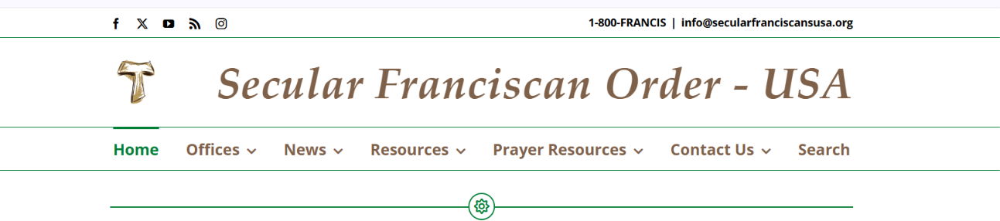
Website
www.Secularfranciscansusa.org
Website Team – Sharon Winzeler, Jim Thomas, Terri Leone, Carolyn Seal, Michael Gath, Miriam Kennedy

Slide 20
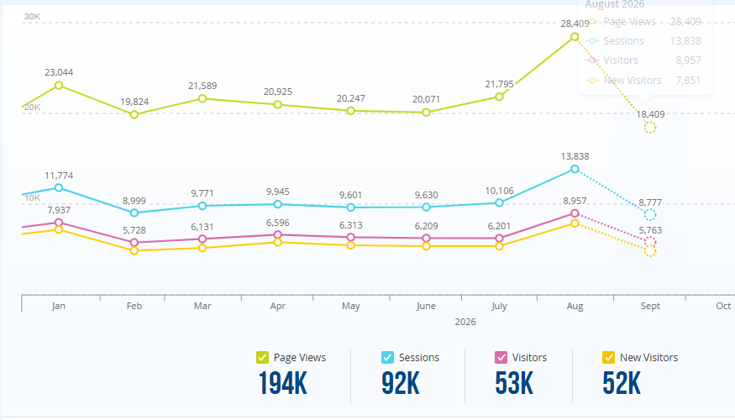
Website Activity – 2026 Year to Date

Slide 21
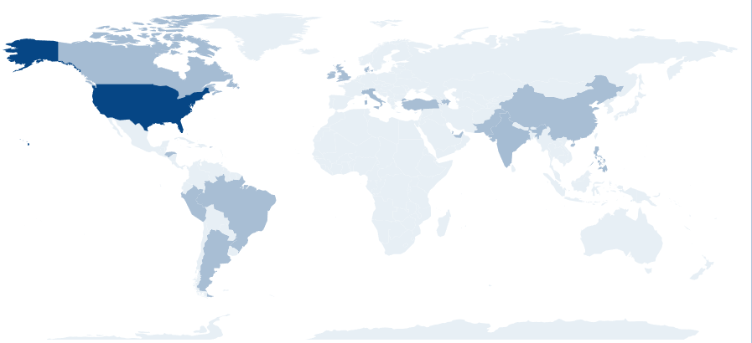
Locations of Visitors to the Website (7-hour period) on 09/27/2026
Location | % age of views
USA | 90
Italy, Philippines, India, Canada | 1-2 each
14 other countries | <1 each

Slide 22
Website – keeping content fresh
Voices of Gospel Living – Articles of the Rule
Blogs
Homilies by Fr. Christopher
Slider
Centenaries
Links to FB page

Slide 23
Facebook
Secular Franciscans, USA
Barb Scott,OFS
Diane Menditto, OFS
Christine Blood, OFS

Slide 24
Facebook
597,900 views (up 5% over last year)
1
1100 reels viewed 3 seconds or longer (up 31% over last year)
2
20,200 content interactions (likes, reactions, saves, comments, shares, etc) (down 23.5% over last year)
3
10 hours, 30 mins of watch time (time reels played/ replayed (up 11.8% over last year)
4

Slide 25
Facebook – Top Content
Casting call for the talent show at the Q
Pope Leo XIV calls Franciscans to possess the source of inner peace and be instruments of God’s peace.

Slide 26
1-800-Francis - Fran Acosta, OFS
Average Number of
Communications
(April 2024-August 2026)
Emails
Calls
12/month

Slide 27
1-800-Francis Inquiry Topics
The "Q" (Quinquennial Congress) Questions
Jubilee & Indulgences
Fraternity Locations & Contacts
Franciscan Items & Relics

Slide 28
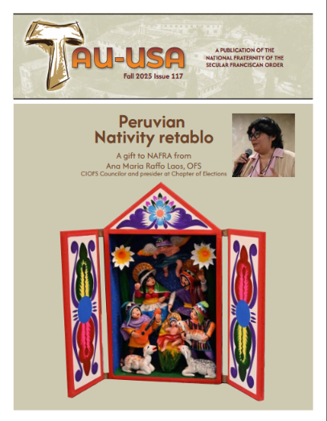



TAU-USA
Caroline Yandell, Editor

Slide 29

Gospel to Life Bookstore – Claudia Kauzlarich, OFS

Slide 30
Visitation and Elections
Updated documents and provided sample templates
Added a Google Form for Visitations: REC Self-Evaluation Form (15 questions)
Added an email address on the website to be used to request a Visitation/Election
Conducted 10 Visitations and 7 Elections in the last year (covered 16 Regions).
Met with over 600 members

Slide 31
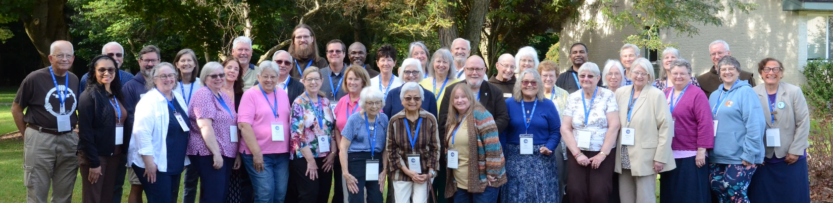
Divine Mercy Regional Visitation

Slide 32
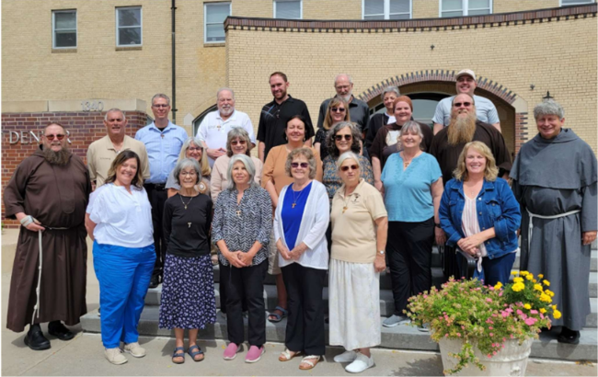
Santa Maria De Las Montanas Regional Visitation

Slide 33
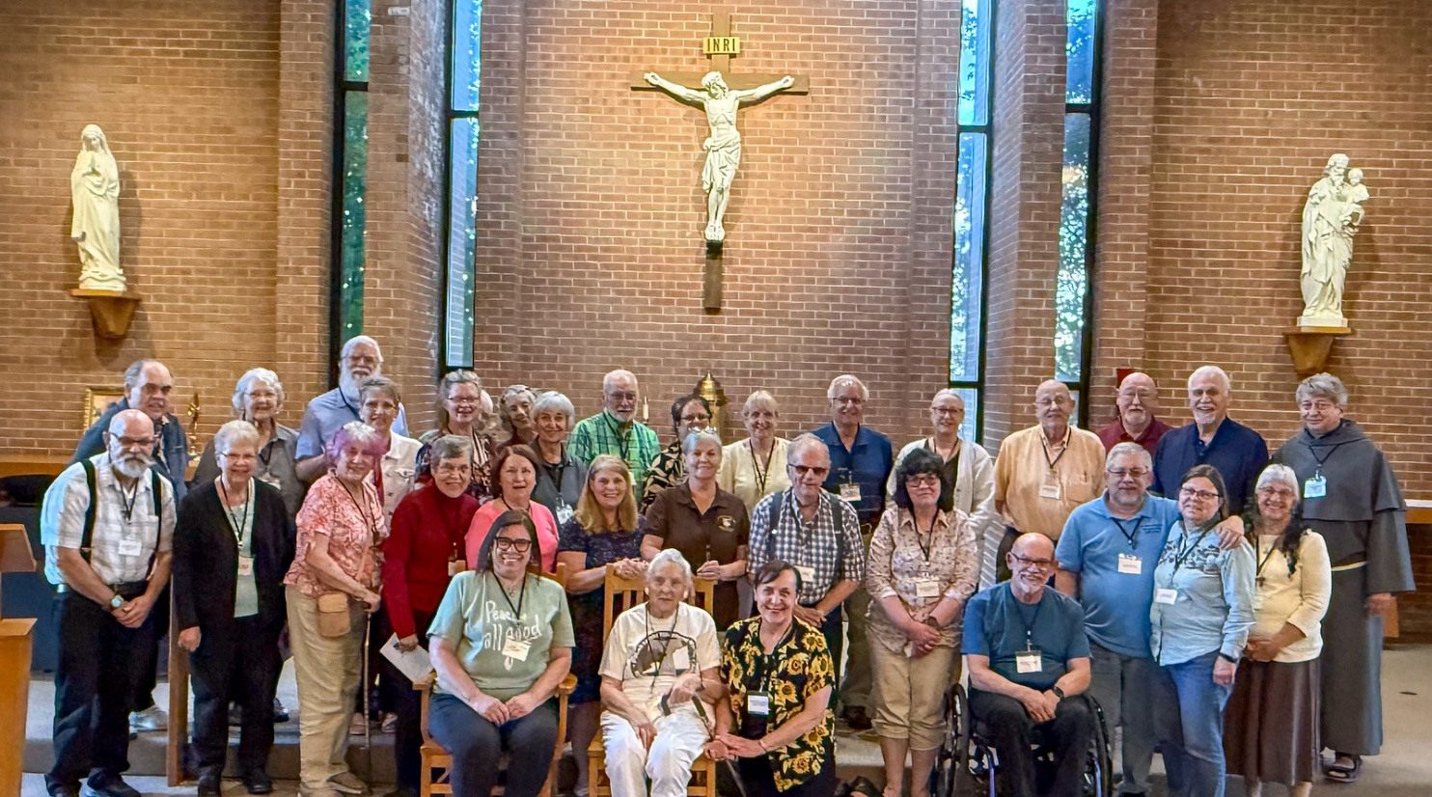
St. Kateri Tekakwitha Regional Visitation

Slide 34
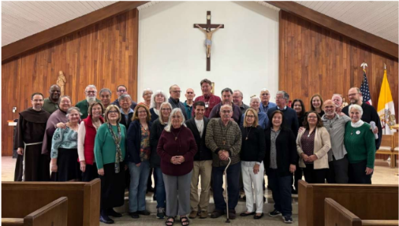
St. Margaret of Cortona Regional Visitation

Slide 35
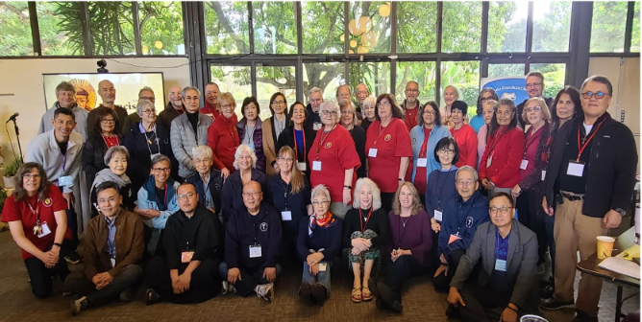
St. Francis Regional Visitation

Slide 36
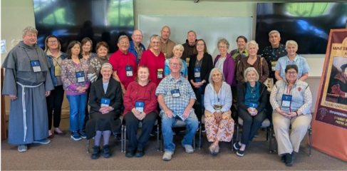
St. Thomas More Regional Visitation

Slide 37
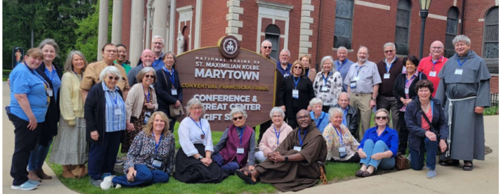
Mother Cabrini Regional Visitation

Slide 38
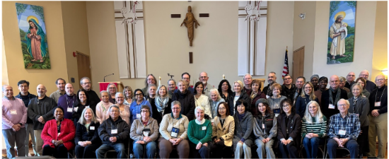
Our Lady of the Angels Regional Visitation

Slide 39
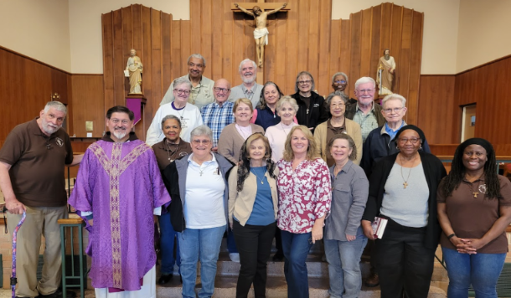
St. Joan of Arc Regional Visitation

Slide 40
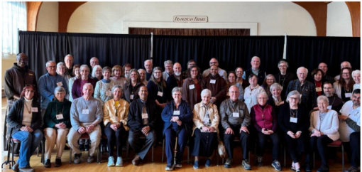
St. Elizabeth of Hungary Regional Visitation

Slide 41
Efforts to serve the members
Updated Transfer Document
Updated Regional contact on website to generic email
Quarterly meetings with their RM groups, work to provide similar agenda for consistent message
CNSA - focus on meeting with SAs at visitations and met with SAs who attended the Q
Sharing the messages from CIOFS in a timely manner.
Reviewed appointed positions

Slide 42
Vocations
Outreach methods as described above
Communications Manual updated and available on website
Contracted with a consulting firm to provide initial recommendations for improved marketing efforts. First two phases completed.
Entertained at the Q!

Slide 43
Commissions
Formation Chair – RFD sessions, progress on Formation texts, answering questions
Justice, Peace, Integrity of Creation –Topic based sessions, training, newsletters
Franciscan Youth/Young Adult – Sharing ideas – so we can build relationships
Vocations and Communications – initial consultant review

Slide 44
Committees and Individual
Appointments
Accessibility – Raising awareness from a variety of perspectives
Communications: Website, FB, 1-800-Francis, PR at Q,
Database – Manages the information, but also provides a means to communicate with members who have emails
Archivist – Stores the history - 2300 files – 120 boxes

Slide 45
Others adding to the mission
Ecumenical/Interfaith - transition
Multicultural - transition
Historian - transition
Mail Courier
Legal Team
"Q" 2031 – TBD
Duns Scotus Board – one term ending
Centenaries Task Force – concluding their service

Slide 46
What Was Accomplished to Impact the Trend?
Efforts on the Regional Level

Slide 47
Based on the annual reports from the regions, the efforts align into 5 categories.
Charity
Justice
Fraternity
Prayer/Formation
Humble Presence

Slide 48
Charity
Feeding and material aid — Dorothy Day House Ministry
Housing and shelter support — St. Anthony Shelter, Gianna House for pregnant women
Support for the imprisoned — letter-writing ministries to incarcerated persons (the Fr. Cedric Pen Pals ministry)
Care for the sick and dying — cemetery visits and prayer for deceased members, care for homebound and frail members, and 40 Days for Life participation.
Support for immigrants and refugees —sustained, personal accompaniment including ongoing legal and financial support for migrant children, funds toward immigration-hearing attorney fees for a refugee family
International solidarity — the H2O Project and support for a leprosy center in Zimbabwe

Slide 49
Justice
Anti-racism and reconciliation work
1
Advocacy for farmworkers
2
Structured reflection on conscience and action — resources like a "Franciscan Ecological Examination of Conscience".
3
Environmental stewardship — a Season of Creation engagement as a lived call to care for creation.
4
Pro-life and human-dignity engagement —prayer campaigns to direct material support for expectant mothers.
5

Slide 50
Fraternity
Committed to living the Gospel in our fraternities and in our communities
Unity across differenceS, camaraderie within a group, diverse in age, race, ethnicity, and even political viewpoint
hospitality and mutual care: visiting homebound members, celebrating professions and birthdays together
"fraternal love," "hospitality," "servant leadership," "presence"

Slide 51
Prayer and Formation
Liturgy of the Hours and Franciscan Prayer
Days of Recollection and retreats
The Transitus with Franciscan Family
"Formation Friday" materials, distributed nationally
Formation as spiritual deepening: instruction on the legislative documents is explicitly tied to "spiritual growth," not mere compliance.

Slide 52
Humble Presence
JPIC emphasis on empowering and accompanying local fraternities' own action.
1
Personal, sustained accompaniment of individual migrants (rather than only general advocacy)
2
Weekly Zoom rosaries, small book-study groups, and cemetery visits — modest, repeated acts of fidelity rather than headline projects.
3
Simply "living their vocation 'out loud'" — suggesting Gospel witness understood as consistent daily character
4

Slide 53
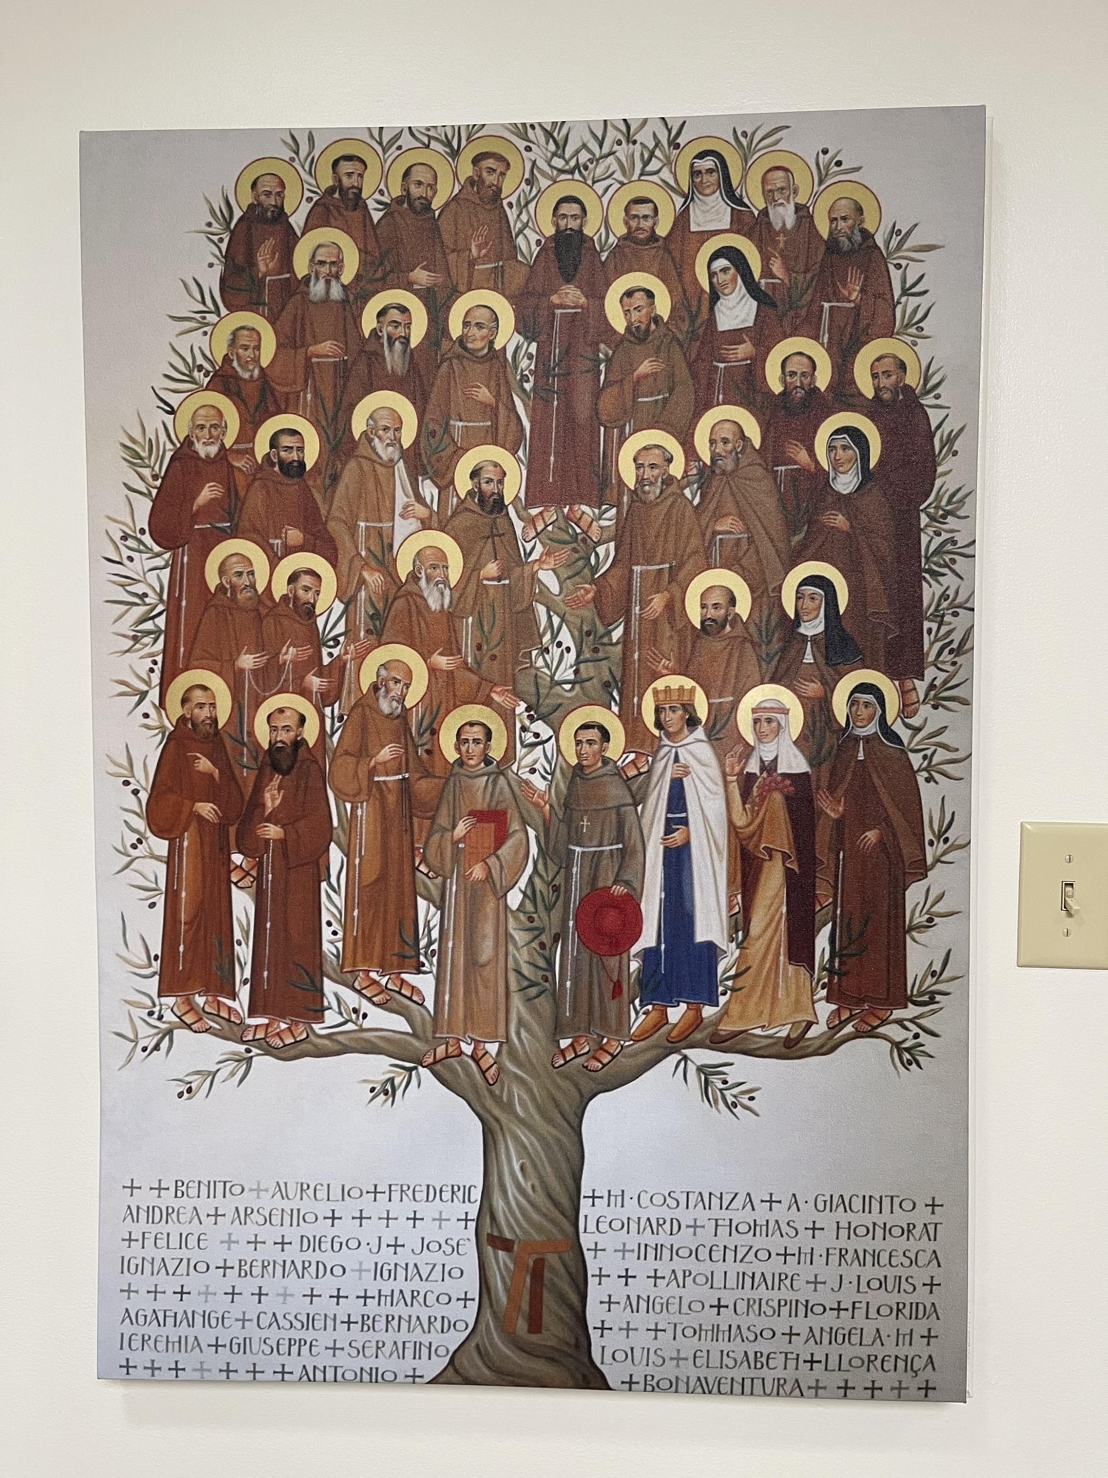
What’s the goal?

Slide 54
Goal: Thriving Local Fraternities
Rekindling the flame of our local fraternities – requires joint efforts.
RECs – spending time to know their fraternities
NEC, CNSA, Commissions and Committees – supporting the RECs and Local Fraternities
The numbers are not identifying the symptoms or diagnosing the problems

Slide 55

Concluding Thoughts
Attrition rate is stabilizing
Over 1000 in formation

Slide 56

We are more than numbers!

Slide 57
Living the Gospel
Forgiving a family member
Being a servant leader
Prison Ministry
Read the bible to follow up
Join a Franciscan Justice Circle
Read a book on St. Francis
Help at a food pantry
Evangelized

Slide 58
Living the Gospel (con’t)
Lectio Divina on the Gospel
attempting to apply the Gospel to my life
Fraternity scripture study
Prioritizing apostolates
Help support elderly families
Expressing my beliefs
My action and words

Slide 59
Living the Gospel (con’t)
Bring the Eucharist to an elderly member
Love family, serve parish, be kind,
Vote
Keeping the faith alive in family and fraternity
Follow the Rule
Trying to follow the Gospel in my daily life
Parish cantor
Share faith with whoever will listen
One form of mortification/penitential act daily

Slide 60
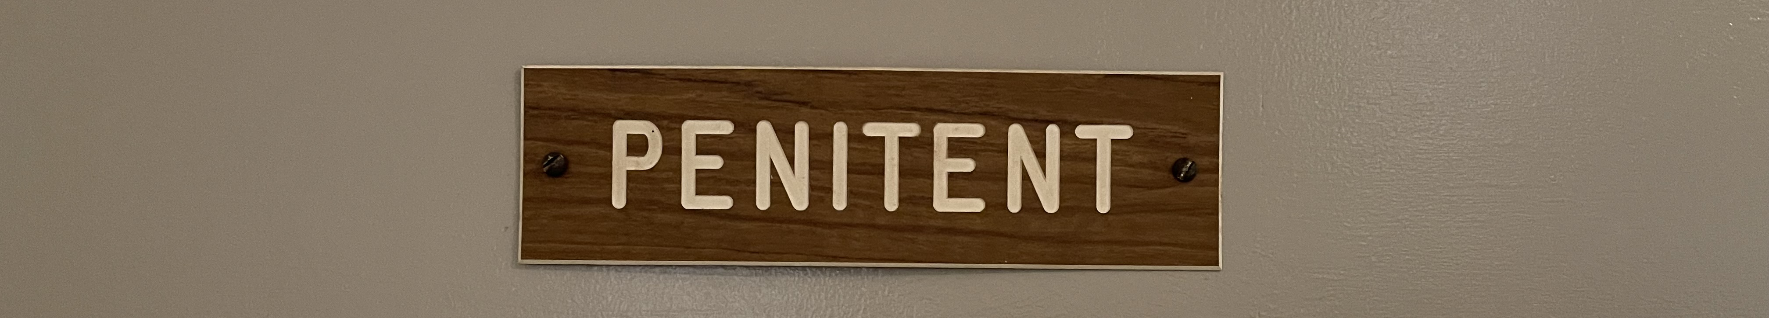
Living the Gospel (con’t)

Slide 61
What’s next?
5-year plan – short-term and long-term activities with concrete actions for helping local fraternities
  Branding/Vocational Materials
  Management of the Bequest
  Youth/Young Adult
National Statutes Revision
Guidelines
2028 - Celebration of the 50th Anniversary of OFS Rule and 800th Anniversary of Canonization
2031 Q

Slide 62
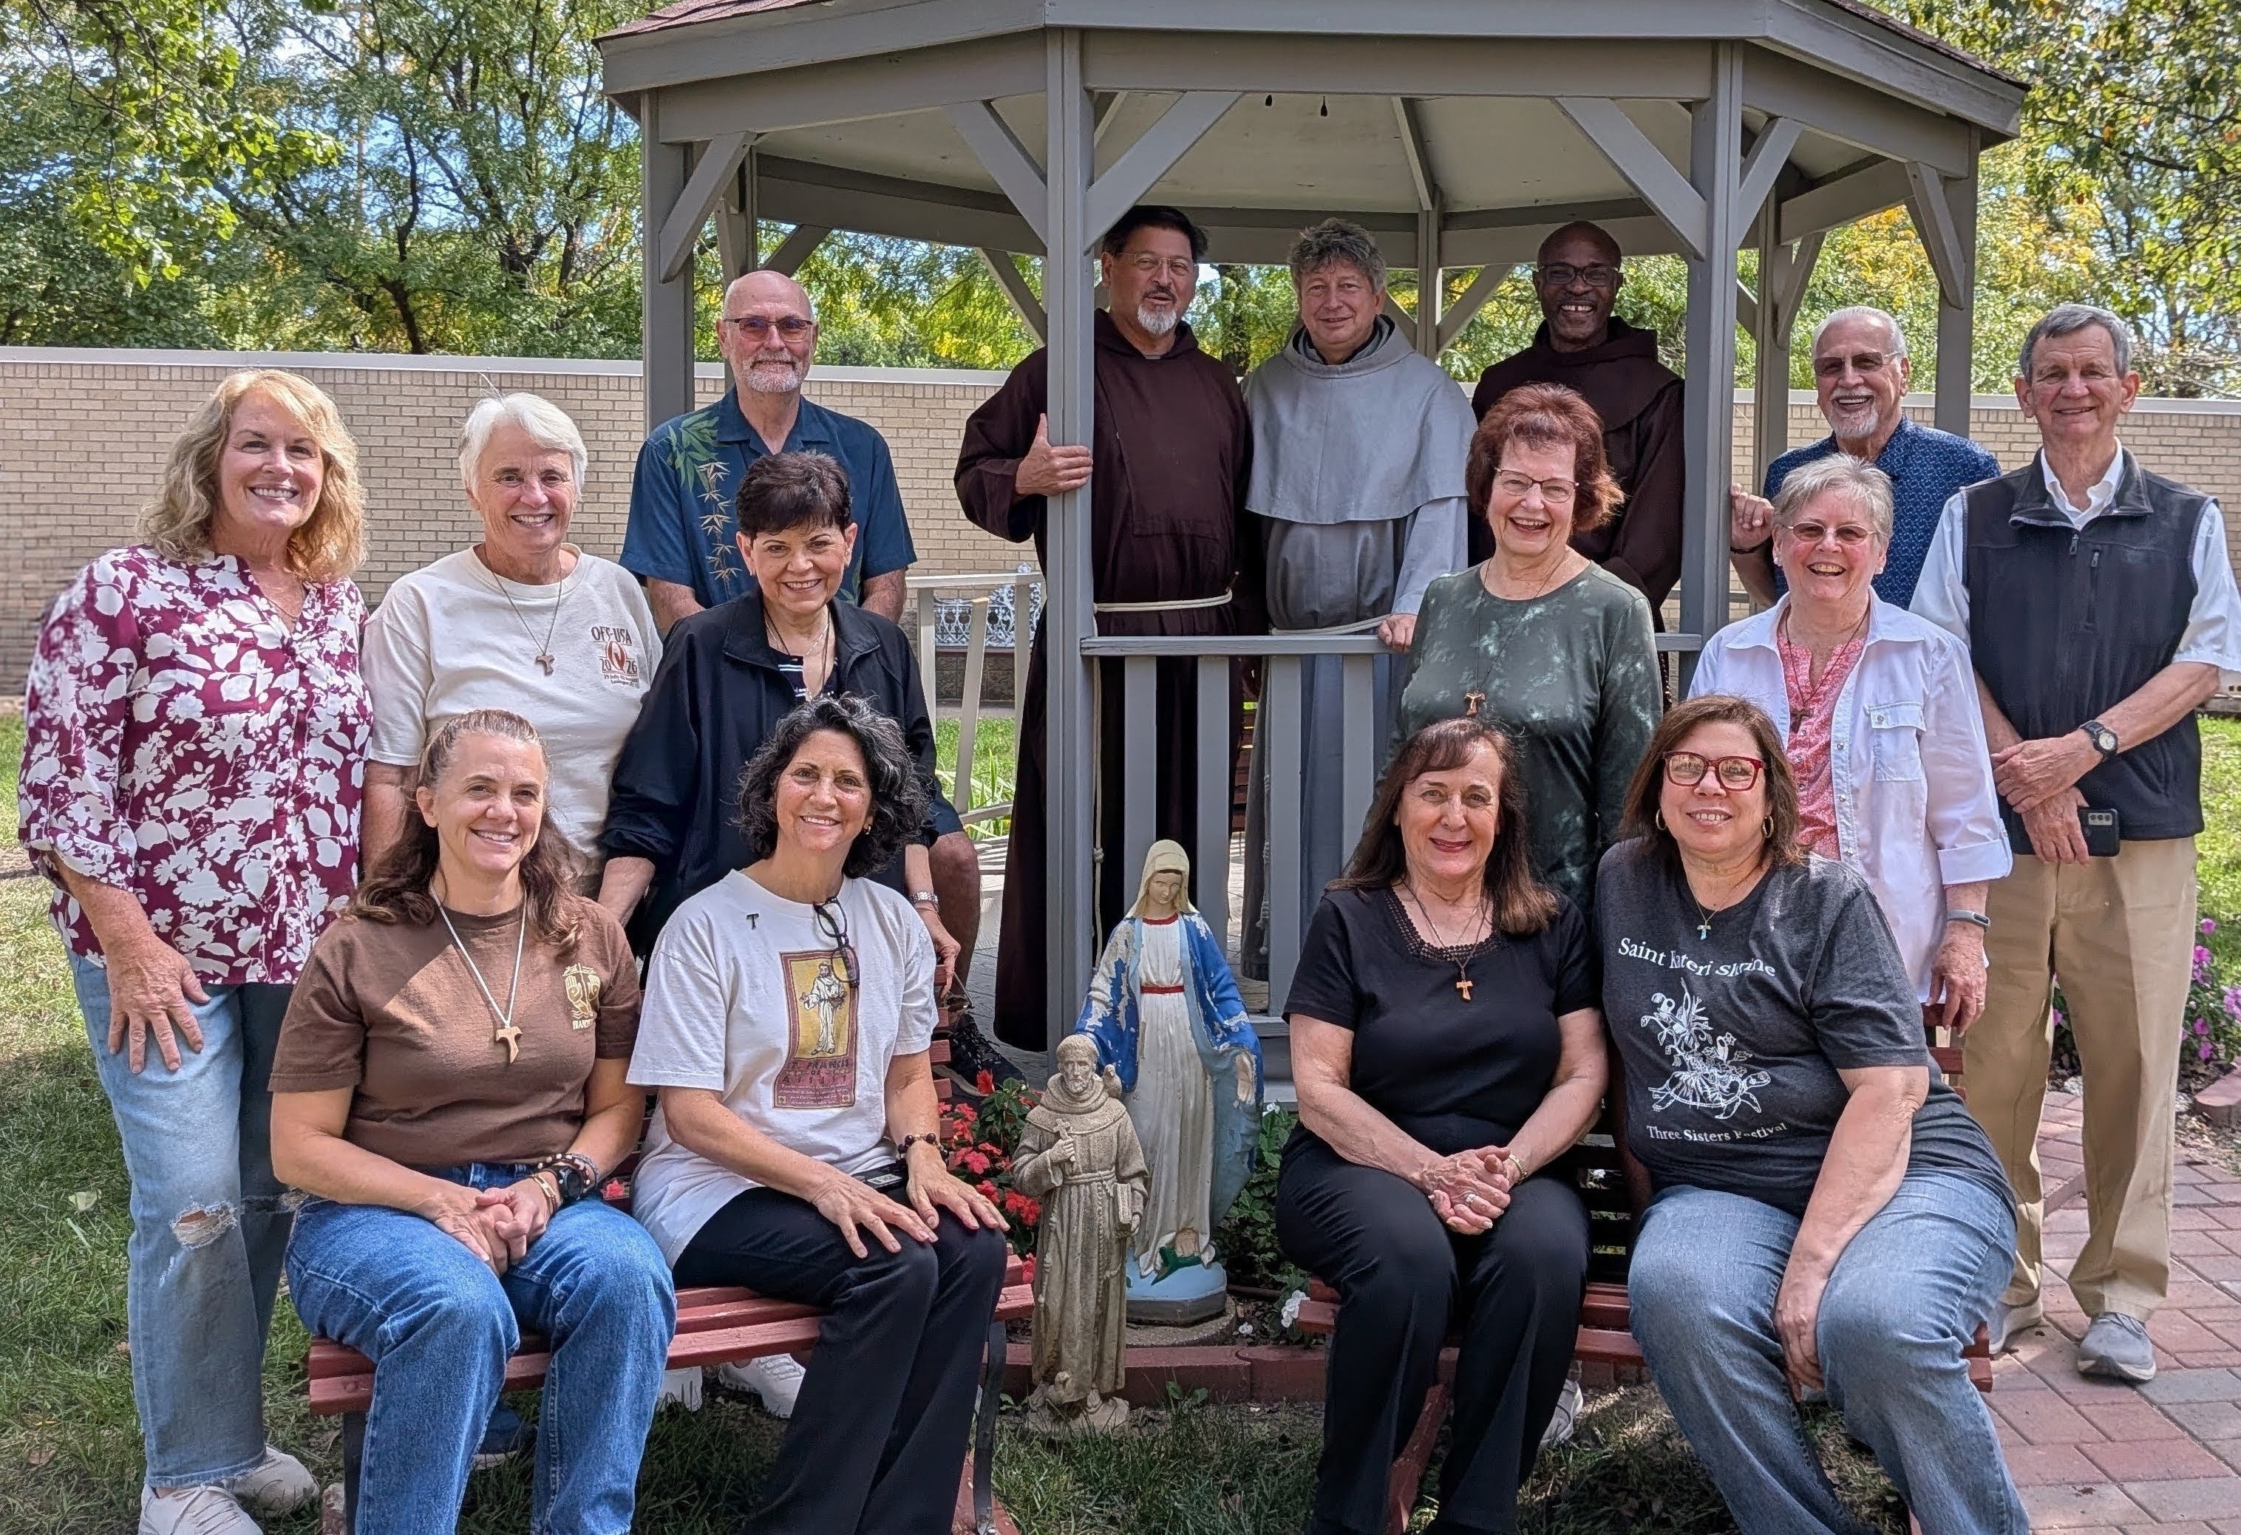
The National Executive Council,
Conference of National Spiritual Assistants
National Commission Chairs
Front Row: Jennifer Drees OFS, Jane DeRose-Bamman OFS, Mary Frances Charsky OFS, Layna Maher OFS
Middle Row: Christine Blood OFS, Corinne Lorenzet OFS, Diane Menditto OFS, Susan Ronan OFS, Kathleen Molaro, OFS
Back Row: Steve Roszhart OFS, Fr. John De La Riva, OFM Cap; Fr. Marek Stybor, OFM Conv,
Fr. Cidouane Joseph, OFM, Chris Leone OFS, and Joseph Makley OFS
Notes:
It’s been a busy period so far….and we are still smiling!
We’d like to commend the Regional Ministers (and your executive councils) for the times you’ve grappled with issues on your own and acknowledge the times you brought issues to us so we can collaborate to resolve them early on.
Thank you for your support and quick responses to our requests for information and feedback..

Slide 63

“our life cannot continue as before. It cannot continue as if nothing special happened. … we are responsible to share it and make our fraternities a better place to live our vocation.” Tibor Kauser, OFS, Minister General October 4, 2026

