Slide 1
A Call to Prophetic Creativity
Presented by: Sr. Agnes Marie Regan, OSF
Notes:
A Call to Prophetic Creativity- Presented by: Sr. Agnes Marie Regan, OSF

Slide 2
May the Lord give you peace!
Notes:
“Wherever we are . . .place, hour, time of day . . . let us give thanks to the Most High and Supreme Eternal God Trinity and Unity, Father, Son and Holy Spirit . . . (“The Earlier Rule, FA:ED, Vol. 1, pp. 85-86).”

Slide 3
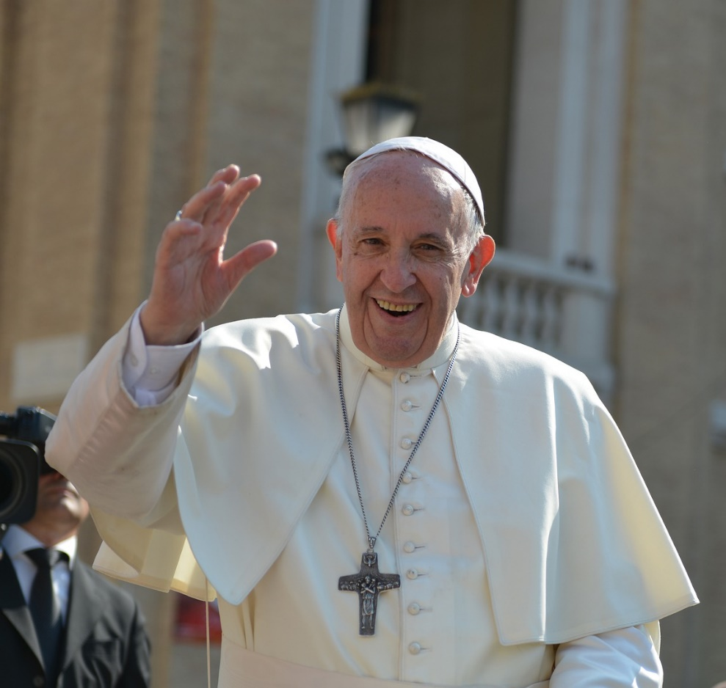
Prophetic Creativity: “Rebuild”
Pope Francis spoke about the need for prophecy in the church today, saying “prophecy is born whenever we allow ourselves to be challenged by God, not when we are concerned to keep everything quiet and under control. When the Gospel overturns certainties, prophecy arises. Only someone who is open to God’s surprises can become a prophet.”
Francis added that “we need lives that manifest the miracle of the love of God. Not forcefulness, but forthrightness. Not palaver, but prayer. Not speeches, but service. You want a prophetic church? Then begin to serve and stop talking. Not theory, but testimony.”
Moreover, he said, “We do not need to become rich, but rather to love the poor. We are not to save up for ourselves, but to spend ourselves for others, not to seek the approval of the world...We need pastors [Franciscans] who offer their lives” like Peter and Paul. What they did “was prophecy. And it changed history (America Magazine, June 2020).”
Notes:
In an article in AMERICA MAGAZINE in June of 2020, we were gifted with a wonderful article by our good Holy Father, Pope Francis. In that article, he “ . . . spoke about ……
--- quote on Slide #2

Slide 4
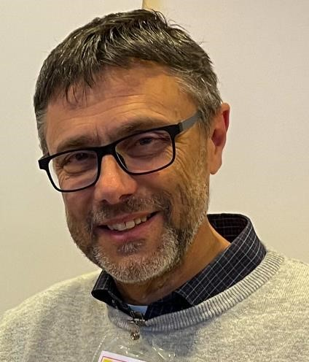
“[Service] is not limited to “bureaucratic issues” not to the execution of the “guidelines” of the Council of the high level, but requires
Prophetic Creativity
for the realization of the Secular Franciscan life, both as individuals and as Fraternity, consistent with the Gospel and the Magisterium of the Church (Instrumentum Laboris, p.5, 2021).”
Tibor Kauser, OFS, Minister General of the Secular Franciscan Order, and General Council
Notes:
As preparation for the General Chapter, Tibor Kauser and the General Presidency gave the Secular Franciscan Order the INSTRUMENTUM LABORIS to “Animate and Guide with Servant Leadership”
Within that document we read: “Service is not limited . . .”

Slide 5
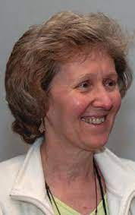
A Call to Prophetic Creativity
“Our God is the God of Surprises”
- Pope Francis
Summary: Message of Jan Parker, OFS, National Minister

Slide 6
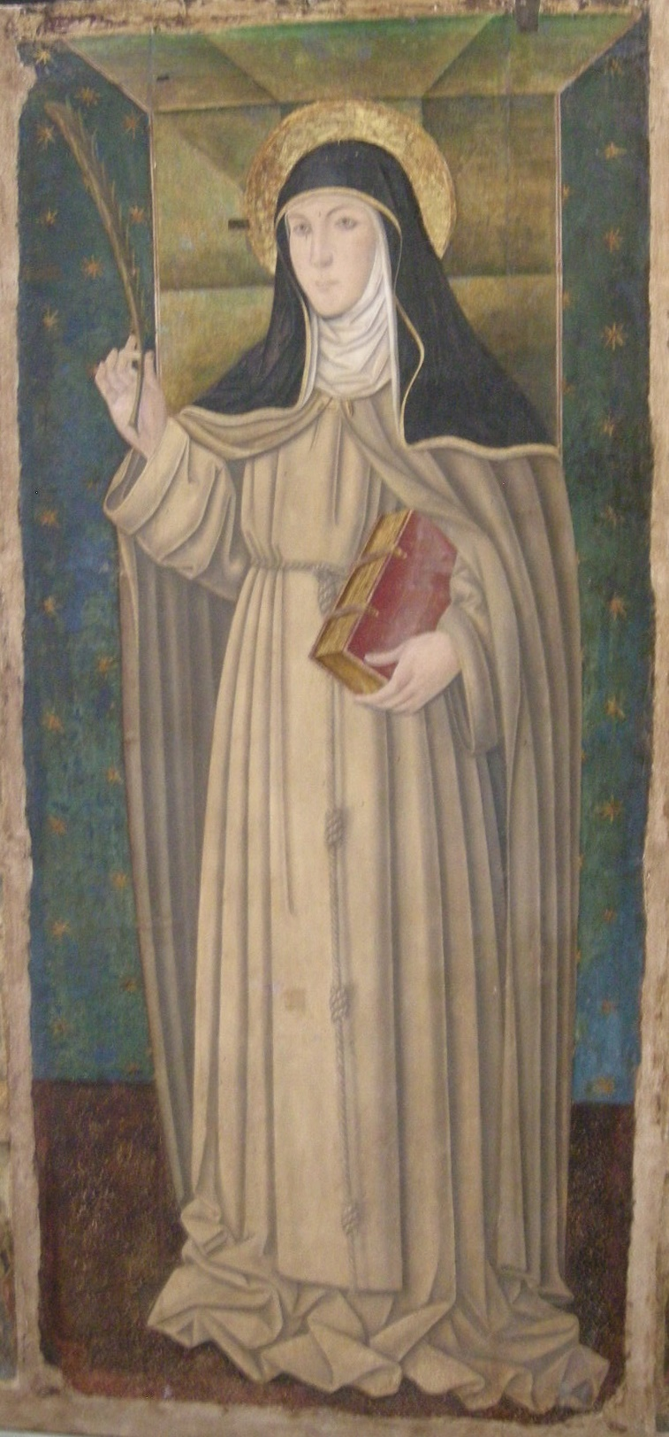
St. Clare: “Let us be filled with a remarkable happiness and a spiritual joy.”
Hope is bold!
“It is an exciting time for Franciscans as, one after another, God’s gifts to the Franciscan Order just keep coming . . . three . . .”
Notes:
Jan’s letter opens with a message from our sister, St. Clare: “Let us be filled with a remarkable happiness and a spiritual joy.”
But the words of the Christmas Letter of the Franciscan Ministers General could and also should ring in our ears: HOPE IS BOLD!
We have spoken of TOTAL RENEWAL of our Order and the trajectory God has set us upon for its fulfillment. It began 40 years with the promulgation of our Rule, and continued in following years . . .
It’s an exciting time for Franciscans as
For example -- the visioning gatherings which have taken place during the past three years for
-- Youth
-- Justice and Peace
-- Formation
But now the Holy Spirit is calling us again . . . And once again speaking in THREES!!!!
And as Jan wrote, “ . . . God gifts to the Franciscan Order just keep coming . . . “ And once again the Holy Spirit is speaking in threes . . . . Wouldn’t St. Bonaventure love it??????

Slide 7
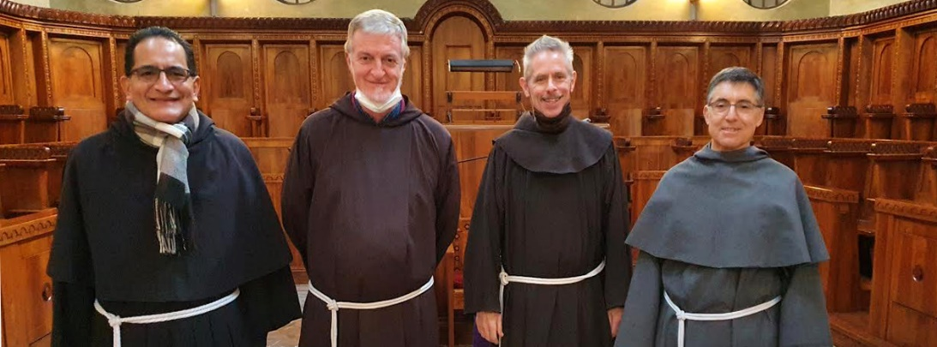
The three gifts . . .
Christmas Letter
“Instrumentum Laboris”
“Fratelli tutti”
CIOFS Presidency
His Holiness Pope Francis
Ministers General
. . . God is continuing to chart our course.
Notes:
What are the three gifts?
The INSTRUMENTUL LABORIS
The Encyclical Letter of our Holy Father, FRATELLI TUTTI
The CHRISTMAS LETTER of the Ministers General “HOPE IS BOLD”
Together these three documents present a daring, but exciting challenge to REBUILD by taping into the prophetic gifts given to all of us at Baptism and Confirmation and through our Profession of the Gospel life.
So, God is continuing to chart our course.

Slide 8
“God’s purpose in sending us these three documents . . .
Prophetic Creativity
. . . I believe God is calling us to focus our prayer and energy in this direction.”
Notes:
The journey began with the promulgation of the Rule 40 years ago . . And continued with many events and gatherings even up to the present moment as you assemble here.
Rooted in Baptism and our Profession the call to PROCLAIM THE GOSPEL TO THE ENDS OF THE EARTH, still holds true and should ring loudly and clearly in our Franciscan ears and hearts.
Jan rightly wrote: “ . . . I believe God is calling us to focus our PRAYER and ENERGY in this direction.” And, as Franciscans, it can not be either-or, following St. Francis it must be both-and PRAYER and ENERGY.
At our meeting in St. Louis, your former Minister General was quoted:

Slide 9
“I firmly believe that, based on the experience of the first 40 years, the future of formation in the Order must be oriented toward BEING. Only by DOING, without BEING, the Order will not mature, and gradually regress to a simple and tired routine.” Encarnacion del Pozo, OFS, General Minister, Rome, 24th March, 2019
Notes:
For those of us gifted with being present as Fr. Jerome Schroeder, OFM Cap, spoke the last two months at the Gathering of the Franciscan Family Forum, our good brother made that concept of BEING resonate more and more deeply as he spoke so eloquently about its meaning.

Slide 10
That challenge to all of us is exactly what we read in the INSTRUMENTUM LABORIS :
[Service] “ . . . is not limited to “bureaucratic issues” nor to the execution of the “guidelines “ of the Council of the higher level, but requires “prophetic creativity” for the realization of the Secular Franciscan life, both as individuals and as Fraternity, consistent with the Gospel and the Magisterium of the Church (Instrumentum Laboris page 5).”

Slide 11
What is PROPHETIC CREATIVITY?
To see as God sees with spiritual eyes– and then to act, allowing God’s grace to strengthen us to do his will
It is innovative action taken in response to the Holy Spirit working with and within us
Example of Pope Francis: uses “create” no less than 44 times
GENERAL MINISTERS: CONVERSION impossible without motivation and change
It directs us to look at Jesus . . . and to Francis for our examples

Slide 12
THOUGHT QUESTIONS
“ . . . To be a faithful witness and instrument of the (Church’s) mission among all people (Ritual p. 25).”
How many times did [Francis] hear the Word of God speaking directly to him and immediately put it into practice?
-- How do I do that? How does my fraternity do that? my Franciscan Order?
If we follow in the footsteps of St. Francis, how can we not do that and still be faithful to what we promised?
Notes:
How does my Regional, National, International Fraternity do that?
If we follow in the footsteps of St. Francis, how can we NOT do that and still be faithful to what we promised? Namely; “ . . . To be a faithful witness and instrument of the [Church’s] mission among all people (Ritual, p. 25).”

Slide 13
NOT limited to administration and bureaucracy
Animate
MOST IMPORTANTLY focused on the HEART of our call . . .
Servant
Leadership
That means ALL of us!
PROPHETIC CREATIVITY
Living the Gospel of Our Lord Jesus Christ
Guide
HOW?
Notes:
These two words from SFO legislation are important ANIMATE and GUIDE
-- not limited to administration and bureaucracy
--MOST IMPORTANTLY – focused on the HEART OF OUR CALL – living the GOSPEL OF OUR LORD JESUS CHRIST
HOW? ITEMS MENTIONED ARE NOT EXHAUSTIVE . . . Time to be CREATIVE

Slide 14
INSTRUMENTUM LABORIS:
Seek new ways to help development of fraternities – both new ones and by infusing life into older ones
Seek new ways to help the development of the spiritual life of the sisters and brothers: they’re hungry for a deeper relationship with God and a broader understanding of their Franciscan calling
Being open to and responding to the voice of the Holy Spirit along with the signs of the times.
Notes:
The IL states emphatically that to achieve this goal “prophetic creativity is required.” To accomplish any one of those and / or all three requires courage and prophetic creativity

Slide 15
THOUGHT QUESTION
What will move our fraternities, and our Order(s) forward, so we become what the Church expects as the Instrumentum Laboris challenges us?
Notes:
How does my Regional, National, International Fraternity do that?
If we follow in the footsteps of St. Francis, how can we NOT do that and still be faithful to what we promised? Namely; “ . . . To be a faithful witness and instrument of the [Church’s] mission among all people (Ritual, p. 25).”

Slide 16
A GOOD QUESTION: does PROPHETIC CREATIVITY apply only to servant leaders?
CO-REPONSONSIBILITY
Applies to every member of the Order
“The brothers and sisters are co-responsible for the life of the fraternity to which they belong and for the OFS as the organic union of all fraternities throughout the world (Article 30. 1).”
“The sense of co-responsibility of the members requires personal presence, witness, prayer, and active collaboration, in accordance with each one's situation and possible obligations for the animation of the fraternity (Article 30.2).”
Notes:
Co-responsibility --- needs to be seriously pondered and its implementation encouraged.
Fraternity implies co-responsibility and I cannot push off, shove off, or excuse myself from my share of fraternal life in all its manifestations – personal presence, witness, prayer, collaboration, etc.

Slide 17
THOUGHT QUESTIONS
Co-responsibility: what is MY part?
What would result if we all responded to the Holy Spirit’s call as did Francis and Clare?

Slide 18
We would grow closer to God and to each other
We would engage more deeply in our vocation and what we have promised and there would be a re-birth of our Franciscan Order
Our fraternities would be more alive with enthusiasm, joy, and hope
HOW can this happen?
Notes:
Can you imagine how living this way would re-light the world on fire with love for Jesus and the Church as it did through our Holy Father, St. Francis?

Slide 19
The three gifts . . .
Christmas Letter
“Instrumentum Laboris”
“Fratelli tutti”
CIOFS Presidency
His Holiness Pope Francis
Ministers General
God will continue to chart our course . . .
Notes:
What are the three gifts?
The INSTRUMENTUL LABORIS
The Encyclical Letter of our Holy Father, FRATELLI TUTTI
The CHRISTMAS LETTER of the Ministers General “HOPE IS BOLD”
Together these three documents present a daring, but exciting challenge to REBUILD by taping into the prophetic gifts given to all of us at Baptism and Confirmation and through our Profession of the Gospel life.
So, God is continuing to chart our course.

Slide 20
“We need to unpack them in the months ahead as a part of Ongoing Formation in local fraternities . . . ”
“I believe strongly more than ever God is calling us to live a life worthy of our call, and as always, he is providing us with all we need . . .

Slide 21
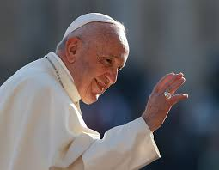
“It is true that our God is the God of surprises. Each day carries another surprise! . . . We will never move forward if we do not have the courage [HOPE IS BOLD] to break the mold, for our God impels us to do the following:
BE CREATIVE ABOUT THE FUTURE!!

Slide 22
YOU . . . shall be called a prophet of the Most High
for you will go before the Lord to prepare His ways and
to give knowledge of salvation to his people . . .

Slide 23
. . . to give light to those who sit in darkness . . .
and guide our feet into the way of peace (Luke 1.76ff).”

Slide 24
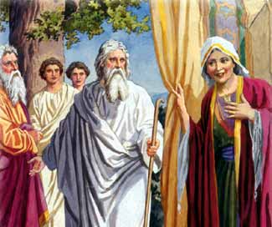
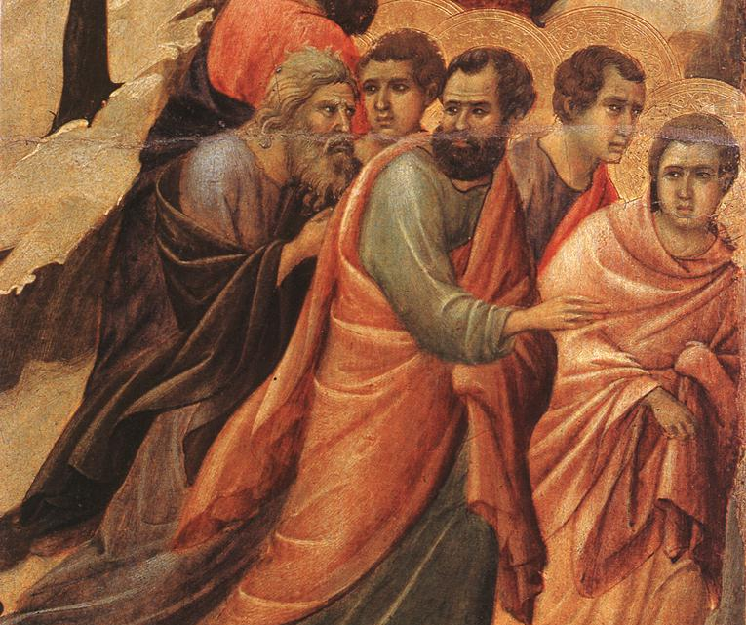
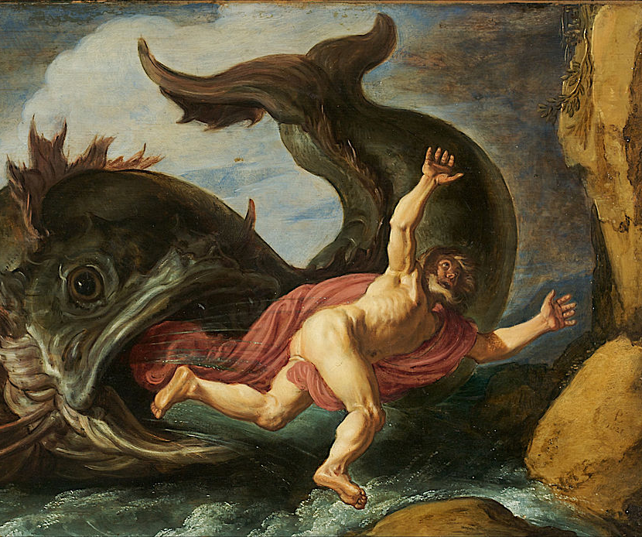
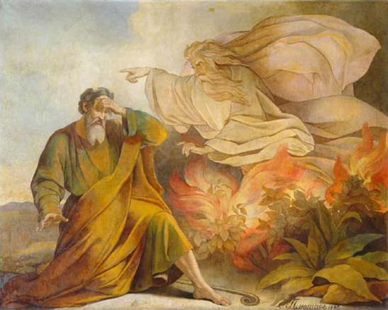
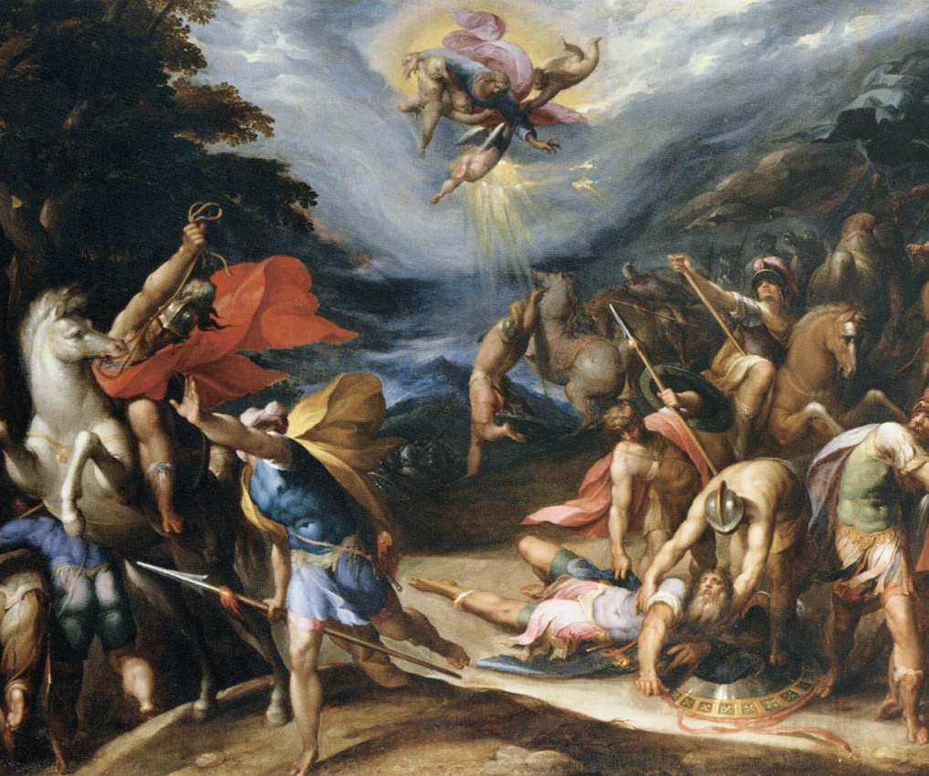
Sarah laughed because they were “too old”
Apostles: Last Supper on Thursday, desertion on Friday
Jacob – wrestling match with God !
Jonah . . . Well, it wasn’t on
Carnival Cruise Line!
Moses said, “Send my brother.”
St. Paul, “I’ll kill them all.”
How do you react to God’s call to be a prophet . . . to rebuild?
Notes:
Sarah and Abraham in Public Domain: https://en.wikipedia.org/wiki/Sarah#/media/File:Sarah_Abraham.jpg
Jacob Wrestling in Public Domain: https://commons.wikimedia.org/wiki/File:Rembrandt_-_Jacob_Wrestling_with_the_Angel_-_Google_Art_Project.jpg
Jonah and Whale inPublic Domain: https://commons.wikimedia.org/wiki/File:Pieter_Lastman_-_Jonah_and_the_Whale_-_Google_Art_Project.jpg
St. Paul in Public Domain: https://commons.wikimedia.org/wiki/File:Hans_Speckaert_-_Conversion_of_St_Paul_on_the_Road_to_Damascus_-_WGA21655.jpg
Apostles Fleeing in Public Domain: https://commons.wikimedia.org/wiki/File:Duccio_di_Buoninsegna_-_Christ_Taken_Prisoner_(detail)_-_WGA06794.jpg
Moses: https://commons.wikimedia.org/wiki/File:Moses_Pluchart.jpg

Slide 25
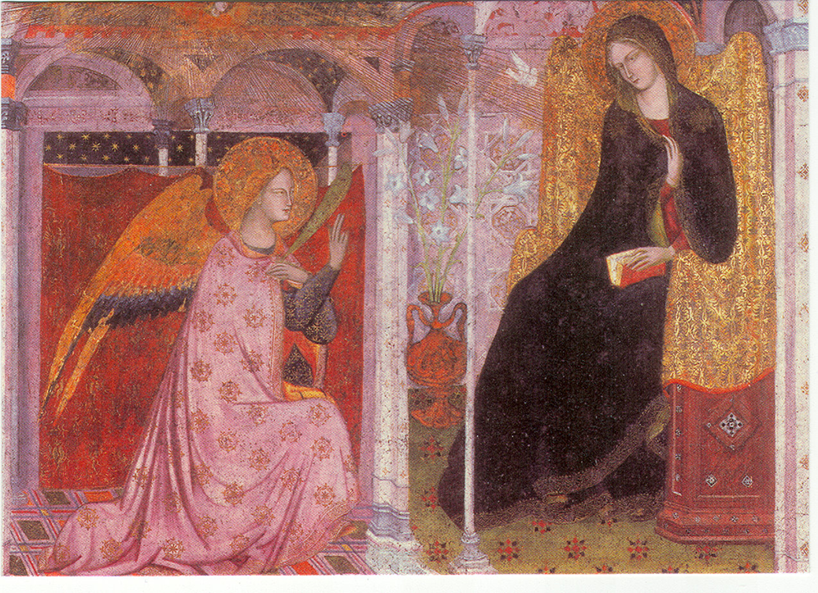
“May it be done to me, as you say . . . “

Slide 26
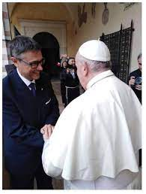
Tibor, you’re head of the largest religious Order in the world.
Where are you?
Let’s answer that question later . . .

Slide 27
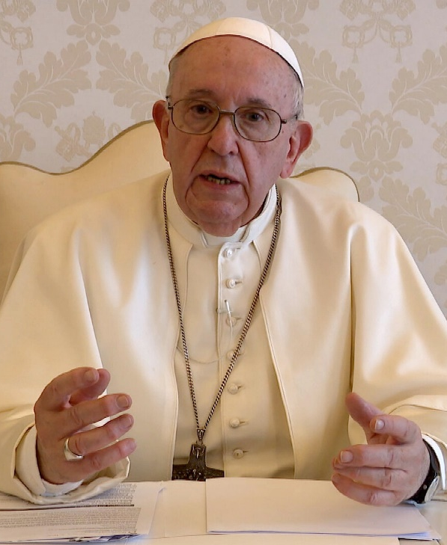
Prophetic Creativity – we’ve been challenged !!!
“ . . .appreciate it as coming from St. Francis through Pope Francis, like a new musical score to be learned, practiced, and performed as part of the great composition of history (IL, p. 2).”
Notes:
They’ve given us a challenge – now it’s in our hands.

Slide 28
Renaissance
Rebirth
Re-found
New Pentecost
Renewal
Rebuild
Identity
Contemplation
Telling Our (my)Story
Etc.
Be Creative about the Future!
Notes:
Go slowly before ASKING THE QUESTION . . . give attendants a chance to reflect

Slide 29
From the RULE . . .
6. “They have been made living members of the Church by being buried and raised with Christ in baptism; they have been united more intimately with the Church by profession. Therefore, they should go forth as witnesses and instruments of her mission among all people, proclaiming Christ by their life and words. Called like Saint Francis to rebuild the Church and inspired by his example, let them devote themselves energetically to living in full communion with the pope, bishops, and priests, fostering an open and trusting dialogue of apostolic effectiveness and creativity.”

Slide 30
“Why do we in the Church today constantly stare only at the decreasing numbers instead of JOYFULLY and CREATIVELY doing what is possible with the sisters and brothers who are there? . . . I am convinced that the future of the Gospel does not depend on numbers.
The Gospel unfolds its power where people honestly commit their lives to the message of Jesus.”
--Cornelius Bohl, OFM

Slide 31
Where
are
YOU?
Notes:
Let’s go back to that question . . .
How will that “renaissance”, rebuilding happen?

Slide 32
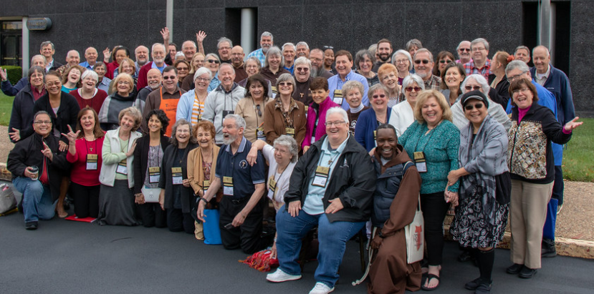
Here we are!
Send us, the living stones!
Notes:
We are the LIVING STONES . . .

Slide 33
Questions for Discussion and Discernment
Where do you see PROPHETIC CREATIVITY being most needed in our Order?
How have you applied it in the past?
How could you apply it now in your Fraternity and in your Region that they might be “… visible signs of the Church, a community of faith and love (Ritual, p. 22)
What could be YOUR part in doing it? “YOU . . .shall be the prophet of the Most High . . .”
How can we motivate our brothers and sisters to be prophetically creative about rebuilding and renewing our Order ?

Slide 34
Acknowledgements:
Letter of National Minister, Jan Parker, OFS, “A Call to Prophetic Creativity” in TAU Magazine, Winter 2021
2. “Christmas Letter from the Franciscan Ministers General”, Christmas 2020,
3. Links to Reading Materials (Courtesy of Tim Short, OFS, Regional Formation Director, Our Lady of Indiana): https://ofsongoing.com/2021/03/08/a- call-to-prophetic-creativity/
Also see: www.ofsongoing.com
Summary of Letter and Power Point presentation: Sr. Agnes Marie Regan, OSF, Regional Spiritual Assistant, Our Lady of Indiana.
Best attempts have been made to indicate sources of images with credit given. If there are any omissions, this author is more than willing to make necessary corrections in this nonprofit educational work.

Slide 35
May the Lord give you peace!
Notes:
“Wherever we are . . .place, hour, time of day . . . let us give thanks to the Most High and Supreme Eternal God Trinity and Unity, Father, Son and Holy Spirit . . . (“The Earlier Rule, FA:ED, Vol. 1, pp. 85-86).”

Slide 37
Discussion Questions for Discernment
Making PROPHETIC CREATIVITY concrete action

Slide 38
Questions to ponder at another time . . .

Slide 39
1. “The function of servant leaders………is not limited to administration or bureaucracy but, most importantly, applies to.………the full realization of the Secular Franciscan life…….” “This goes beyond the “day to day” running of the fraternity. We should always seek new ways that help the development of the……….spiritual life of the sisters and brothers.”
How can we help “ . . . the development of the spiritual life of the sisters and brothers" at all levels of the fraternity?
“What future world do we wish to hand to those who will come after us(CL, p.3)”
What specific gifts can we offer them? How would they like to be gifted toward a deeper spiritual life? “ “What will its values, lifestyle and thought look like?(CL, p.3)”

Slide 40
2 “What is prophetic creativity? ………… It is innovative action we take in response to the Holy Spirit working within us.” “This “full realization” is the renewal we long for.”
Would you agree that prophetic creativity requires personal interaction to bear fruit?
What specific ways might we an Order be more responsive to the voice of the Holy Spirit? How might we be more proactive in limiting the effects of competitive voices from our surrounding culture?
“Our hearts are restless until . . . ” and our Franciscan hearts are also restless. Identify specific ways we as an Order can bring about the renewal we long for. “Where can we learn the notes of this new piece of music?(CL).”

Slide 41
3) In the quote at the end of the article, Pope Francis says this: “We will never move forward if we do not have the courage to break the molds, for our God impels us to do the following: to be creative about the future.”
Are you open to “breaking molds” order to better serve your members?
Being creative is not easy. Not everyone is gifted in that area. If you are a leader, but you are not sure how to implement prophetic creativity, dialogue with your brothers and sisters to find some common ground and innovative ideas.
If you are willing to engage in “a season of prophetic creativity,” brainstorm with your brothers and sisters a list of possibilities –don’t be afraid to list what seems to be impossible and incredulous. Don’t forget: HOPE IS BOLD!

Slide 42
where “the Holy Spirit leads us” (4)
”going forth as witnesses and instruments . . .” (6)
“united . . .” and “motivated by the dynamic power of the Gospel”(7)
“by means of that radical interior change . . .”(7)
In “prayer and contemplation” (7)
“going from Gospel to life and life to Gospel (10-12)
“selfless service”(14)
“promoting justice be the testimony of their human lives and their courageous initiatives: (15)
“mindful that they are bearers of peace”(19)
“messengers of perfect joy(19)
Secular Franciscan Rule
Notes:
We are offered some wonderful wisdom from our good Fr. Christopher Panagoplos, TOR – showing that prophetic creativity is deeply rooted in the Rule of 1978 – there is no escaping its demands . . .
Empowered by the words of the Secular Franciscan Rule we already possess a blueprint of how the “message of Jesus” can be creatively proclaimed to the whole world..

