Slide 1
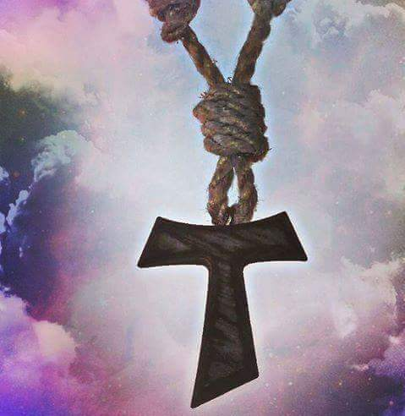
Baptism-New Life in Christ
Mini-Retreat Presented by the Joint Committee on Franciscan Unity
Presenters: Rev. Andrew Chavanak OLF, Rev. Ron Nuss-Warren OEF,
Rev .Masud Ibn Syedullah TSSF, Marie Bianca OFS

Slide 2
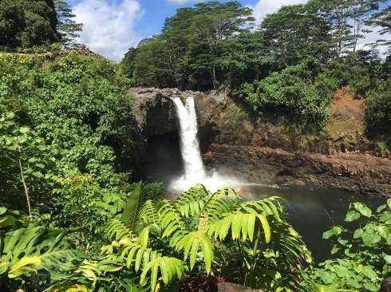
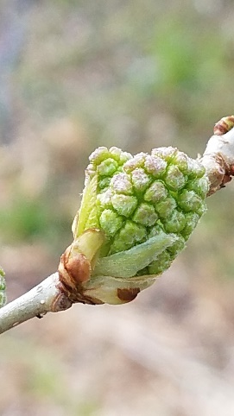
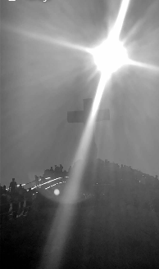
Holy Baptism 1st Essential Element of the Joint Committee on Franciscan Unity
To foster understanding,
Affirmation,
And cooperation among its Franciscan communities
Future Mini Retreats will cover the Elements of Vocation, Christ- Centered, Charism, and Prophetic Voice

Slide 3
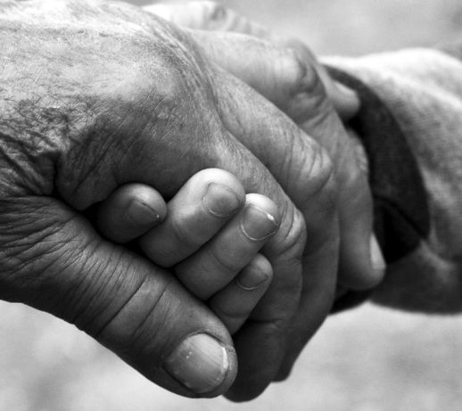
Foundation
Our Franciscan Orders understand that our Franciscan unity springs from our shared relationship with God through Holy Baptism. The waters of our birth in the name of the Triune God signify our unity in one baptism by one God.
This unity through baptism is the underpinning of our shared worship and witness as Franciscans.

Slide 4
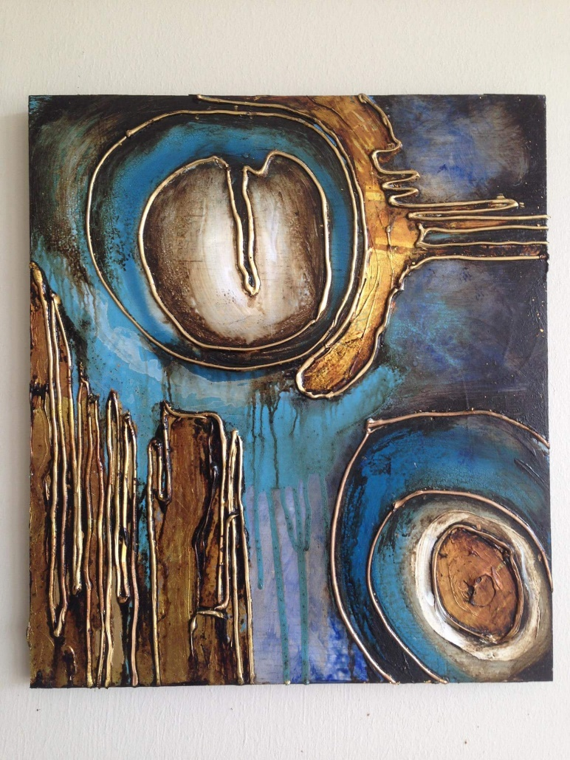
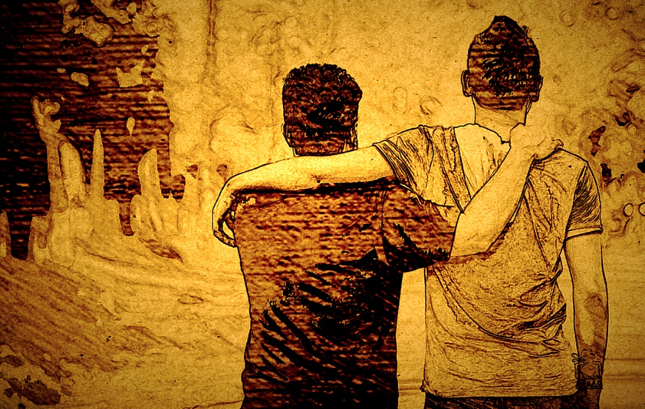
Baptism as a Sacrament
That which represents and conveys some aspect of God’s blessing (grace) to persons to accomplish a particular purpose.

Slide 5
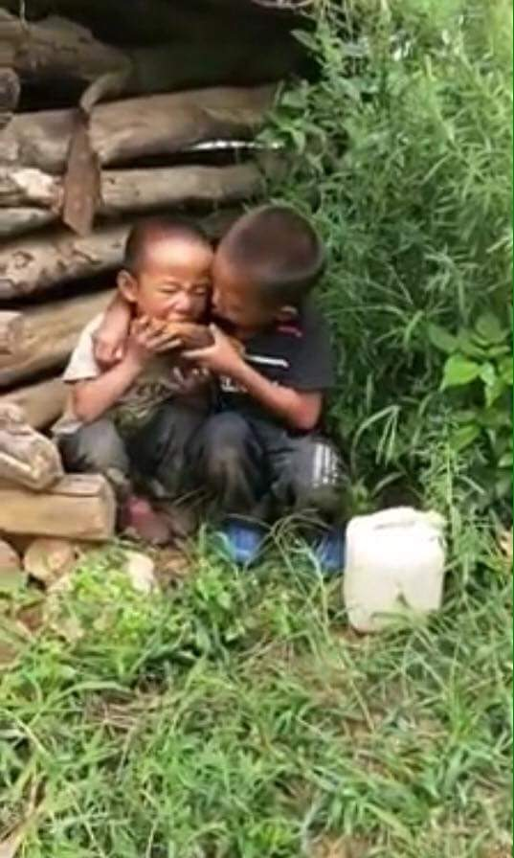
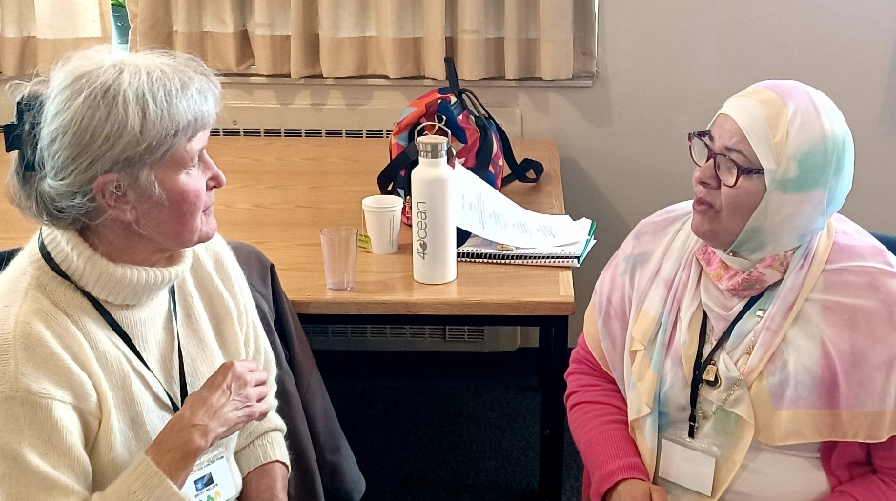
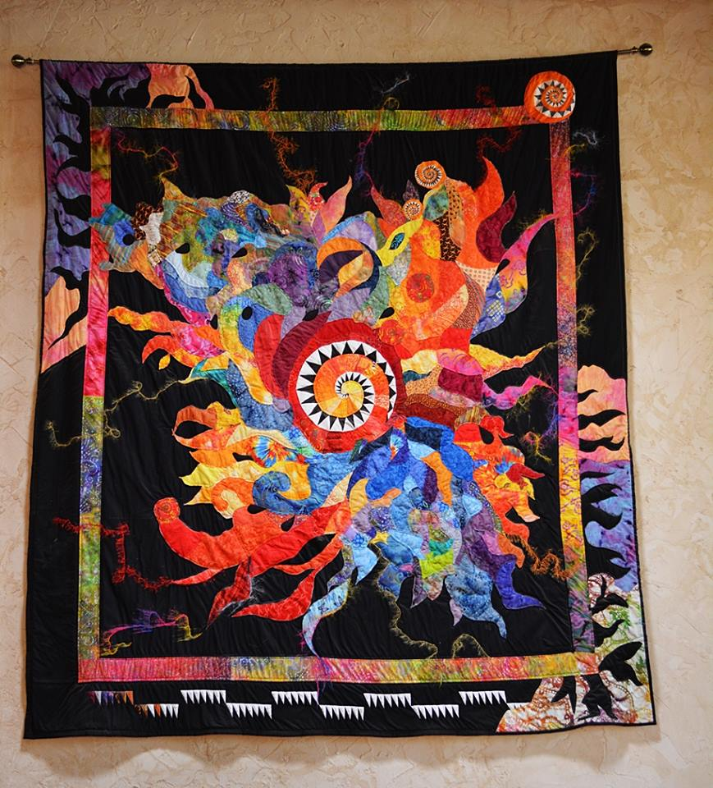
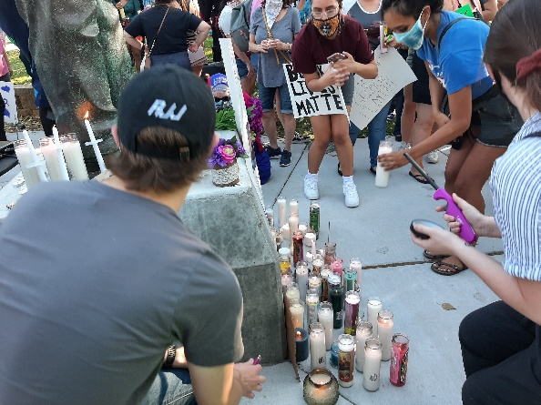
Sacraments have an outward sign representing the blessing (grace) God is giving and through to accomplish God’s work in and through people.
Group Title
Group A
Group B
Group C
Group D

Slide 6
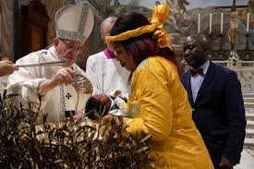
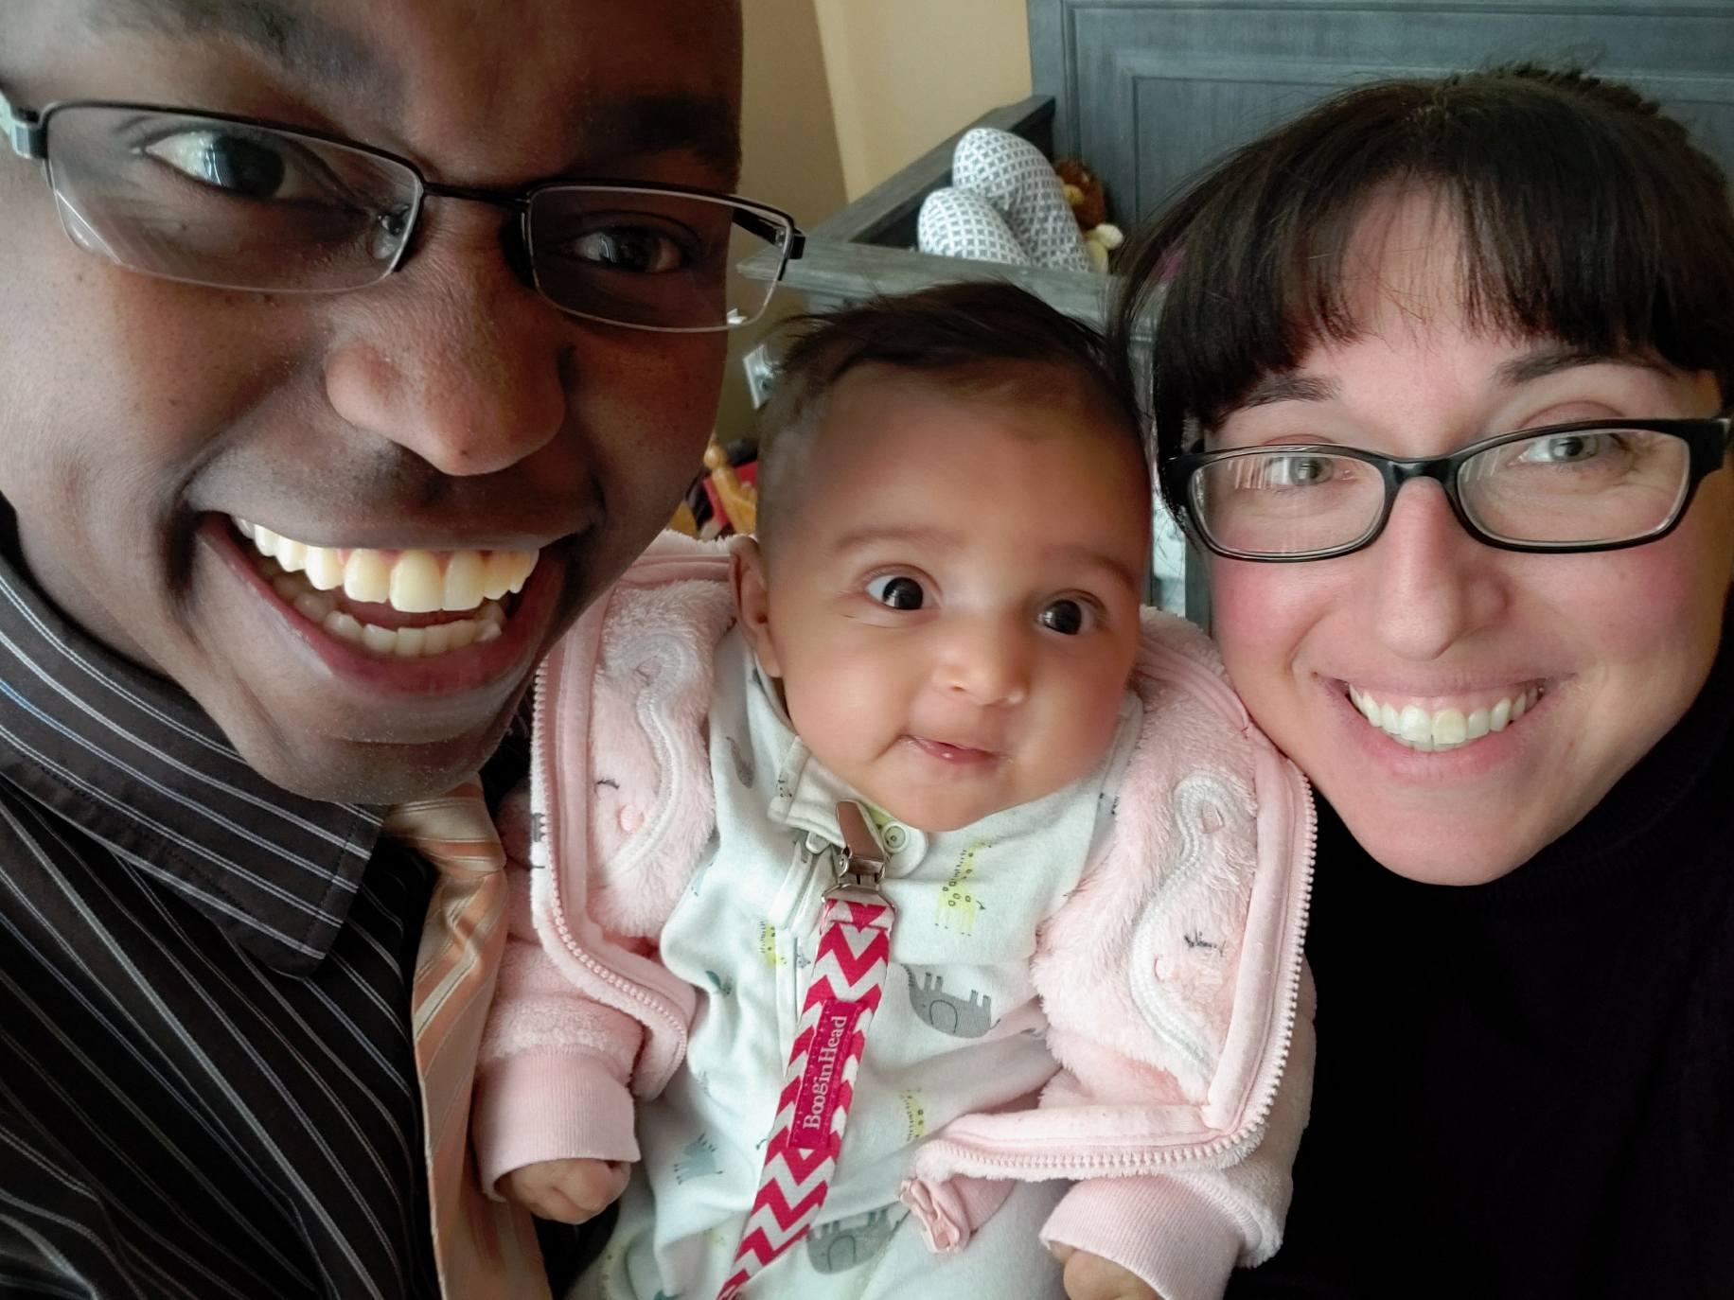
Water being the chief outward sign of Holy Baptism, poured, sprinkled, or that in which the person is emersed, administered in the name of the Holy Trinity. Some traditions will also use Holy Oil, in addition to water, as a sign of the Holy Spirit being poured out upon the person at Baptism.

Slide 7
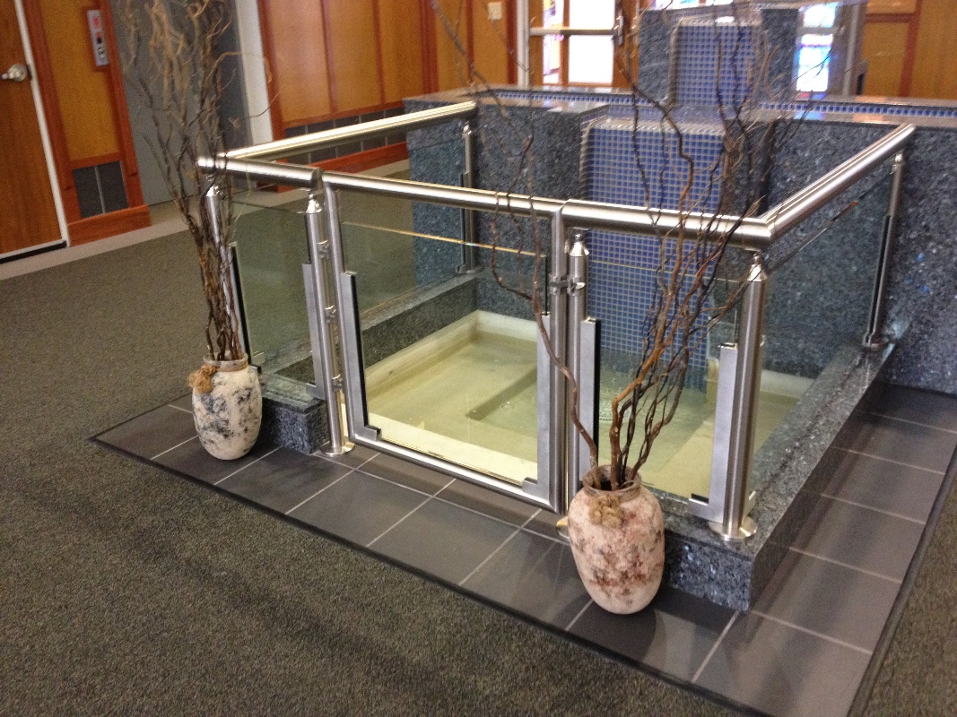
Cleansing
Washed clean from the “stains” of the past
Notes:
Within the Catholic Branch of the family, Baptism is an opening of the door to faith in community. We follow in the foots steps of Christ- this washing, blessing and grace that the Creator has bestowed. When Jesus was Baptized by John the Baptist, water flowed, the Spirit appeared and God’s voice witnessed and proclaimed at that moment,” This is my beloved son, with whom I am well pleased.” “Jesus’ gesture is a manifestation of his self-emptying. The Spirit who hovered over the waters of the first creation descended then on the Christ as a prelude of the new creation, and the Father revealed Jesus as his “beloved Son.” The Greek word for Baptism is baptizein meaning to “plunge” or “immerse”; the “plunge” into the water- symbolizes the catechumen’s burial into Christ’s death, from which he rises up by the resurrection with him, as “a new creature.” (CCC)
Our foundation claims it washes clean all sin, that at that moment, is present in our lives binding us to salvation won in Jesus’ death and resurrection. It welcomes us too as children of the One God, One Body, One People in Christ. It sets a seal of eternal life within us.

Slide 8
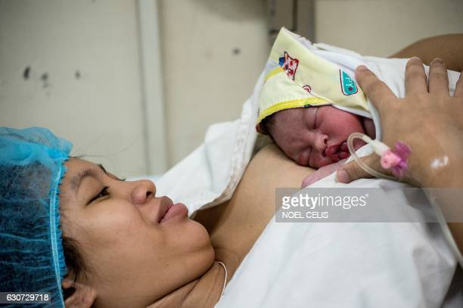
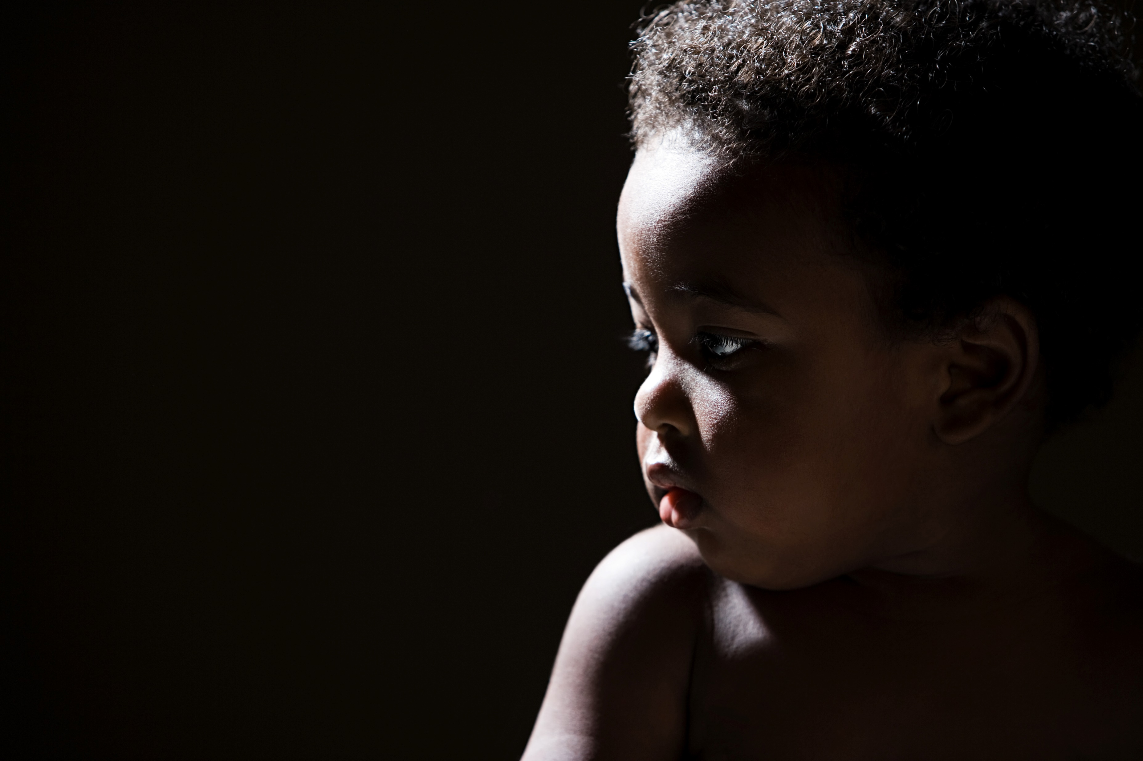
We are birthed into a new reality, not unlike the breaking of waters at the birth of a child.
Notes:
Slide 8:
To borrow a phrase: Life is messy, clean it up! That is what the profound moments of Baptism does, cleanses the slate, and lays a new foundation to build upon. It graces us with a rich reality that includes forgiveness of original sin and all personal sins- a regeneration, birth into the new life, recreation, by which man becomes an adoptive son of the Father, a member of Christ and a temple of the Holy Spirit (personal Pentecost). By this very fact the person baptized is incorporated into the Church, the Body of Christ, and made a sharer in the priesthood of Christ. (Catechism of the Catholic Church) Without water there is no life, baptismal waters bring this life anew into our world and personal realities. The baptized dawns a white garment- signifying spiritual purity, royal call, priestly presence, and prophetic voice. In the Catholic tradition, Holy Chrism is also used signifying the presence of the Holy Spirit and the sanctifying grace that is brought, creating life in fullness and joy.

Slide 9
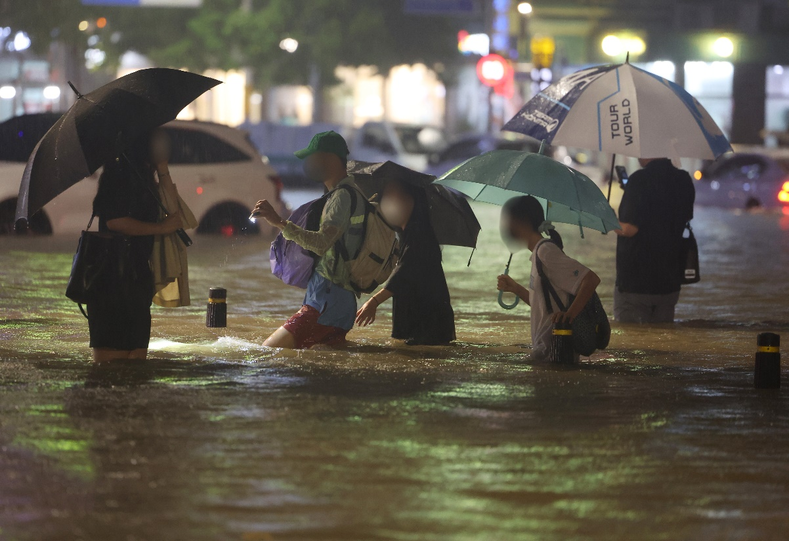
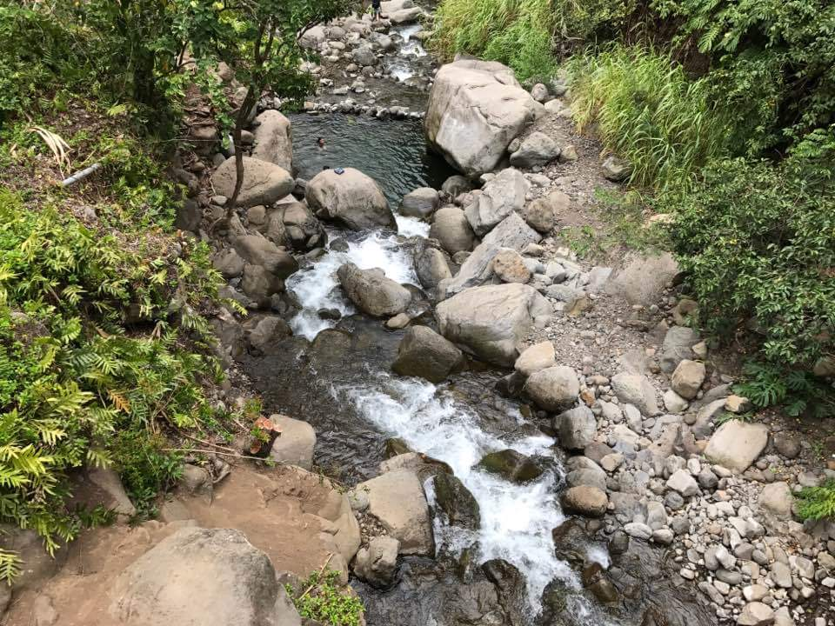
Dying to Self
Rising to new life in Christ
Notes:
Water has many properties. We mentioned its cleaning ability, it can also be seen as a force of destruction- taking away that which was built on a weak foundation or no longer of usefulness. After a flood, people see nothing but devastation in their life, but hope blooms from this gift of letting go and dying to a part of our selves. It often is a painful process this rebuilding- but the new life that is molded- strengthens us and re-news our life, making our connectedness vital and important. We are connected to each other and our Creator- often in this letting go- we discover who we are at our true essence. We are raised to a new life- a life in the love of God, the Love of our brother Jesus, and filled with the gifts of the Spirit. We have a profound indelible union in the Body of Christ. This indelible sign reminds me of a story. A friend who in a Native American, but embraced his Catholic heritage was invited to sit in the Sacred Circle of the elders from the tribe he came from. He very much wanted to go but realizing the Sacredness of the gathering- and the fact that non- traditional members are not usually welcomed at the gathering, he attempted to decline. But the one who invited told him, just come- it will be ok. So, with no small trepidation he went. He indeed was welcomed in the Sacred Circle. But he wanted to be clear that he was a practicing Catholic. The chief assured him that he had “The Mark”. My friend said what mark? The Chief smiled and said, the mark on your forehead, at your Baptism you were anointed with Holy Oil and Waters. We as elders and trained in the Spiritual world, can see everyone so marked. It gave my friend a deep peace knowing that those who can see- truly are aware of who we are Children of a living God, being embraced as His sons and daughters. So, our Baptism is an outward sign in many ways that we are not fully aware of at times.

Slide 10
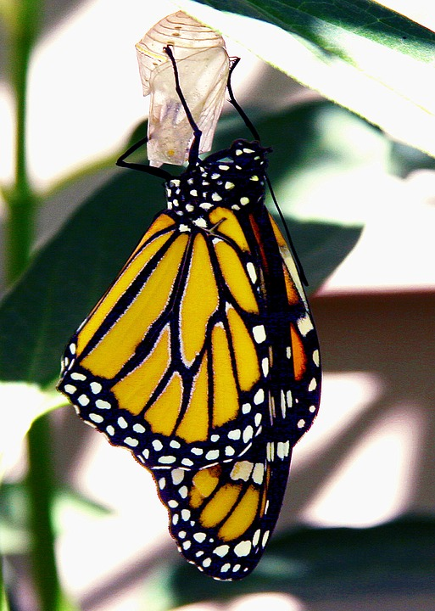
As a result, in the Order of Ecumenical Franciscans we look to a more mystical belief about baptism, one that reaches beyond mechanics and doctrine…
The baptism we as Christians receive is an outward and visible sign of an inward and invisible grace.

Slide 11
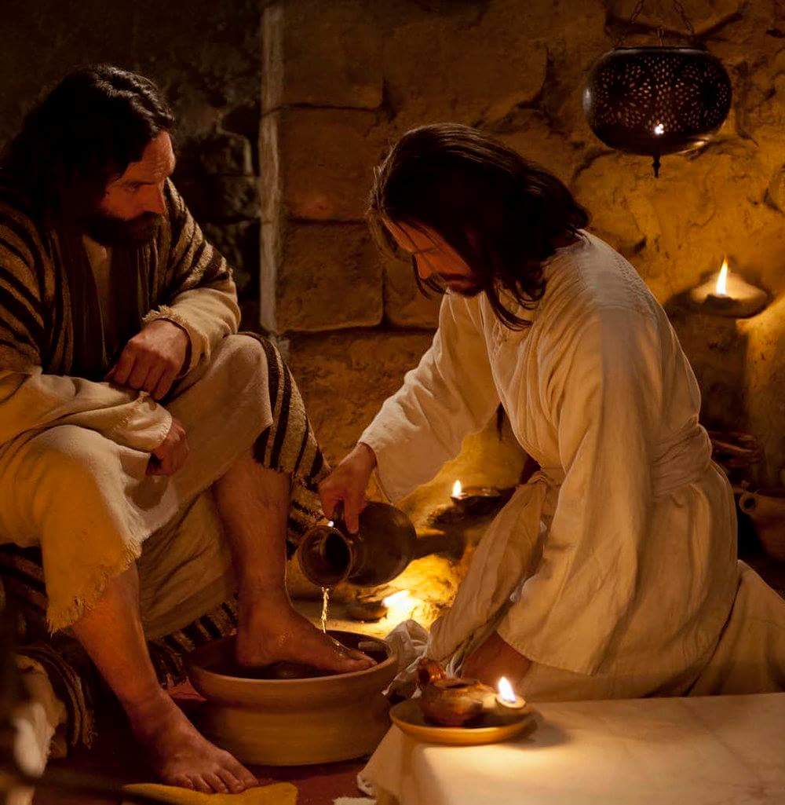
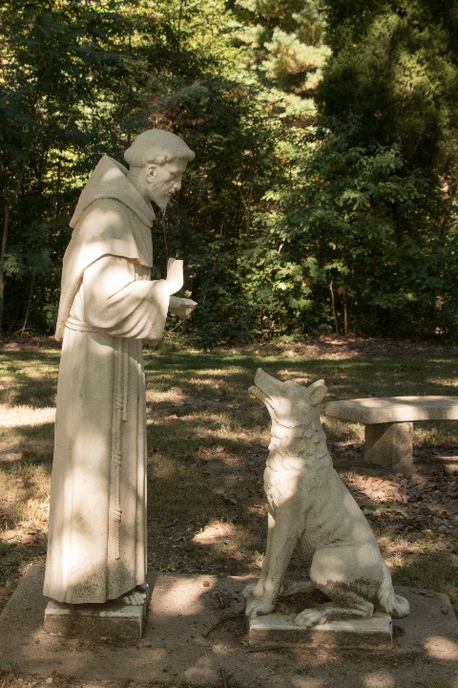
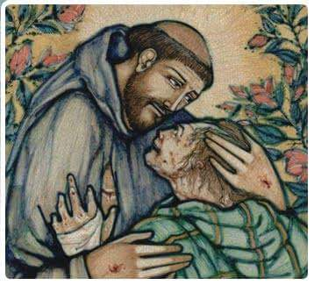
We claim our baptism with our words and deeds.

Slide 12
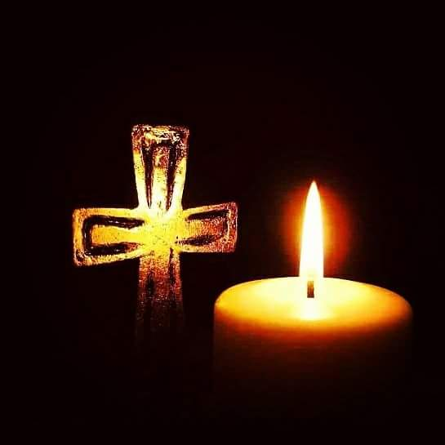
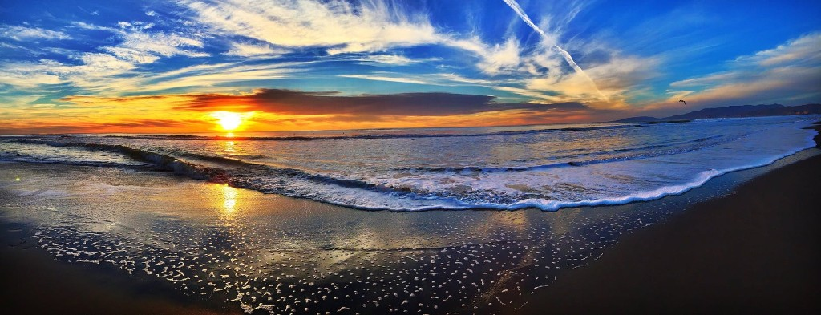
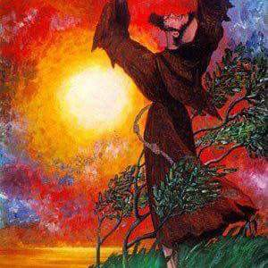
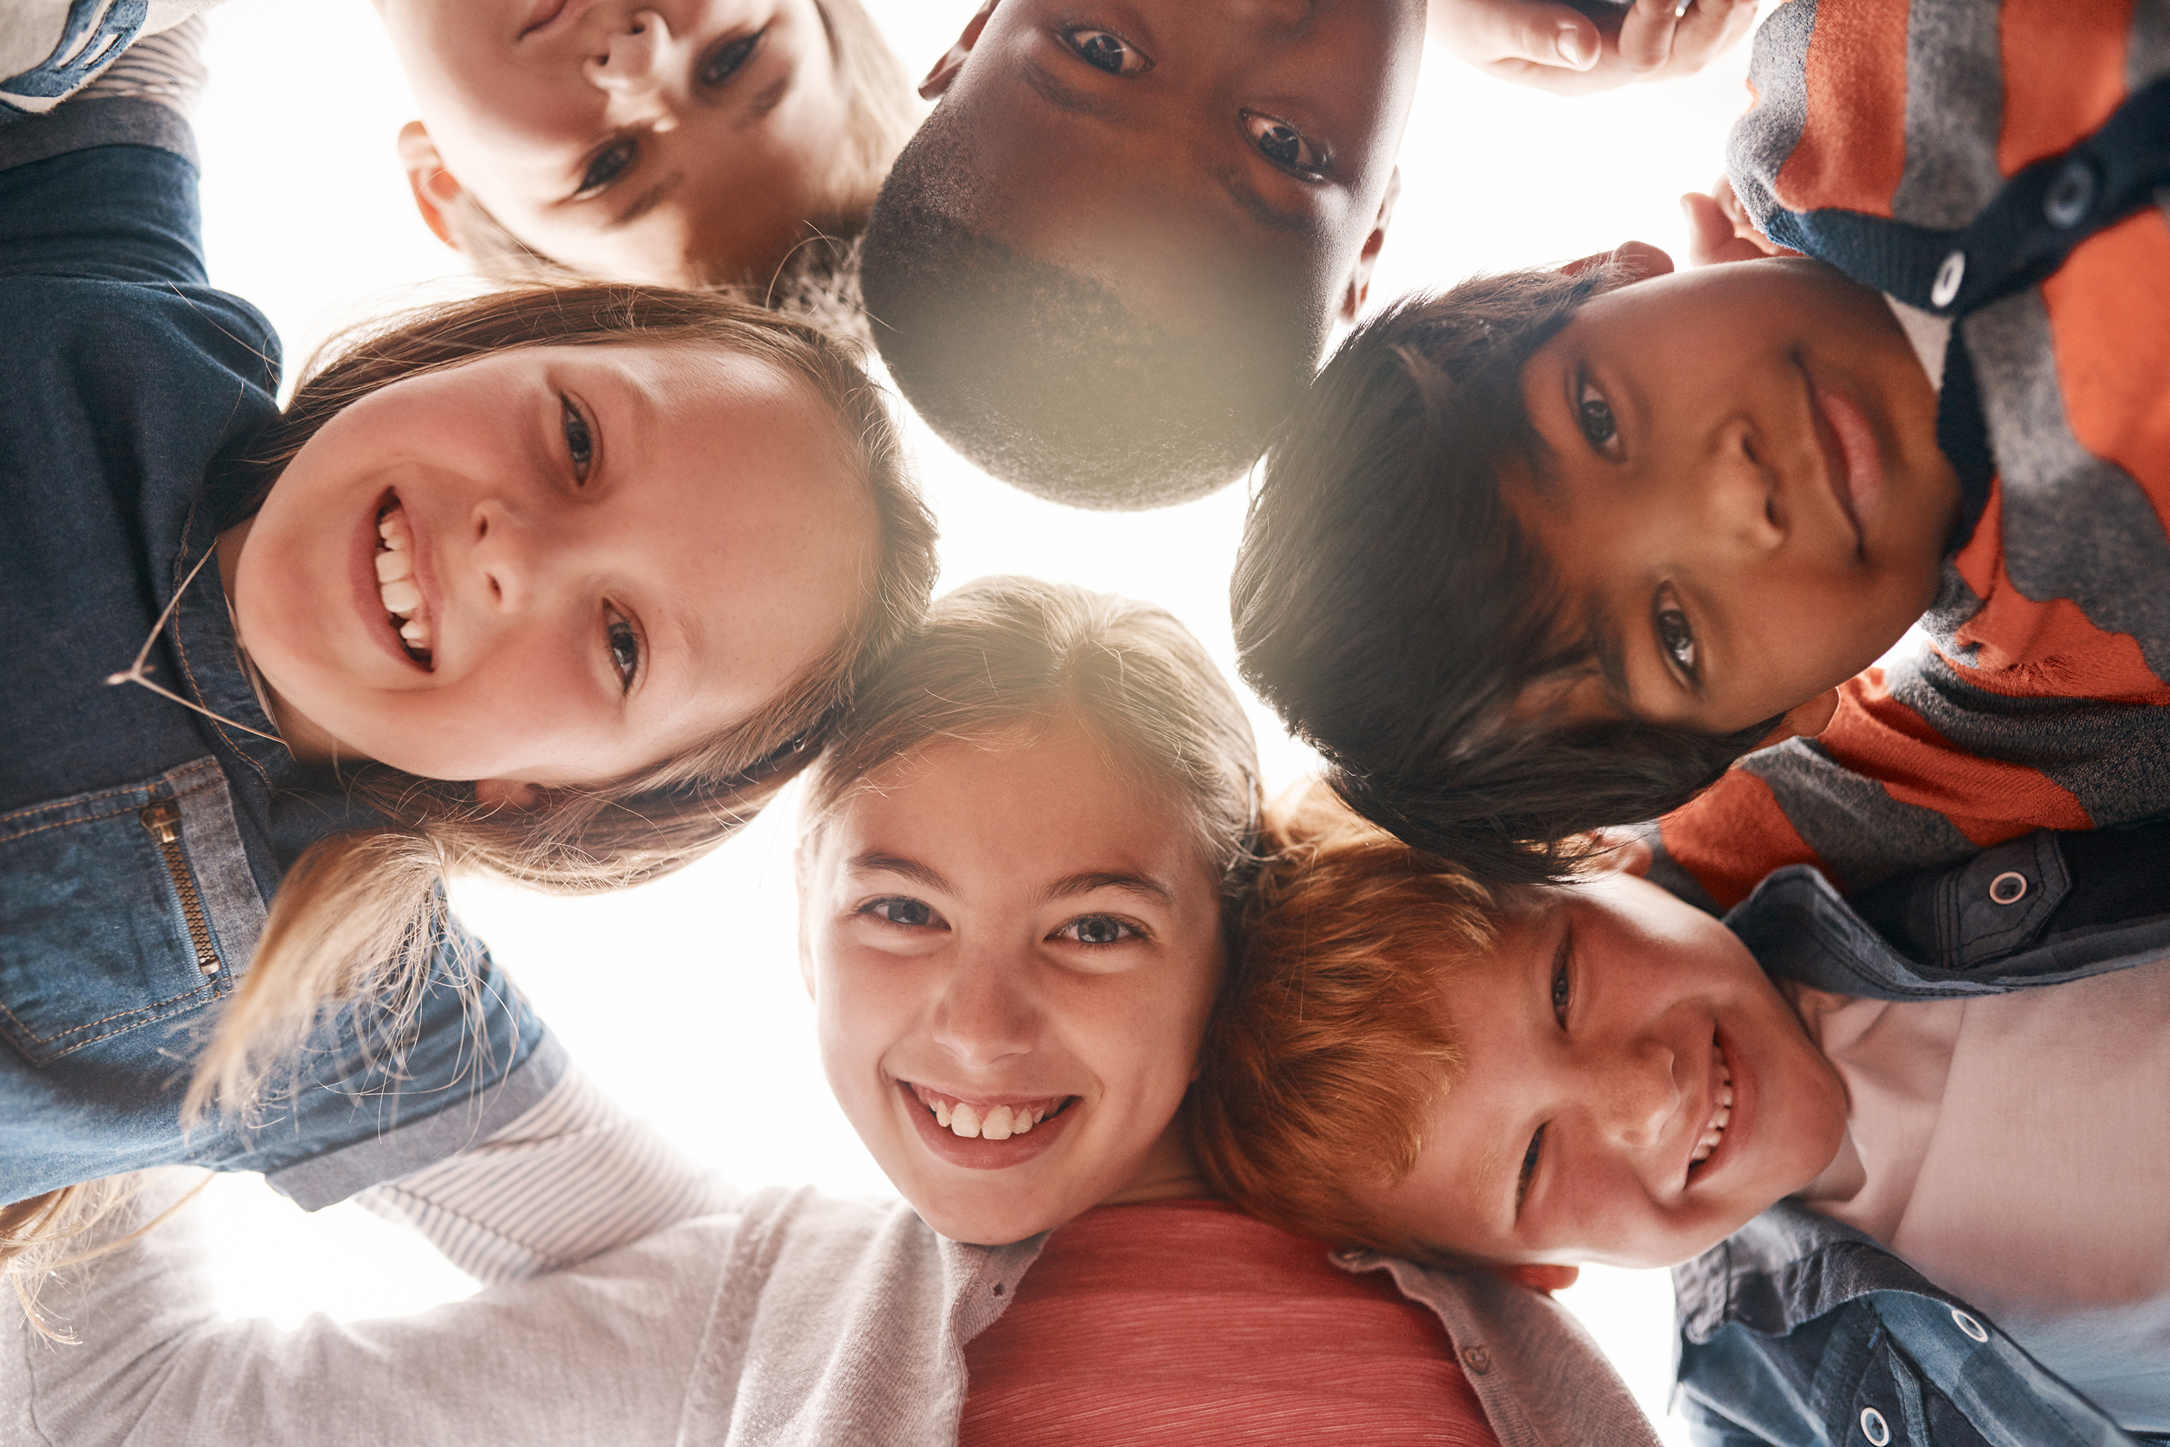
Baptism as the Sign of Unity among All followers of Jesus, regardless of denomination. As Franciscans, we take this point seriously. Jesus prayed that All may be one, as he and the father are one. We are unified in and through Jesus.

Slide 13
Each of us connected to Christ, the Vine, and to each other

Slide 14
Jesus said, “Abide in me, as I in you. As the branch cannot bear fruit by itself, unless it abides in the vine, neither can you, unless you abide in me. I am the vine; you are the branches. By this my Father is glorified, that you bear much fruit, and so prove to be my disciples. As the father has loved me, so I have loved you; abide in my love.” JN 15: 4-5a, 8-9

Slide 15
Baptism symbolizes our connection to Jesus, the Vine

Slide 16
Each denomination is committed to following Jesus

Slide 17
Each branch of the family bears unique fruits of the Spirit, building the greater Kingdom of God

Slide 18
Each branch according to Jesus ”is to bear much fruit”,

Slide 19
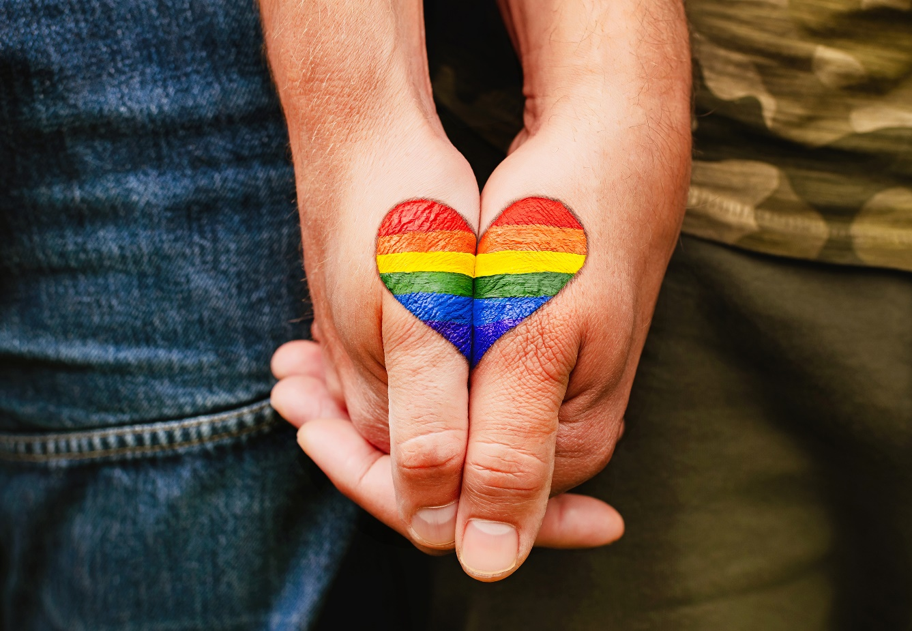
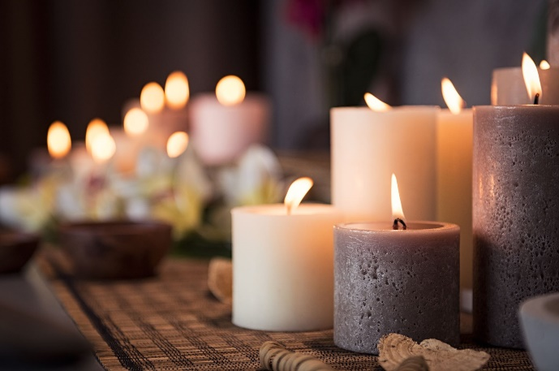
Committed to following Jesus, being connected to Christ the Vine

Slide 20
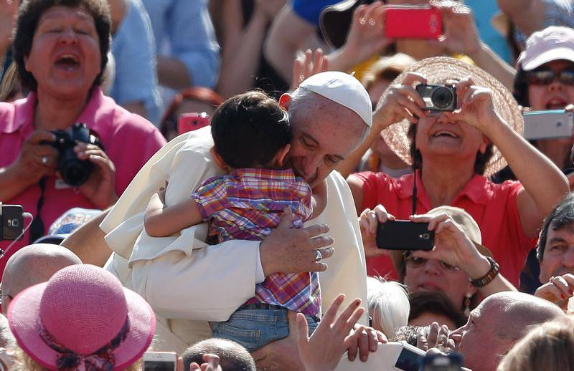
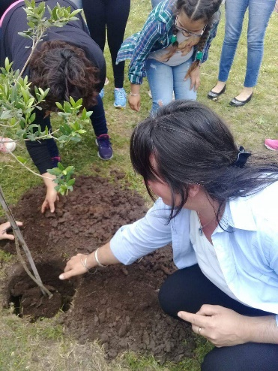
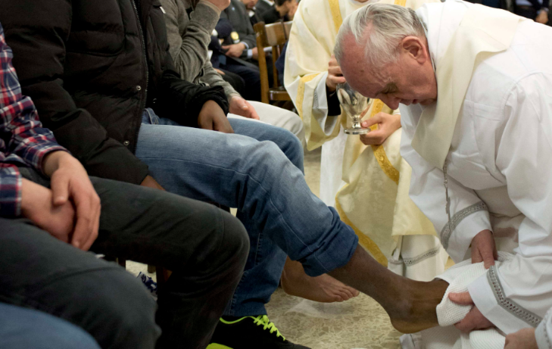
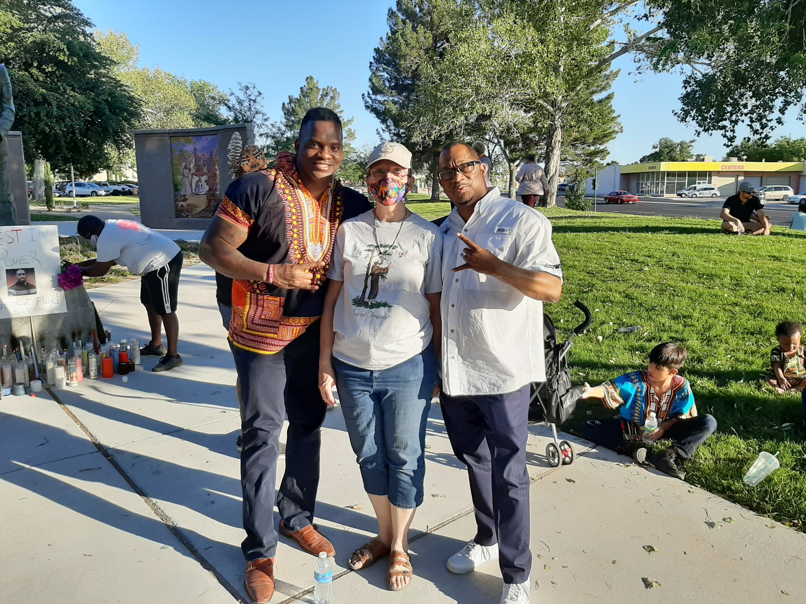
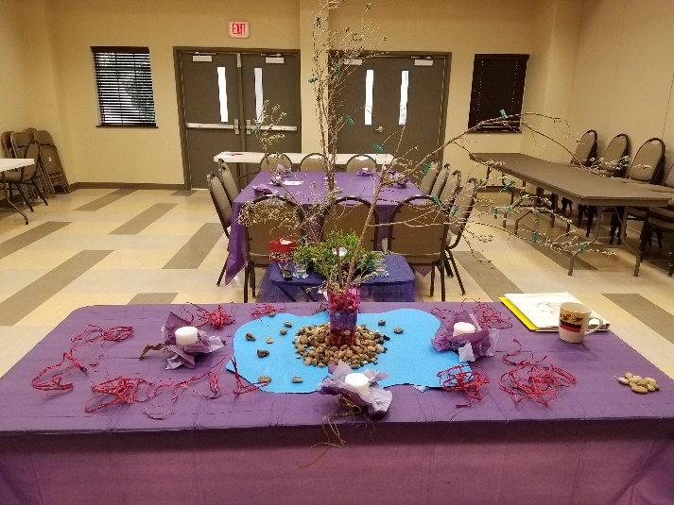
Fruits of the Spirit

Slide 21
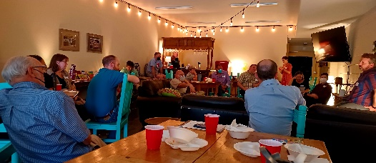
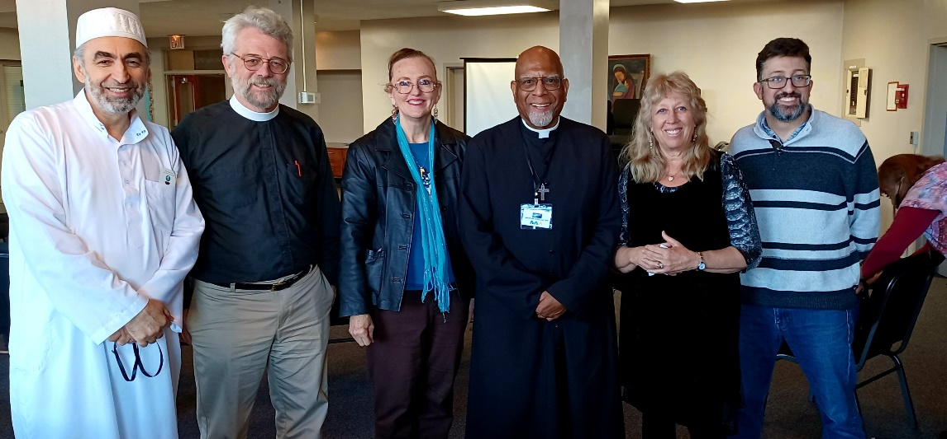
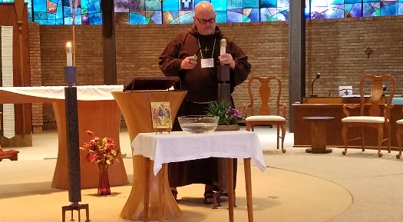
Working towards Unity-evidences the Fruits of the Spirit

Slide 22
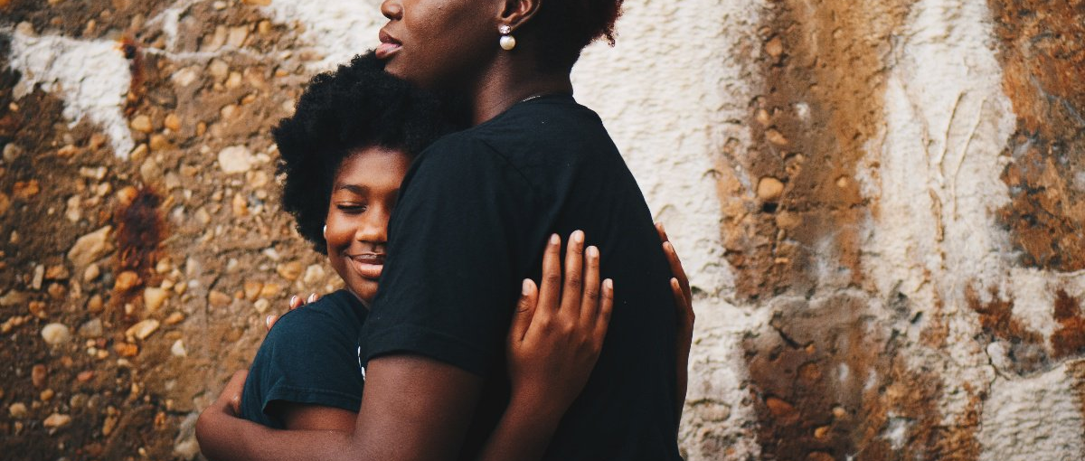
Can we love as Christ?

Slide 23
Baptism is a commitment to follow Jesus, demonstrate love towards all, partner with Jesus to bless, heal, reconcile, a sign of God’s Presence, Compassion, and Active Care

Slide 24
What projects (ministries or Franciscan observances) might your local Fraternity/Fellowship create in cooperation with Franciscans of another denomination?
Being informed, or reminded that Baptism is a universal sign among all Franciscans of being followers of
Jesus (part of the Body of Christ), how does that affect your attitude toward, or understanding of those who are part of a denomination/Church other than your own?
In what ways can you be instrumental in establishing, or strengthening a relationship with Franciscans (or other Christians) beyond your own order or denomination?

Slide 25
Agape Meal
Deb: And the Power of God was revealed in the running wave and the flowing river, in the quiet earth and the shining sun and the stars.
All/Bev: Out of darkness came light.
Deb: And the image of God was revealed in the human face and the gentle heart, in the warmth of flesh and the depth of soul.
All/Bev: Out of the dust came life.
Deb: And the wisdom of God was revealed in the need to grow and the will to love, in the chance to know and the power to choose.
All/Bev: Out of justice came freedom.
Deb: And God looked at all creation,
All/Bev: And behold, it was very good.

Slide 26
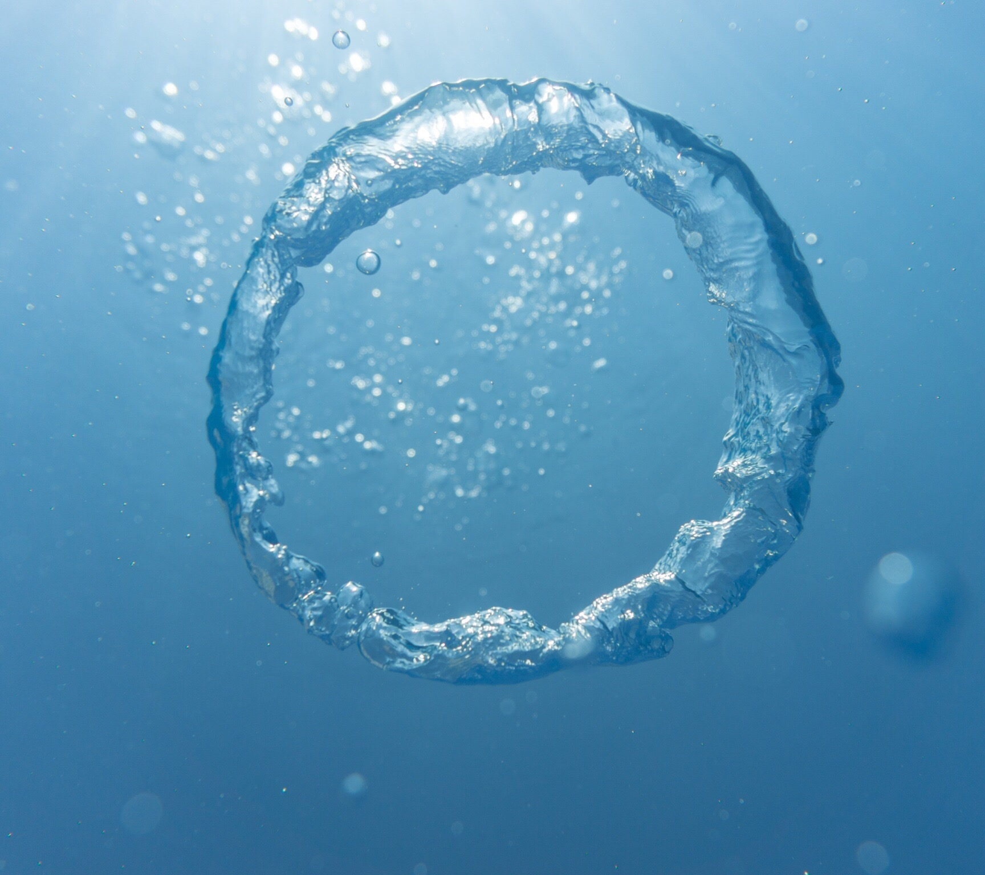
Scripture: Ephesians 4:4-6
Bev :“There is one body and one Spirit, just as you were called to one hope when you were called; one Lord, one faith, one baptism; one God and Father of all, who is over all and through all and in all.”
Deb: Let us pray: Living God, our loving parent; we cherish Your creation!
All/Bev: we praise you.
Deb: With earth, air, water, fire, sun, moon and stars: in our element as your children,
All/Bev: we praise you.

Slide 27
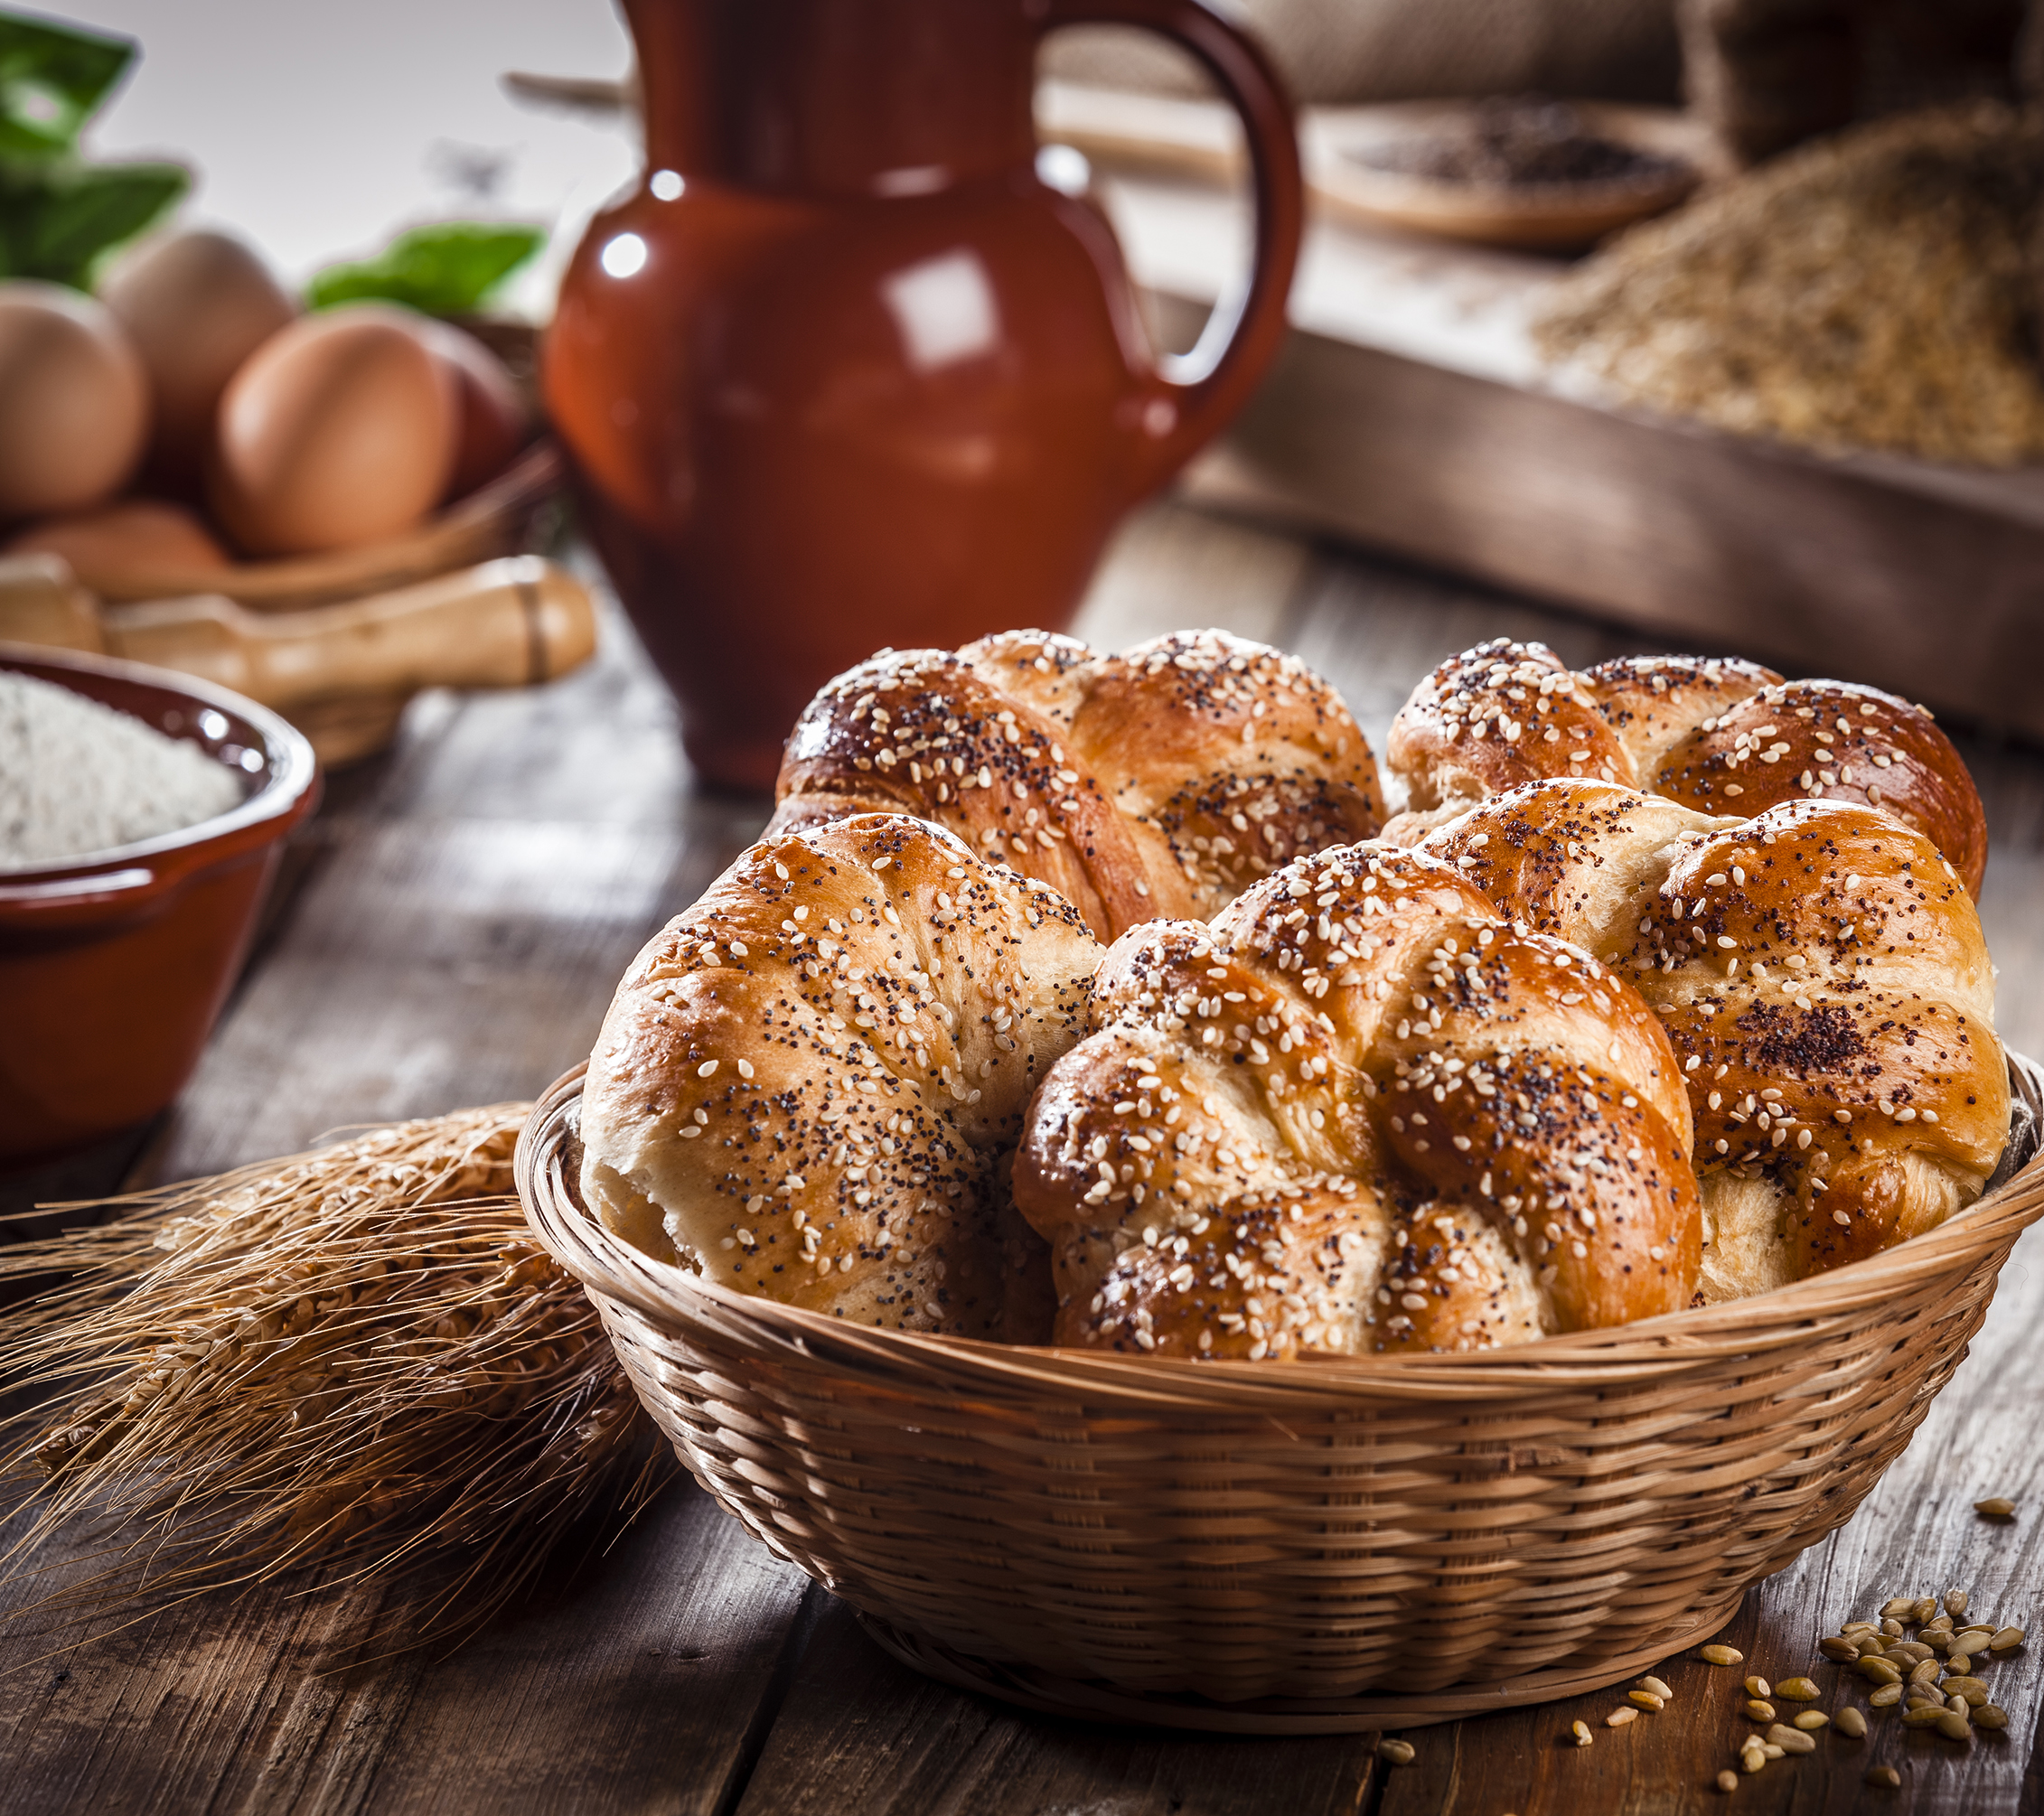
Deb: With our lips, with our lives, in all our diversity, each one made in Your image,
All/Bev: We praise you.
Deb: Because in Jesus, you came to share our human lives, our sorrows and joys,
All/Bev: we praise you.
Deb: Because your Spirit is at work here today: encouraging us, strengthening us, drawing us closer in unity,
All/Bev: we praise you.
Deb: Holy Creator, above all, this day, we give thanks for the gift of eternal life! May this bread, which Sister Earth has given and human hands have molded, be for us a reminder to walk as siblings united, following in the footsteps of the poor and humble Christ. (Partake in the Bread)

Slide 28
Deb: As we take this cup, we thank You for the earthly drink that quenches our thirst, and for the Living water with which You enrich and transform our lives. (Partake of the drink) Deb: Thank you, Most Holy One, for each of us gathered here today. For this time shared. For the message of unity through Christ Jesus, the living water of life that flows through all of us. We ask that our physical and spiritual nourishment today leads us forth in the light of Faith, Love, Hope and Service. All/Bev: Amen. Closing Remarks Andrew

Slide 29
Thank you to Donna Hollis who presented this basic imagining back in 2019, Donna laid the foundation this presentation was sprung from.
Deb Snider –Scott for the gift of the Agape Meal.
To the Joint Committee on Franciscan Unity, for their tireless work on this and many other projects.
To the individuals who prepared this opportunity and those committed to the work of Ecumenical and Interfaith work, You are honored.

