Slide 1
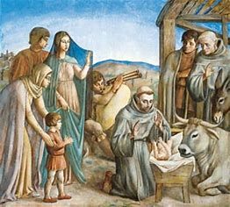
CELEBRATING
CHRISTMAS AT GRECCIO
1223-2023

Slide 2
CELEBRATING
CHRISTMAS AT GRECCIO
1223-2023
OVERVIEW:
OPENING HYMN – O COME, O COME, EMMANUEL
GUEST SPEAKER
THE CRECHE STORY COMPARISONS FROM CELANO AND ST. BONAVENTURE
REFLECTION ON THE BARE MANGER SCENE - By Terri Leone, OFS
CONTEMPLATION
BREAKOUT SESSIONS
SOMETHING TO THINK ABOUT – WHERE DO WE GO FROM HERE?
CLOSING PRAYER
CLOSING HYMN – O LITTLE TOWN OF BETHLEHEM
FRATERNITY ACTIVITY FOR ADVENT…NATIVITY SCENE FIGURES

Slide 3
O COME, O COME, EMMANUEL
O come, O come, Emmanuel
And ransom captive Israel
That mourns in lonely exile here
Until the Son of God appear
Rejoice! Rejoice! Emmanuel
Shall come to thee, O Israel
O come, O come, Thou Lord of might
Who to Thy tribes, on Sinai's height
In ancient times didst give the law
In cloud, and majesty and awe
Rejoice! Rejoice! Emmanuel
Shall come to thee, O Israel
O come, Thou Wisdom from on high
And order all things, far and nigh
To us the path of knowledge show
And cause us in her ways to go
Rejoice! Rejoice! Emmanuel
Shall come to thee, O Israel

Slide 4
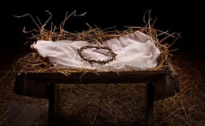
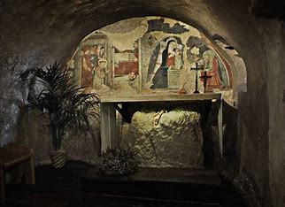
Crèche Story Comparisons from St. Bonaventure and Thomas of Celano
Francis of Assisi, Early Documents, Editors: Armstrong, Hellmann, Short
TC – Thomas of Celano (1185-1265)
SB – St. Bonaventure (1221-1274)
TC: So thoroughly did the humility of the Incarnation and the charity of the Passion occupy his memory that he scarcely wanted to think of anything else. Three years prior to his death, blessed Francis had John (a certain man in that area who had a good reputation) summoned to him some fifteen days prior to the birthday of the Lord.
SB: It happened, three years prior to his death, that he decided to celebrate at the town of Greccio the memory of the birth of the Child Jesus with the greatest solemnity, in order to arouse devotion. So that this would not be considered a type of novelty, he petitioned for and obtained permission from the Supreme Pontiff.

Slide 5
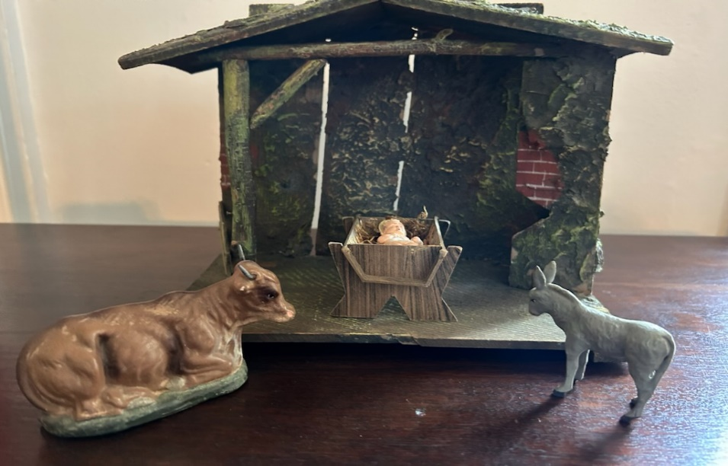
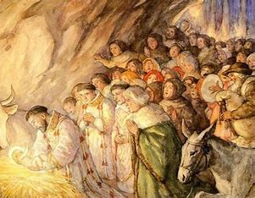
TC: Francis said to John: “Hurry before me and carefully make ready the things I tell you. For I wish to enact the memory of that babe who was born in Bethlehem: to see as much as possible with my own bodily eyes the discomfort of his infant needs, how he lay in a manger, and how, with an ox and an ass standing by, he rested on hay.”
SB: He had a manger prepared, hay carried in and an ox and an ass led to the spot. The brethren are summoned, the people arrive, the forest amplifies with their cries, and that venerable night is rendered brilliant and solemn by a multitude of bright lights and by resonant and harmonious hymns of praise.

Slide 6
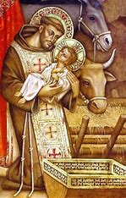
TC: The holy man of God is dressed in the vestments of the Levites, since he was a Levite, and with full voice sings the holy gospel. Here is his voice: a powerful voice, a pleasant voice, a clear voice, a musical voice, inviting all to the highest of gifts. Then he preaches to the people standing around him and pours forth sweet honey about the birth of the poor King and the poor city of Bethlehem. Moreover, burning with excessive love, he often calls Christ the “babe from Bethlehem” whenever he means to call Him Jesus. The gifts of the Almighty are multiplied there, and a virtuous man sees a wondrous vision. For the man saw a little child lying lifeless in the manger and he saw the holy man of God approach the child and waken him from a deep sleep.

Slide 7
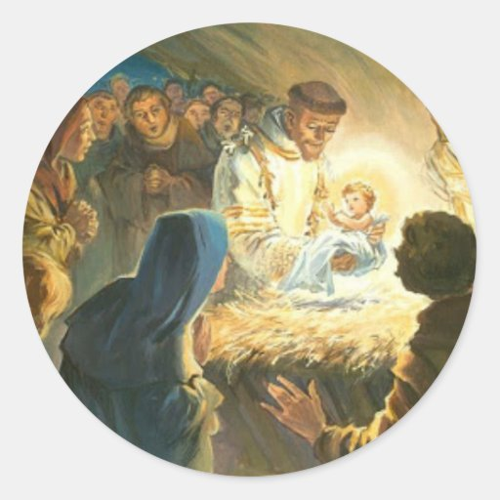
SB: The man of God stands before the manger, filled with piety, bathed in tears, and overcome with joy. A solemn Mass is celebrated over the manger, with Francis, a Levite of Christ, chanting the holy Gospel. Then he preaches to the people standing around him about the birth of the poor King, whom, whenever he means to call him, he called in his tender love, the Babe from Bethlehem. A certain virtuous and truthful knight, Sir John of Greccio, who had abandoned worldly military activity out of love of Christ and had become an intimate friend of the man of God, claimed that he saw a beautiful little child asleep in that manger whom the blessed father Francis embraced in both of his arms and seemed to wake it from sleep.

Slide 8
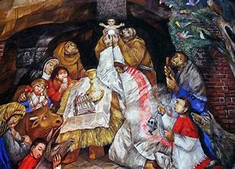
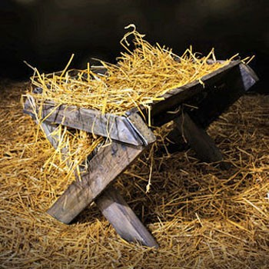
TC: He seems to lick his lips whenever he uses the expressions “Jesus” or “babe from Bethlehem”, tasting the word on his happy palate and savoring the sweetness of the word. Nor is this vision unfitting, since in the hearts of many the child Jesus has been given over to oblivion. Now He is awakened and impressed on their loving memory by His own grace through His holy servant Francis. At length, the night’s solemnities draw to a close and everyone went home with joy.
SB: Not only does the holiness of the witness make credible the vision of the devout knight, but also the truth it expresses proves its validity and the subsequent miracles confirm it. For Francis’s example, when considered by the world, is capable of arousing the hearts of those who are sluggish in the faith of Christ. The hay from the crib was kept by the people and miraculously cured sick animals and drove away different kinds of pestilence. Thus, God glorified His servant in every way and demonstrated the efficacy of His holy prayer by the evident signs of wonderful miracles.

Slide 9
REFLECTION…
- By Terri Leone, OFS
Why was the scene so bare?
Where were the people, especially Mary &
St. Joseph?
A gentle voice spoke to my heart; it contains only
the most important elements…

Slide 10
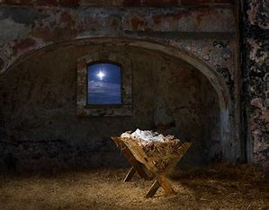
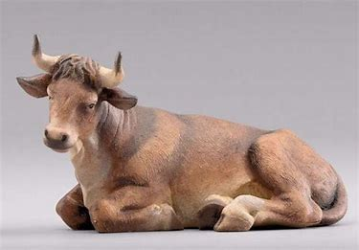
You/the heart - is the stable/animal shelter where Jesus wants to be born. I know you are far from perfect and will provide minimum shelter from the world outside, but My original home was in a similar state. The openness of the animal shelter was important – it provided easy access between Me and the world – I wanted nothing to keep us apart.
The Ox - represents the everyday mundane burdens/chores of your life that you carry in your heart.

Slide 11
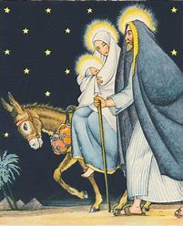
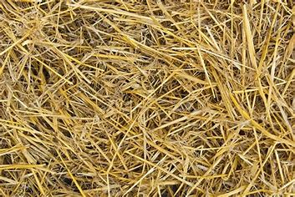
The Donkey - because he carried Mary & Baby Jesus from Nazareth to Bethlehem & from there to Egypt, represents the spiritual/religious portion of your life carried in your heart. I want so much to be a part of your whole life – not just the spiritual/religious.
The straw/hay - My original bed, provided food & bedding for the animals & stuffed mattresses and had other uses for the humans. The bed is empty because I await your invitation to enter. My great desire/My goal was, and still is, to provide for all the needs of people – the mundane, everyday “stuff” as well as the spiritual/religious portions of your life, and for the needs of all of creation.

Slide 12
CONTEMPLATE…
How well do we understand the connection between humanity and Divinity?
Do we appreciate the great act of humility that Jesus exercised for our salvation?
How can we meditate, like Francis did, on both the Incarnation and the Passion at the same time?
What actions can we take to show humility in our lives as Franciscans?

Slide 13
SOMETHING TO THINK ABOUT: WHERE DO WE GO FROM HERE?
Will you invite Me in?
Will you ask Me to stay with you every day for the rest of your life?
Will you bring Me to others that I may provide for their needs, too?

Slide 14
CLOSING PRAYER (adapted from Guideposts – Author: Bob Hostetler)
“Lord, make this home a place that welcomes You and exalts You.”
“Jesus, let humility—like that of Your surroundings at Your birth — be a characteristic of my life.”
“As Mary prayed and Joseph exemplified, let it be to me according to Your will.”
“Gracious Christ, as You condescended to take on human flesh, be born in a stable, and laid in a manger, please condescend to me and abide with me through this season in a special and enduring way.”
“As the angels said, let peace on earth and goodwill toward all multiply among me and mine this Christmas season.”
“Lord, how excited those shepherds were to welcome You and spread the news about You. Make me like them.”
“As the magi came from afar to worship and present their gifts to You, let my life and dedication be acceptable in Your sight, O Lord, my strength and my redeemer.”

Slide 15
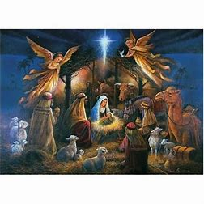
Glory to God in the highest!
And peace to people of goodwill!

Slide 16
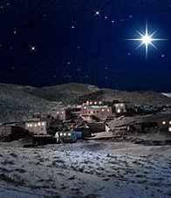
O LITTLE TOWN OF BETHLEHEM
O little town of Bethlehem,
How still we see thee lie.
Above thy deep and dreamless sleep
The silent stars go by;
Yet in thy dark streets shineth
The everlasting Light;
The hopes and fears of all the years
Are met in thee tonight.
For Christ is born of Mary,
And gathered all above
While mortals sleep, the angels keep
Their watch of wondering love.
O morning stars, together
Proclaim the holy birth.
And praises sing to God the King.
And peace to men on earth.

Slide 17
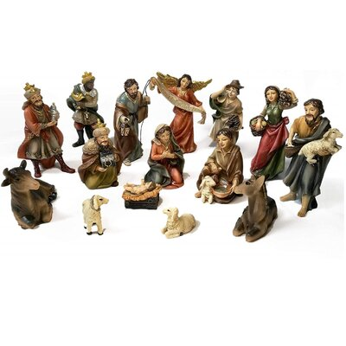
ADVENT ACTIVITY AND REFLECTION FOR USE IN YOUR FRATERNITY…
WHICH NATIVITY FIGURE DO YOU IDENTIFY WITH AT THIS STAGE IN YOUR JOURNEY?

