Slide 1
What is Franciscan youth (youfra)?
Core training session 2

Slide 2
A Little history
In the early days the first order started youfra as a ministry to young people. It was a way to journey with young people and to invite them into a faith life.
With the establishment of the ofs rule of 1978 the first order gave the responsibility of youfra to the ofs.
The last four words to be added to the rule of 1978 before it was sent for establishment were “especially with youth groups” to article 24.
IN a visitation to the u.s. in the late 1990s the ciofs minister general visited and asked the pointed question to our national fraternity, “where are your youth?”
2016 – visioning conference – some of the same people who worked on the vision are on the commission today or serving as animators.

Slide 3
Mission statement (excerpt)
“We envision journeying with youth and young adults as they discern their purpose in life and develop a relationship with Jesus christ. After experiencing Franciscan fraternal life, these young people may desire to form a Franciscan Youth and Young Adult community (YouFra), and the ofs at all levels commits to support them.”

Slide 4



Ten steps to Youfra: step one
To motivate your fraternity or region, and point them in the right direction, present ongoing formation such as the fy/ya commission’s session: our responsibility to youth: what do our documents say? (found on National website)
Once you determine those who wish to take on leadership, let the regional Animator and the Executive council know of your intentions.
You can also Contact the national commission in order to receive the support you need. We will walk with you on this adventure too.

Slide 5
Ten steps to youfra: step two
Become familiar with all fy/ya essential documents: mission statement, national statutes, and publications from ciofs, which address and clarify these steps in detail. These can be found on the National website, or you can request copies from your Fraternity animator (or minister if you have no animator).
All Fraternities were gifted with a binder of fy/ya essential documents and a flash drive which include all essential documents and many faith development sessions from which to choose.

Slide 6
Ten Steps to youfra: step three
Comply with all diocesan rules, guidelines, and safe environment certification requirements regarding working with youth. Submit proof of certification to the Regional YouFra Animator..
This is an important step. Some fraternities are doing this as a group!

Slide 7

Ten steps to youfra: step four
Research the youth in your area.
Determine what age group is available and if there are already existing groups in which you can volunteer your services.
Build connections, being careful not to undermine other programs.
Brainstorm ways to begin forming relationships with younger Catholics and with those who work with them.

Slide 8
Ten steps to youfra: step five
Seek opportunities for you and the youth to become visible to and more comfortable with each other. Let them experience the Franciscan charism through your efforts to reach out, walk with them on their journey, and support their faith growth. Again, brainstorm ideas. Prayer services, social justice/care for creation activities, sponsor young people graduating from high school or receiving confirmation, etc.
Once you determine a plan that works best in your situation, submit a simple budget to your council for funding possible needs, such as copies of suggested resource materials for the leaders, service projects, events, etc.

Slide 9

Ten steps to youfra: step six
After you’ve been with your young people for a while, identify youth who may be eager to explore our Franciscan spirituality in a deeper way. Offer them the opportunity to form a YouFra group and clarify the steps and commitment.

Slide 10
Ten steps to youfra: step seven
At this point, leadership training for both youth and young adults would be advisable, as you will want to help young adults learn to share their gifts, help with planning, and take more ownership of their group; and we older folks will need to learn how to listen, let the young people determine how their group will function. In other words, we will step back in the process and simply walk with them in their journey, providing whatever assistance or guidance is necessary.
Acting as a core team, We each hold a significant role in the success of a youfra.

Slide 11
Ten steps to youfra: step eight
Keeping in mind formation guidelines (YouFra Formation in FY/YA Essential Documents and National Statutes # 22-31) which lead to the Promise, help the group plan their strategy, topics, activities and time-line.
If you are with youth (under 18), you will more than likely work directly with them as presenters, mentors, and planners.
If you are working with young adults (18-39), they will need some guidance and formation in Franciscan spirituality, but all involved must also realize and respect their autonomy.

Slide 12

Ten steps to youfra: step nine
Once youth have made a request to form a YouFra, determine whether a Fraternity or the Region will sponsor them. Secure an Animator and Spiritual Assistant. (This step may have been done earlier! But if not, they cannot proceed any further toward an official YouFra unless they have fulfilled this requirement.)
The group of five who have made their Promise are the ones that apply to be an officially recognized YouFra. They will choose a name (and perhaps a patron saint) and send their request to the Regional Council. The Region will notify National and National will submit their information to International.

Slide 13
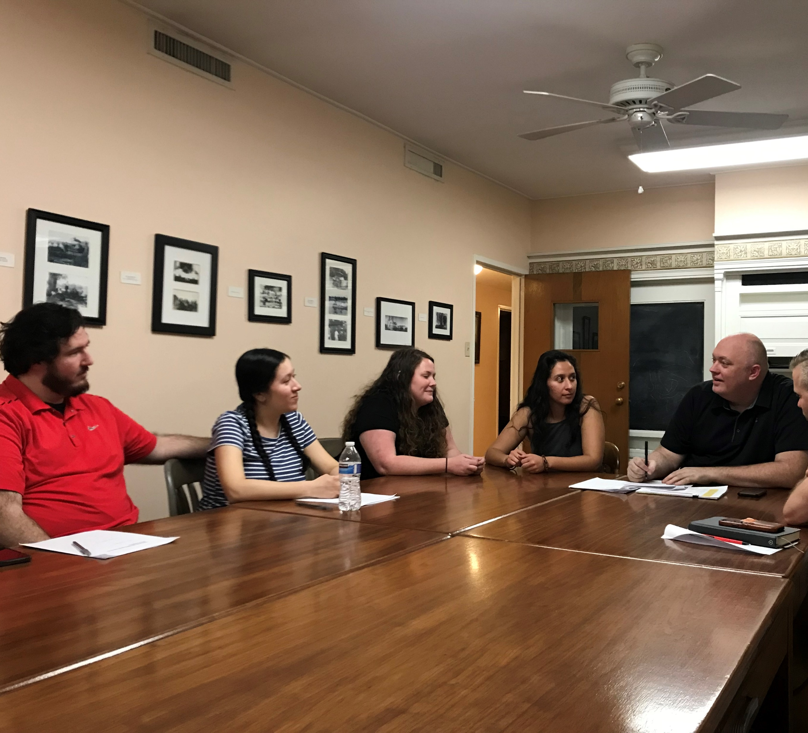
Ten steps to youfra: step ten
After becoming official, they will form an
elected council to serve their YouFra.
Young adults will also be eligible to serve
on higher level councils. In other words, one of
their council members will serve on the
fraternity council as a liaison.
The Promise of Yes is made on an annual basis—
as a renewal or a first time Promise.

Slide 14

Even these beginning steps may be too much for your fraternity for very valid reasons. However, developing a heart for and an understanding of the needs of young people will help you advocate for them and be ready if a young person walks through the door into your fraternity.
Spend time evaluating your fraternity. Are you vibrant? Joyful? Faithful to the Franciscan charism? Are you visible?
work on creating a youth friendly community of love, because whether we have Youfra or not, who we are and how we witness the gospel life is ultimately what will draw young catholics to us.

Slide 15
Blessings on your journey!
Questions and discussions?
Celebrate a new generation of Franciscan minded Gospel people,
And the possibility of a new YouFra (JuFra)!

