Slide 1
National Formation Highlights
Visioning Workshop and Plans for the Future
October 9, 2018
Prepared by Diane Menditto, OFS, and Mary Stronach, OFS
Photography: Robert Stronach, OFS

Slide 2
Visioning: Background
2014: Challenge from CIOFS
New direction for formation
Our response
Notes:
In 2014 CIOFS asked each National Fraternity to respond to questions relative to the management of the Order at different levels. Every country was to handle gathering this information as it saw fit. Although every country did not do a survey of its membership, you will remember that our National Fraternity asked us to fill out a survey in 2016.--
Results from that request put formation at the top of the list in almost every instance.
Our National Fraternity responded by setting a new direction for formation in the United States.

Slide 3
Visioning: Background
2018: The National Formation Visioning Workshop was born
Collaboration of the NEC and the NFC
Notes:
To begin the process, we held an extended weekend where we shared with Regional Formation Directors, the National Formation Commission, the National Executive Council, the Commission chairs and 12 invited Secular Franciscans who have a passion for formation. Each participant, including Regional Spiritual Assistants, who had had their own workshop in the prior days, helped us to get a sense of the larger body and begin the visioning process.

Slide 4
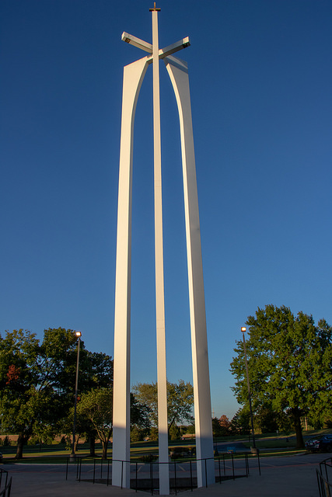
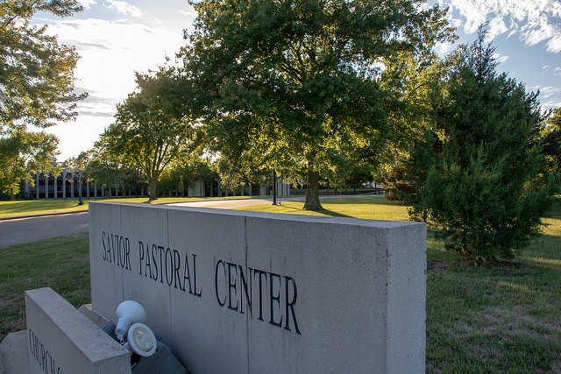
Savior Pastoral Center
Notes:
There were a total of 90 participants who gathered at Savior Pastoral Center in Kansas City to pray, share and reflect on the future of formation in our Order in the United States.

Slide 5
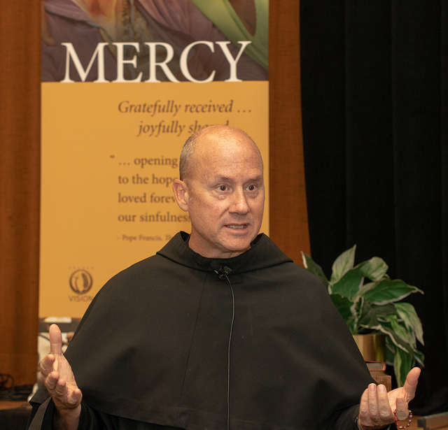
Come Holy Spirit!
Fr. Dave Pivonka, TOR, set the tone.
Notes:
Participants were inspired by our keynoter, Fr. Dave Pivonka, TOR. As the NEC and the NFC discussed a guest speaker, members of the National Formation Commission suggested Fr. Dave because we had read his book Breath of God: Living a Life Led by the Holy Spirit and we had seen his YouTube series on the Wild Goose is Loose. We were sure that he would draw the Holy Spirit to us.
Father spoke on the postmodern Catholic Church and our challenges for the future as Catholics and as Secular Franciscans. In referring to post-modern, we need to keep in mind that in this school of thought God is no longer the center of everything as he was prior to the Middle Ages and during the Renaissance. Now the person him or herself determines his or her own beliefs. This has a big effect on the issues facing the Church and the Order.

Slide 6
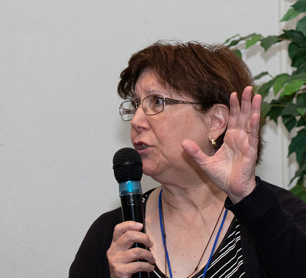
The Realities of the Order
Mary Stronach, OFS, related fundamental challenges
Notes:
In her talk, Mary Stronach asked the participants: “Are the challenges the International Order has experienced also true at our National level and… we asked…are they formation issues?
Jan referred to these challenges in her State of the Order talk this morning.

Slide 7
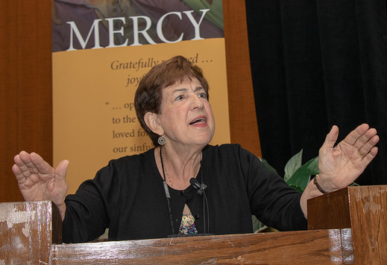
Visioning: Background
Anne Mulqueen, OFS, explained the visioning process.
Notes:
Now it was time to begin the important work of visioning.
Anne Mulqueen prepared us with her talk on Transformative Visioning, explaining that Visioning is a communal faith journey testing our willingness to step out in faith and leave behind that which no longer has meaning.

Slide 8
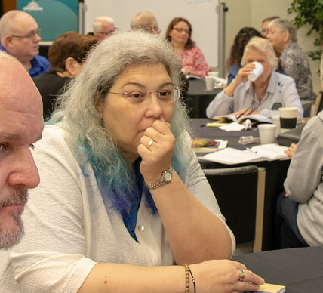
The Pivotal Questions
What would the ideal Order look like?
Notes:
Following the talks, we divided everyone into 10 random groups and we asked some pivotal questions: (By the way, these are great questions for formation sessions at local or regional gatherings. )
• What would the ideal Order look like?

Slide 9
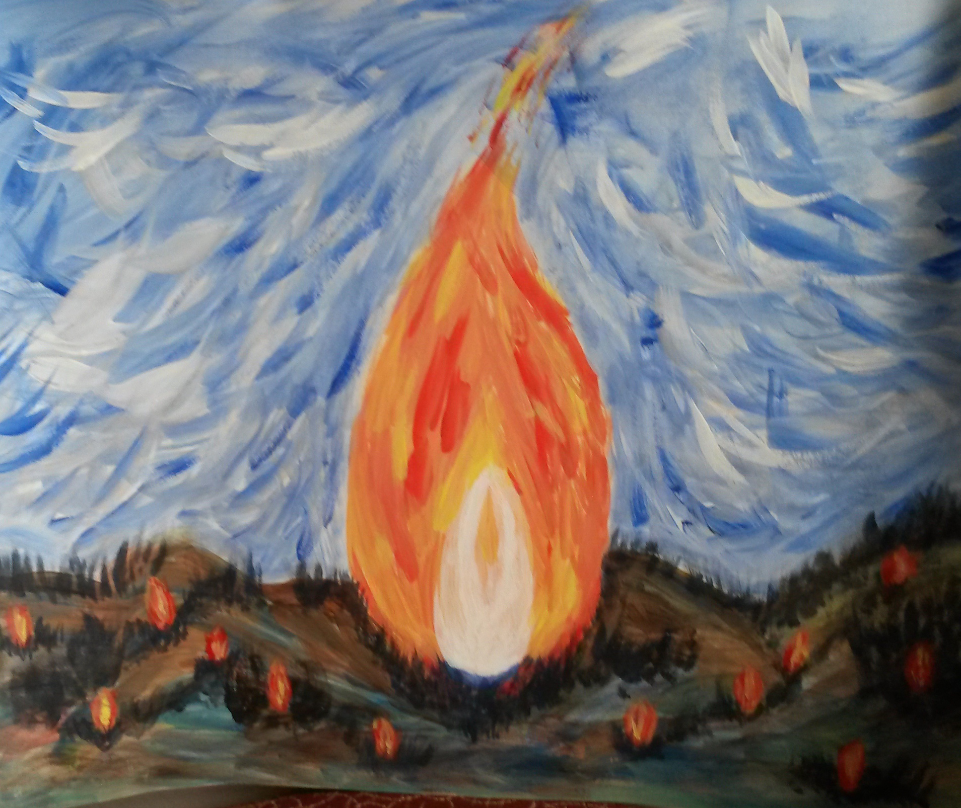
The Pivotal Questions
What is God’s direction for the Order?
Notes:
What is God’s direction for the Order?

Slide 10
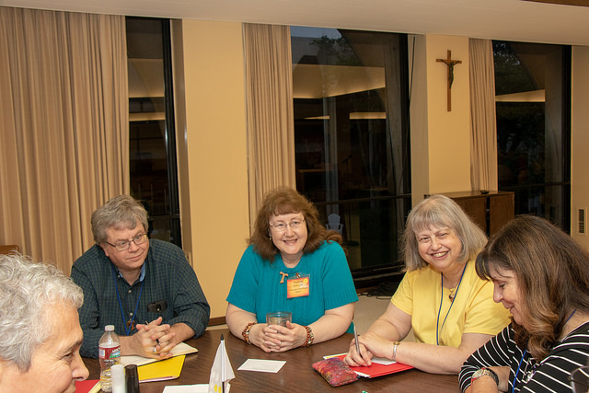
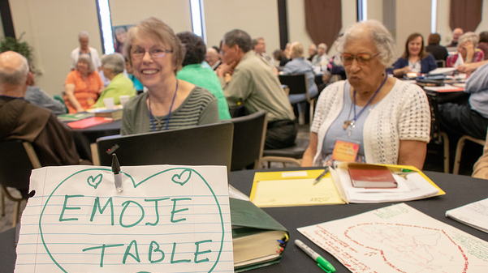
The Pivotal Questions
Who does God want us to be?
Notes:
All the small group responses were collated, and we are in the process of looking at the patterns that the answers to the questions tell us about the participants’ vision for formation in the USA.
Of the ten groups, many of the responses, issues and desires were similar and important enough that, as we begin to set our priorities and develop a plan, we will be addressing them specifically.

Slide 11
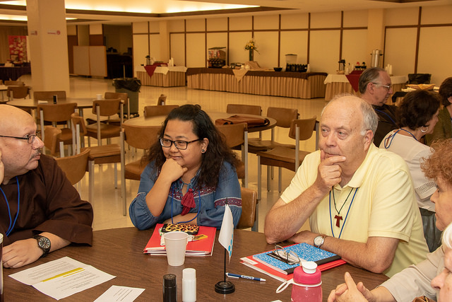
Saturday Afternoon: Special Interests
Fraternal life & relationships
Spiritual life, prayer and contemplation
Apostolates and outreach: expressing the Franciscan charism
Notes:
On Saturday afternoon, we gathered in interest groups and discussed topics that are central to formation:
1. Fraternal life and relationships
2. Spiritual life, prayer and contemplation
3. Apostolates and outreach expressing the Franciscan charism

Slide 12
Saturday Afternoon: Special Interests
Communications
& social media
Essential documents
Scripture and Franciscan sources
Secular identity
and the Franciscan charism
Notes:
4. Communications and social media
5. Essential documents
6. Scripture and Franciscan sources
7. Secular identity and the Franciscan charism

Slide 13
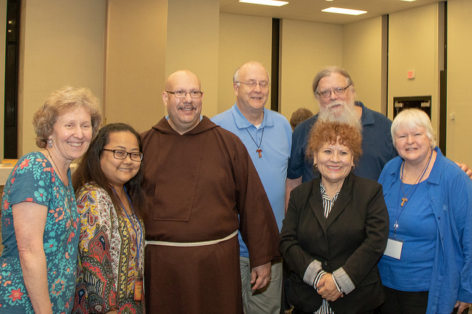
Saturday Afternoon: Special Interests
Commitment to the Order: Time, Talent and Treasure
Servant Leadership
Youth
Notes:
Commitment to the Order: Time, talent and treasure
Servant leadership
Youth

Slide 14
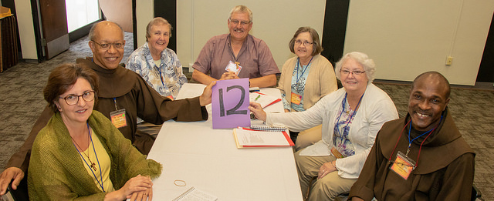
Saturday Afternoon: Special Interests
Spiritual assistants & their relationship to the OFS
Discerning the vocation
Multiculturalism
Notes:
11. Spiritual assistants and their relationship to the OFS
12. Discerning the vocation
13. Multiculturalism
Within these groups (some big and some small since they were by interest), we saw passion, vision and practical suggestions that will guide us as we move forward with the formation program in the USA.

Slide 15
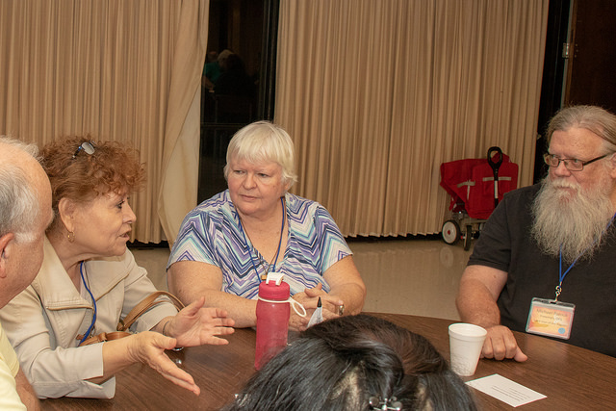
To be answered:
What is it going to take to get to the vision?
Notes:
The Holy Spirit was definitely present among us during the weekend.
And now, the real work of processing and implementing ideas begins.
The National Formation Commission and the National Executive Council will be collaborating as we set priorities based on the discussions held at this workshop.

Slide 16
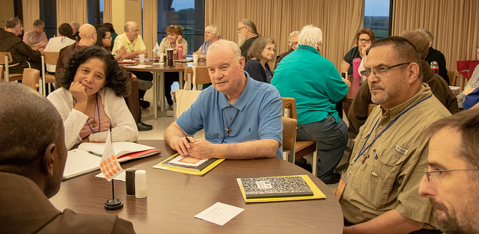
To be answered:
What will formation look like?
Notes:
Our hopes for the future are many.
The National Formation Commission has already begun work on completing some projects from the last Commission and starting some new ones.

Slide 17
National Formation Plans
NAFRA-FORM
TIME AND TALENT SURVEY
COMMISSION AND TASK FORCES
WEBSITE, FUN Manual, Formation Director Handbook
Notes:
All Regional Formation Directors have now signed on to the NAFRA-FORM. RFDs are in the process of sending in the name of an additional formation team member who will be their back-up on the FORM. RSAs will also be asked if they would like to receive an invitation. We want to have a lively interchange of ideas and best practices, some of which will be posted on our National Website.
We will also be updating the Formation web page, soon to be located on the new National website. The updates and edits to the FUN Manual will make the information more manageable and useful. We have already updated the Formation Director Handbook. This will be sent to all RFDs and posted on the Formation web page.
At the workshop, the participants filled out a Time and Talent survey. We are compiling the names and areas of expertise of those willing to work with the National Formation Commission. As we undertake the many projects that will put flesh on the vision, we will be calling on them, and you, to help us by participating on the task forces which will be established. And this is just the beginning. We’ll keep you posted!

