Slide 1
Conflict Resolution
Fr. Marek Stybor, OFM Conv.

Slide 2
Conflict is deeply embedded in the human heart, in the entire History of Salvation...
Image by Gordon Johnson from Pixabay
Notes:
Conflict is deeply embedded in the human heart, in the entire History of Salvation...
Conflict between good and evil, love and hate
Heaven and hell...
Saint Paul writes that there is a fight in my heart because I do not what is good but what is evil, even though I don't want to...

Slide 3
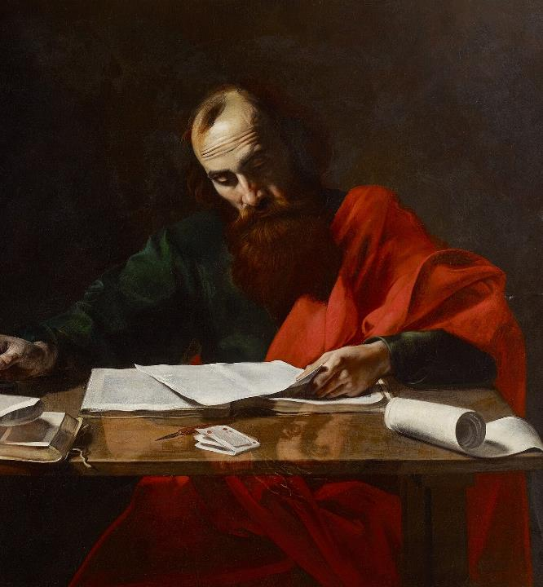
Saint Paul writes… What I do, I do not understand. For I do not do what I want, but I do what I hate... Romans 7:15
Valentin de Boulogne, Public domain, via Wikimedia Commons
Notes:
Conflict is deeply embedded in the human heart, in the entire History of Salvation...
Conflict between good and evil, love and hate
Heaven and hell...
Saint Paul writes that there is a fight in my heart because I do not what is good but what is evil, even though I don't want to...

Slide 4
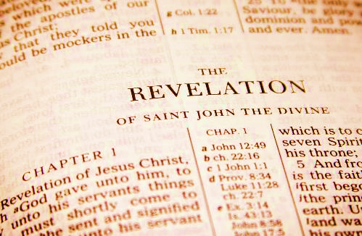
Endless series of conflicts between God and the Evil Spirit
ID 127839669 © Renamarie | Dreamstime.com
ID 334685 © Ishook | Dreamstime.com
Notes:
The entire Bible from the Book of Genesis to the Book of Revelations is an endless series of conflicts between God and the Evil Spirit,
Good and Evil...

Slide 5
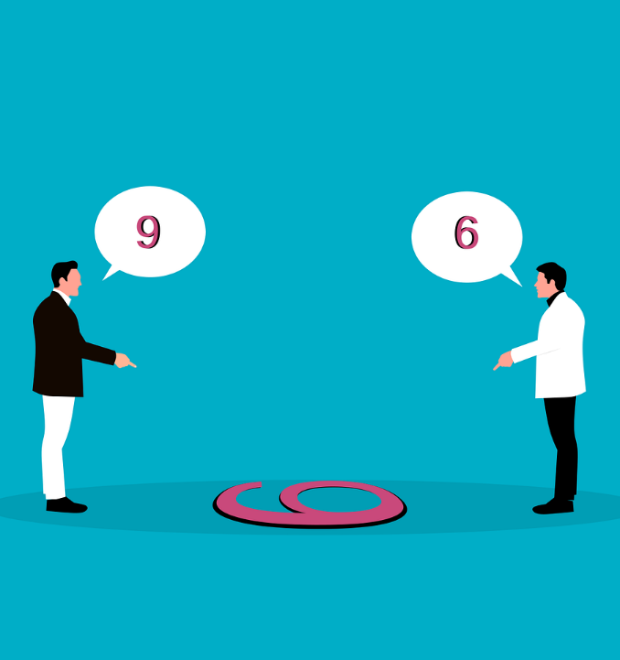
In every community, a healthy community, there is a difference of opinions, which results in conflict, confrontation, and a fight for the dominance of opinions and views.
Photo by Yi Fay: Pexels
Notes:
In every community, a healthy community, there is a difference of opinions, which results in conflict, confrontation, and a fight for the dominance of opinions and views.

Slide 6
ID 49707247 © Michal Bednarek | Dreamstime.com
Notes:
In every community, a healthy community, there is a difference of opinions, which results in conflict, confrontation, and a fight for the dominance of opinions and views.

Slide 7
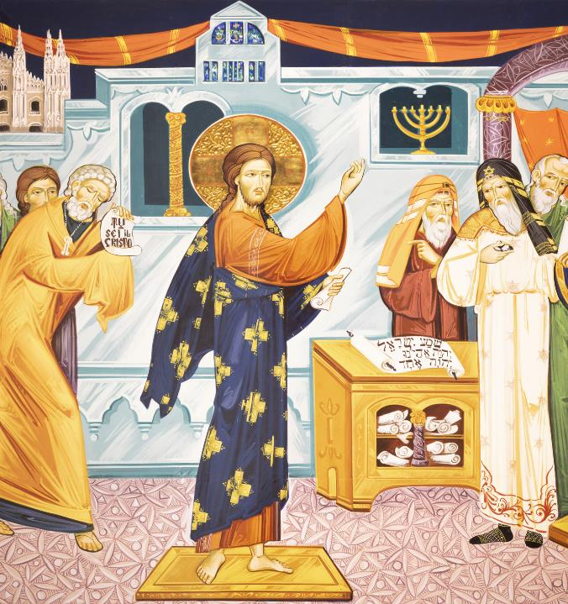
The Gospel is the never-ending conflict of Jesus with the Pharisees
ID 327108547 © Jozef Sedmak | Dreamstime.com
Notes:
The Gospel is the never-ending conflict of Jesus with the Pharisees...
Note...Jesus did not seek this conflict, but by preaching the Gospel He provoked people to stand for the truth and this always results in conflict.
It is no different in the Family or the Religious Community.
Often we are not looking for conflict, but the conflict is looking for us....

Slide 8
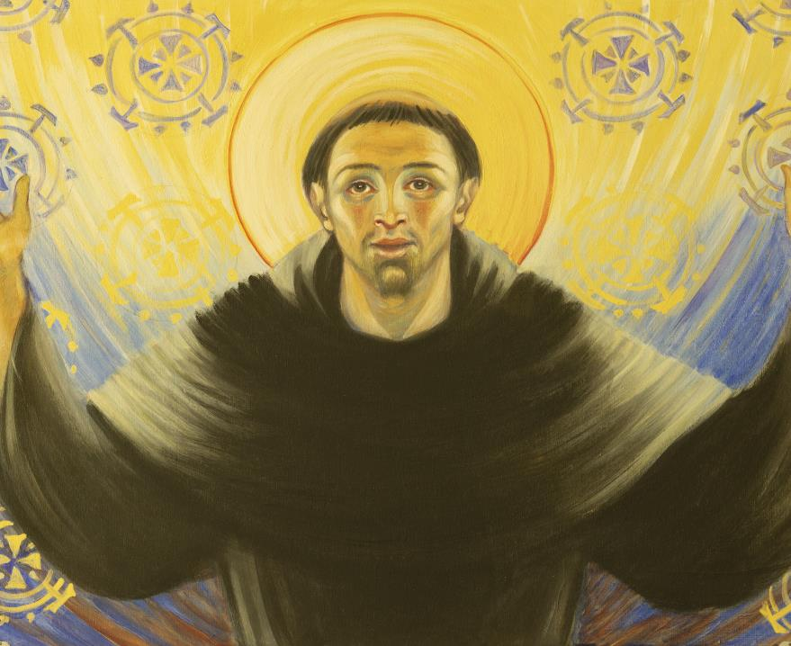
Saint Francis is a symbol of peace and forgiveness,
ID 183867103 © Jozef Sedmak | Dreamstime.com
Notes:
Saint Francis, a symbol of peace and forgiveness, was in conflict with the Father, the Mother with the inhabitants of Assisi, with the Brothers, when he radically lived the Gospel, he was in conflict.
Jesus says that he did not bring peace, but a sword... Defining oneself by the values ​​of the Gospel automatically invites conflict... this cannot be avoided... Conflict often ends with the rejection of one of the parties, a painful misunderstanding... The example of Jesus, Francis, thousands of Saints...
The Holiness of Life provokes, is uncomfortable, creates conflict... for or against... The history of conflict is rich, hidden in human fear, which is the fruit of original sin.

Slide 9
Tools that Jesus gives us in conflict situations.
ID 103845523 © Shuang Wang | Dreamstime.com
Notes:
Jesus gave us tools in conflict situations.

Slide 10
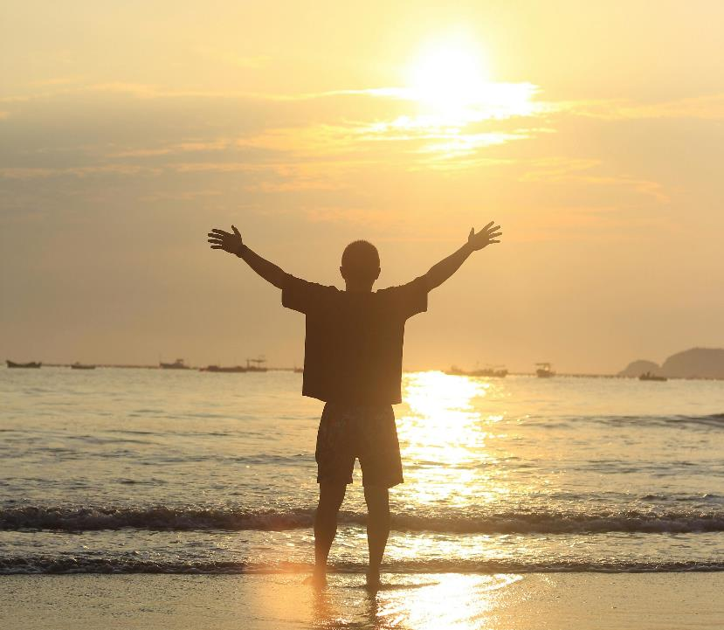
Prayer, inviting God to the conflict that results in division, is the first, and most important step
Photo by Yi Fay: https://www.pexels.com/photo/28315995/
Notes:
A. PRAYER... Jesus prays to the Father... Father, make them One...
Prayer, inviting God to the conflict that results in division, is the first, most important step

Slide 11
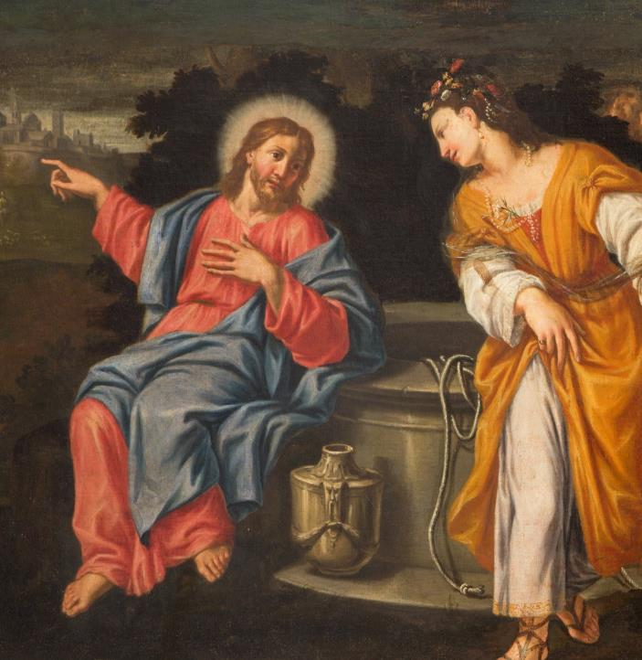
Jesus teaches dialogue: Gospel of John 4:4-42 The Samaritan Woman
ID 44716994 © Jozef Sedmak | Dreamstime.com
Notes:
B. DIALOGUE
The Lord Jesus teaches dialogue in Saint John, chapter 4.
Meeting with the Samaritan woman.
There is no one there, there is a sincere conversation from heart to heart... this is the cure for conflict. Only Jesus and the Samaritan woman without witnesses

Slide 12
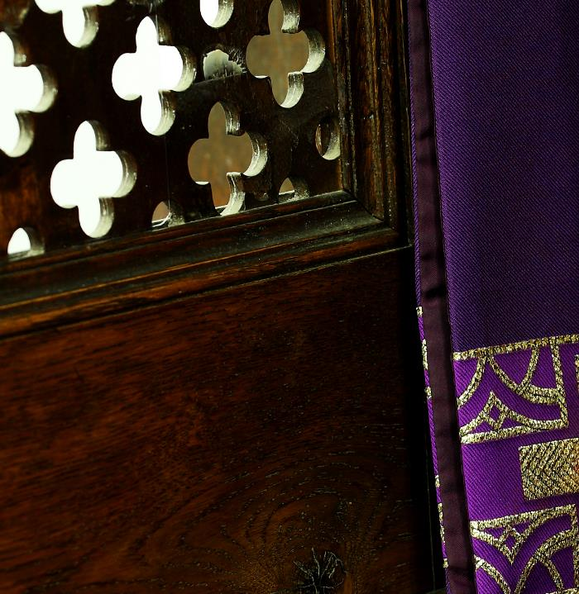
The Sacrament of Reconciliation
ID 28498544 © 8213profoto | Dreamstime.com
Notes:
C. THE SACRAMENT OF RECONCILIATION has a huge impact on healing tensions in the community...Jesus, Mercy

Slide 13
Time heals wounds
ID 330809488 © Ruslan Batiuk | Dreamstime.com
Notes:
D. TIME heals wounds, heals... there are no quick cures... sometimes it takes a whole life for healing, agreement, reconciliation.

Slide 14
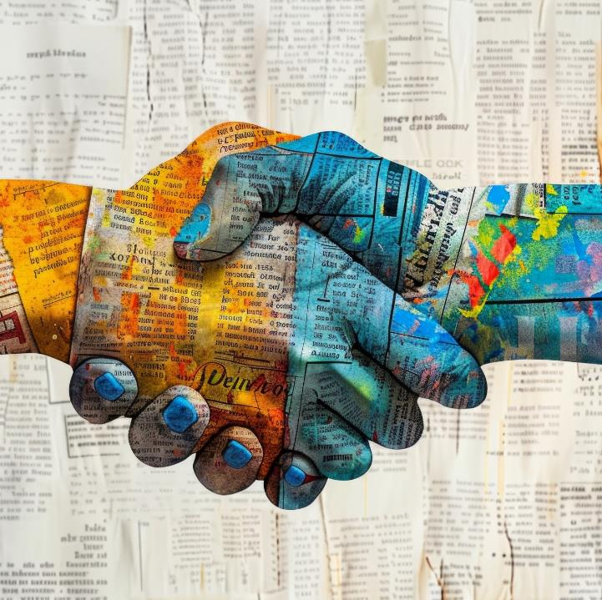
Reconciliation with Another Person
ID 315690100 © Pavel Shlykov | Dreamstime.com
Notes:
E. RECONCILIATION WITH ANOTHER PERSON... this is always God's greatest miracle
It requires God's intervention...
On the cross, Jesus asks the Father
Forgive them, Father, for they know not what they do...
Ask God like Jesus on the cross... there is no other psychological answer, no cure.

Slide 15
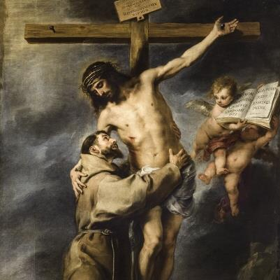
Spirituality of Failure Jesus and Francis teach us to win you must lose
Bartolomé Esteban Murillo, Public domain, via Wikimedia Commons
Notes:
F. SPIRITUALITY OF FAILURE
Jesus and Francis teach us that to win you have to lose....
In a conflict, Friday’s defeat on the cross brings fruit of Resurrection Sunday....
This is God’s most beautiful Logic of Love
Without Crucified Love we will not solve any conflict, we will only deepen it.
Love that knows how to lose, allows itself to be crucified, and will overcome the conflict
It will bring peace of heart...
I wish you this peace of heart.

Slide 16
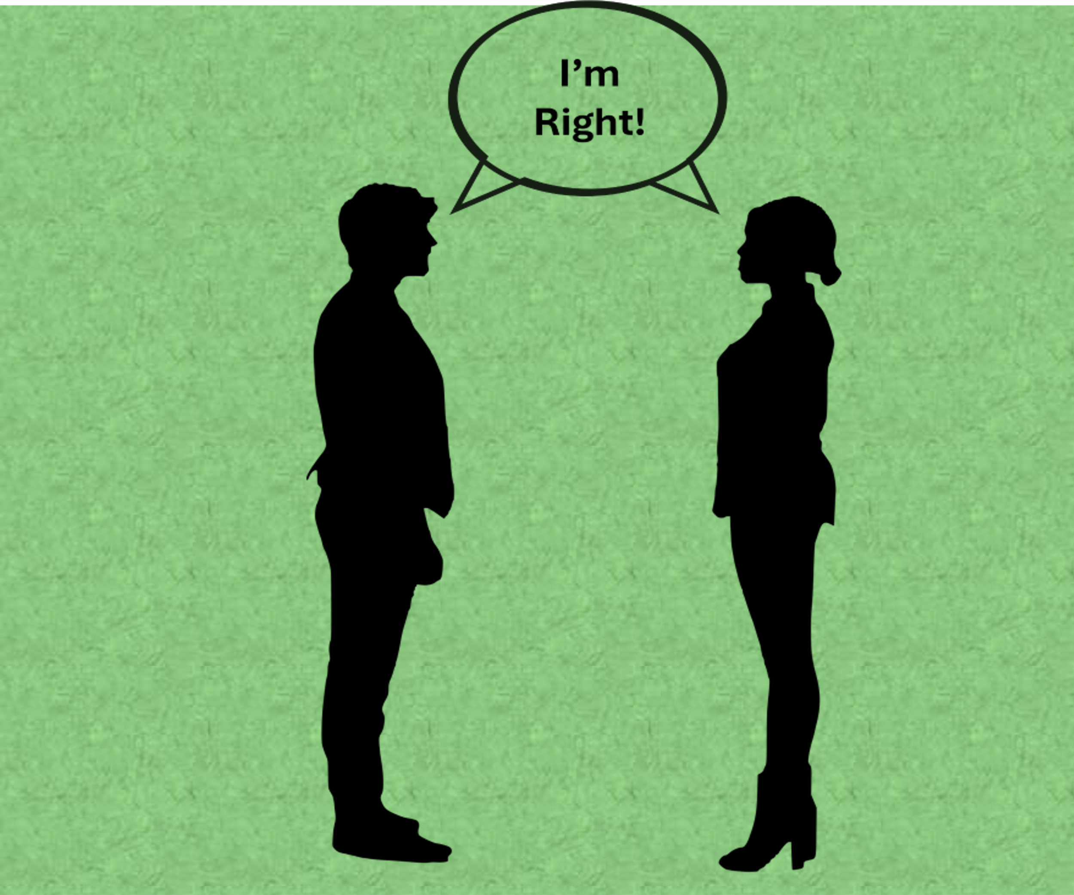
Who is right and Who is Wrong?
Image by Mohamed Hassan from Pixabay
Notes:
SOCRATES, famous for resolving conflicts
Two brothers had a quarrel over the property, the inheritance of their parents... so they came to Socrates and he awarded the share to the older brother, and after listening to the younger one, also to him.
Socrates' wife reacted to this and exclaimed from the kitchen...
"Socrates, you are a fool, how can both brothers be right...
To which Socrates replied to his wife...
You're right too.....
Discovering part of the truth in each side is a wise way to resolve conflicts.
It's worth trying it...

Slide 17
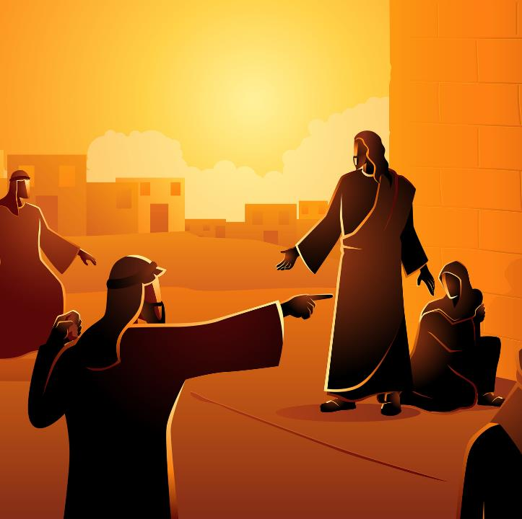
Gospel of John
Chapter 8:1-11
The Adulterous Woman
ID 157809830 © Rudall30 | Dreamstime.com

Slide 18
Gospel of John: Chapter 8:1-11
1. Jesus teaches us how to free human hands from the stones of judgments, executions, unjust verdicts...
2. In this scene everyone is trapped...
3. Jesus invites those who are without guilt or sin to deal out the execution.
4. Every conflict in the community begins and ends in my heart.
5. Only in the Church are we invited to say the words at the beginning of the Holy Mass...
Notes:
Gospel of St. John: Chapter 8: 1 - 11
Woman caught in adultery....
1. Jesus teaches us in this dramatic scene how to free human hands from the stones of judgments, executions, unjust verdicts...
2 In this scene everyone is trapped...
Woman, Jesus, People with stones...
3 Jesus solves the conflict brilliantly. He invites only those who are without guilt or sin to deal out the execution.
4. Every conflict in the community begins and ends in my heart.
5. Only in the Church are we invited to say the words at the beginning of the Holy Mass...

Slide 19
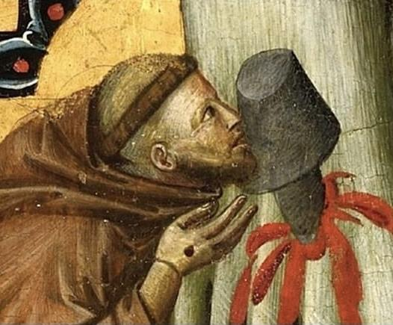
There is no better therapy for conflict healing.
Saint Francis repeated that he himself is the greatest sinner on earth who needs conversion, mercy and forgiveness
Photo by Fr. Marek Stybor, OFM Conv.

Slide 20
Grandma and Grandson
The grandson, who is in the Church, was forced to attend Mass even though he wanted to stay at home and play on the computer...
He spoke... at the beginning of Holy Mass
Her fault
Her fault
Her very grievous fault

Slide 21
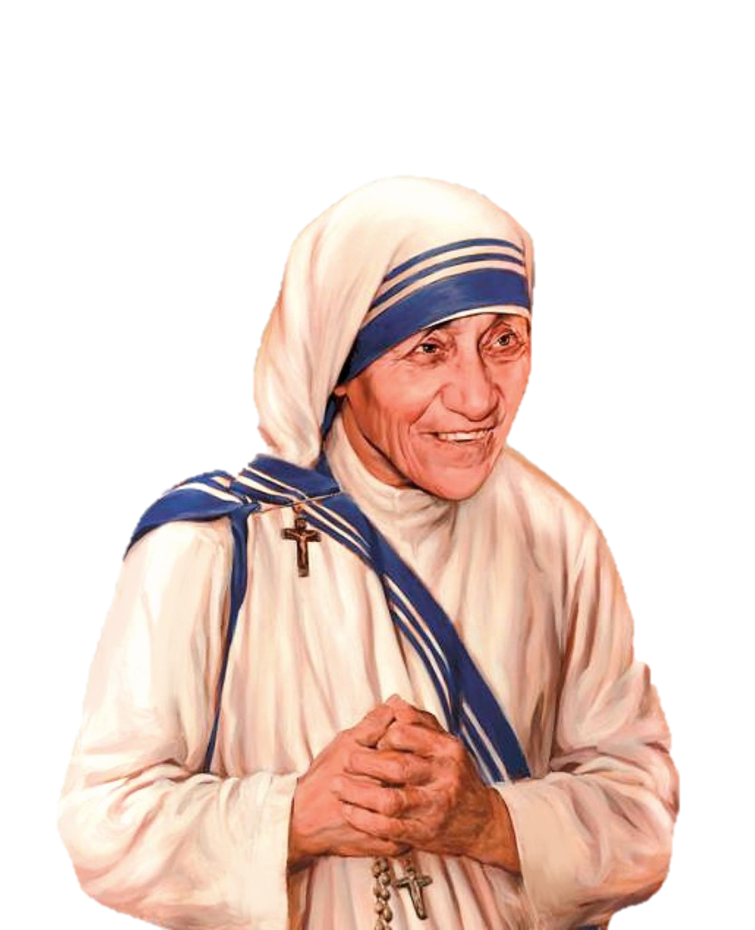
IF YOU ARE KIND, PEOPLE MAY ACCUSE YOU OF SELFISH MOTIVES. Be kind anyway IF YOU ARE HONEST, PEOPLE MAY CHEAT YOU. Be honest anyway IF YOU FIND HAPPINESS, PEOPLE MAY BE JEALOUS. Be happy anyway THE GOOD YOU DO TODAY MAY BE FORGOTTEN TOMORROW. Do good anyway GIVE THE WORLD THE BEST YOU HAVE AND IT MAY NEVER BE ENOUGH. Give your best anyway FOR YOU SEE, INDEED, IT IS BETWEEN YOU & GOD It was never between you and them anyway -Mother Teresa
Mother Teresa Charitable Trust - MTCT, CC BY-SA 4.0, via Wikimedia Commons

