Slide 1
1 THE ANNUNCIATION

Slide 2
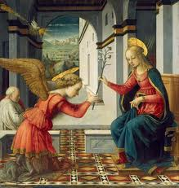

Slide 3
2 THE VISITATION

Slide 4
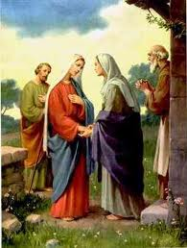

Slide 5
3 THE BIRTH OF THE LORD AND THE ADORATION OF THE MAGI

Slide 6
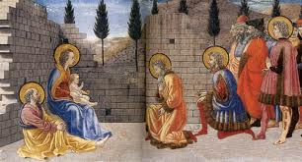

Slide 7
4 THE PRESENTATION OF THE LORD AND THE PURIFICATION OF THE BLESSED VIRGIN

Slide 8
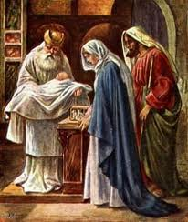

Slide 9
5 THE FINDING OF THE CHRIST CHILD IN THE TEMPLE

Slide 10
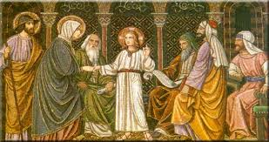

Slide 11
6 THE RESURRECTION AND THE MEETING OF MOTHER AND SON

Slide 12
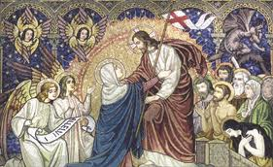

Slide 13
7 THE ASSUMPTION Of THE BLESSED VIRGIN AND HER CORONATION AS QUEEN OF HEAVEN AND EARTH AND PROTECTRESS AND ADVOCATE OF THE FRANCISCAN FAMILY

Slide 14
