Slide 1
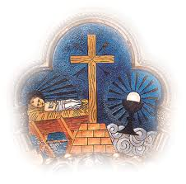
FRANCISCAN PRAYER Trinitarian with a focus on the Incarnation
Notes:
Definition of Franciscan Prayer
Explain Pictures →Trinity Prologue to Gospel of John and Francis fascination with the incarnation
HUMILITY AND POVERTY OF THE INCARNATION

Slide 2
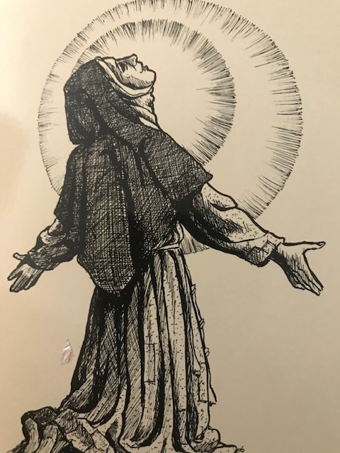
Franciscans at Prayer
Common threads run through all Franciscan Prayer
but diversity exists in how St. Francis prayed,
how St. Clare prayed, how St. Bonaventure prayed,
how St. Anthony of Padua prayed, etc., etc., etc.
Personality and experience has a lot to do with how individual Franciscans pray.
As Duns Scotus said, we are all unique, yet all of us embrace the same charism.
And all of us have the same focus as set forth in our Rule.

Slide 3
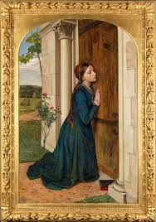
SECULAR FRANCISCAN SAINTS AT PRAYER
Can you name these three Saints?
One is in ecstasy, one is going off on a crusade, and one is a pious child skipping off to the chapel.
Notes:
St. Margaret of Cortona
St. Louis of France
St. Elizabeth of Hungary

Slide 4
Common Franciscan Threads
All place the Eucharistic celebration above all other forms of prayer.
The Divine Office holds a place of prominence in daily prayer life.
Prayer is Trinitarian in focus and centered on the life and teachings of Christ, especially in the gospels.
Contemplative prayer is essential and leads to action.
Notes:
Explanation for Slide
Discus Articles 8 and 5 of the OFS Rule
Rule Article 8
Rule Article 4b
Francis prayed with the Gospels – Rule Article 4c

Slide 5
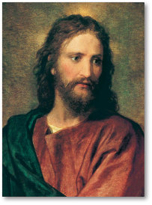
SAINT FRANCIS AND PRAYER Focus
Both Trinitarian and Centered on Christ
Letter to the Entire Order
Inwardly cleansed, enlightened and inflamed by the fire of the Holy Spirit, may we be able to follow in the footprints of Your beloved Son, our Lord Jesus Christ, and by Your grace alone, may we make our way to You, Most High, Who live and rule in perfect Trinity and simple unity and are glorified God almighty, forever and ever, Amen.

Slide 6
SAINT FRANCIS AND PRAYER Focus
Evolving, Maturing, and Creative
Office of the Passion
Canticle of the Creatures
In Harmony With His Beloved
Let us desire nothing else, let us want nothing else, let nothing else delight us, except our Creator, Redeemer, and Savior, the only true God … Earlier Rule, 23.9
Notes:
Office of the Passion and Canticle of the Creatures will be covered later on in presentation.

Slide 7
1205/06 Young Francis At the Beginning of His Conversion
Most High, Glorious God,
Enlightened the darkness of my heart,
And give me True faith,
Certain hope,
And perfect charity,
Sense and knowledge, Lord,
That I may carry out your holy and true command.
Notes:
Explain that St. Francis’ prayer of PETITION is one of only two prayers asking for something. All his other prayers are in praise, adoration gratitude and thanksgiving.

Slide 8
Prayer of Saint Francis Maturing in Faith and Creative in Expression
OFFICE OF THE PASSION

Slide 9
OFFICE OF THE PASSION
Probably the least known of St. Francis’ writings.
Perhaps the most original liturgical writing.
It is thought this little office evolved and changed over many years from his conversion to his death.
The 15 Psalms are a composite of various verses of the Davidic psalms and other part of Scripture.
Notes:
This is introductory information.
One needs to become familiar with and pray the component parts.

Slide 10
COMPONENTS
Francis began his office with the Our Father.
Followed by Glory be, ….
After the Our Father and Gloria, Francis prayed his original prayer, The Praises to be Said at All Hours.
Followed by his antiphon honoring the Blessed Virgin Mary.

Slide 11
COMPONENTS
5. Then a single psalm is prayed reflecting on the psalm appropriate for each hour.
6. Followed by a prayer.
7. The antiphon to the Holy Virgin Mary is repeated.

Slide 12
COMPONENTS
8. The Office concludes with his dismissal prayer.
Let us bless the Lord, the living and true God;
to Him let us always render praise, glory, honor, blessing and every good.
So be it. So be it. Amen.

Slide 13
Office of the Passion of St. Francis of Assisi
Laurent Gallant, OFM
André Cirino, OFM
The Geste of the
Great King
Notes:
Christ is the Hero
The Mission is entrusted to Christ
Enemies confront Christ
The Hero, Christ, is victorious

Slide 14
THE GESTE OF THE GREAT KING [Undated]
BACKGROUND MATERIAL ON THE FIFTEEN PSALMS
Psalms 1 to 7, tell the story line of the Geste in the words of the Hero, our Lord Jesus Christ.
Psalm 1: Begins with the agony in Gethsemane.
Psalm 2: The Hero goes before the Sanhedrin.
Psalm 3: A Morning Interlude: A time of calm before the horrific events that will follow.
Notes:
DEFINITION OF GESTE: noun archaic. a notable deed or exploit. a tale of adventure or romance.

Slide 15
THE GESTE OF THE GREAT KING [Undated]
Psalm 4: The Hero encounters the Imperial authority.
Psalm 5: We see the Hero on the Cross.
Psalm 6: The Hero passes from this world to the Father.
Psalm 7: The Hero speaks to the people.

Slide 16
THE GESTE OF THE GREAT KING [Undated]
EASTER VARIATION
Psalm 8: Echoes of Gethsemane: Taken from Psalm 69 without any changes. Hero affirms his trust in the Father.
Psalm 9: The New Song: The Hero’s passage from this world to the Father, liberating people and all creation from the clutches of the devil.

Slide 17
THE GESTE OF THE GREAT KING [Undated]
VICTORIOUS PSLAMS
Psalm 10: Raises a shout of joy to the Lord … (v. 1) – A psalm of joy and praise.
Psalm 11: Come, listen … (v. 4) and see who Christ is for St. Francis. Taken predominately from Psalm 19.
Psalm 12: Bless our God … (v. 7) The Hero expresses his trust in His Father’s love.

Slide 18
THE GESTE OF THE GREAT KING [Undated]
FOR ADVENT
Psalms 13 and 14:
A Time of Expectation and a Vision of Fulfillment
Emphasis in these psalms is on the Hero’s second coming in glory and the completion of God’s plan for creation.
Notes:
DEFINITION OF GESTE: noun archaic. a notable deed or exploit. a tale of adventure or romance.

Slide 19
THE GESTE OF THE GREAT KING [Undated]
FOR CHRISTMAS
Psalm 15: The last Psalm of the Office speaks of the Hero’s origin and his birth. Christmas holds a special place in Francis’ heart and, therefore, it is a song full of joy and exultation.
Notes:
DEFINITION OF GESTE: noun archaic. a notable deed or exploit. a tale of adventure or romance.

Slide 20
CHRIST, THE HERO

Slide 21
Canticle of the Creatures In Final Form at the End of Francis’ Life

Slide 22
Canticle of the Creatures
After Praising God
for Sir Brother Sun and Sister Moon and Stars;
Brother Wind and Sister Water;
Brother Fire and Sister Mother Earth,
St. Francis adds verses on Reconciliation and Peace
And in his final hours of life,
composes the last verses on Sister Death.

Slide 23
Verses 10-11 Reconciliation and Peace
Praised be You, my Lord,
through those who give pardon for your love,
and bear infirmity and tribulation.
Blessed are those
who endure in peace
for by You, Most High, shall they be crowned.
Notes:
Added after his original composition because of
Bitter feud between the bishop and mayor of Assisi
Francis ordered the Canticle be sung by 2 friars at a meeting of the bishop, the mayor and other citizens of Assisi
Outcome 2 men set aside differences and peace restored

Slide 24
Verses 12-13 Welcoming Sister Death
Praised be You, my Lord,
through our Sister Bodily Death,
from whom no one living can escape.
Woe to those who die in mortal sin.
Blessed are those whom death will find
in Your most holy will,
for the second death shall do them no harm.

Slide 25
Verses 12-13 Welcoming Sister Death
FRANCIS ON DEATH by ERIC DOYLE, OFM
Not only did Francis accept this last and most powerful of human diminishments, he actually included it in the universal brotherhood and sisterhood of all creation.
There had been many “little deaths” during his life and out of the experience of each came new life, an increase in being. These “little deaths” were sacraments of the “great death” which now came to him benignly as his sister.

Slide 26
ERIC DOYLE FRIAR MINOR BORN IN 1938 – DIED 8,1984 (46) ENGLISH FRIAR
THOSE WHO HAVE DIED HAVE NOT GONE VERY FAR.
THEY HAVE GONE TO GOD
AND GOD IS VERY NEAR.

Slide 27
LET US ALL PRAY THE FOLLOWING
Praise and bless my Lord
and give Him thanks
And serve Him
with great humility.
So be it. So be it. Amen.

