Slide 1
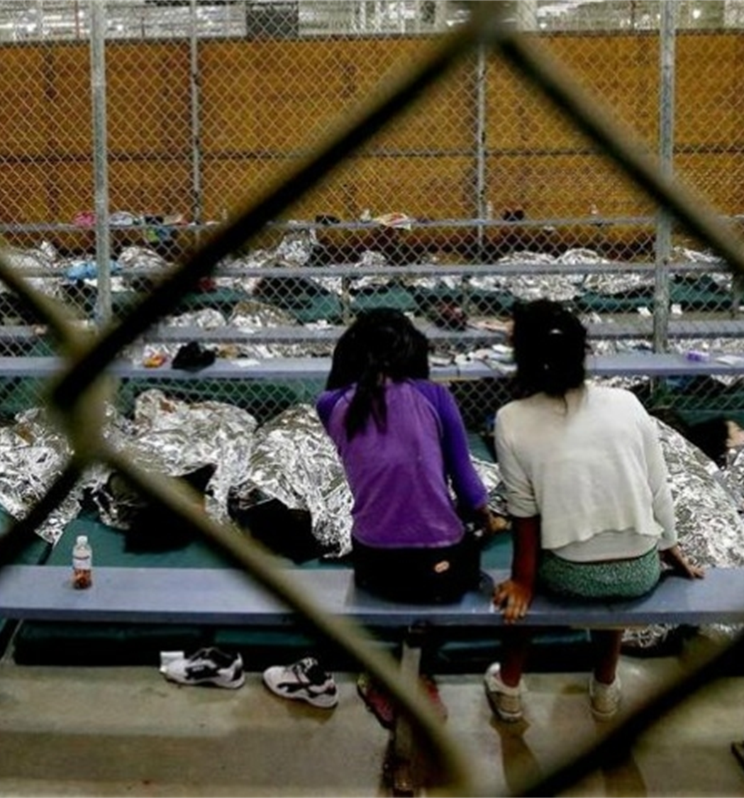
Creator God, we live in a nation at a time when refugees, immigrants, and asylum seekers are being turned away from our borders and held in detention centers

Slide 3
808 Days
in Detention

Slide 4
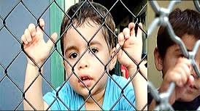

Slide 9
Pope Francis, calls “protecting the world’s migrants and refugees… a moral imperative.”

Slide 10
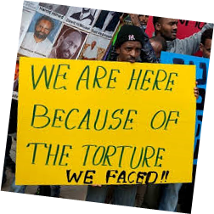

Slide 11
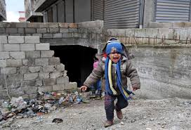
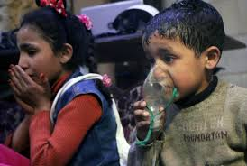
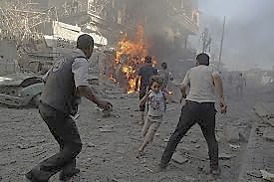
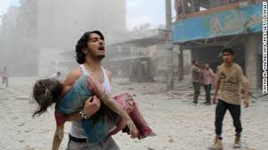

Slide 12
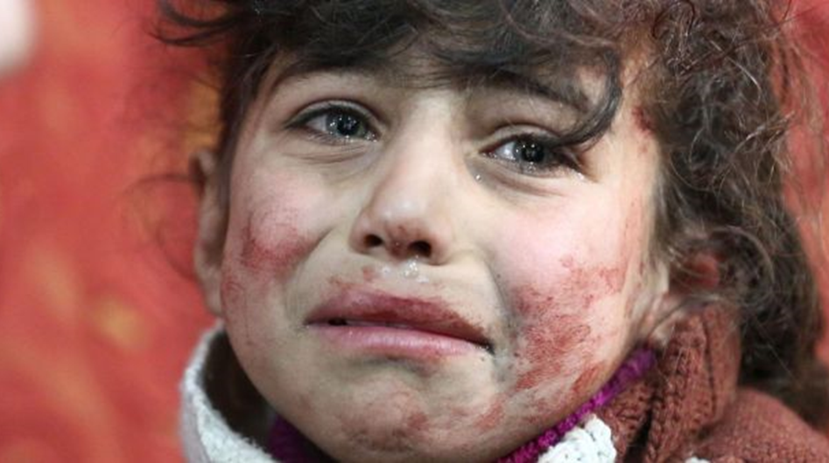

Slide 13
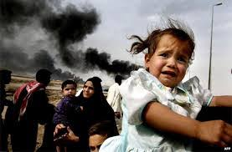
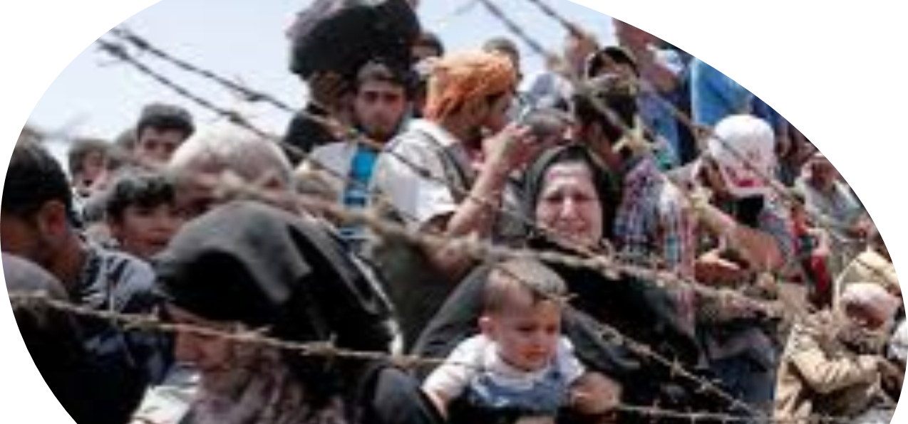
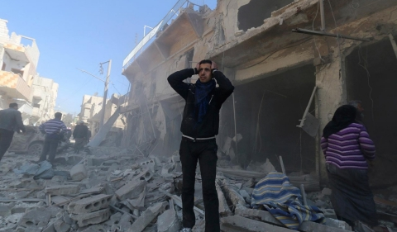
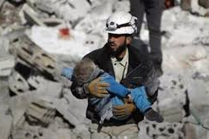
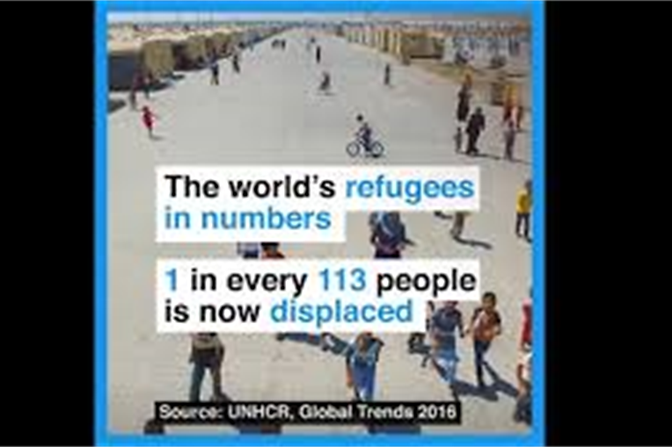

Slide 14
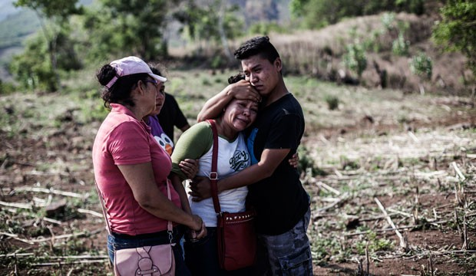

Slide 15
St. Francis, who himself identified as a pilgrim and stranger, reached out to all people by noting that “the law of pilgrims is to be sheltered under someone else’s roof, to thirst for their homeland, and to travel in peace” (LMj7:2).

Slide 16
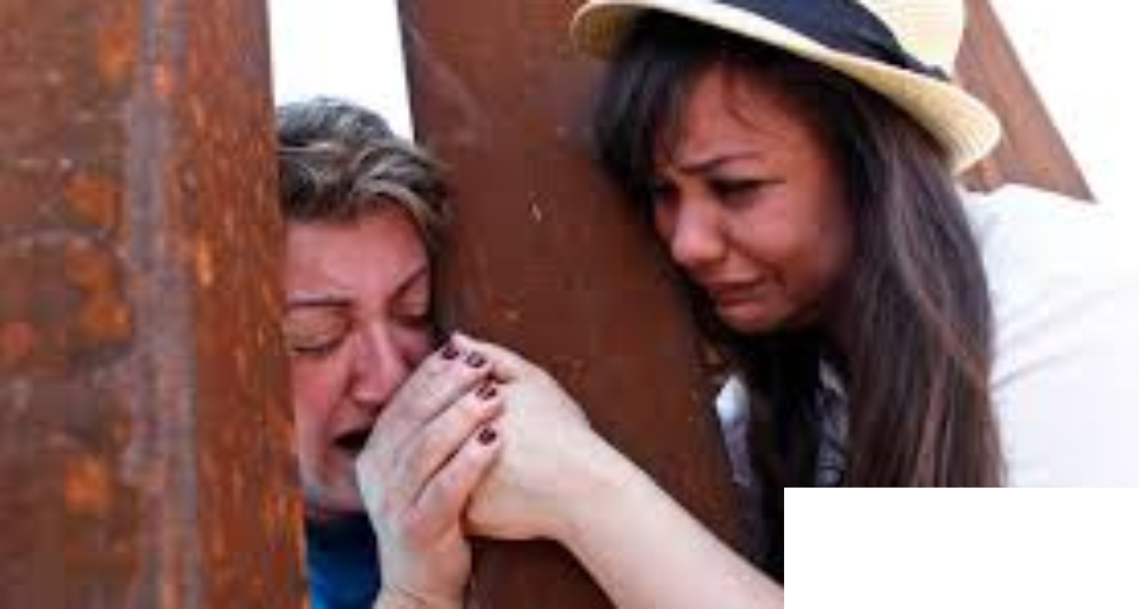
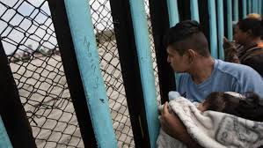

Slide 17
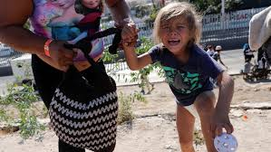
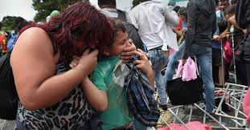
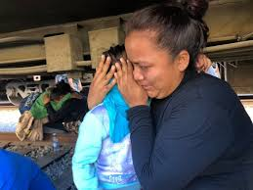
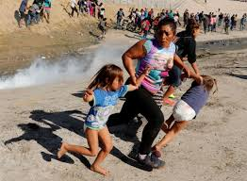
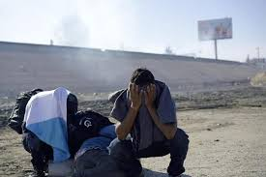
Tear Gas at United States Border
Tear Gas
at the Border

Slide 18
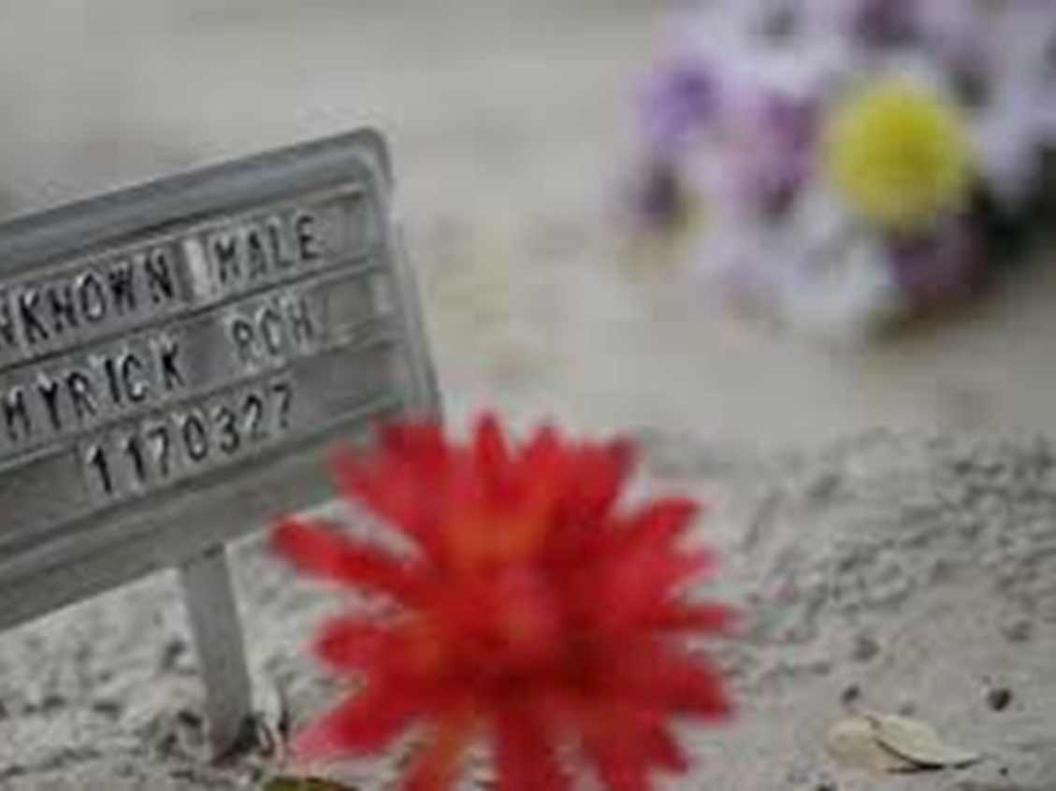
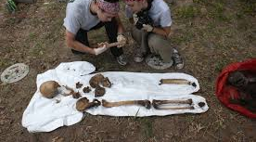
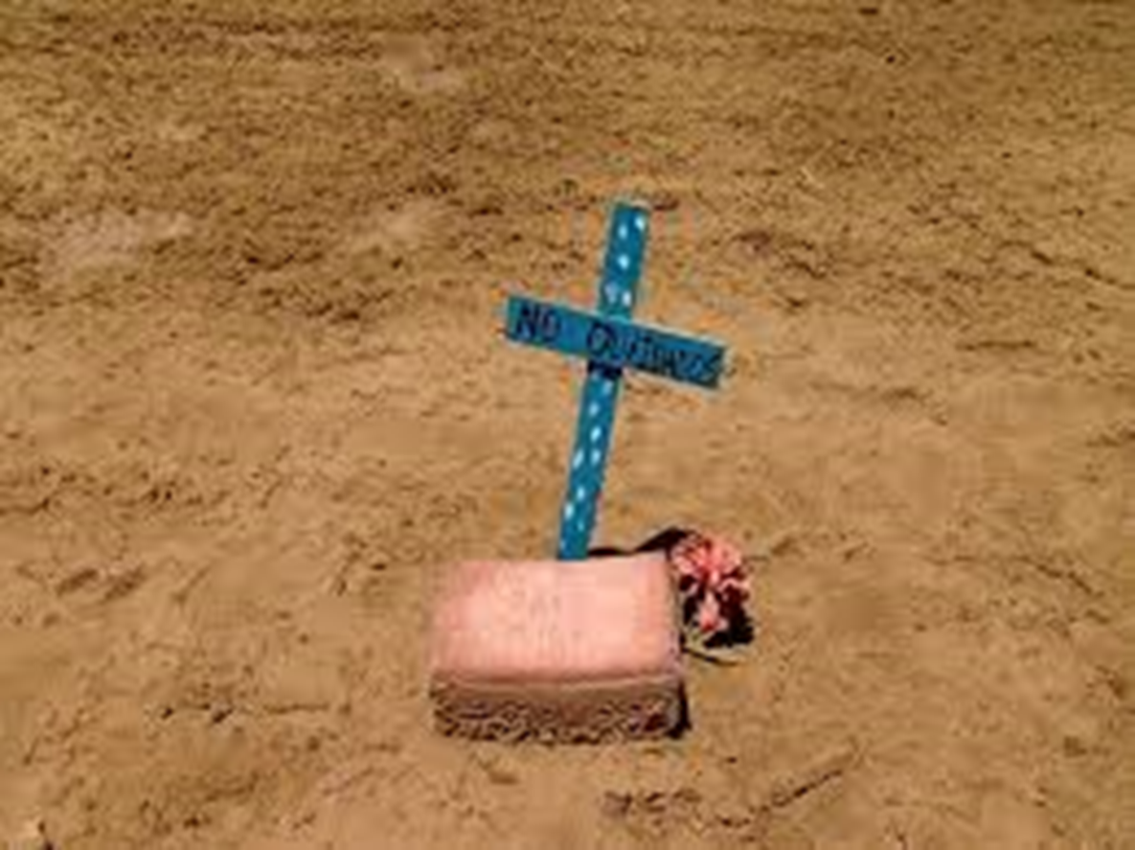

Slide 19
We recall that Jesus, Mary, and Joseph sought refuge in Egypt and that St. Francis not only welcomed all peoples but also went beyond borders himself to visit and befriend the enemy and stranger.

Slide 20
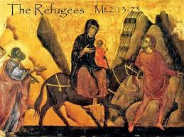

Slide 22
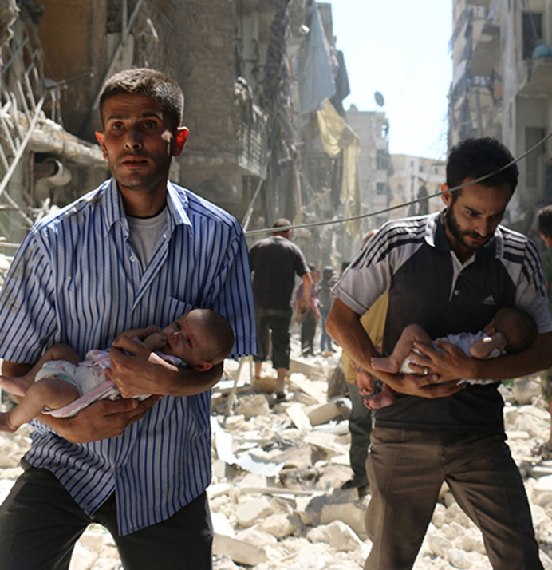
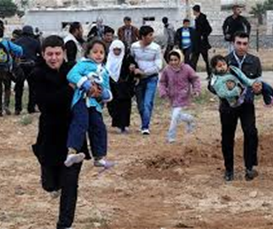
As Franciscans, we are urged to “support our neighbor in his [her] weakness as one would want to be supported were he [she] in a similar situation,” (Adm XVIII: 1).

Slide 23
Our baptismal mandate calls us to action and so we commit to:
Contact the
Department of Homeland Security
and demand that they
reunite the children
with their family.

Slide 24
By Breath
By breath, by blood, by body, by spirit, we are all one
The air that is my breath is the air that you are breathing
And the air that is your breath is the air that I am breathing The wind rising in my breast is the wind from the east, from the west From the north, from the south, breathing in, breathing out

Slide 25
By breath, by blood, by body, by spirit, we are all one
The water that is my blood, my sweat, tears from crying Is the water that is your blood, your sweat, tears from crying And the rising of the tide is in our veins and in the ocean wide We are in the rising steam, rushing river, running stream

Slide 26
By breath, by blood, by body, by spirit, we are all one
The earth is dust, the earth is clay, flow’rs blossoming and fading
We are dust and we are clay, we are blossoming and fading
Every color, every sound, every place is holy ground
Oh, every living thing, can you hear it laugh? Can you hear it sing?

Slide 27
By breath, by blood, by body, by spirit, we are all one
The fire in my heart, my soul flame burning
Is the fire in your heart, your soul flame burning
We are Spirit burning bright, by the light of day, in the dark of night
We are shining like the sun, and like the moon,
like the Holy One
By breath, by blood, by body, by spirit, we are all one

