Slide 1

Working with Our Hearts and Heads
ID 92591044 © Glolyla | Dreamstime.com
Emotional Intelligence Skills for Leaders
Notes:
“It is very important to understand that emotional intelligence is not the opposite of intelligence, it is not the triumph of heart over head – it is the unique intersection of both.”
Emotional Intelligence, a key to success.
Why Emotional Intelligence At Work Is Important?
Emotional intelligence in the workplace is not just a feel-good factor; it’s a critical component for workplace success. While logic and efficiency are considered top priorities in the workplace, emotional intelligence deserves recognition as a vital component of organizational success as well. Contrary to the notion that personal connections hinder productivity, emotional intelligence enhances it by fostering healthier interactions and improved decision-making.
Let’s take a closer look at what we mean and start with some other names for Emotional Intelligence.
Emotional intelligence (EI)- or EI as it is often referred to
Emotional quotient (EQ)- Unlike IQ, which is believed to be relatively static and unchanging- Emotional intelligence had the potential for growth
Emotional leadership (EL)- This refers directly to a person that uses their emotional intelligence to lead others.
They all mean the same thing. Today we’re going to be using the Emotional Intelligence or the acronym EI
According to R. Sternberg in "Successful Intelligence," the research shows that your IQ contributes a mere 20% to your overall success in life. The rest depends on your Emotional Intelligence (EQ/EI). Your resume may get you hired, but it’s your emotional intelligence helps you to be successful.
CHAT: What makes you successful in the workplace and in life?
-Successful relationships and the ability to communication with others.
CHAT: When we think about conversely, what makes us and our work teams unsuccessful?
-Conflict, people not working will together, disrespect, and not valuing others and their perspective,
Emotional intelligence is your ability to recognize and understand emotions in yourself and others, and your ability to use this awareness to manage your behavior and relationships. EI is the process that informs you , impacts your thinking and influences how you relate to others and influencing how others relate.
Some people are book smart, emotionally intelligence means people smart.
The great news is that because it is a process it is something we can improve on if we choose to work on it.
Transition: Let’s take a look at our objectives for today

Slide 2
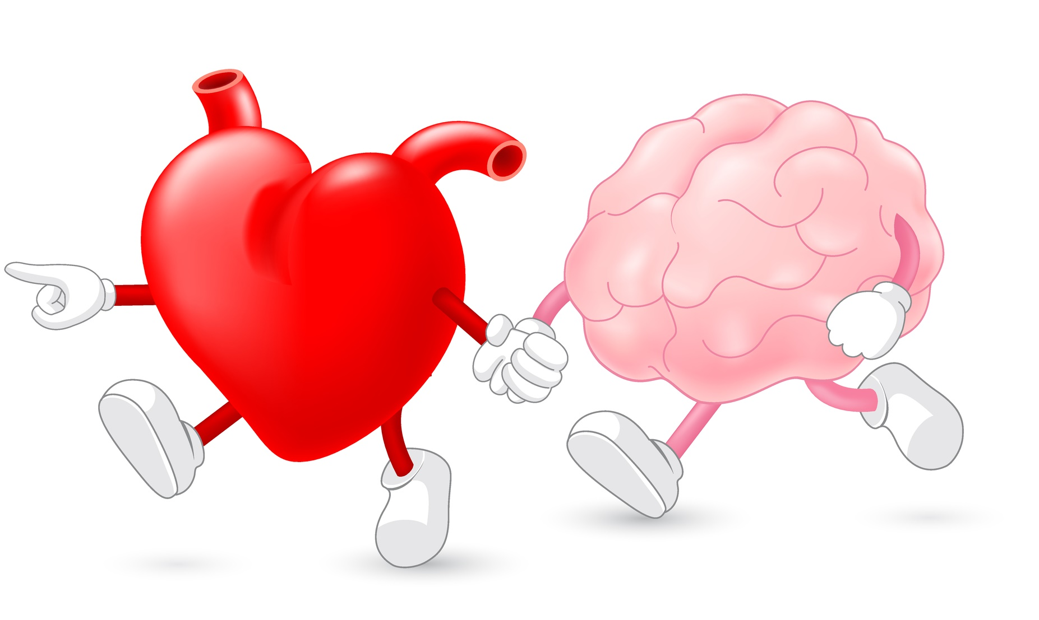
“…emotional intelligence is not the opposite of intelligence; it is not the triumph of heart over head – it is the unique intersection of both.”
~David Caruso
Emotional Intelligence Skills Group,
Yale Center for Emotional Intelligence
ID 92591044 © Glolyla | Dreamstime.com
Notes:
“It is very important to understand that emotional intelligence is not the opposite of intelligence, it is not the triumph of heart over head – it is the unique intersection of both.”
– David Caruso, Co-Founder of Emotional Intelligence Skills Group, Yale Center for Emotional Intelligence
CHAT: What makes you successful in the workplace and in life?
-Successful relationships and the ability to communication with others.
CHAT: When we think about it conversely, what makes us and our work teams or any relationship for that matter, unsuccessful or difficult?
-Conflict, people not working will together, disrespect, and not valuing others and their perspective,

Slide 3

“Emotional intelligence is your ability to recognize and understand emotions in yourself and others, and your ability to use this awareness to manage your behavior and relationships.”
~ Travis Bradberry
ID 225211291 © Illustratorolgafilippova | Dreamstime.com
Notes:
Dr. Travis Bradberry is the award-winning coauthor of the worldwide best-selling book Emotional Intelligence 2.0. He is the cofounder of TalentSmart and world-renowned expert in emotional intelligence
Emotional intelligence is your ability to recognize and understand emotions in yourself and others, and your ability to use this awareness to manage your behavior and relationships. EI is the process that informs you , impacts your thinking and influences how you relate to others and influencing how others relate.
Some people are book smart, emotionally intelligence means people smart.
The great news is that because it is a process it is something we can improve on if we choose to work on it.
Transition: Let’s take a look at our objectives for today

Slide 4
Our Goals
Understanding of Emotional Intelligence
4 Core Components
Strategies and Skills to Increase your EI
Role of EI in Your Relationships
Your Reactions and Responses
Notes:
Our objectives for today are that by the end of the training you will
Gain an understanding of what Emotional Intelligence is and the role it plays in your success
Identify the core components of Emotional Intelligence and the role your reactions and responses play
Develop strategies and skills to increase your Emotional Intelligence.

Slide 5
4 Core Components of Emotional Intelligence
Self-Management
Social Awareness
Relationship Management
Self-Awareness
Notes:
Here are the Components of EI- Keep in mind that there are really skill areas and one you can build and improve on.
Self Awareness: Recognize Your Own Emotions
Self-Management: Positively Manage Your Responses
Social Awareness: Recognize the Emotions of Others
Relationship Management: Positively Responding to Others
Empathy and Listening: the ability to understand the emotional makeup of other people and how to use Empathetic Listening
We will be taking a closer look at each skill area to understand what it is, recognize the signs to tell you how to identify what happening and then cover some specific questions to help you check yourself
Transition: Let’s start off with an activity

Slide 6
Self-Awareness
Identify your own emotions
Recognize how your emotions affect others
Know your strengths and weaknesses
Notes:
What do we mean by Self Awareness?
Self-awareness involves understanding one’s emotions and the way they influence decisions. Intuition, sometimes called a “gut feeling”, is connected to self-awareness. It’s those subtle hunches that often turn out to be right, guiding us to make good choices.
It begins with being able identify and understand your own emotions and what going on with you. We have habitual responses we may be unaware of
It’s about listening and discerning to your feelings.
How are you feeling?
Are you feeling: What mood are you in? Frustrated? Distracted? Nervous? Tired? Stressed? I am so over this? I don’t like working with this person? OR I love working with this person?
ASK: What are some other examples of things that you experienced or maybe have gone through your mind?
ASK: Why do you think it’s important to know what is going on with you? (Answer: Impacts how others are seeing you)
That brings us to the next part of building Self-Awareness: Recognizing how your emotions and body language are affecting others.
How are others seeing you? What we want to project and what we are actually projecting may very well be two different things. Think about non-verbal signals like your body language, facial expressions and gestures
ASK: What are somethings you have or may notice in a person that is communicating with you? (Raised/shaky voice, shaking knee, rolling eyes, deep sigh)
ASK: How does that make you feel? Discuss answers
ASK: How about when a person exhibits intent listening? Confident voice? Appears Interested? Discuss answers
Employee Example: You are in a team meeting discussing a new project. As the conversation progresses, you start feeling uneasy. Your self-awareness kicks in, allowing you to recognize that their discomfort stems from the fact that the project’s direction contradicts your values. This awareness prompts you to address your concerns in a constructive manner, contributing to a more aligned and effective project plan.
In Self-Awareness we are recognizing that our emotions can have either a positive or negative effect on communication.
If you want to be successful with the skill of self awareness it’s important to take a good look at yourself to figure out your strengths and weaknesses and make an accurate self assessment. There are online resources that can help you with this. One example is at www.skillsyouneed.com Link to an assessment: https://www.skillsyouneed.com/ls/index.php/343479
Key is to be honest with yourself and open to improvement. Identify how you are not how you want to be. You may also want to seek honest feedback from someone you have a good relationship with.
Transition: Let’s discuss the signs that can help us to become more self-aware
https://chools.in/wp-content/uploads/2021/02/Chools-self-awareness-checklist.pdf

Slide 7
Recognizing the Signs
Emotional changes
Physical changes
Triggers
Notes:
There are three things to consider when we work on Self-awareness. We are working to identify not judge our feelings
The first is what emotional changes are you experiencing:
ASK: What comes to mind when you hear the words “emotional changes”? Discuss
Possible Answers Include: Feel nervous, anxious, tense, worried, angry, silly,
The second is what physical changes are you experiencing:
ASK: How about physical changes? Discuss
Possible Answers Include: Body begins to feel tense, knot in your stomach, lump in your throat, nauseous, heart racing, flushed or trembling, sweating
The third sign is recognizing your personal triggers. We’re talking about where something happens and you react with an to it. Triggers tend to happen for three main reasons. Opposing beliefs or values, sense of threat, or maybe a previous trauma. The trigger reaction could easily be a habit from past practice or an experience. It could be just about anything from the tone of someone’s voice to their personal opinions and viewpoints. A person that felt isolated or left out in the past might get triggered when walking by a group of people laughing and seeming to have to good time.
Triggers range from things as simple as someone chewing gum making you irritated, loud noises that distract you, to the actions of a colleague that provoke an intense rage reaction because they are challenging beliefs or values we hold personally important. Triggers can also come from fears. With triggers the question we need to ask ourselves is what happened just before? Try to identify the reason or cause of the trigger.
Transition: let’s move onto to Self-Awareness checks with some specific questions we can ask ourselves.

Slide 8

Self- Awareness Success
Learn new Skills
Ask For Feedback
Know Your Weaknesses
Know Your Strengths
Identify Your Emotions
Don’t Judge Your Emotions
This Photo by Unknown Author is licensed under CC BY-NC-ND

Slide 9

Self Awareness Checks
What am I feeling?
Why am I feeling this?
Is this a trigger for me?
What’s my body language saying?
Notes:
There are four questions we can ask ourselves
The first question you should ask yourself is “What am I feeling right now?”
Am I feeling impatient? That could be an emotional change.
Am I feeling my body start to tense? That might be a physical change.
ASK: What are some other emotional or physical changes you have experienced in the past?
Blood pressure rising
Breathing speeds up
The second question to ask yourself is “Why an I feeling this?” Remember our purpose here is to identify what’s happening for us not to judge it as good or bad.
Am I feeling
We also need to recognized when our buttons are being pushed.
ASK: By a show of hands, who has ever been in a situation where you find yourself talking to or working with a person and you all of a sudden feel resentful or angered by what the other person is doing or saying?
RESPOND: All that raised your hand are showing awareness. The next step is to figure out why you were triggered so the same things doesn’t happen again.
Trigger habits can often lead to quick reactions that don’t allow us to time to make good choices and get in the way of good relationships.
Lastly, but just as importantly, we need to ask what is my body saying. When we consider how we communicate we look at three parts to communications.
Words, Tone of Voice and Body language. Let’s take a quick look at the breakdown.
ASK: Which of those three components do you think holds the biggest percentage? Next biggest? The smallest percentage?
(Words 7%, Tone of Voice 38%, Body Language 55%)
Our body language is a powerful part of communication and we need to be aware of what it is saying. It can be both positive or negative.
ASK: What might be some body language communicated:
Possible answers include: clenched fist vs. relaxed, shaking leg or tapping foot, rolling eyes or looking away, leaning forward, smiling vs frowning, nodding your head vs shaking your head, looking at clock vs looking at person. It is often easier to notice body language in others. Where we want to build our skill and awareness is noticing it for ourselves.
Now that we have recognized what’s going for us individually. We’ll take a look at what you can do to positively manage your responses

Slide 10
Self Management
Know your values
When to speak vs. listen
See opportunity
Welcome new ideas
How you handle stress
Slow it down
Notes:
Self-Management is the ability to manage one’s emotions and thoughts despite external circumstances. This skill allows you to stay composed and adapt to various circumstances, even when facing difficult emotions like anger or anxiety.
Self Management goes from knowing yourself to knowing how to conduct yourself. It begins with SELF and then goes to managing your emotions and how they can affect relationships and impact the situation. Remember we are focusing on successful relationships. It’s not about hiding your emotions but controlling them appropriately in order to maintain good relationships. Choosing when to act and when not to act.
First step is to know who you are, knowing what you value and what matters most to you. Often times we when we feel our values are under attack we will react with a trigger response. Think back to triggers when we discussed someone with personal views that are in direct opposition to yours. I bet many of you have had an experience when you felt that or maybe even reacted to it.
How we handle stress is another way to manage ourselves. Often time stress can be detrimental and become a negative factor in our relationships. Think for a minute about how you handle stress.
Employee Example: You’re stuck in traffic on the way to an important work event. Frustration begins building up, but you consciously regulate your emotions. Instead of succumbing to anger, you remind yourself that getting upset won’t change the situation. You maintain a calm demeanor, ensuring that your emotions don’t spill over and affect your interactions when you arrive at the event.
ASK: How would you finish this sentence? When I feel stressed I…. Think of way you have witnessed or acted in a detrimental way.
Possible Answers- Start to lose my patience, Lose my focus
ASK: What are some constructive ways you have handled stress?
Slow things down so you don’t make rash decisions you might regret later. The bottom line is to learn to control your emotions not to let your emotions control you. It is purposefully handling to positively influence the outcome.
Let’s take a look at what successful self-management looks like.
https://www.skillsyouneed.com/ps/self-management.html
http://www.free-management-ebooks.com/faqpp/developing-03.htm
https://trans4mind.com/counterpoint/index-emotional-intelligence/zimmerman-eq2.shtml
https://chools.in/wp-content/uploads/2021/02/Chools-self-management-checklist.pdf

Slide 11
Self- Management Success
Respond vs react
Openly Admit mistakes
Prepare for Responses
Check in for clarity
Suspend judgement
Remain calm
This Photo by Unknown Author is licensed under CC BY-NC-ND

Slide 12
Self Management Checks
What am I missing?
Should I step back?
What voice am I listening to?
What would be most effective?
Notes:
Ask questions

Slide 13
Social Awareness
What other are feelings
What others are really saying
Are people’s needs being met?
Is everyone included?
Are people feeling heard?
Recognize and respect differences
Notes:
Social Awareness- Social Skills – Proficiency in managing relationships
Empathy
Empathy is the ability to comprehend and connect with someone else’s situation, also known as “putting yourself in their shoes”. It includes sharing another’s feelings even if they haven’t been through the same experience while listening attentively and offering comfort. Empathy allows employees to comprehend and connect with others’ situations, providing a foundation for effective teamwork.
Employee Example: You’re at a social gathering and notice a colleague appears distant and sad despite their attempts to smile. Drawing on your empathetic abilities, you approach them and engage in a genuine conversation. Through active listening, you uncover that your colleague is dealing with a personal challenge. Your empathetic response helps them feel understood and supported.

Slide 14
Social Awareness Success
Remember People’s Names
Ability to Read Others
Being Present
Paying Attention
Respect Other Perceptions
Care About Your Impact
This Photo by Unknown Author is licensed under CC BY-NC-ND
Notes:
https://chools.in/wp-content/uploads/2021/02/Chools-social-awareness-checklist.pdf

Slide 15
Social Awareness Checks
Am I distracted?
What is the pulse of the room?
Are people engaged?
Have I recognized people?

Slide 16
Relationship Management
Build relationships
Recognize conflict early
Tap into people’s values and desires
Does everyone understand?
Provide a clear vision
Find a common ground
Notes:
Relationship management is about your interpersonal skills. It’s how you well you work with both individuals and groups.
Building blocks of Relationship management include:
Building relationship
Recognize conflict early means you are identifying and analyzing what is going on
Does everyone understand?
Provide a clear vision
Tap into people’s values and desires
Find a common ground

Slide 17
Relationship Management Success
Demonstrate Empathy
Inspire & Develop
Acknowledge People
Develop Others
Ensure Understanding
Influence Others
Resolve Conflict
This Photo by Unknown Author is licensed under CC BY-NC-ND
Notes:
Demonstrate empathy and gratitude. Our emotions come with us and they do so with others as well. Think back to the first component, Self-Awareness. We discussed how emotions can be a power force. This is true for everyone. There are three words that you most likely learned at a very young age that can make a big difference here.
ASK: What do you think they are? Answer- Please, Thank you and Sorry. ASK: Why do you think those words are so important? Discuss
We have the ability to inspire and motivate others with positivity. How we treat others can inspire them to be there best self. Building trust comes into play here and how we act all the time is what gives us our reputation and character. We can also focus on helping others to develop their skills. As a supervisor, especially, that shows a commitment to the individual and their personal growth and development.
Acknowledge people and give them your full attention. How can you tell if a person is giving you their full attention? How does it feel when they don’t seem to be? What impact does that have on your participate, investment and more importantly, the relationship you have with that person.
ASK: How can you ensure understanding? Answer: Ask clarifying questions. Be sure that people are understanding the same thing.
Providing feedback
Influence other: There is an art to persuasion: The fable of the sun and the wind is a good example:
The wind and the sun decided to have a competition to decide once and for all who was stronger. They agreed that the winner would be the one who could persuade a man to take off his coat. The wind blew and blew, but the man only held on more tightly to his coat. Then the sun shone gently down, and within minutes, the man took off his coat.
The moral here is that you can’t force someone to do what they don’t want; instead, the art of persuasion is to get them to want what you want.
Resolves conflict: I statements

Slide 18
Relationship Management Checks
Have I exhibited trust?
Have I shown respect?
What do people need?
Have I been articulate?
Notes:
https://chools.in/wp-content/uploads/2021/02/Chools-relationship-management-checklist.pdf

Slide 19

Share with a Partner
I am going to work on…
Self-Awareness
Self-Management
Social Awareness
Relationship Management
ID 233016205 © Niall Wiggan | Dreamstime.com
Notes:
“In a very real sense we have two minds, one that thinks and one that feels” ― Daniel Goleman, Emotional Intelligence: Why It Can Matter More Than IQ
https://www.youtube.com/watch?v=5XqXsLnDV-U&feature=youtu.be
Take a minute to think about the four component of Emotional Intelligence and think of at least one or two things would be most beneficial to help you increase your emotional intelligence. Remember, this is very individual and can be different for each of us. Then write down your answer or answers on your tip sheet
Please put in the Chat the component of EI and something specific you plan to work on in that area.
Emotional Intelligence is something we can work on continually .
https://chools.in/wp-content/uploads/2021/02/Chools-self-awareness-checklist

Slide 20

Making Difficult Conversation Easier
ID 48069663 © Sylverarts | Dreamstime.com
Skills and Strategies to Increase Success
Notes:
What is a challenging conversation? A difficult conversation is anything that YOU find hard to talk about-past experiences, background, etc. so everyone will have a different view on what is challenging.
POPCORN – what do you consider a challenging conversation?

Slide 21

Avoid
Discuss
ID 61731144 © Chakrapong Worathat | Dreamstime.com
Notes:
Do you generally feel stressed or anxious?
Why would you avoid?
This person would not LIKE me, Damage the relationship, offend someone, person might feel attacked.
Not knowing how the other person will respond – 43%
Not being able to get a point across clearly – 31%
Being in a confrontational situation – 29%
Getting upset or emotional – 29%
The other person getting upset or emotional – 21%
Even when the subject matter is difficult, conversations can remain mutually supportive. Respect the other person’s point of view, and expect them to respect yours.
If you avoid, you are encouraging the negative behavior and sending the message to that individual and colleagues that the behavior/performance is acceptable and the problem can get worse. “This reluctance to talk things through not only has a negative impact on individuals, but can quickly affect wider team morale.”
One of the biggest mistakes leaders can make is trying to avoid conflict. Dealt with the right way conflict can be a force for positive change. It opens the channel to better communication and stronger relationships.
The goal and your job, as a supervisor, is to create a learning conversation. Going from a message stance to a learning stance. Message perspective meaning “make the deadline next time” vs. hearing their perspective why they didn’t make the deadline.
Think of a challenging conversation that you need to have with someone that you supervise. You will be using this situation throughout the training.

Slide 22

You Are Not Alone
66%
Feel stressed or anxious if they know a difficult conversation is coming up
ID 191399186 © Kostiantyn Levin | Dreamstime.com
Notes:
You are not alone. 66% feel stressed or anxious knowing that they have to discuss a difficult topic with someone that they supervise.
And most people have received no formal training on how to have these conversations.
Raise your hand if you have taken the EI training? A lot that was discussed in that training will def. be utilized before, during and after a challenging conversation.
To decrease your nerves, think of this as a learning opportunity for both of you and a chance to build trust and strengthen your relationship- work thorough the issue together, Offer alternative solution of you have to say no to someone. Normalize the conversation- its just a conversation.

Slide 23

The Rule of 3
Don’t address but note
Don’t address and document, include note
Action is required
Wait until you calm and collected
Use a private setting and include another person
Allow enough time for both of you to ask questions
ID 10638204 © Palto | Dreamstime.com

Slide 24

Preparing for the Conversation
Pray
Check your emotions
Assume good intent
Focus on issue
Gather data
Note Impact on the fraternity
Determine your purpose
ID 121132101 © Skypix | Dreamstime.com
Notes:
Don’t make assumptions- assume nothing
Do you know that other persons intentions? We assume we know the other persons intentions, but you don’t, so we judge instead of wonder. Intentions are invisible- we cannot see them and should not guess.
Blame= Avoiding blame or giving blame. Instead of blame, we should that on the perspective that everyone has good intentions- no one comes to work and says, I’m going to do a crappy job today.” Work together to fix this situation so it doesn’t occur in the future.

Slide 25

Using "I" Statements
Shifts the focus to your own experience and feelings.
Help deescalate the situation
Makes it easier to find a resolution that works for everyone
“You need to stop interrupting me.” versus
"I feel disrespected when you interrupt me."
Photo by L. Maher

Slide 26
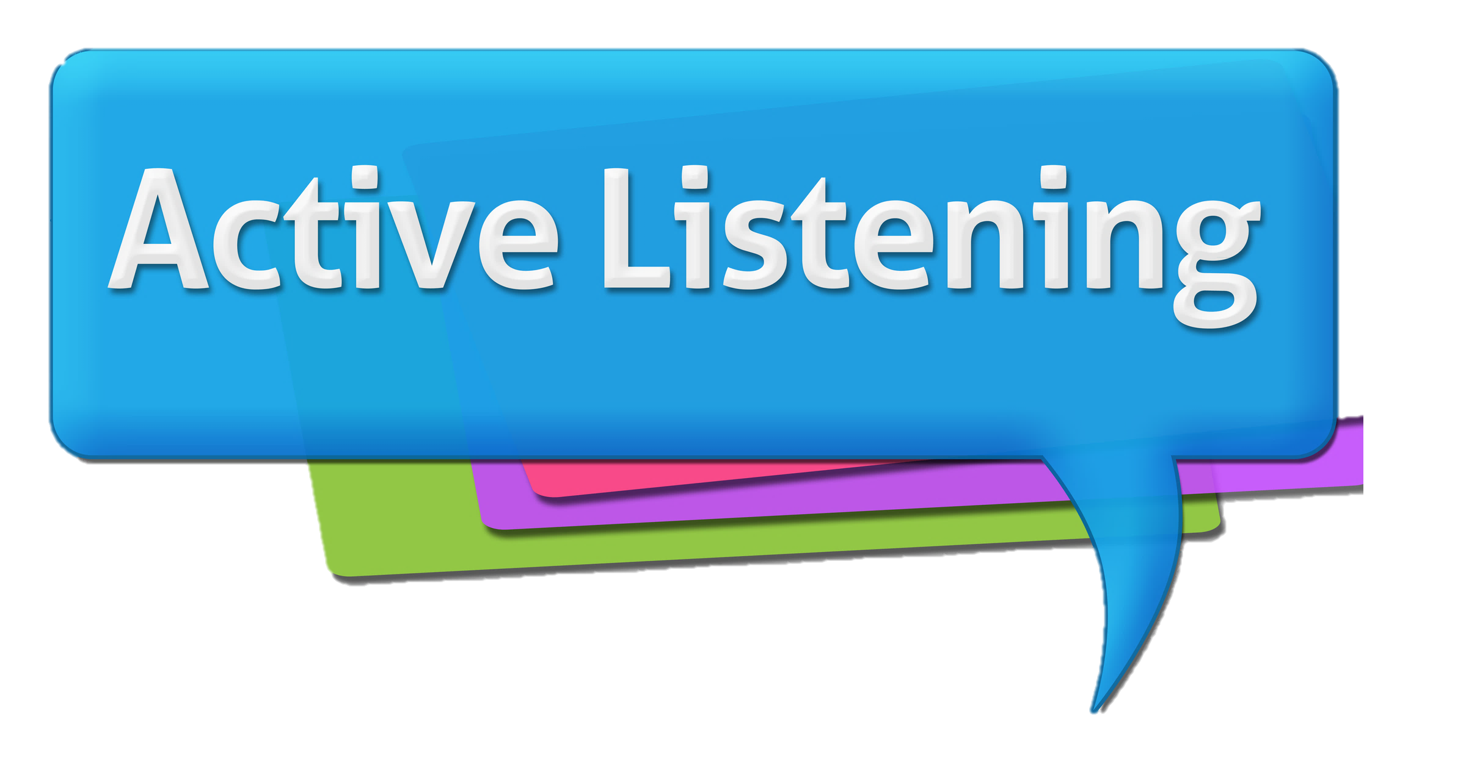
Active Listening Skills
Be fully present
Don’t Interrupt
Commit to patience
Listen with your eyes
Be curious and honest
Listen to understand rather than to respond
Paraphrase and reflect what has been said
Ask open-ended questions to encourage further responses
ID 81903303 © Ileezhun | Dreamstime.com
Notes:
We listen at 125-250 words per minute, but we think at 1000-3000 words per minute.
Do more listening than talking
Listen to the silence as well as the words. Learning to be comfortable sitting in silence with another person is one of the most powerful forms of communication. Silence allows the hearts to connect, and a sacred dialogue is spoken.

Slide 27

Listen to the silence as well as the words.
Learning to be comfortable sitting in silence with another person is a powerful forms of communication.
Silence allows the hearts to connect, and a sacred dialogue is spoken.
ID 317491334 © Justlight | Dreamstime.com
Notes:
We listen at 125-250 words per minute, but we think at 1000-3000 words per minute.
Do more listening than talking
Listen to the silence as well as the words. Learning to be comfortable sitting in silence with another person is one of the most powerful forms of communication. Silence allows the hearts to connect, and a sacred dialogue is spoken.

Slide 28
Steps for the Conversation
Purpose/
Outcome
Your Story-Data/Impact on Fraternity
Listen to Their Story-curiosity
Problem Solve Together

Slide 29

Helpful Phrases to Begin
Thank you for taking the time to talk with us
We value you as a fraternity brother/sister
Help us understand where you’re coming from
Let’s work on this problem together
Let’s see how we can prevent this from happening in the future
We care about you and we’re confident we can find a solution that we can all work with
Notes:
https://pumble.com/blog/phrases-to-use-to-diffuse-conflict-at-work/
https://www.lollydaskal.com/leadership/12-phrases-that-will-help-you-resolve-any-conflict/
Thank you for taking the time to talk with us
Let’s take a break and get back to this issue when we’ve thought about it and cooled down a bit
I need a few minutes to process this/think about this
Help me understand where you’re coming from
Thank you for being honest with me
How can we support you
What I heard you say is… Did I get that right?
I agree with you on…
Let’s work on this problem together
What do you suggest we do about this?
Let’s see how we can prevent this from happening in the future
I hear your point, but I have a different view
We care about you and we’re confident we can find a solution that we can all work with
Tell me more
So, to recap our conversation, we’ve agreed to _________. Is that your understanding?
Let’s schedule some time to talk about this again, and see how our solution is working

Slide 30
Helpful Phrases During
I need a few minutes to process this/think about this
How can we support you
What I heard you say is… Did I get that right?
I agree with you on…
I wasn’t aware of this—tell me more
That is helpful to know
I hear your point, but I have a different view
Tell me more, I want to understand
Notes:
https://pumble.com/blog/phrases-to-use-to-diffuse-conflict-at-work/
https://www.lollydaskal.com/leadership/12-phrases-that-will-help-you-resolve-any-conflict/
Thank you for taking the time to talk with us
Let’s take a break and get back to this issue when we’ve thought about it and cooled down a bit
I need a few minutes to process this/think about this
Help me understand where you’re coming from
Thank you for being honest with me
How can we support you
What I heard you say is… Did I get that right?
I agree with you on…
Let’s work on this problem together
What do you suggest we do about this?
Let’s see how we can prevent this from happening in the future
I hear your point, but I have a different view
We care about you and we’re confident we can find a solution that we can all work with
Tell me more
So, to recap our conversation, we’ve agreed to _________. Is that your understanding?
Let’s schedule some time to talk about this again, and see how our solution is working

Slide 31
Helpful Phrases to End
Let’s take a breather before we think this through
Let’s take a break and get back to this issue when we’ve thought about it and cooled down a bit
Thank you for being honest with us
So, to recap our conversation, we’ve agreed to _________. Is that your understanding?
Let’s schedule some time to talk about this again, and see how our solution is working
What do you suggest we do about this?
Notes:
https://pumble.com/blog/phrases-to-use-to-diffuse-conflict-at-work/
https://www.lollydaskal.com/leadership/12-phrases-that-will-help-you-resolve-any-conflict/
Thank you for taking the time to talk with us
Let’s take a break and get back to this issue when we’ve thought about it and cooled down a bit
I need a few minutes to process this/think about this
Help me understand where you’re coming from
Thank you for being honest with me
How can we support you
What I heard you say is… Did I get that right?
I agree with you on…
Let’s work on this problem together
What do you suggest we do about this?
Let’s see how we can prevent this from happening in the future
I hear your point, but I have a different view
We care about you and we’re confident we can find a solution that we can all work with
Tell me more
So, to recap our conversation, we’ve agreed to _________. Is that your understanding?
Let’s schedule some time to talk about this again, and see how our solution is working

Slide 32
Steps for the Conversation
Purpose/
Outcome
Your Story-Data/Impact on Fraternity
Listen to Their Story-curiosity
Problem Solve Together

Slide 33
Share your strategy to Making a Difficult Conversation Easier
ID 48069663 © Sylverarts | Dreamstime.com
Notes:
What is a challenging conversation? A difficult conversation is anything that YOU find hard to talk about-past experiences, background, etc. so everyone will have a different view on what is challenging.
POPCORN – what do you consider a challenging conversation?

