Slide 1
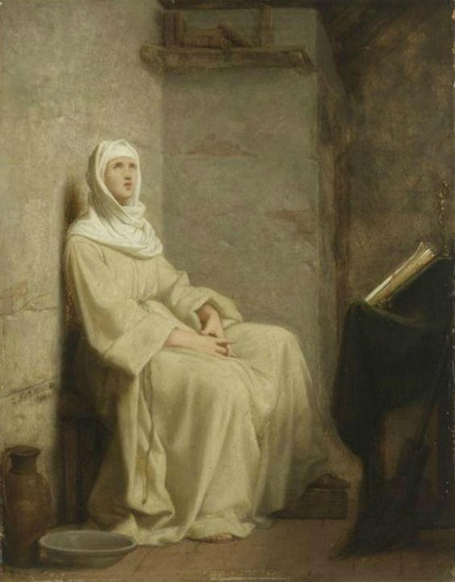
Praying with St. Clare of Assisi*
2019 National Chapter of the
Secular Franciscan Order, USA
Corpus Christi Texas
September 7, 2019
Presenters: Francine Gikow, OFS and Layna Maher, OFS
National Formation Commission

Slide 2
How Did St. Clare Pray?
Contemplative
Vivid
Passionate
Draws Close to Jesus
Feels His Embrace
Relational
Notes:
.“Contemplating” is about “looking.” You turn your gaze toward God
Contemplative
Vivid
Passionate
Draws close to Jesus
Feels His Embrace
keeping our eyes focused on Jesus: looking, listening, becoming mercy, all of us modeling and mirroring the gospel path
a movement of circling Christ at the center

Slide 3
How Did St. Clare Pray?
Gaze
Consider
Contemplate
Imitate
Notes:
.“Contemplating” is about “looking.” You turn your gaze toward God
Contemplative
Vivid
Passionate
Draws close to Jesus
Feels His Embrace
keeping our eyes focused on Jesus: looking, listening, becoming mercy, all of us modeling and mirroring the gospel path
a movement of circling Christ at the center

Slide 4
Clare’s 4th Letter to Agnes of Prague
Gazing:
Reflecting as we see ourselves as in a mirror
Attending to what is occurring
Responding and
Remembering
Notes:
Sharing and Wrap up 10 minutes Share what you experienced with the person next to you – Reflective questions for consideration.
Choose a Question(s) to Discuss with Your Partner
What touched you during this prayer?
What insight or reaction did you experience? How did you respond?
Do you think this Way of Prayer will make an impact on you own prayer life? Your evangelical life? If so, how?

Slide 5
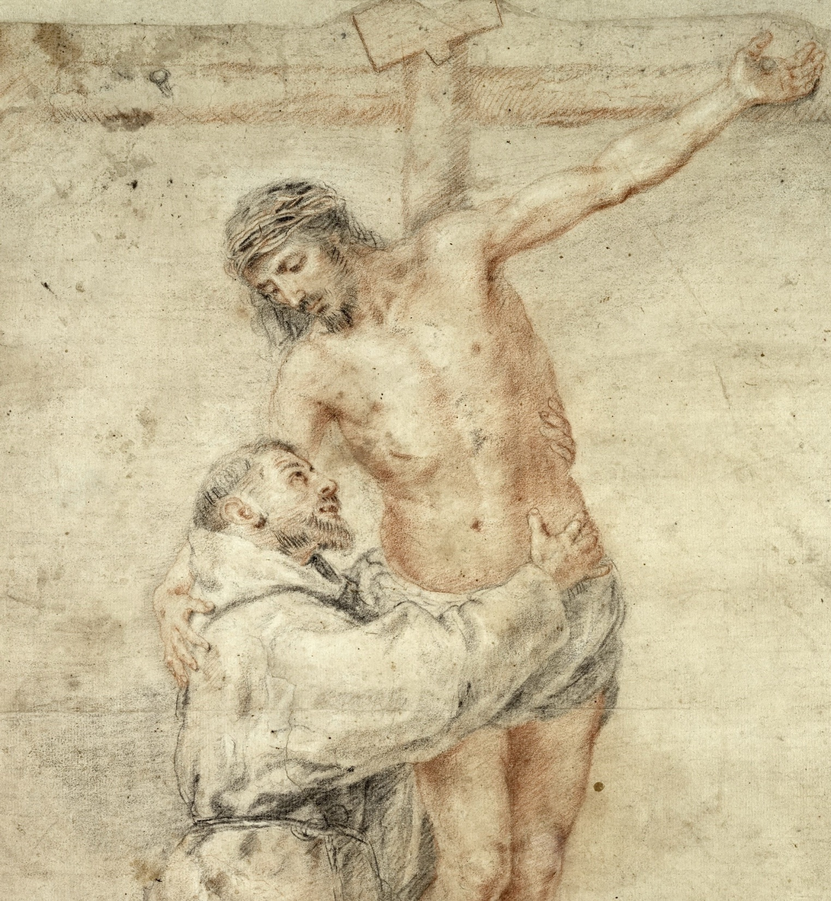

Slide 6
Sharing Your Experience
What touched you during this prayer and how did you respond?
Notes:
Sharing and Wrap up 10 minutes Share what you experienced with the person next to you – Reflective questions for consideration.
Choose a Question(s) to Discuss with Your Partner
What touched you during this prayer?
What insight or reaction did you experience? How did you respond?
Do you think this Way of Prayer will make an impact on you own prayer life? Your evangelical life? If so, how?

Slide 7
“O Queen of our heavenly King, may you, therefore, be inflamed ever more strongly with the fire of love! As you further contemplate His ineffable delights, riches and perpetual honors, and, sighing may you cry out from the great desire and love of your heart:
Notes:
Sharing and Wrap up 10 minutes Share what you experienced with the person next to you – Reflective questions for consideration.
Choose a Question(s) to Discuss with Your Partner
What touched you during this prayer?
What insight or reaction did you experience? How did you respond?
Do you think this Way of Prayer will make an impact on you own prayer life? Your evangelical life? If so, how?

Slide 8
Draw me after you,
Let us run in the fragrance of your perfumes,
O heavenly Spouse!
I will run and not tire,
Until You bring me into the wine-cellar,
until Your left hand is under my head
And your right hand will embrace me happily,
You will kiss me with the happiest kiss of your mouth.”
(4LAg 27-32)
Notes:
Draw me after you,
Let us run in the fragrance of your perfumes,
O heavenly Spouse!
I will run and not tire,
Until You bring me into the wine-cellar,
until Your left hand is under my head
And your right hand will embrace me happily,
You will kiss me with the happiest kiss of your mouth.”
(4LAg 27-32)

Slide 10
Sharing Your Experience (New Questions on HANDOUT)
What touched you during this prayer?
What insight or reaction did you experience? How did you respond?
Do you think this Way of Prayer will make an impact on you own prayer life? Your evangelical life? If so, how?
Did this prayer experience help you to understand Clare’s Way of Prayer better? If so, in what ways?
* Materials and quotes from Armstrong, Regis, OFM, in Early Documents: Clare of Assisi: The Lady. New City Press, New York, N.Y. 2006. Used with permission.

Slide 11
1) Introduction 10-15 minutes, How did Clare pray? What were the hallmarks of her prayer? Is it possible for us to pray this way? If we were going to pray the way Clare prayed, what would we do?
2) Prayer Experience 25 minutes. Opportunity to experience the way Clare prayed.
will include steps—here is the way Clare prayed – this would be the model of what they should do
3) Sharing and Wrap up 10 minutes Share what you experienced with the person next to you – Reflective questions for consideration. (Mock up for slide below)
Choose a Question(s) to Discuss with Your Partner
What touched you during this prayer?
What insight or reaction did you experience? How did you respond?
Do you think this Way of Prayer will make an impact on you own prayer life? Your evangelical life? If so, how?
Did this prayer experience help you to understand Clare’s Way of Prayer better? If so, in what ways?

Slide 12
She Turns to See Jesus as Her Beloved Bridegroom
“As you further contemplate His ineffable delights, riches and perpetual honors, and, sighing, may you cry out from the great desire and love of your heart:
Draw me after You! Let us run in the fragrance of Your perfumes, O heavenly Spouse! I will run and not tire, until You bring me into the wine-cellar, until Your left hand is under my head and Your right hand will embrace me happily, You will kiss me with the happiest kiss of Your mouth." (4LAg 28-32)

Slide 13
Sharing Your Experience
What touched you during this prayer?
What insight or reaction did you experience? How did you respond?
Do you think this Way of Prayer will make an impact on you own prayer life? Your evangelical life? If so, how?
Notes:
Sharing and Wrap up 10 minutes Share what you experienced with the person next to you – Reflective questions for consideration.
Choose a Question(s) to Discuss with Your Partner

