Slide 1
Spiritual Assistance
Information on various roles and relationships with the OFS

Slide 2
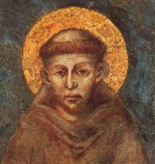

Slide 3
Role of the S.A.
Art. 13 Statutes for spiritual and pastoral assistance to the OFS
1. The principal task of the assistant is to foster a deeper insight into Franciscan spirituality and to co-operate in the initial and continuing formation of the secular Franciscans. (see OFS Const. 90.1)

Slide 4
Role of the S.A.
2. In the Council of the fraternity and in elective and ordinary Chapters the assistant will be respectful of the responsibilities and role of the secular Franciscans, giving them priority with regard to the guidance, co-ordination, and animation of the fraternity.

Slide 5
Role of the S.A.
3. The assistant participates actively and votes in the discussions and decisions taken by the Council or by the Chapter. He or she is specifically responsible for the animation of liturgical celebrations and spiritual reflections during the meetings of the Council or of the Chapter.

Slide 6
General Assistants
Art. 17
1. The general Assistants are appointed by their respective general Minister, after consultation with the Presidency of the International Council of the OFS. (OFS Const 91.3)
2. They give their service to the Presidency of the International Council of the OFS, form a conference, and collegially see to the spiritual assistance to the OFS as a whole. (OFS Const 90.3)

Slide 7
National Assistants
Art. 19
1. The national Assistants of the OFS and the Franciscan Youth are appointed by the competent major Superior, after consultation with the respective national council. Where more than one major Superior is involved in the appointment, the norms established together by the Superiors with jurisdiction in the national territory shall be followed. (OFS Const 91.2)

Slide 8
National Assistants
2. They give their service to the national council and see to the spiritual assistance to the national fraternity. If they are more than one, they form a Conference and render their service collegially.(OFS Const 90.3)

Slide 9
National Asssistants
3. It is the responsibility of the Conference of national Assistants, or to the national Assistant if there is only one:
-- to collaborate with the national Council in the task of spiritual and apostolic animation of the secular Franciscans in the life of the Church and the society of the country, and in a special way in the formation of the leaders;

Slide 10
National Assistants
-- to provide for the pastoral visits of the regional Councils of the OFS and to ensure a presence at the regional elective Chapters;
-- to coordinate, at the national level, the service of spiritual assistance, the formation of the assistants, and the fraternal union among them;
-- to foster the interest of the friars in the OFS and in the Franciscan Youth.

Slide 11
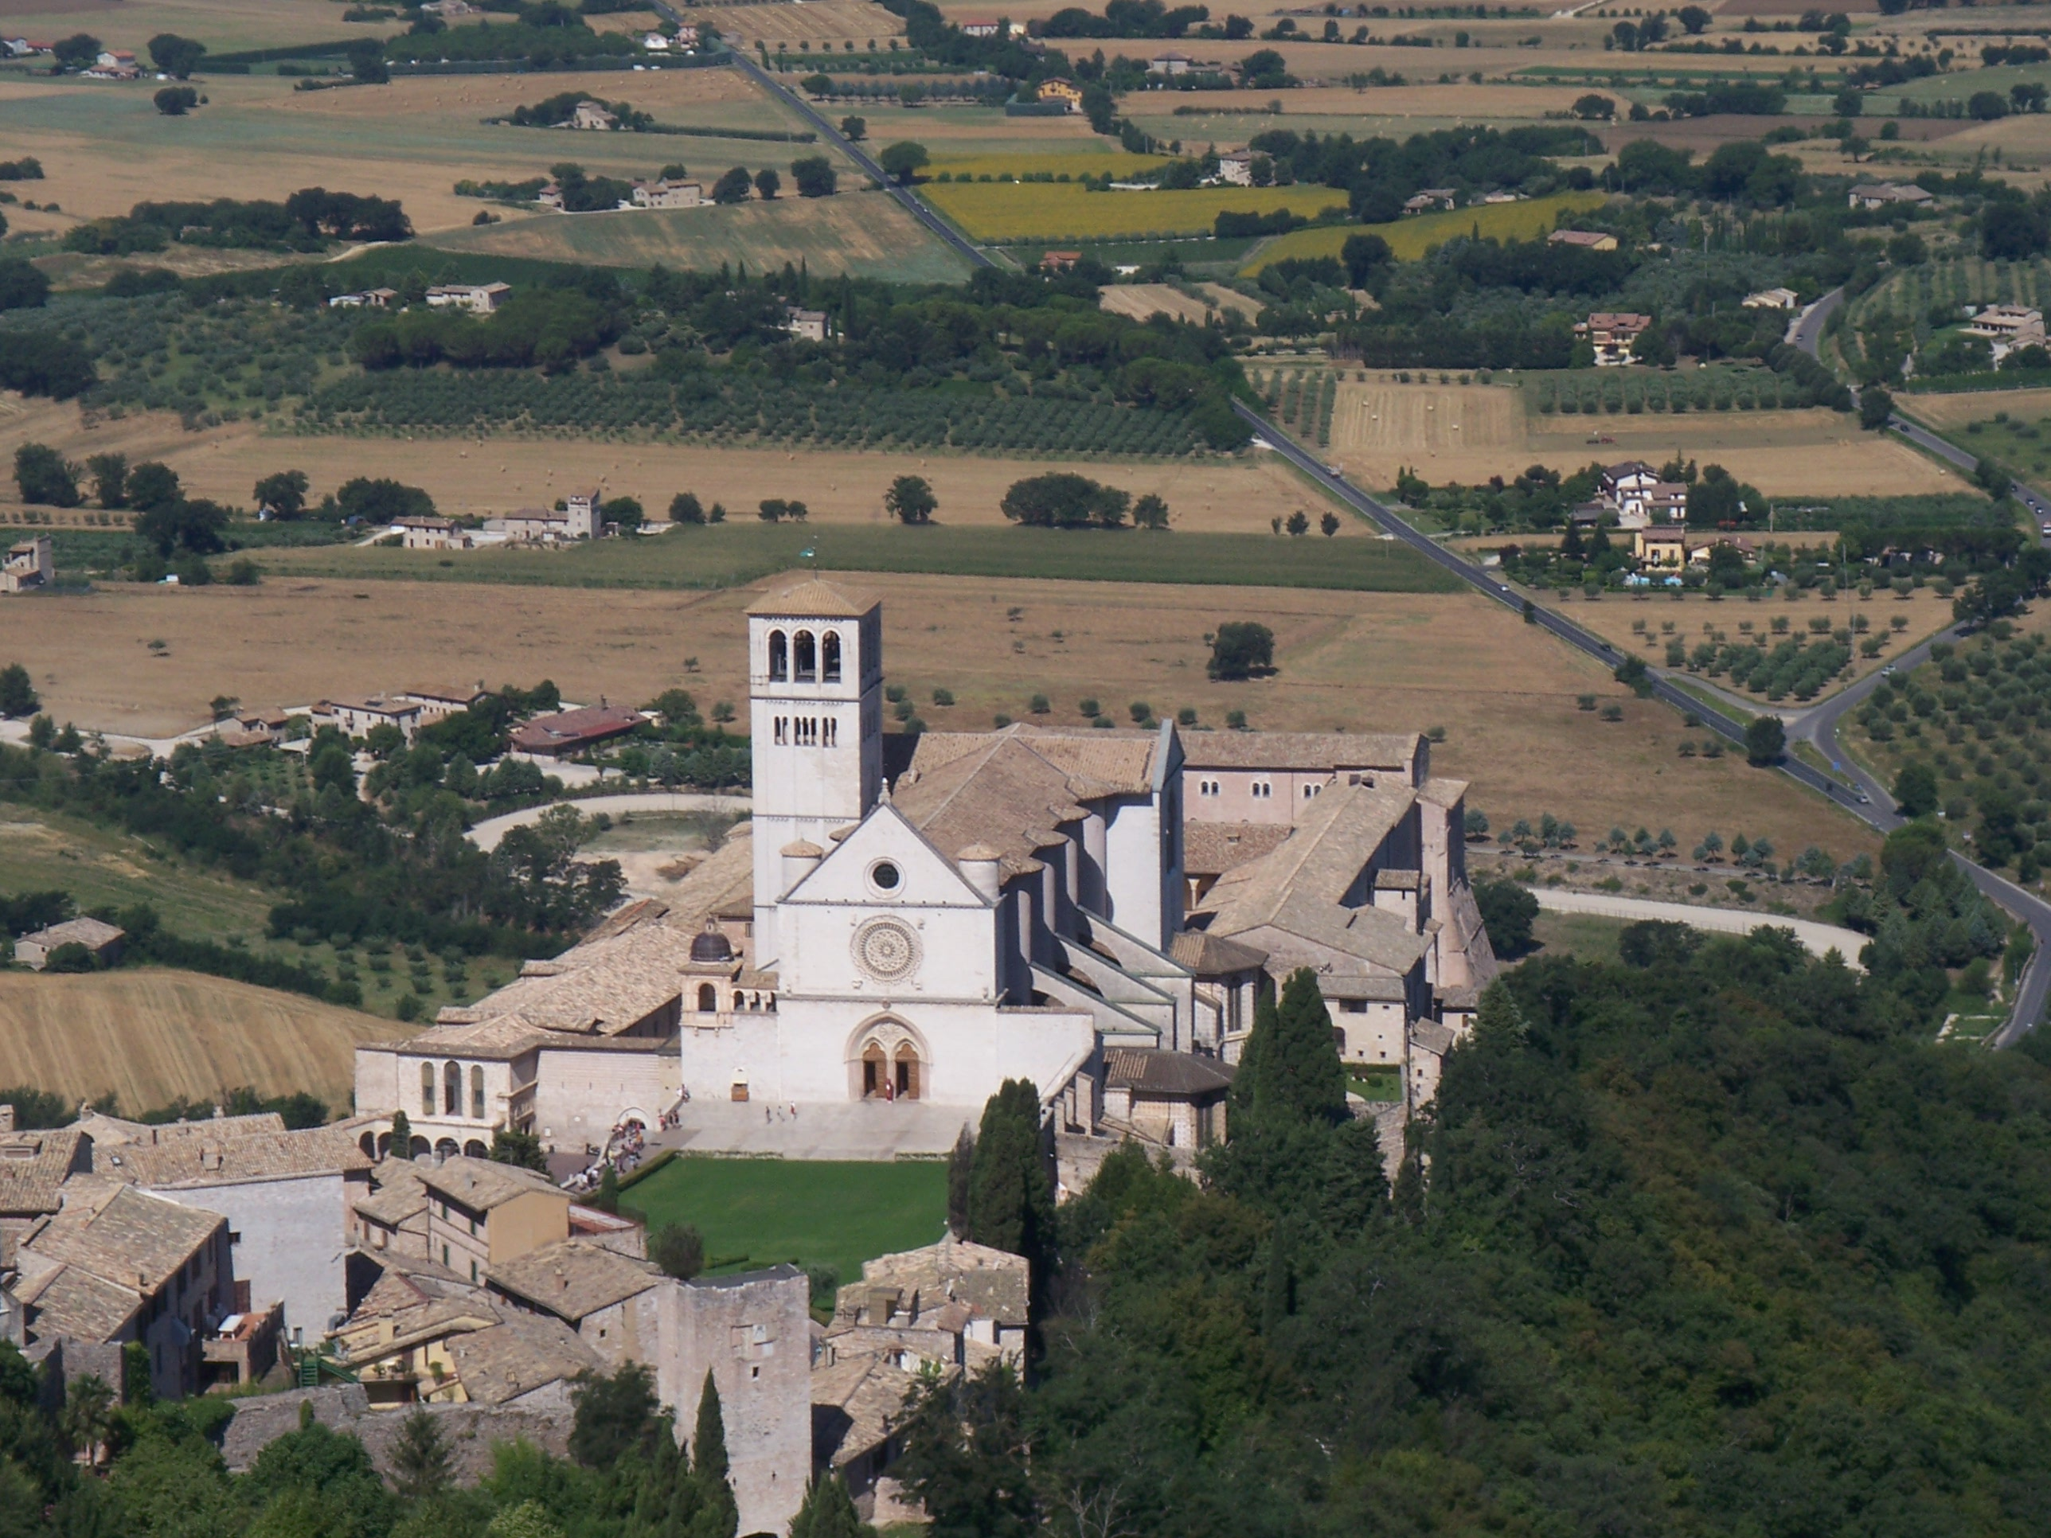

Slide 12
Regional Assistants
Art. 21
1. The regional Assistants to the OFS and the Franciscan Youth are appointed by the competent major Superior, after consultation with the respective regional council. Where more than one major Superior is involved in the appointment, the norms established jointly by the Superiors with jurisdiction in the territory of the regional fraternity shall be followed. (OFS Const 91.2)

Slide 13
Regional Assistants
2. They give their service to the regional council and see to the spiritual assistance to the regional fraternity. If they are more than one, they form a conference and render their service collegially. (OFS Const 90.3)

Slide 14
Regional Assistants
3. It is the responsibility of the Conference of regional Assistants, or to the regional Assistant if there is only one:
-- to collaborate with the regional Council in the task of spiritual and apostolic animation of the secular Franciscans in the life of the Church and of society in the region, and in a special way in the formation of the leaders;

Slide 15
Regional Assistants
-- to provide for the pastoral visits of the local Councils of the OFS (OFS Const 93.1-2) and to ensure a presence at the local elective Chapters [14];
-- to coordinate, at the regional level, the service of spiritual assistance, the formation of the Assistants and the fraternal union among them;
-- to foster the interest of the friars in the OFS and in the Franciscan Youth

Slide 16
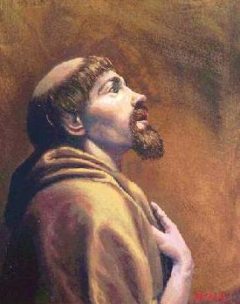

Slide 17
Local Assistants
Art. 23
1. The local Assistant is appointed by the competent major Superior, according to the law of his own Order, having heard the council of the fraternity concerned.

Slide 18
Local Assistants
2. The local assistant fosters communion within the fraternity and between the fraternity and the First Order or the TOR. In harmony with the local Guardian or Superior, the assistant sees to it that between the religious and the secular fraternities a real life-giving union with each other exists. He or she fosters the active presence of the fraternity in the Church and in society.

Slide 19
Local Assistants
Art. 24
1. The local Assistant, together with the Council of the fraternity, is responsible for the formation of the candidates (OFS Const 37.2) and expresses his or her assessment of each of the candidates before profession. (OFS Const 41.1)
2. Together with the Minister, the assistant discusses with the brothers or sisters in difficulty, who want to retire from the fraternity or who act in serious opposition to the Rule. (OFS Const 56.1-2; 58.1-2)

Slide 20
OFS General Constitutions
As an integral part of the Franciscan Family and called to live the charism of Francis within the secular dimension, the OFS has particular and close relations to the First Order and the TOR. (OFS Const., 85, 1)

Slide 21
OFS General Constitutions
The spiritual and pastoral care of the OFS, entrusted by the Church to the First Franciscan Order and the TOR, is the duty above all of their Ministers General and Provincial. The “altius moderamen” of which canon 303 speaks, belongs to them. The purpose of the “altius moderamen” is to guarantee the fidelity of the OFS to the Franciscan charism, communion with the Church and union with the Franciscan family, values which represent a vital commitment for the Secular Franciscans. (OFS Const. 85, 2)

Slide 22
Principle elements of OFS GC
Witness of Franciscan spirituality and fraternal affections. (OFS Const. 89.3)
2. Cooperation in th e initial on ongoing formation of the brothers and sisters of the OFS. (OFS Const. 89.4)

Slide 23
Letter of a TOR Minister General
It is first of all necessary that we become more conscious and more sensitive of the historical and spiritual ties that bind us to the Secular Franciscan Order. For centuries we shared a common Rule; it was only additional statutes that distinguished Tertiary religious from their secular counterparts. We must begin anew with the idea of a common spirit and tradition, and not simply in terms of promoting another movement or association. Roland Faley, TOR in a Letter of the T.O.R. Minister General “Ordo Franciscanus Secularis,” 1979 (bold added)

Slide 24
Letter of a TOR Minister General
In a special way it is the responsibility of the Ministers Provincial, in collaboration with the National assistant, to see that our young friars in formation receive the necessary training to assume responsibilities with the Secular Franciscans in the future. Roland Faley, TOR in a Letter of the T.O.R. Minister General “Ordo Franciscanus Secularis,” 1979 (bold added)

Slide 25
Sr. Antonella Perugini in a recent article in The Franciscan Family:
"Life-giving union with each other" in the vision of the Poor Clare Sisters,
"I am profoundly convinced that what unites us is quantitatively and qualitatively much more than what distinguishes us from one another; but it is, nevertheless, true that the distinctions do exist and, in their complementing, constitute a reciprocal richness and contributes to making complete and, thus, more authentic, the face of Franciscanism."

Slide 26
Final thoughts
The Franciscan Family, as one among many spiritual families raised up by the Holy Spirit in the Church, unites all members of the people of God – laity, religious and priests – who recognize that they are called to follow Christ in the footsteps of St. Francis of Assisi. In various ways and forms but in life-giving union with each other, they intend to make present the charism of their common Seraphic Father in the life and mission of the Church. OFS Rule, #1

Slide 27
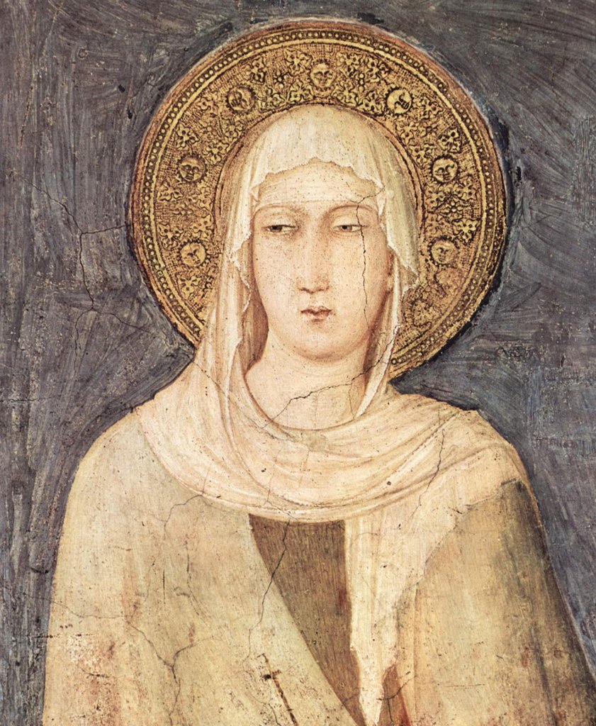

Slide 28
Points to ponder
-- Do you find that your own concept of Spiritual Assistance is reflected in the documents presented?
-- In the Franciscan literature, we find the concept of “right relationship.” How does the S.A. find such a balance with the OFSs in the fraternity he or she pastors?

Slide 29
