Slide 1
JUBILEE! REJOICE IN THE CHOICE

Slide 2
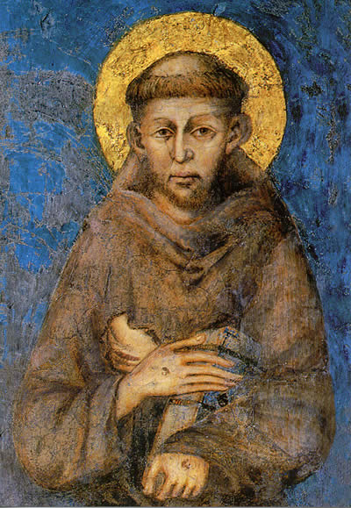
The Praises of God
(St. Francis of Assisi)

Slide 3
Refrain:
You, you are holy. You, are three and one.
You are the most high. You, the holy one!
For you are good, 2. For you are great
the highest good. and wonderful.
You are living and true. You are sweetness and hope.
For you are God above all gods. For you are our eternal life.
Strong and mighty are you! You are all that we need!

Slide 4
Let us begin, brothers (and sisters), to serve our Lord God, for until now we have made but little progress (or we have done little or nothing).
(The Life of Saint Francis of Assisi,
Saint Bonaventure, Chapter XIV)

Slide 5
ALWAYS MOVING FORWARD …
towards the building of a more fraternal world.

Slide 15
Called to “a radical reorientation of our whole life, a return, a conversion to God with all our heart … which entails the desire and resolution to change one’s life.”

Slide 16
Letter to All the Faithful (1215/1220)- St. Francis
Memoriale Propositi (1221) – Pope Honorium III
Supra Montem (1289) - Pope Nicholas IV
Misericors Dei Filius (1883) - Pope Leo XIII
Seraphicus Patriarcha (1978) - Pope Paul VI

Slide 17
“Gospel to life and life to the Gospel”
Based on OFS Rule, Article 4.
Music by Debbie Tessier
G

Slide 18
Refrain:
Gospel to life and life to the Gospel,
Rule of love and truth.
Praise of God, blest with simplicity
Holy Spirit, form us all with Francis into Christ.
1. Penance bears much fruit, 2. Blest by the Church,
the Rule lights our path. Protected by Mary.
Daily conversion, turning, turning, Life in fraternity, global family,
let us renew our promise! let us keep our promise!
3. Thanks be to God
for this way of life!
Brothers and sisters, called to unity,
let us share our promise!

Slide 20
From Memoriale Propositi
To
Our Present Rule
800+ years of living the Gospel life

Slide 21
Fraternity
Memoriale Propositi
Article 19
Our Present
OFS Rule
Articles 13 & 24

Slide 22
Simplicity
Memoriale Propositi
Articles 1-3
Our Present
OFS Rule
Article 11

Slide 23
Family
Memoriale Propositi
Article 18
Our Present
OFS Rule
Article 17

Slide 24
Reconciliation
Memoriale Propositi
Article 15
Our Present
OFS Rule
Article 7

Slide 25
Prayer
Memoriale Propositi
Articles 7 & 12
Our Present
OFS Rule
Article 8

Slide 26
Peace
Memoriale Propositi
Articles 16 & 26
Our Present
OFS Rule
Article 19

Slide 27
JUBILEE! REJOICE IN THE CHOICE

Slide 28
Wherever the Spirit Leads Us
Refrain:
Wherever the Spirit leads us,
Wherever we go,
Wherever the journey takes us,
Together we’ll go
1. Our God is a God of love,
Who cares for our every need
He calls us to trust in Him,
To follow his lead
2. Our God is a God of hope
Who never forgets his own.
He calls us to go beyond
to places unknown
3. Our God is a God of joy
Who wants us to all belong.
He gives us fraternity
To help us along

