Slide 1
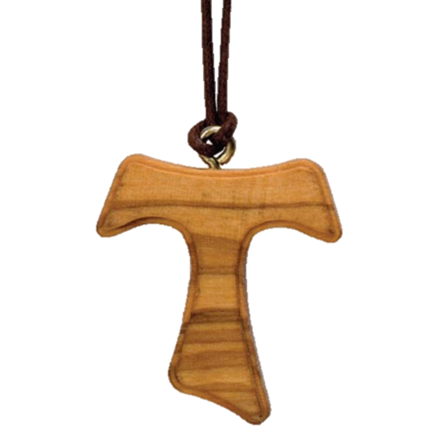
The Rite of Profession
Using the Ritual as a Formation Resource
Notes:
The Rite of Profession: Using the Ritual as a Formation Resources
The Ritual of the Secular Franciscan Order is a rich formation resource routinely overlooked in initial (and ongoing) formation.
Rites and Rituals add to the richness of Catholic liturgical inheritance.
Before we dig into the Rite of Profession, let’s start off by using the chat. We have two questions for you to answer.
1) How many of you used the Ritual as a learning tool during your initial formation?
2) How many of you use the Ritual as an ongoing formation tool?
Debrief chat results.

Slide 2
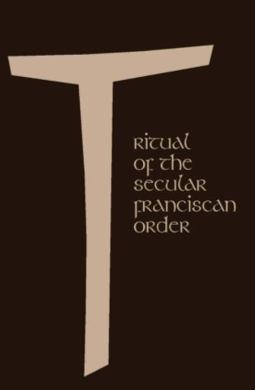
Initial Formation Should Anticipate and Illuminate the Ritual.
Notes:
Initial formation should be structured and organized in part to anticipate and illuminate the ritual.
Each rite is instructive and affirming of the vocation and life of the Secular Franciscan.
Familiarity with and understanding of the rituals should be preliminary to participating in them.

Slide 3
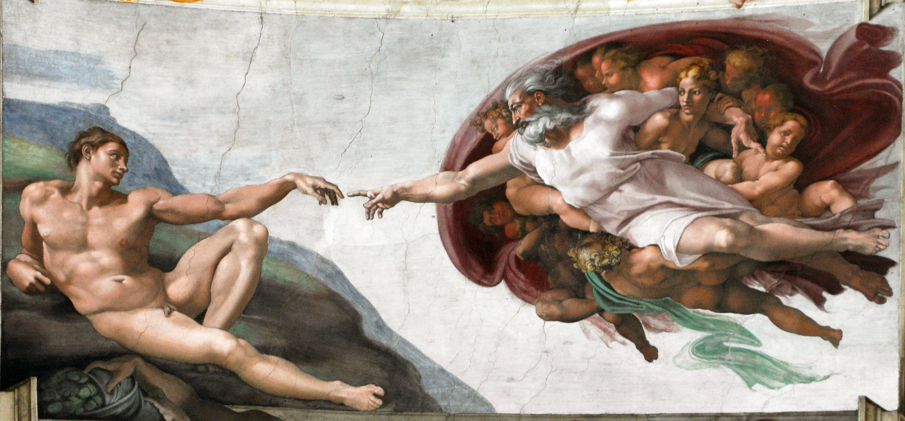
Rites strengthen our union with God
Notes:
Rites Strengthen our union with God.
Take a look at this beautiful paining by Michelangelo to see what is happening.
What do you see? What stands out for you?
Where do you see action/movement?
Who initiated the relationship?
God calls and we respond. Right from the moment of creation
“This aspect is by no means insignificant, because the celebration constitutes the foundational moment of the identity of the professed and is simultaneously the condition for a dialogue to take place in response to God’s action. In fact, the consequences of the commitment a human being expresses by means of a promise derive from a prior commitment, that of God to man.” (Br. Felice Cangelosi OFM Cap)
A rite represents an ecclesiastical tradition about how the sacraments are to be celebrated. Rites are an intensification; they serve to strengthen the union of God and humankind. Rites are entrusted to the pastoral government of the Roman pontiff, the divinely appointed successor of St. Peter in the Primacy. Certain words cannot be changed.
A Rite isn’t about ceremony or looking good. The true meaning is about giving ourselves to God. We are called to bring God alive in who we are and how we live.
While it’s important to prepare for the celebration, it’s most important to prepare for the profession

Slide 4
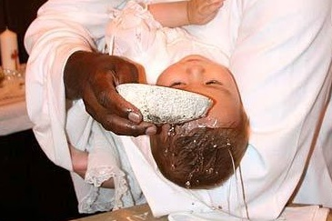
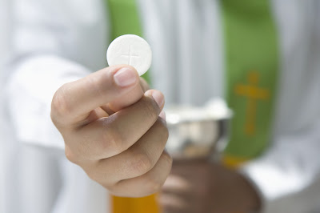
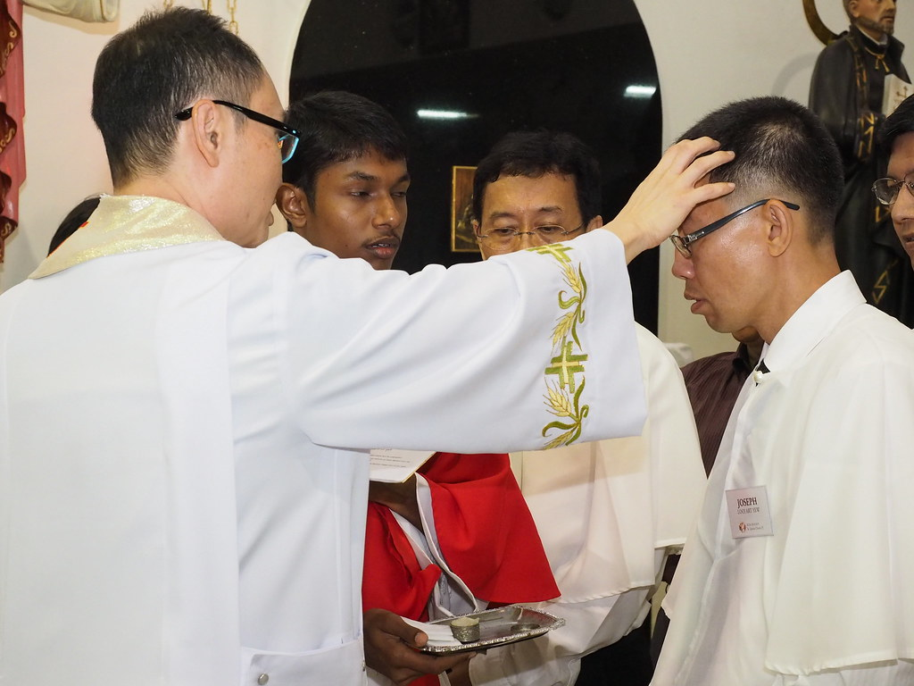
Sacraments are familiar and visible rites that celebrate, signify, and make present the graces proper to each sacrament
This Photo by Unknown Author is licensed under CC BY
Notes:
Sacraments are familiar and visible rites. by which the sacraments are celebrated signify and make present the graces proper to each sacrament
Each Sacrament, beginning with Baptism, brings us closer to God. Each subsequent sacrament intensifies and deepens the relationship.
Let us think for a minutes about the Rites you would have participated in Prior to profession. These are one all individual would have experienced and are also prerequisites Rites to profession
Confirmation
Eucharist
Reconciliation
Baptism

Slide 5
Each rite includes similar essential elements
Questioning
Witnesses
Wording
Assent
Symbols
Notes:
Each rite includes similar essential elements
We find these essential elements in Catholic Rites. Think of the Rite of Baptism,
Questioning Parents-What do you ask of God’s Church for N.?
God Parents Are you ready to help the parents of this child in their duty as Christian parents?
Confirmation- renewal of baptismal vows (remember we said intensification)
What questions do we hear during the Rite of profession?
Witnesses, In confirmation we have a sponsor, What witnesses do we have at the Rite of profession
Wording
Assent Willingly agree, ”I Do’s”
Symbols: Wedding Rings, Candles
Let’s think about what each of these elements are in the rite of profession

Slide 6
OFS Rites signify and effect the desire to become a member of the order and to make a permanent commitment to the Gospel Life.
Rite Admission
Rite of Profession
Notes:
OFS Rites signify and effect the desire to become a member of the order and to make a permanent commitment to the Gospel Life.
The rites celebrated in the formation of a Secular Franciscan signify desire to become a member of the order and to make a permanent commitment to the Gospel life.
The celebration of Profession testifies to all of this, because it is God’s action and a saving event: it is a moment when salvation reaches the faithful:
1. enabling them to make a promise to live the Franciscan gospel life and
2. producing in them particular effects of grace, by which they are deputed to specific tasks within the People of God.
The Rite of Admission, whereby we become members of the order
The Rite of Profession, whereby we make our perpetual commitment to life the Gospel life according to our Rule

Slide 7
Each rite is instructive and affirming of the vocation and life of the Secular Franciscan.
Notes:
Each rite is instructive and affirming of the vocation and life of the Secular Franciscan.
Of particular importance in this regard are two main rites: the Rite of Admission and the Rite of Profession.
Each rite is instructive and affirming of the vocation of the Secular Franciscan.
However, too often the inquirer or candidate encounters the contents of these rituals for the first time close to or on the day of the rite itself.
The ritual for each of these rites encapsulates and affirms the chief elements of Secular Franciscan vocation central to that stage formation.
In each of these rites, the language of the responses and prayers recapitulates what should have been the main emphases of formation up to that point.
Conversely, initial formation should be structured and organized in part to anticipate and illuminate the ritual.

Slide 8
The language of the responses and prayers recapitulates the main emphases of formation up to that point.
Notes:
The language of the responses and prayers recapitulates the main emphases of formation up to that point.
Of particular importance in this regard are two main rites: the Rite of Admission and the Rite of Profession.
Each rite is instructive and affirming of the vocation of the Secular Franciscan.
However, too often the inquirer or candidate encounters the contents of these rituals for the first time close to or on the day of the rite itself.
The ritual for each of these rites encapsulates and affirms the chief elements of Secular Franciscan vocation central to that stage formation.
In each of these rites, the language of the responses and prayers recapitulates what should have been the main emphases of formation up to that point.
Conversely, initial formation should be structured and organized in part to anticipate and illuminate the ritual.

Slide 9
The Rite of Profession incorporates into the ritual key themes to be explored and learned during initial formation.
Notes:
The Rite of Profession incorporates into the ritual key themes to be explored and learned during initial formation.
For example, the Rite of Profession incorporates into the ritual key themes to be explored and learned during initial formation:
living the gospel following St. Francis of Assisi
fidelity to the Church
importance of the Rule
renewal of our Baptism and Confirmation
mission to rebuild the church
centrality of life in fraternity
permanence of the commitment

Slide 10
The Key Themes Include:
Living the gospel following St. Francis
Fidelity to the Church
Spirit of Service
Importance of the Rule
Renewal of Baptism and Confirmation
Mission to rebuild the church
Centrality of life in fraternity
Permanence of the commitment
Notes:
The Key Themes Include:
For example, the Rite of Profession incorporates into the ritual key themes to be explored and learned during initial formation:
living the gospel following St. Francis of Assisi
fidelity to the Church
importance of the Rule
renewal of our Baptism and Confirmation
mission to rebuild the church
centrality of life in fraternity
permanence of the commitment

Slide 11
These themes are expressed in the very language of the ritual
Notes:
These themes are expressed in the very language of the ritual
For example, the Rite of Profession incorporates into the ritual key themes to be explored and learned during initial formation:
living the gospel following St. Francis of Assisi
fidelity to the Church
importance of the Rule
renewal of our Baptism and Confirmation
mission to rebuild the church
centrality of life in fraternity
permanence of the commitment

Slide 12
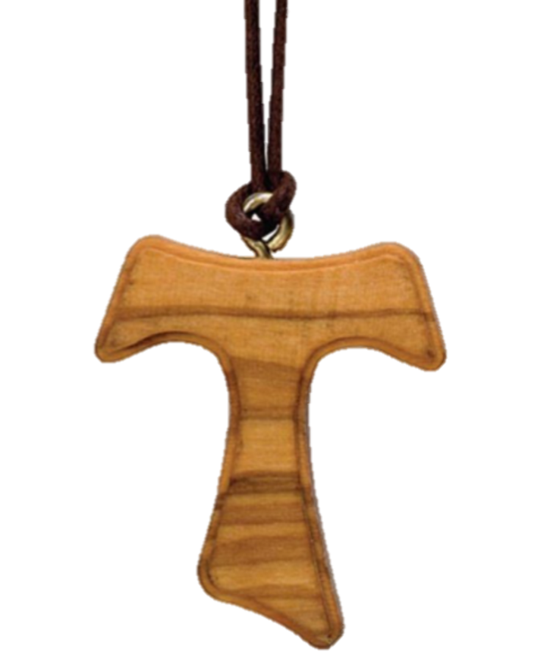
Do you wish to embrace the gospel way of life by following the example and words of St. Francis of Assisi, which are at the heart of the Rule of the Secular Franciscan Order?
Notes:
Do you wish to embrace the gospel way of life by following the example and words of St. Francis of Assisi, which are at the heart of the Rule of the Secular Franciscan Order?
Questioning After the homily, those to be professed stand. The celebrant questions them about their intent in these or similar words:
Question 1:
Celebrant: Before this fraternity and the other members of the People of God gathered here, I ask you to express your will. Do you wish to embrace the gospel way of life by following the example and words of St. Francis of Assisi, which are at the heart of the Rule of the Secular Franciscan Order?
Candidates: Yes, this is what I want.

Slide 13

Do you wish to be faithful to this vocation and to practice the spirit of service proper to Secular Franciscans?
Notes:
Do you wish to be faithful to this vocation and to practice the spirit of service proper to Secular Franciscans?
Question 2:
Celebrant: You have been called to give witness to the Kingdom of God and to build a more fraternal world based on the gospel, together with all people of goodwill.
Candidates: Yes, this is what I want.

Slide 14
Do you wish to bind yourself more closely to the Church and to work intently to rebuild the ecclesial community and fulfill its mission among all people?
Notes:
Do you wish to bind yourself more closely to the Church and to work intently to rebuild the ecclesial community and fulfill its mission among all people?
Question 3:
Celebrant: You have been made members of the People of God by your Baptism, and strengthened in Confirmation by the new gift of the Spirit, in order to proclaim Christ by your life and your words. Do you wish to bind yourself more closely to the Church and to work intently to rebuild the ecclesial community and fulfill its mission among all people?
Candidates: Yes, this is what I want.

Slide 15
I, ________, by the grace of God, renew my baptismal promises and consecrate myself to the service of his Kingdom.
Therefore, in my secular state
I promise to live all the days of my life the gospel of our Lord Jesus Christ in the Secular Franciscan Order by observing its rule of life.
May the grace of the Holy Spirit, the intercession of the Blessed Virgin Mary and our holy father St. Francis, and the fraternal bonds of community always be my help, so that I may reach the goal of perfect Christian love.
Notes:
These themes are expressed in the language of the ritual.
Renewal of baptismal promises: renew my baptismal promises
Service to God: service of his Kingdom
Permanence of the commitment: all the days of my life
Gospel life: the gospel of our Lord Jesus Christ
Importance of the Rule: by observing its rule of life
Centrality of Fraternal life: the fraternal bonds of community

Slide 16
I, ________, by the grace of God, renew my baptismal promises and consecrate myself to the service of his Kingdom.
Therefore, in my secular state
I promise to live all the days of my life the gospel of our Lord Jesus Christ in the Secular Franciscan Order by observing its rule of life.
May the grace of the Holy Spirit, the intercession of the Blessed Virgin Mary and our holy father St. Francis, and the fraternal bonds of community always be my help, so that I may reach the goal of perfect Christian love.
Notes:
Renewal of baptismal promises: renew my baptismal promises
Service to God: service of his Kingdom

Slide 17
I, ________, by the grace of God, renew my baptismal promises and consecrate myself to the service of his Kingdom.
Therefore, in my secular state
I promise to live all the days of my life the gospel of our Lord Jesus Christ in the Secular Franciscan Order by observing its rule of life.
May the grace of the Holy Spirit, the intercession of the Blessed Virgin Mary and our holy father St. Francis, and the fraternal bonds of community always be my help, so that I may reach the goal of perfect Christian love.
Notes:
Permanence of the commitment: all the days of my life

Slide 18
I, ________, by the grace of God, renew my baptismal promises and consecrate myself to the service of his Kingdom.
Therefore, in my secular state
I promise to live all the days of my life the gospel of our Lord Jesus Christ in the Secular Franciscan Order by observing its rule of life.
May the grace of the Holy Spirit, the intercession of the Blessed Virgin Mary and our holy father St. Francis, and the fraternal bonds of community always be my help, so that I may reach the goal of perfect Christian love.
Notes:
Gospel life: the gospel of our Lord Jesus Christ
Importance of the Rule: by observing its rule of life

Slide 19
I, ________, by the grace of God, renew my baptismal promises and consecrate myself to the service of his Kingdom.
Therefore, in my secular state
I promise to live all the days of my life the gospel of our Lord Jesus Christ in the Secular Franciscan Order by observing its rule of life.
May the grace of the Holy Spirit, the intercession of the Blessed Virgin Mary and our holy father St. Francis, and the fraternal bonds of community always be my help, so that I may reach the goal of perfect Christian love.
Notes:
Centrality of Fraternal life: the fraternal bonds of community

Slide 20
Familiarity with the rites provides a deeper understanding of their significance and expectation
Notes:
Through familiarity with the rites, a person in initial formation progresses toward these events with a deeper understanding of their significance, a truly informed enthusiasm and expectation, and an awareness of how initial formation overall complements these important steps in the life of a Secular Franciscan.

Slide 21
The Rite of Profession
Using the Ritual as a Formation Resource
Notes:
The Ritual of the Secular Franciscan Order is a rich formation resource, and we hope you, your formation teams, and your fraternity members will see it in a new light and recognize the many gifts within.

