Slide 1
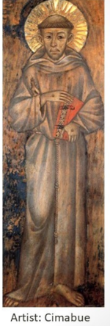
THE TESTAMENT OF ST. FRANCIS
Adapted for Secular Franciscans

Slide 2
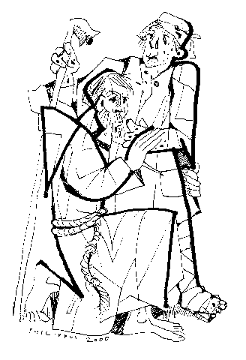
Penance:
“the Lord Himself led me among them (the lepers)
and I showed mercy to them…
what had seemed bitter to me
was turned
into sweetness of soul & body.”

Slide 3
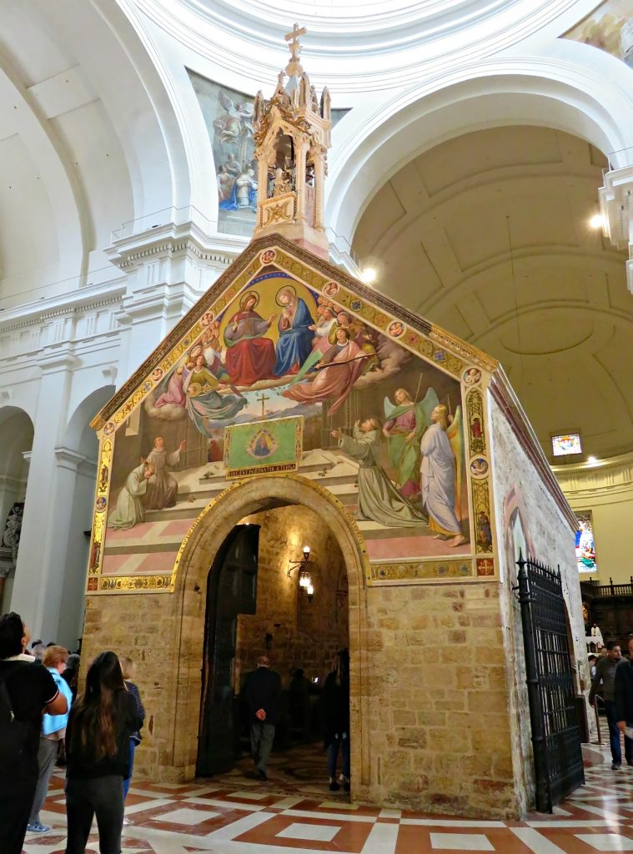
Faith in Churches:
“The Lord gave me such faith in Churches, I would say, ‘We adore You, Lord Jesus Christ, in all Your Churches throughout the whole world and we bless You because by Your Holy Cross You have redeemed the world.’”

Slide 4
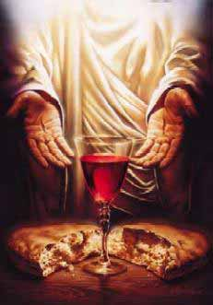
Respect for priests:
“The Lord gave me & still gives me such faith in priests …that were they to persecute me, I would still want to have recourse to them … I act this way because I see nothing corporally of the Most High Son of God except His Most Holy Body & Blood which they receive & they alone administer to others.” “I…respect them as those who administer to us spirit & life.”

Slide 5
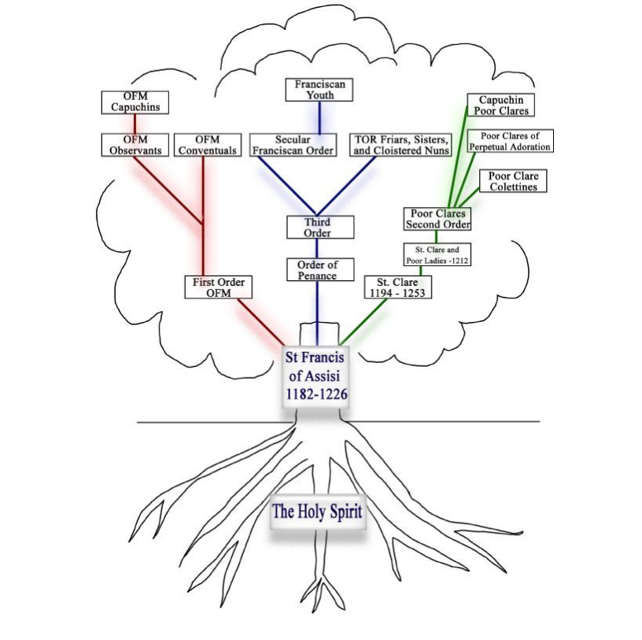
Brotherhood/Fraternity:
“The Lord gave me some brothers … “

Slide 6
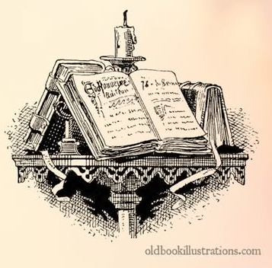
Live the Gospel:
“The Most High Himself revealed to me that
I should live according to the pattern of
the Holy Gospel.”
“Clerics should pray the Divine Office & lay brothers should pray the Our Father.

Slide 7
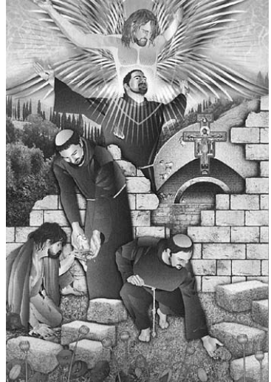
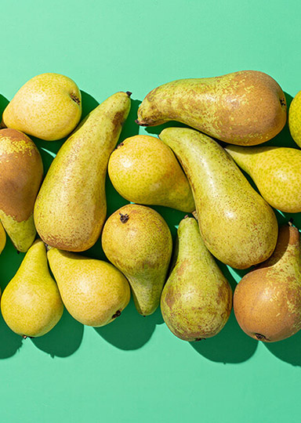
Work:
“I worked with my hands”
“Work not from a desire for wages
but as an example, &
to avoid idleness.”

Slide 8
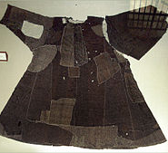
Poverty:
“Not to accept any churches, dwellings or anything else built for them unless they are according to holy poverty.”
“Be pilgrims & strangers; let them always be guests..”

Slide 9
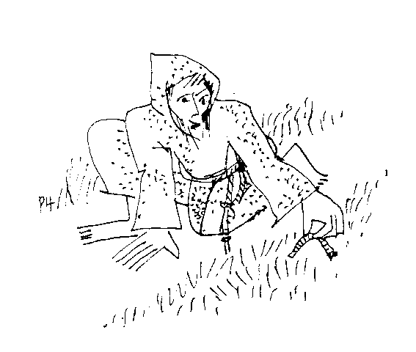
Minority:
“Don’t seek special privileges or
rewards…”
“We were simple and subject to all.”

Slide 10
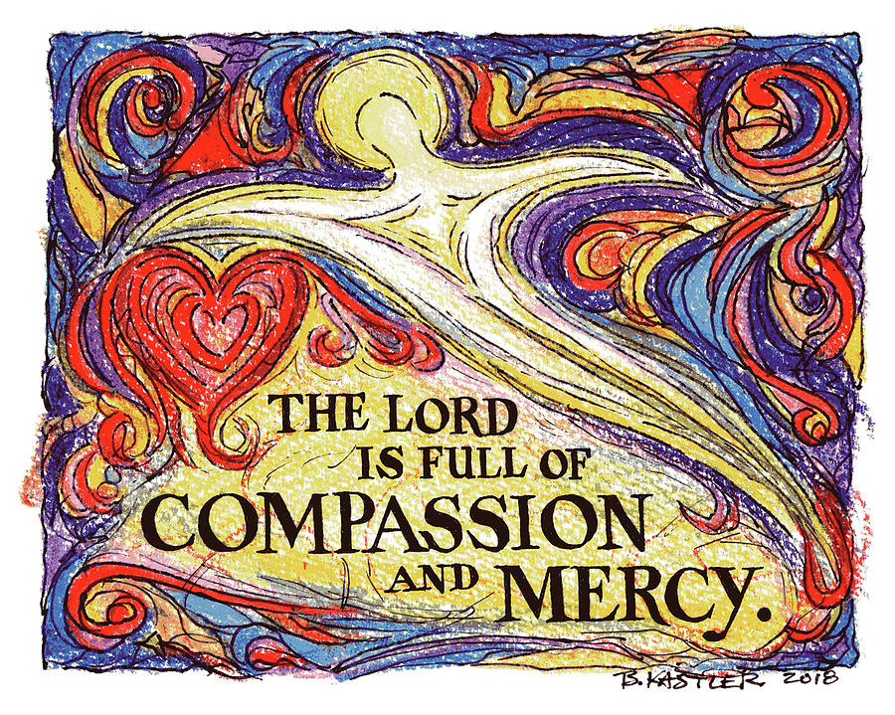
Obey one’s superiors and
Superiors be faithful to one’s duties
Obey (from the Latin word “to listen”)

