Slide 1
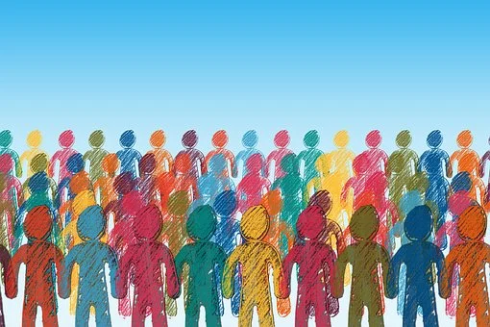
Called to build a more fraternal world:
Secular Franciscans as a
Community of Care & Moral Transformation
David B. Couturier, OFM Cap.
Phoenix 2022

Slide 2
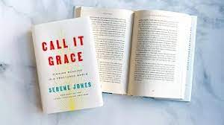
Dr. Serene Jones, a theologian and first woman president of Union Theological Seminary in New York City

Slide 3
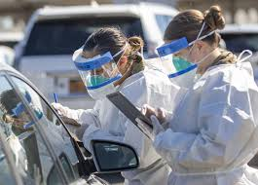
A flourishing life?
We were thrust into a worldwide pandemic that kept us in our houses for months on end. Schools and colleges were closed. Work sites shut down. Children couldn’t visit their grandparents. Hospitals were overwhelmed. Over a million Americans died from the disease and for many who recovered there was the trauma of long-term consequences of memory fog and physical disability.

Slide 4
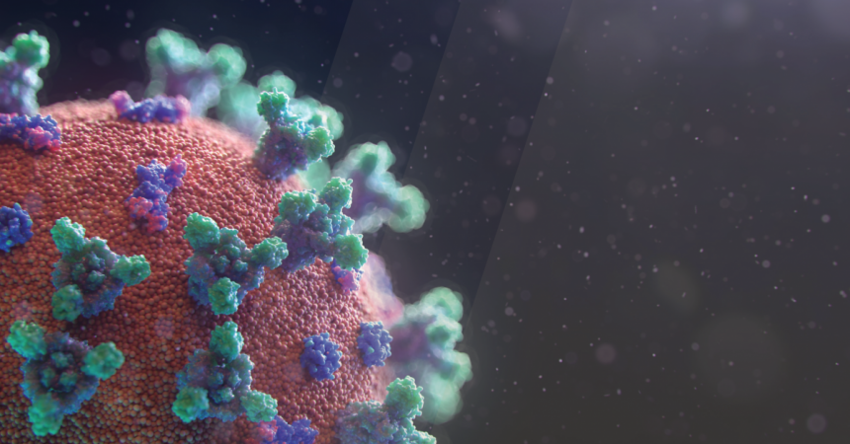
What we saw during covid
Racism
Sexual Harassment
Unfair Economy

Slide 5
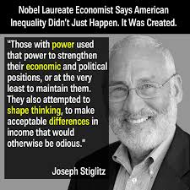

Slide 6
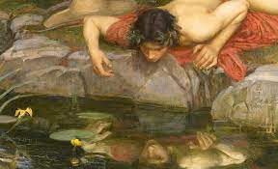
The danger of talking about “A Flourishing life”
Talking of a “flourishing life” could be interpreted in our self-help psychological world as more stress on individual happiness and personal self-fulfillment, just at a time when all signs point to a social crisis, a problem with our group connections and the common bonds we are supposed to have with one another.

Slide 7
Chapter 2, number 14
“Secular Franciscans, together with all people of good will, are called to build a more fraternal and evangelical world so that the kingdom of God may be brought about more effectively.”

Slide 8
“To build a more fraternal world”

Slide 9
What it means/ doesn’t mean
Your international mission;
Reason for your existence as a worldwide Order;
Missionary thrust
Not to build fraternities (primarily)
Not simply to develop warm relationships with those coming to your fraternity

Slide 10
To build a fraternal WORLD…..
What kind of a world are we now building?
What kind of world did Francis want to build?
What would it take for us to build a more fraternal world today?

Slide 11
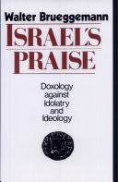
Walter Brueggemann
It has become increasingly clear, however, that reality is not fixed and settled, that it cannot be described objectively. We do not simply respond to a world that is here, but we engage in constituting that world by our participation, our actions, and our speech. As participants in the constitutive act, we do not describe what is there, but we evoke what is not fully there until we act or speak. The human agent, then, is a constitutive part of the enterprise, which means that the shape of reality in part awaits our shaping adherence. Or, as a chemist has put it concerning his research, “The world is not a crossword puzzle to be solved, but a symphony yet to be written.

Slide 12
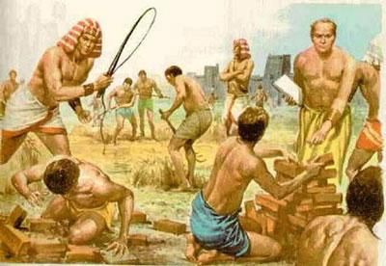
The jews under Egyptian domination
We learn what I call the “embedded social imagination” of Pharaoh and the Egyptians in regard to the Jews living under Pharaoh’s oppression. The world as it had been constructed by the Pharaohs justified the enslavement of Jews as a cheap labor force in a violent arms race conducted by the Egyptians for military superiority over and against neighboring countries.

Slide 13
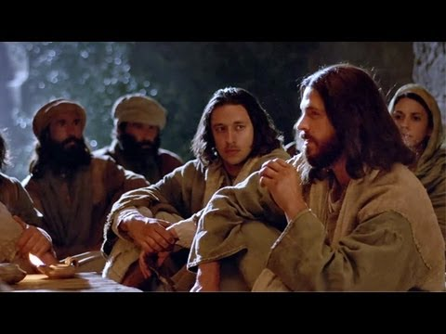
Jesus imagines another worlD
Jesus commanded his followers to imagine another world and another kingdom where mercy substituted for violence, compassion substituted for political control, and universal love substituted for tribalism.
Jesus offered another way of imagining the world and that new interpretative lens is called “gospel” and the change from one lens to the other is what we call “conversion.”

Slide 14
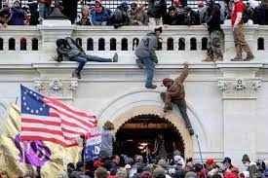
What is the world that we are building?
The world we are building today struggles with trust.

Slide 16
The Knight Commission on trust
There is a crisis of trust in American democracy. By virtually every measure, Americans’ trust in most of their democratic institutions, and particularly in the media, has declined dramatically over the past half century. It is striking that a country known for its freedoms and legacy as one of the oldest and strongest representative governments now finds itself struggling to find support for its very democracy.

Slide 17
The Causes of mistrust
The Causes of Mistrust
Poor institutional
performance
Large global Shocks
Political Polarization
What is Trust?
Increasing Income Inequality
Unfairness

Slide 18
Pope francis and his Franciscan world
It is clear that Pope Francis understands the critical problem of trust not only in politics and economics, but also within the church. His pastoral work has been targeted toward the development of a new understanding and conception of the world that we can live in. In his encyclical on the environment, he imagines a world beyond private interests and personal autonomy and asks policy makers and ordinary citizens to think beyond their immediate personal needs and begin thinking of the earth as “our common home.”

Slide 19
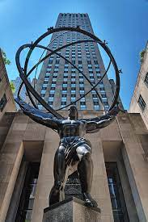
The world we are creating…
The Pope reminds us that world that we have been creating has been in construction since the time of the Enlightenment in the 17th and 18th centuries. It is a world that sees and measures everything and everyone by the distance and differences between individuals and things in the universe. It is a world of private property and autonomous wills clashing and crashing into one another. It is the world described long ago by the Scottish philosopher, Thomas Hobbes, as the “war of all against all,” a world of inevitable violence and selfishness that Christianity cannot avoid and should not try to change, but should only admit, utilize and mitigate.

Slide 20
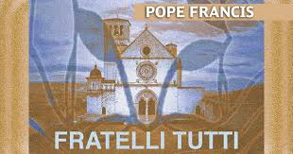
The Pope has lamented this world, because a world exclusively designed for individualism, autonomy, and self-interests severely cheapens relationships and instrumentalizes them. In that world, individuals are only as important as what they can consume or spend in an increasingly consumptive and aggressive market-driven world.

Slide 21
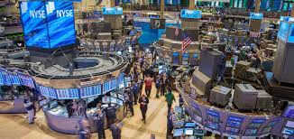
The myth is…
We are at the mercy of the invisible hand of the marketplace, even as the marginalization and exclusion once reserved for the poor is now transferred over to the planet, which cries in agony because of severe climate change and impending ecological disasters.

Slide 22
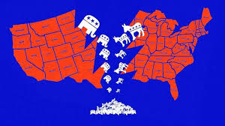
An ambiguous and dangerous world

Slide 23
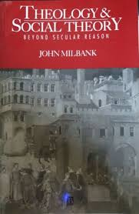
John milbank
God as the infinite community of trust

Slide 24
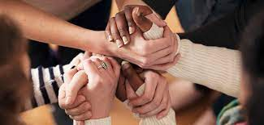
The Church and Trust
The Church is unlike every other society in the world today. The Church, for example, is not built on the “ontology of violence” as were the communities of ancient Greece and Rome. The Church, Milbank maintains, is built on an ontology of peace, that is, on the harmonious relations of trust within the Trinity. We build trust relationships, because the Trinity exists as the “infinite community of trust.”

Slide 25
Francis according to milbank
For if there was a novum about Francis, then it concerned his revolutionary attempt more closely to follow Jesus and the apostles in their restoration of a paradisal life on earth as far as possible. For Francis this meant adoption of altissima povertà, the “most high poverty,” refusing not just private property, like the traditional monastic orders, but even any notion of property shared in common. This refusal undergirded the new ideal of a mendi­cant, wandering, begging way of life, in which truly one became like the birds of the air and lilies of the field, trusting solely to the providence of the heavenly Father.
John Milbank, “The Franciscan Conundrum,” Communio 42 (Fall 2015), 466.

Slide 26
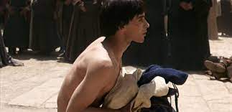
Naked in the public square
Having cast off his clothes in the marketplace, Francis aligns himself not with culture but with nature itself. When he leaves the public square, he does not search out a monastery, a desert hermitage, a radical community of rebels or hermits. That is not where he will place his trust anymore. He goes instead to nature, the vestige of God’s image, in order to undergo a primal new birth and incarnation. In this way, he starts a new “civilization of love” outside the conventions, customs, and laws of Assisi.

Slide 27
Francis & Everywhere
First, he did not simply react against the new urban civilization by returning to the desert of the fields or fleeing to a monastic asylum. Rather, he did a new thing by fleeing to “everywhere,” that is to say, to nature as such, rather than cul­ture, and yet in such a way that his path of continuous flight now possibly passes through every street of every town.
Milbank, “The Franciscan Conundrum,” 470.

Slide 28
For francis poverty is not an ascetical exercise
Francis’ poverty is not a negation that cancels culture, builds defensive walls, condemns a wicked world or silences those who are wrong. It is not a flight into protected spaces, like a monastery or desert where we simply wait for heaven to liberate us from all that is bad. It is not a flight from the world at all. The Franciscan vocation is not an escape from the “evils of mortality” or temptations of the flesh. It is a flight into the relational space of “everywhere,” where only domination and deprivation are excluded.

Slide 29
Poverty as radical trust
Francis chose poverty as his way of life, because poverty was the only way to create a new community of men and women who would develop a radical trust in a provident God and a radical trust in one another.

Slide 30
Francis and his community of trust
In the world, through every street of every town, Franciscans would trust in the providential abundance of God and attempt to create relationships of trust with all men and women, beyond the boundaries and social limits of class, race, tribe, ethnicity, religion, culture, and status.

Slide 31
Secular Franciscans as a Community of Caring Encounters in the World Today
Pope Francis uses that term seven times in his critical encyclical, Fratelli Tutti, and speaks of the importance of encounter about forty times more in the encyclical. In a world of fragmentation, isolation, inequality, polarization and mistrust, Pope Francis is recommending that we turn to a new and consistent exercise of “encountering” other people.
Paul Elie, “Close Encounters,” Commonweal (August-September, 2022), 12.

Slide 32
Caring is not a perillo tour

Slide 33
Models of encounter

Slide 34
Francis encounters the leper

Slide 35
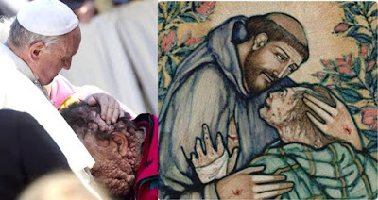
Pope Francis: The theology of encounter
There is always movement in an encounter. If we all stand still, we will never meet. “Life, for all its confrontations, is the art of encounter” (Fratelli Tutti, 215). This is what life is: the art of encounter. Encounter is, as it were, the oxygen of life. And this is why we need a culture of encounter, because “we, the people, should be passionate about meeting others, seeking points of contact, building bridges, planning a project that includes everyone” (216).

Slide 36
Pope Francis: elements of The culture of encounter
Humility
Generosity
Realism
Patience

Slide 37
THE CARING ENCOUNTER
When a poor person “knocks on the door of our house, it is very different because we are no longer facing an image but are personally involved,” he explained.
“In these instances, what is my reaction? Do I turn away? Do I move on? Or do I stop to talk and take an interest? If you do this, there will always be someone who says, ‘This one is crazy, talking to a poor person,’” the pope said.
Recalling St. James’s affirmation that “faith without works is dead,” Pope Francis said that Christians cannot “delegate” feeding the hungry to others ...
Juno Arrocho Esteves, “Pope says contributions to the poor are great, but need a personal touch,” Crux (October 19, 2016) at: https://cruxnow.com/vatican/2016/10/pope-says-contributions-great-charity-needs-personal-touch.

Slide 38
The caring encounter….
He told the religious sisters that when he hears confessions, he likes to ask the penitent if they give to the poor. When the person answers that he or she gives to charity, he said he likes to follow-up with the question, “when you give alms, do you touch the hand of the person asking, do you look them in the eyes?”
“If you are able to touch, to look in the eyes, it is beautiful like that,” Francis explained, adding that it is important not to “balconize” one’s self, remaining aloof and indifferent, but to approach people and care for them in their humanity.
“Every time we approach a person with charity, with love, we restore his dignity. The dignity of Christ, who comes with our gesture of charity,” he said.
Hannah Brockhaus, “Pope Francis wants us to do this when we give to the poor,” Crux (March 26, 2022) at: https://www.catholicworldreport.com/2022/03/26/pope-francis-wants-us-to-do-this-when-we-give-to-the-poor/.

Slide 39
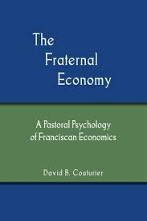
Francis and the fraternal economy
He developed a new economic model that challenged the major assumptions of his day. Francis’ economic model challenged the absolute necessity and inevitability of greed and violence. He took himself out of the arms race of his day and rejected the “common sense” notion that everyone must have a weapon. (He had seen how that mentality had fractured his family and nearly cost him his life.)

Slide 40
Dr. rod Hewlett, secular franciscan
Hewlett reminds us that our present economic models do not prioritize or maintain the social bonds we hold dear and need so badly. Our connections to one another are deteriorating and our relationship to the earth itself is reaching a crisis point. We need a third way of dealing with money and working out the way we buy and sell. We need a model based not on growth alone, but on sustainability and one that places the needs of people ahead of the need for profit. Hewlett outlines what an economy would look like when it respects the Franciscan tradition’s emphasis on fraternity, the dignity of all creation, and a society that elevates all humans.

Slide 41
Yours is a call to build communities of caring encounters

Slide 42
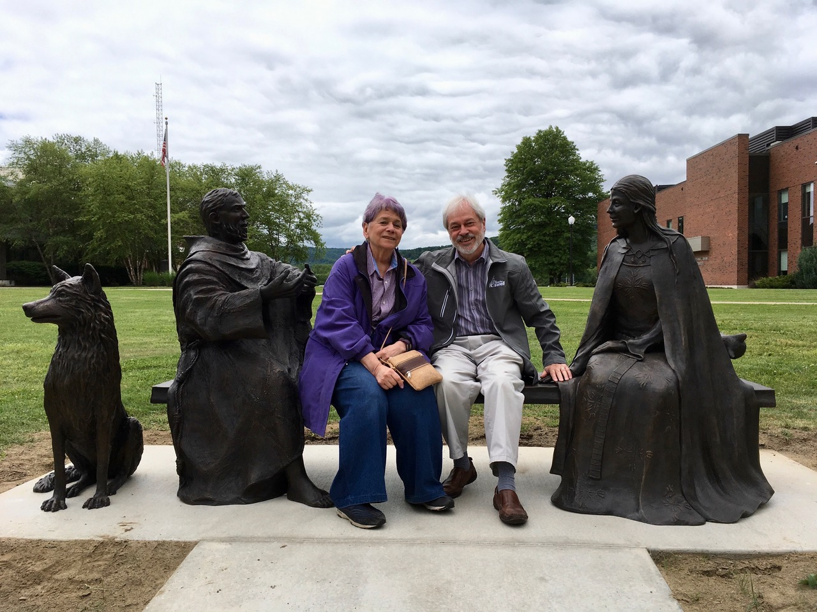
St. Francis and St. Clare once imagined a caring world in the violent and greedy times of their youth. They left us a legacy of radical trust to be the foundation of our new Gospel world. They did theirs; it is time for us to do ours. May care be our mission and our joy in the love of Christ, who is the Lord, now and forever. Amen.

