Slide 1
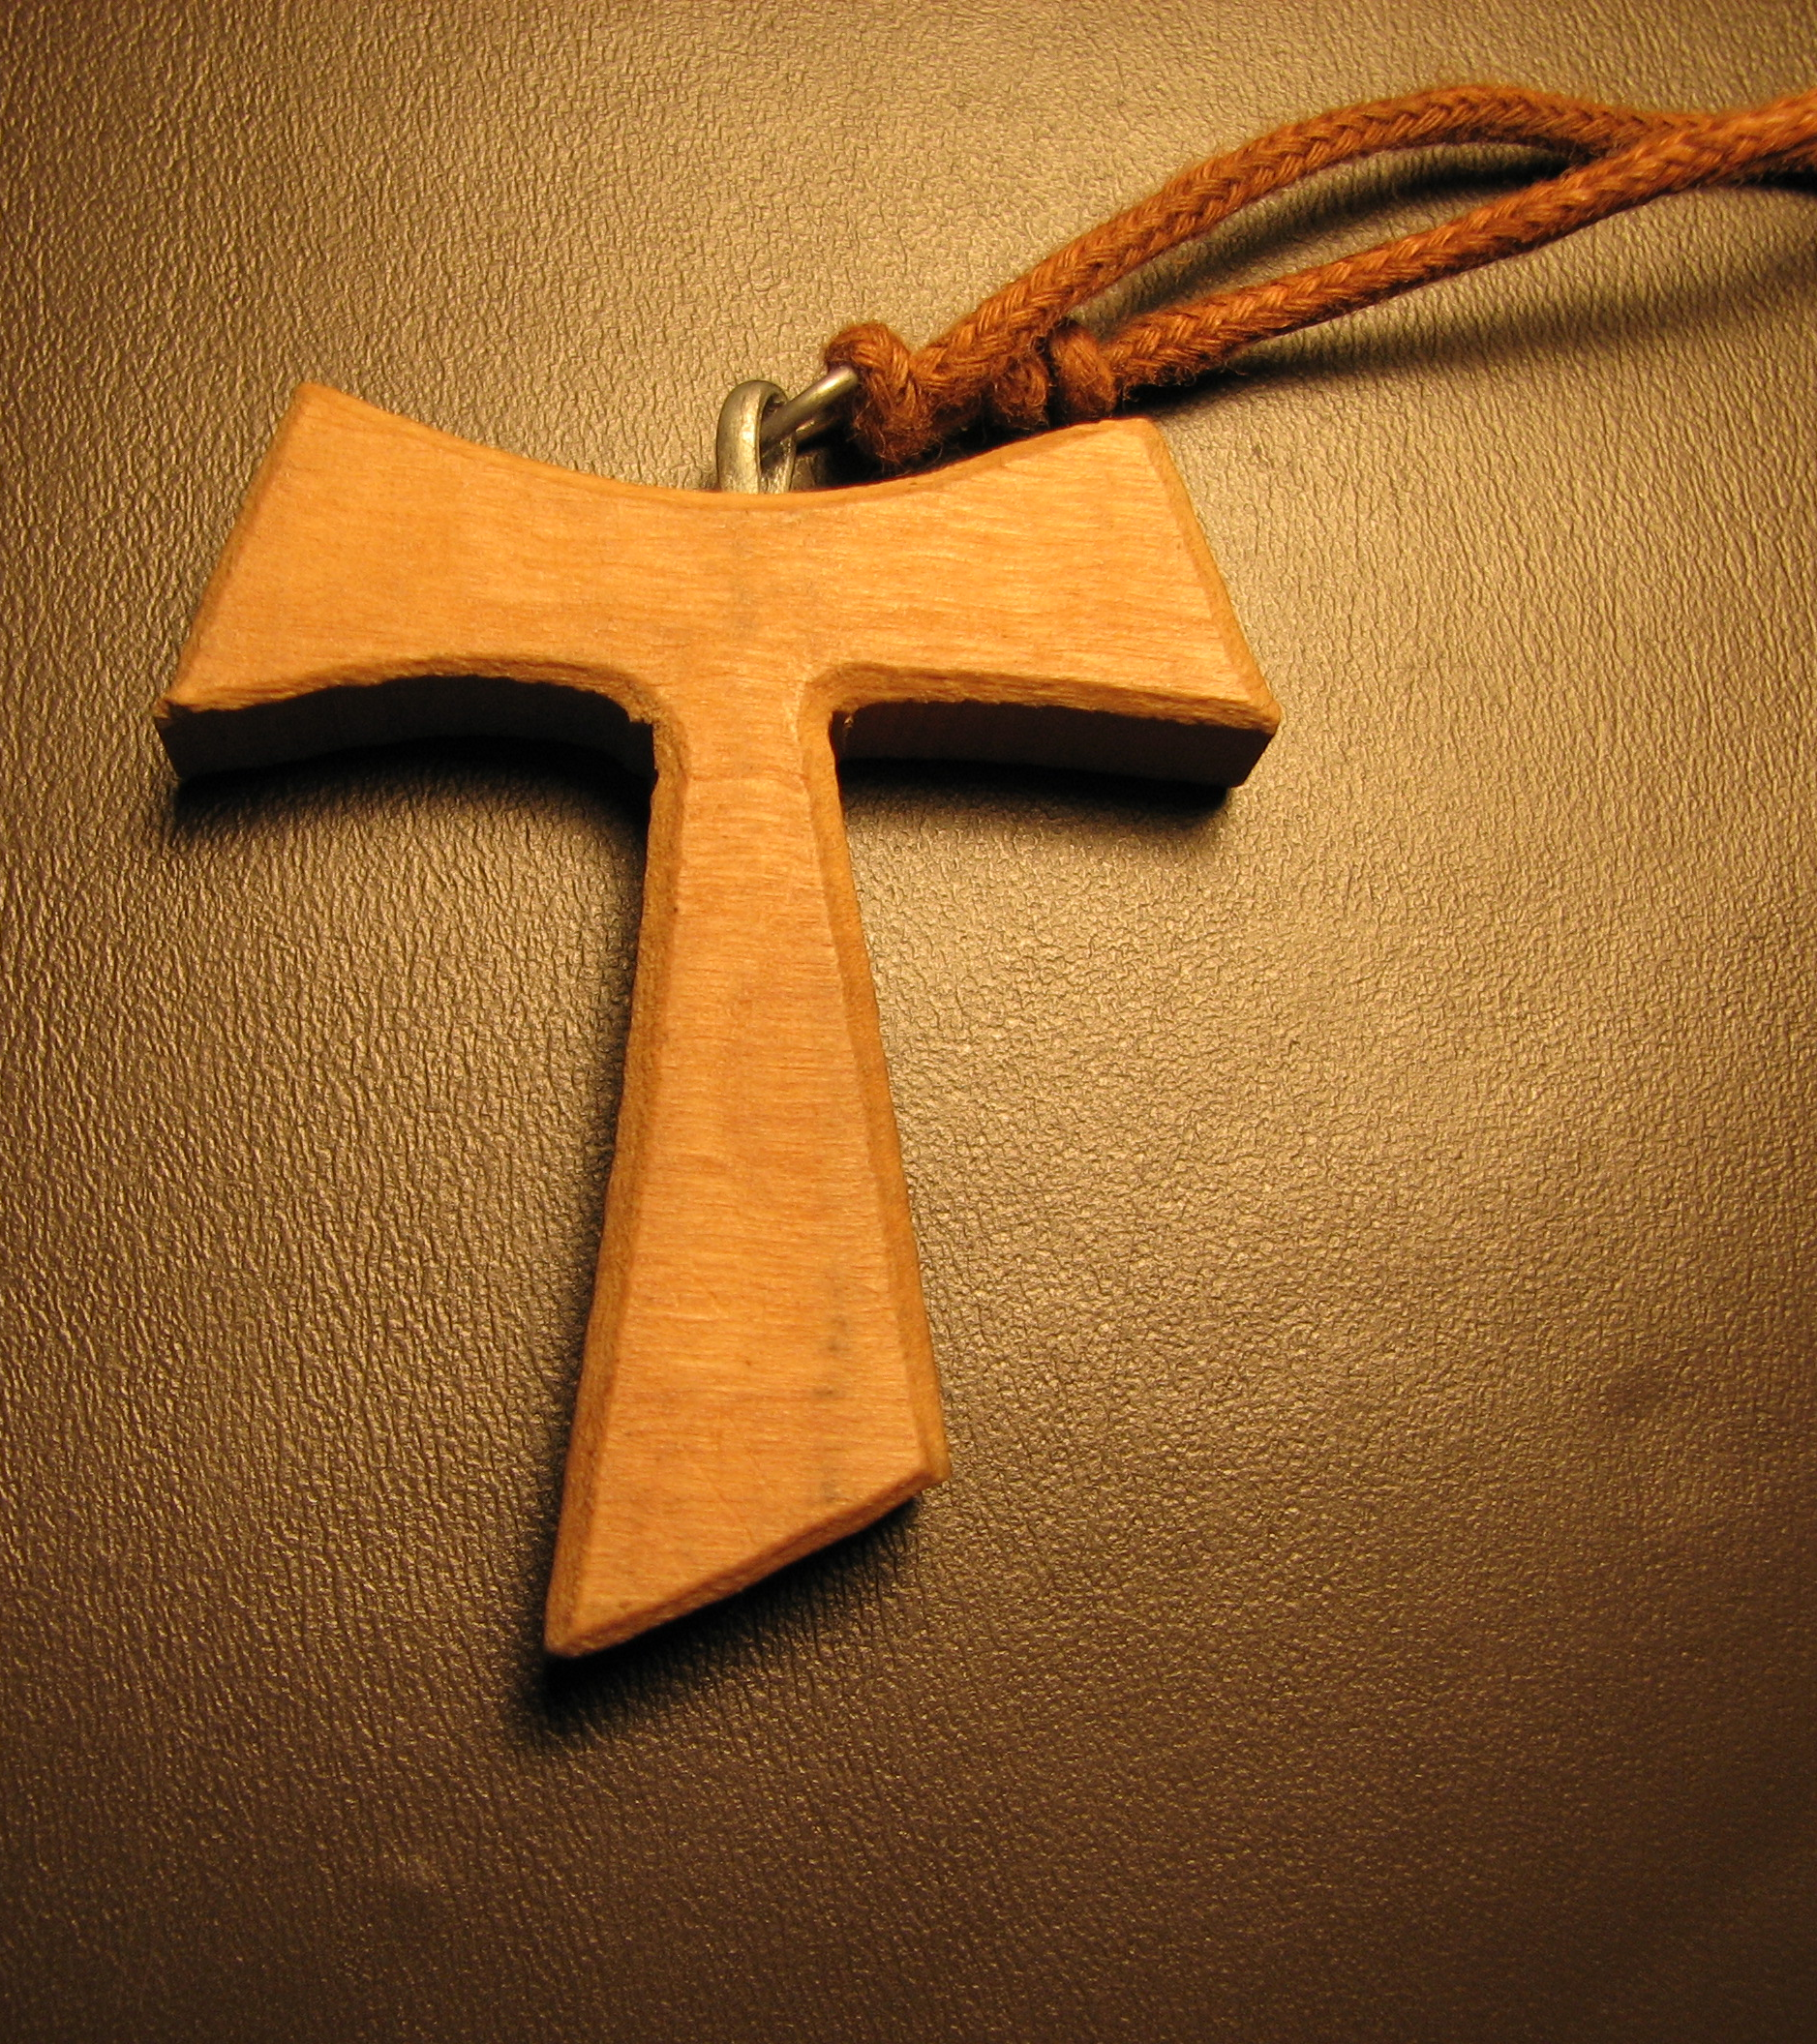
Serving as a Spiritual Assistant
Relationships and Responsibilities

Slide 2
Major Topics
Role of the Spiritual Assistant
Franciscan Theology and Spirituality
The Trinity
Formation
Franciscan Writers
Vatican II
OFS Structure
Activity in the World
The Ritual and Devotions
Church and Eucharist
Franciscan Spirit
Conversion
Theology of Profession
Basic Theology
Prayer
Franciscan Family
Pastoral Visitations

Slide 3
Role of the Spiritual Assistant
Connecting the OFS with the Church and the Franciscan First Order/TOR

Slide 4
Altius Moderamen
The Catholic Franciscan Family
First Order
Order of Friars Minor
Order of Friars Minor, Capuchin
Order of Friars Minor, Conventual
Second Order
Poor Clares
Third Order
Secular Franciscan
Third Order Regular

Slide 5
Local Spiritual Assistants
Communicate Franciscan Spirituality
Cooperate in Formation
Witness of Franciscan Spirituality
Animator of Liturgical Celebrations
Lead by Assisting

Slide 6
Regional Spiritual Assistants
Serve the Regional Council
Serve the Regional Fraternity
Formation of Spiritual Assistants
Foster Interest of Friars and Youth

Slide 7
Franciscan Spirituality and Theology
Providing Perspective on the Incarnation, Salvation and Trinitarian Theology

Slide 8
Christ-Gospel-Centered Life
A God Who Always Loves Us
Love Manifested Through Incarnation
Call to Conversion
The Holy Spirit
Messengers of Perfect Joy

Slide 9
The Trinity
A model for the relationships we establish in life

Slide 10
Father, Son and Holy Spirit
A Relationship of Love
Transformative Power
Individual Skills and Gifts from God
“As the Father see in every person the features of his Son… so the Secular Franciscans with a gentle and courteous spirit accept all people as a gift of the Lord and an image of Christ…”
SFO Rule # 13

Slide 11
Called to Build Relationships
Trinitarian model of collaboration
Seek peaceful resolution
Mutual Respect
Love is the foundation

Slide 12
Formation
A Spiritual Assistant is a key part of the process of initial and ongoing formation

Slide 13
Initial Formation
Discerns the reality of the call
Experience the Rule in daily life
Stages of formation
Orientation
Inquiry
Candidacy

Slide 14
Ongoing Formation
Required to keep a Franciscan perspective
Vital to be Faithful to the Rule
Celebrate with People
Positively deal with the World
“ …called to build a more fraternal and evangelical world…” SFO Rule # 14

Slide 15
Franciscan Writers
Theological and mystical writers, men and women keep us in touch with our Franciscan heritage

Slide 16
Alexander of Hales
Born 1185 in Glouceshire, England
Teacher of St. Bonaventure
Developed Trinitarian theology
Love, not sin, is the reason for the Incarnation
God choose freely to create the natural world
God choose to be incarnate

Slide 17
St. Bonaventure
Born 1217-1221, Bagnoregio, Italy
Influenced by Scripture
Spirit of love that impelled Christ to suffer and die
Union with Christ enables us to act with compassion
Writer- Insights into nature of God
Itinerarium Mentis in Deum (The Soul’s Journey into God)
Tree of Life
Life of St. Francis (Legenda Major)

Slide 18
John Duns Scotus
Born 1226, Scotland
Saw love as key to our union with God
God desires to be with the people he created
Incarnation gives flesh to the love
Highest glory of creation
Christ is the center of the Universe

Slide 19
Angela of Foligno
Born 1248, Italy
Experienced a sense of Trinity
Great Medieval Mystic
“Teacher of Theologians”
Dictated the Book of Visions and Instructions
The Memoriale: Book of Visions
The Visions

Slide 20
Study and Ongoing Formation
Franciscan Institute
St. Bonaventure University, Olean, NY
OFS International Council Presidency- CIOFS
General Constitutions

Slide 21
Vatican II
La Novitas Franciscana- Franciscan Newness

Slide 22
Vatican II- The Four Constitutions
Sacrosanctum Concilium (this Sacred Council):
Constitution on the Sacred Liturgy
Lumen Gentium (Light of the Nations):
Dogmatic Constitution on the Church
Dei Verbum (Word of God):
Divine Revelation
Gaudeum et Spes (Joy and Hope):
Pastoral Constitution on the Church in the Modern World

Slide 23
Lumen Gentium- Light of the Nations
Love of God active in the Church
Create harmony with diversity of gifts and responsibilities
Love of God and love of neighbor
Sense of dignity and worth
All are welcome

Slide 24
La Novitas Franciscanas- Franciscan Newness
Devotion to the Trinity
Return to the Gospel
Called by God- community of love
Unencumbered by power or possessions
Experiences of the heart

Slide 25
La Novitas Franciscanas- Franciscan Newness
Power of the Holy Spirit
Servant Leadership
Embrace the poor and marginalized- “Little Ones”
Power of Prayer
Compassion, Reconciliation and Forgiveness

Slide 26
Working Together for the Common Good
Dialogue, don’t control
Encourage conversations
Create atmosphere of acceptance
“Called like St. Francis to rebuild the Church and inspired by his example… fostering an open and trusting dialogue of apostolic effectiveness and creativity.”
Rule # 6

Slide 27
OFS Structure
Spiritual Assistants, as servant leaders, work with the councils and the membership of the OFS to give life to our common Franciscan Vision

Slide 28
Structure & Principle of Subsidiarity
International Fraternity- CIOFS
Serves all Franciscans in the world
Presidency: General Minister, Vice-Minister, Presidency Councilors
National Fraternity- NAFRA
Serves all regions and fraternities
National Executive Council Elected at National Chapter
Regional Fraternity
Serves local fraternities in region
Regional Executive Council elected at Regional Chapter
Local Fraternity
Local Council

Slide 29
Spirituals Assistant Service & Collaboration
The Spiritual Assistant helps maintain connection between:
The SFO
Franciscan First Order/TOR
The Poor Clares

Slide 30
Franciscan Vision
Structure supports the vision
Balance between Support and Vision
Promote Franciscan Way
Vital Reciprocity
“We are spouses, when by the Holy Spirit, the faithful soul is united with our Lord Jesus Christ. We are brothers to him when we fulfill “the will of the Father who is in heaven.” Mt 12:50

Slide 31
Activity in the World
A way of life that touches everything we do

Slide 32
Living in the World
Work unceasingly for peace
Respect culture and traditions
Acknowledge human dignity
Promote Justice
“Secular Franciscans….are called to build a more fraternal and evangelical world…”
SFO Rule #14

Slide 33
Servant Leadership
Ability to choose wise ways to serve the fraternity
Decisions from good discernment and dialogue
Lead and celebrate
Love in action
Speak truth with compassion
Err on the side of compassion
“We are not leading until we are empowering someone else to serve our common enterprise.” Leadership: The Art of Empowering

Slide 34
The Ritual and Devotions
An effective means for our worldwide Franciscan Family

Slide 35
Ritual of the Secular Franciscan Order
Enrich local celebrations with
signs
symbols
Gestures
music
Enhance the spirit of prayer
“to have the spirit of God at work within them, while they pray to him unceasingly with a heart free from self-interest.” Rule of 1223. 10

Slide 36
Devotional Life
Vocation is primary commitment
Fraternity gathering takes preference
Support charism and concern for the poor
Bring us closer to Jesus
“…should express their ardent love for her by imitating her complete self-giving and by praying earnestly and confidently.”
Rule # 9

Slide 37
Church and Eucharist
Bringing the Franciscan spirit to the Church with a tender love of the Eucharist

Slide 38
Rebuild My Church
Bring the Franciscan spirit to the Church
Community of love
Share our gifts with humble & grateful hearts
Let the Gospel speak in our lives
“ As you announce peace with your mouth, make sure that greater peace is your hearts.”
Legend of the Three Companions

Slide 39
Living Our Franciscan Life
Stewards of the goods received
Gentle and courteous spirit
Accept all people as a gift of the Lord
Trust in the Holy Spirit
Heal the wounded, bind up the broken, recall the erring

Slide 40
Franciscans and the Eucharist
Tender Love and devotion
Center of the life of Fraternity
Periodic celebrations strengthen fraternal bond
Ongoing formation on the Eucharist

Slide 41
General Reflections
Benet Fonk OFM on issues concerning the SFO

Slide 42
A Spiritual Assistant
Helps connect
Does not impose will or dominate
Assistants to the SFO
Share their gifts for the good of the fraternity

Slide 43
A Spiritual Assistant is Expected to
Be suitable and well prepared
Attend gatherings & chapter
Assist with formation
Keep records
Participate in councils they serve
Term of at least 5 years
Engage in personal ongoing formation

Slide 44
Respects & Moderates Differences
Listens to others without interruptions
Asks questions to ensure understanding
State opinions clearly and calmly
Looks for common ground
“ Our human dignity can never be separated from community with our sisters and brothers.”
At Home in the Web of Life, Appalachian Bishops, 1995

Slide 45
Insights of the Franciscan Spirit
Working for peace and seeking justice for all people

Slide 46
Franciscan Focus
Needs of the poor
Unceasing work for peace
Justice for all people
Concern for family life
Mary is the model for Franciscan Family
Work is a gift from God

Slide 47
Franciscan Focus
Eucharist is source and center
Dedication to giving
Community of Love
Forgiveness and Reconciliation lead to freedom
The Rule gives direction

Slide 48
Conversion
The Call of the Spirit

Slide 49
Framework for Conversion
God initiates
God leads
The Penitent responds
The Penitent accepts
This leads to happiness
“… what had seemed bitter to me was turned into sweetness of soul and body.” SA Handbook

Slide 50
Franciscan Example of Christian Life
Obedient to the Holy Spirit
Prayerful trust
Grateful & Simple use of creation
Delight in gifts of God
Joy at being Christian
Gratitude for the World
Readiness to help others
SA Handbook

Slide 51
Understanding
Animation & Guidance NOT Domination & Dictating
Creating Fraternal relationships
Collaborate with all people of good-will
“… bearers of peace which must be built up unceasingly, they should seek out ways of unity and fraternal harmony through dialogue…” SFO Rule #19

Slide 52
Pastoral Visitation
A privileged moment of communion

Slide 53
Role & Responsibilities
Pastoral & Fraternal visitation every 3 years
Maintain a balance
Each visitor is important
A single report can be drawn
“ The Pastoral visit is a privileged moment of communion of the First Order and the TOR with the SFO… carried out in the name of the Church…”
Statues for Spiritual & Pastoral Assistance to SFO 14.1

Slide 54
Before, During & After Visitation
Before
Prayerful preparation
RSA and local SA connect
Previous visitation report is reviewed
During
Seek ways to help & share ideas
Time with Council
Time with open forum
After
Post-visitation letter
Visitation Report

Slide 55
Theology of Profession
A vocation to live the Gospel in fraternal communion

Slide 56
Profession & Vocation
Examine the path to profession
Formative process is vital
Give flesh to vision
Personal relationship with Jesus
“ The vocation to the SFO is a vocation to live the Gospel in fraternal communion.” GC – Article 3.3

Slide 57
Co-Responsibility for Life of the Fraternity
Personal presence
Witness
Prayer
Active collaboration
Sharing of gifts
“ Whoever does not love does not know God, for God is love.”
1 John 4:8

Slide 58
Demands of Profession
Understand and Live the Rule
Go forth as witnesses- Rule #6
Build a more fraternal & evangelical world- Rule #14
Prayer & contemplation soul of all said & done- Rule #8
Promote justice with courageous initiatives- Rule # 15
Cultivate peace, fidelity & respect for life- Rule # 17

Slide 59
Basic Catholic Theology
A Franciscan approach to how we see God creates a foundational perspective

Slide 60
The Catechism of the Catholic Church
The Human Family
Jesus Christ
Magisterium & Tradition
Bible & Scripture
Church & Eucharist
Caring for the Little Ones
Reconciliation & Mercy
Resurrection

Slide 61
Forms of Prayer
Leads us to a greater intimacy with Jesus and the Trinity

Slide 62
Prayer & Contemplation
Soul of all you do
Variety of forms is good
Silence and recollection
Focused on Christ
“ Franciscan prayer is dynamic because it is about participation in the mystical body of Christ.”
Franciscan Prayer- Ilia Delio OSF

Slide 63
Prayer Forms
Liturgy of the Hours
Adoration of the Blessed Sacrament
Lectio Divina
Centering Prayer
Contemplative Prayer
Crown Rosary
Stations of the Cross
Liturgical Prayer

Slide 64
Franciscan Family
As one among many spiritual families raised up by the Holy Spirit in the Church, unites all members of the people of God… who recognize they are called to follow Christ in the footsteps of St. Francis of Assisi

Slide 65
Vital Reciprocity
The entire Family is involved in bringing a Franciscan spirit and charism to the Church and to the world.
“ In various ways and forms, but in life-giving union with each other, they intend to make present the charism of their common Seraphic Father in the life and mission of the Church.”
SFO Rule #1

Slide 66
The Franciscan Family
Three branches of the First Order
Poor Clares in all their expressions
Third Order Regular in all their expressions, both male & female religious, who embrace the Franciscan spirit
Secular Franciscan Order throughout the world

Slide 67
Other Groups that Follow Francis & Clare
The Anglican Franciscans
Order of Ecumenical Franciscans
Atonement Franciscan Friars & Sisters
We share a common vision and embrace a Gospel response that bears the mark of Francis’ spirit.

Slide 68
Collaborative Efforts
Franciscans International
Franciscan Action Network (FAN)
Franciscan Federation
Poor Clares Federations / Associations
SFO Ministries
Franciscan Family Apostolate
Water Project
Amazon Project

Slide 69
Final Thoughts
In word or deed do everything in the name of Jesus giving thanks to God the Father
Called to integrate the Rule and the Gospel into our personal and fraternity life as a community of love
Rule and Gospel are tools to impact the Church and the world
Success requires faithfulness to the Franciscan way of life

Slide 70
Blessed is that servant who no more exalts himself over the good the Lord says or does through him than over what He says or does through another. A person sins who wishes to receive more from his neighbor than he is willing to give of himself to the Lord God.
Admonition XVII – Francis of Assisi- The Saint- Vol I – Page 134

