Slide 1
Spiritual Assistance
Prayer with Spiritual Assistants
At the Q

Slide 2
Peace and All Good

Slide 3
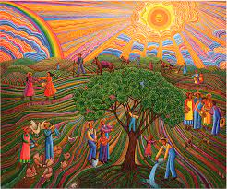
Invocation
Ldr: Almighty, most holy, most high and supreme God, all good, supreme good, totally good, You who alone are good,
All: may we give back to You all praise, all glory, all grace, all honor, all blessing, and all good.

Slide 4
Hymn
O God, You Search Me
O God, You search me and You know me. * All my thoughts lie open to Your gaze. * When I walk or lie down You are before me: * ever the maker and keeper of my days.
You know my resting and my rising. * You discern my purpose from afar, * and with love everlasting You besiege me: * in ev’ry moment of life or death, You are.
Before a word is on my tongue, Lord, * You have known its meaning through and through. * You are with me beyond my understanding: * God of my present, my past, and future, too.
Although Your Spirit is upon me, still I search for shelter from Your light. * There is nowhere on earth I can escape You: * even the darkness is radiant in Your sight.
For You created me and shaped me, * gave me life within my mother’s womb. * For the wonder of who I am I praise You: * safe in Your hands, all creation is made new.

Slide 5
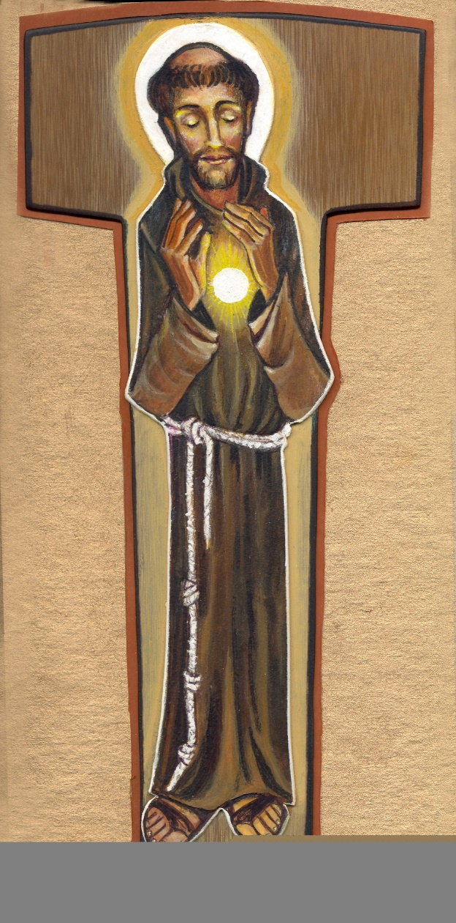
Our Life is to Live the Gospel
Scripture: Isaiah 43, 1-4
But now, says the Lord, who created you, O Jacob, and formed you, O Israel: fear not, for I have redeemed you; I have called you by name: you are mine.
When you pass through the water, I will be with you; in the rivers you shall not drown. When you walk through fire, you shall not be burned; the flames shall not consume you.
For I am the Lord, your God, the Holy One of Israel, your savior. You are precious in my eyes and glorious, because I love you.

Slide 6
Meditation:
The Gospel is the good news, and at the heart of the good news is the height and depth of God’s love for us. Living the Gospel way of life we are able to dwell in God’s love.
God created the human person, but before time began God knew us as beloved daughters and sons. God has loved us first. All love has its source in the love of God. Like an artisan, putting us together in our mother’s womb, God knows us better then we know ourselves. God loves us more than we love ourselves.
Because we are precious, God never leaves our side. God’s love is manifested in its highest form in sending us the Son, Jesus, to save and redeem us. Jesus is the living, breathing revelation of God’s love for us. He came to be one with us to help us understand how ardently God loves us. Let us thank and praise God for such generous and abiding love.

Slide 7
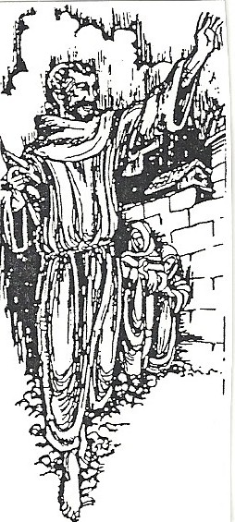
Franciscan Sources: The Prayer Absorbeat:
May the power of Your love, O Lord, fiery and sweet as honey, wean my heart from all that is under heaven,
so that I may die for love of Your love, You who were so good as to die for love of my love.

Slide 8
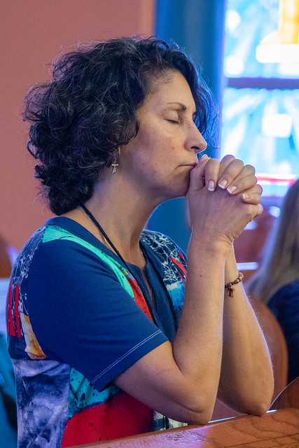
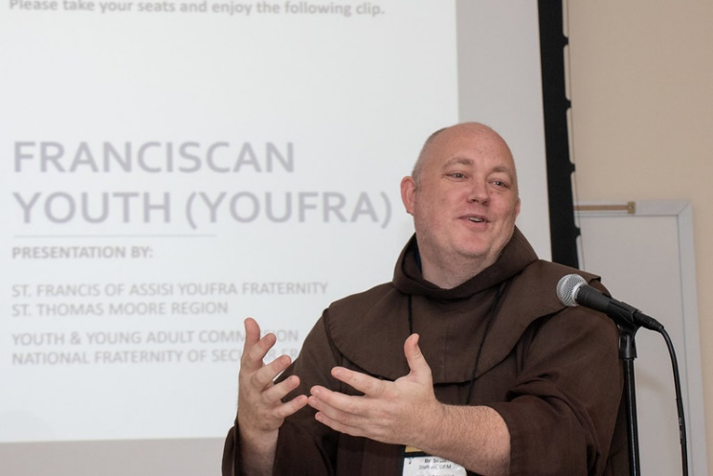
The Foundation of Penance
Scripture: Sirach 35, 16-17
The one who serves God willingly is heard; their petition reaches to the heavens.
The prayer of the lowly pierces the clouds; it does not rest until it reaches its goal.

Slide 9
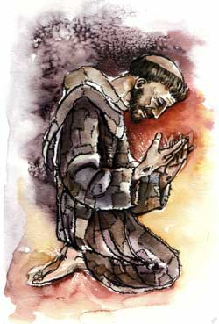
Meditation:
The life of penance is inseparable from a life of prayer. Prayer is such an important means of entering into a more intimate union with God which is the goal of the life of penance.
This conversion through prayer takes place is three ways:
by experiencing Jesus in the mystery of the Eucharist;
by a prayerful reading of the Scriptures;
by praying always through reflection and meditation on the goodness of God in our lives as God’s beloved sons and daughters.

Slide 10
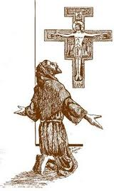
Sources: The Testament
We adore You, Lord Jesus Christ, here, and in all Your churches throughout the whole world,
and we bless You, because by Your holy Cross, You have redeemed the world.

Slide 11
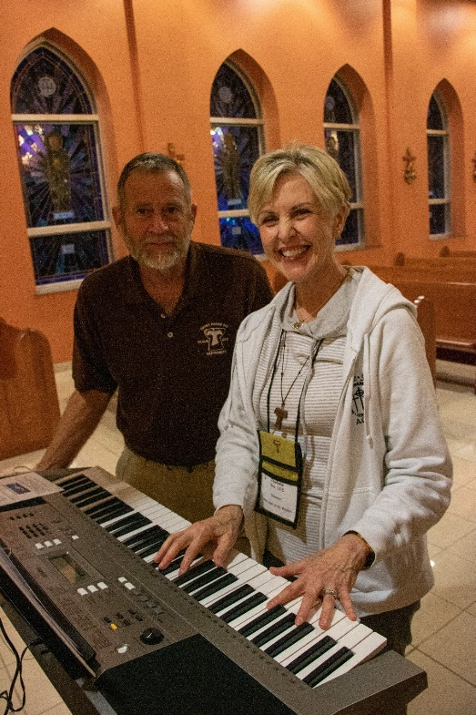
Sisters and Brothers in the Lord
Scripture: Philippians 2, 1-3
In the name of the encouragement you owe me in Christ,
in the name of the solace that love can give,
of fellowship in spirit, compassion and pity,
I beg you: make my joy complete by your unanimity,
possessing the one love, united in spirit and ideals.
Never act out of rivalry or conceit;
rather, let all parties think humbly of others as superior to themselves.

Slide 12
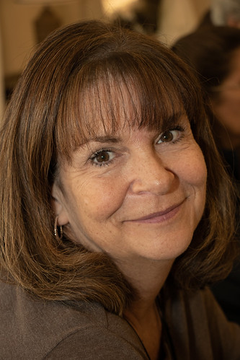
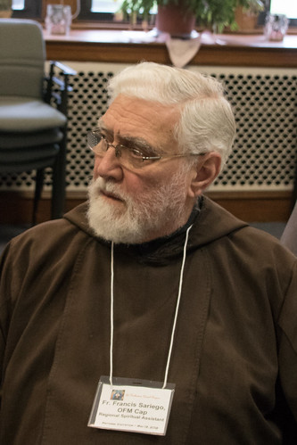
Meditation:
We are called together as God’s sons and daughters to be one in the spirit. Our call to live the Gospel life is heard not only as individuals but as a fraternity. We have made our profession to a life in which we experience grace and salvation as a fraternity.
Therefore, we have a responsibility to co-operate in the salvation of our sisters and brothers. Just as Jesus was the center of the community gathered around Him, so Jesus must be the center of our community today.
It was the love of Jesus that brought about a change of heart in His first followers. It is that same love that will change our hearts of we are open to it.
The first community shared most importantly their love for Jesus and, as a result, they shared their whole lives—their joy, sorrow, anger, disagreements, peace, and material goods.
It was this total sharing that made them one with the Lord and with each other. The Lord wants to bless us with the gift of Himself in our sisters and brothers in fraternity.

Slide 13
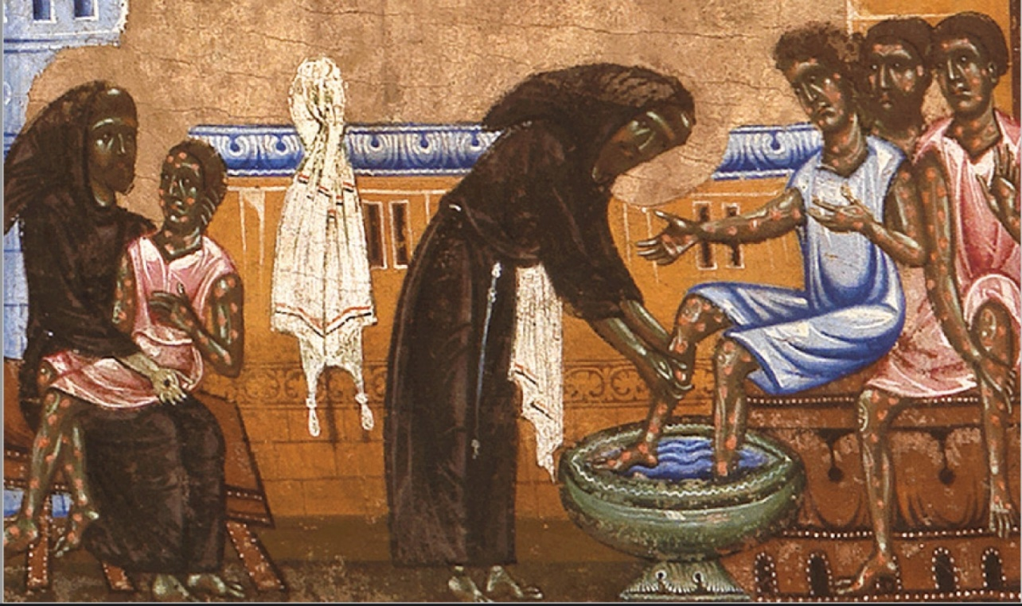
Franciscan Sources: Rule of 1221, #9
The sisters and brothers should let their needs be known to one another, so that the other can find what is needed and give it.
Each is to love and nourish the other as a mother nourishes and loves her child, in everything for which God gives them grace.

Slide 14
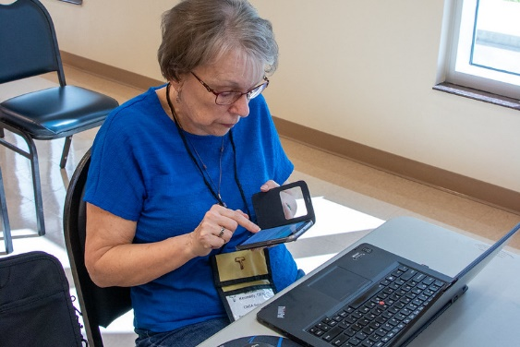
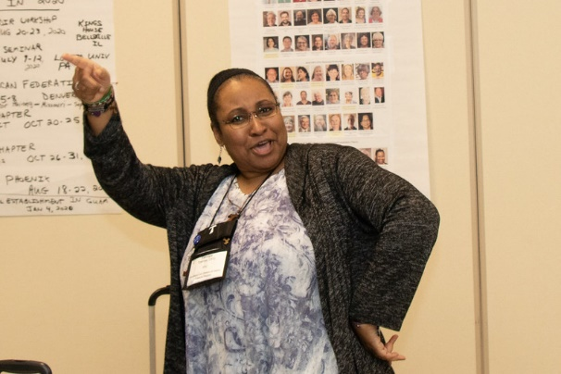
Conversion Through Ministry
Scripture: Mark 10, 42-45
Jesus called them together and said to them, “You know how among the Gentiles those who seem to exercise authority lord it over them;
their great ones make their importance felt.
It cannot be like that with you.
Anyone among you who aspires to greatness must serve the rest;
Whoever wants to rank first among you must serve the needs of all.
The Son of Man has not come to be served but to serve—to give His life in ransom for the many.”

Slide 15
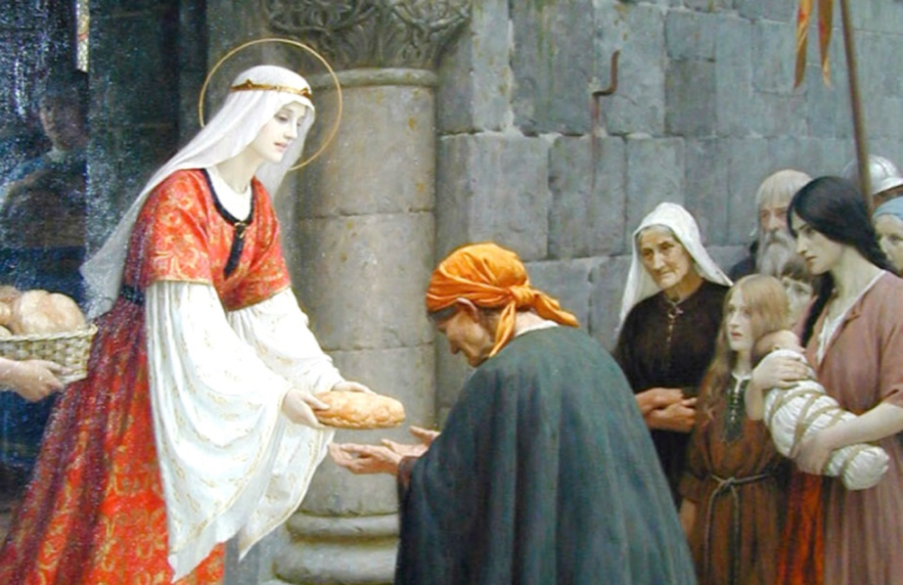
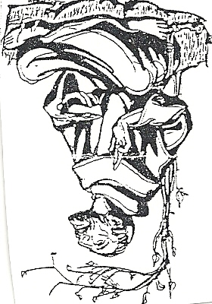
Meditation:
We cannot expect to be an instrument of conversion in the life of others unless we are also converted.
We should also expect our lives to change because we speak words of repentance, reconciliation, and peace.
We are God’s voice, living witnesses.
Our ministry should be humble and simple, ministering to others as their servants.
Our word to them should be God’s word.

Slide 16
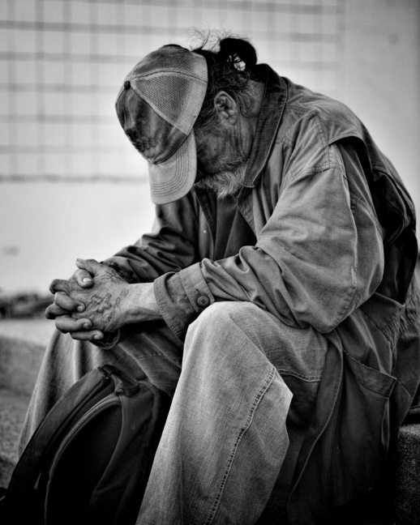
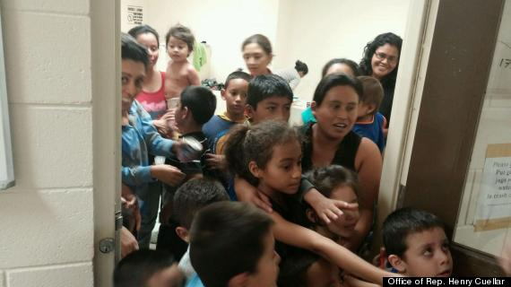
Franciscan Sources: Legend of the Three Companions
For Francis’ great desire was that he, as well as his brothers, would abound in such good deeds for which the Lord would be praised.
He used to tell them, “As you announce peace with your mouth, make sure that greater peace is in your hearts.
Let no one be provoked to anger or scandal through you,
but may everyone be drawn to peace,
kindness,
harmony
through your gentleness.
For we have been called to this:
to heal the wounded,
bind up the broken,
recall the erring.
In fact, many who seem to us to be members of the devil will yet be disciples of Christ.”

Slide 18
Psalm 100
Antiphon: Blessed are they who faithfully and devoutly strive to live according to their vocation
Sing joyfully to the Lord, all you lands; * serve the Lord with gladness; * come before Him with joyful song.
Know that the Lord is God, He made us, His we are; * His people, the flock He tends.
Enter His gates with thanksgiving, His courts with praise; * give thanks to Him, bless His name.
For He is good, the Lord, whose kindness endures forever; * and His faithfulness, to all generations.
All: Glory to the Father, and to the Son, and to the Holy Spirit; as it was in the beginning, is now, and will be forever. Amen.
Antiphon: Blessed are they who faithfully and devoutly strive to live according to their vocation.

Slide 19
Most high, glorious God,
may Your just and loving will be fulfilled.
May You be praised above all things.
+
During the challenging moments of fraternal life
grace us with optimism and joy
born,
not of age or temperament, but of a deep interior life
and the frequent reflection of the role of
spiritually assisting our sisters and brothers in fraternity.

