Slide 1
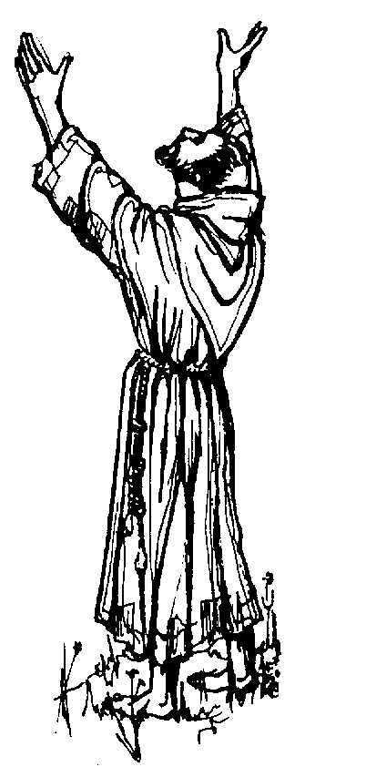
National Fraternity of the Secular Franciscan Order USA State of the Order
October 2018

Slide 2
HAPPY JUBILEE!
Celebrating 40 Years of Our OFS Rule

Slide 3
Who we are…
Celebrating 40 Years of Our OFS Rule

Slide 4
Renewed and Confirmed: Live the Treasure!
Celebrating 40 Years of Our OFS Rule

Slide 5
brother and sister

Slide 7
General Minister Tibor Kauser, OFS

Slide 8
Reaffirmed 2015-2018

Slide 9
Communications

Slide 10
Vocations

Slide 11
Formation

Slide 12
Spiritual Assistance

Slide 13
JPIC: “O Breath of God, Unite Us in Action.”

Slide 14
Youth and Young Adult

Slide 15
Multicultural Councilor

Slide 16
Administration

Slide 17
Image (Holy Spirit
The Spirit moves
Hope of Renewal: The Rule of 1978

Slide 18
Hope of Renewal: The Rule of 1978
“The hope of renewal hinges upon returning to the origins and to the spiritual experience of Francis of Assisi …
… and upon openness to the Spirit in the signs of the times.”

Slide 19
MILESTONES
Unification
Codification
Amalgamation
Integration
Formation
Management

Slide 20
CHALLENGES
“…We still experience problems in how the sense of unity and belonging are perceived…”
“(We) have not yet lived up to what the Church expects of us.”

Slide 21
FUNDAMENTAL PROBLEMS
Lack of understanding…of our profession.
Lack of commitment to conversion
Ignorance of scriptures, sources and the essential documents
Lack of accountability

Slide 22
QUESTIONS
Newly professed disappear?
Unwillingness to serve?
Priority to other activities?
Not attending to Franciscan responsibilities?
Lack of a Franciscan disposition?
Lack of conversion?

Slide 23
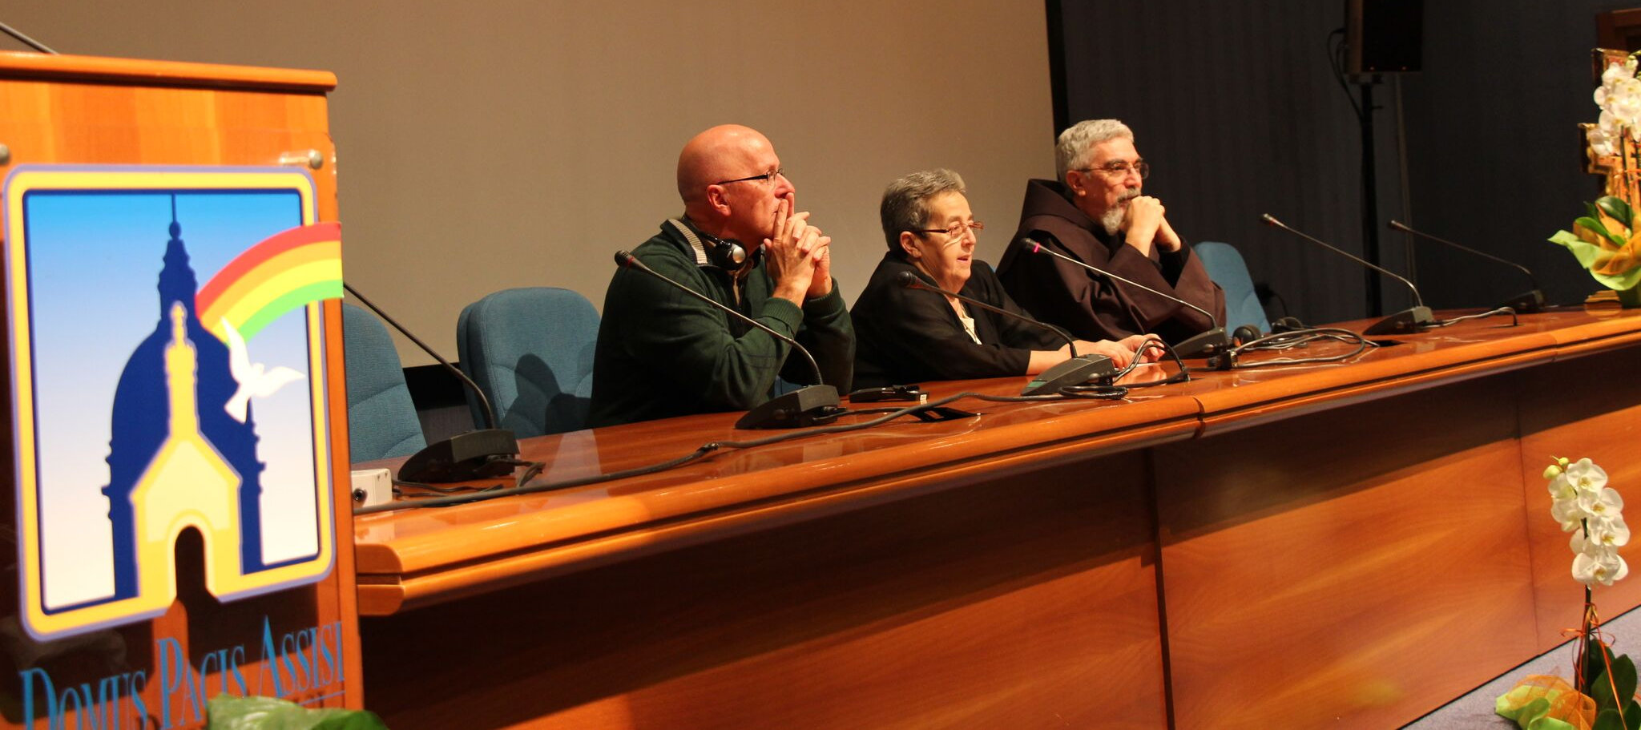
CIOFS RESPONSE
Management of the Order Initiative

Slide 24
TERMS OF REFERENCE
International Formation Office
Fraternal Life Proposal
Building a Fraternal and Evangelical World
Leadership
Communications
Finance

Slide 25
If the real point is conversion of heart--can the answer be more structure?.

Slide 26
“We need the Order because ‘a charism without an institution is a daydream. An institution without a charism is a nightmare.’” Fr. Lester Bach, OFM Cap.

Slide 27
The Structure of the Order supports us…

Slide 28
TERMS OF REFERENCE
International Formation Office
Fraternal Life Proposal
Building a Fraternal and Evangelical World
Leadership
Communications
Finance

Slide 29
SETTING OUR PRIORITIES
Based on…
Our Rule
CIOFS Priorities - Terms of Reference
The Signs of the Times

Slide 30
SETTING OUR PRIORITIES
Based on…
Our Rule
“Before we will know what to do, it is imperative that we know who we are.”
Tibor Kauser, OFS

Slide 31
SETTING OUR PRIORITIES
Based on…
CIOFS Priorities - Terms of Reference

Slide 32
SETTING OUR PRIORITIES
Based on…
The Signs of the Times

Slide 33
What is God’s vision for our Order?

Slide 34
SETTING OUR PRIORITIES
Based on…
Our Rule
CIOFS Priorities - Terms of Reference
The Signs of the Times

Slide 35
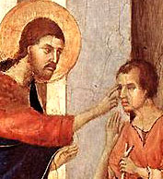
Christ the Divine Physician
Our Answer…

Slide 36
“Trust in the Lord with all your heart…”

Slide 37
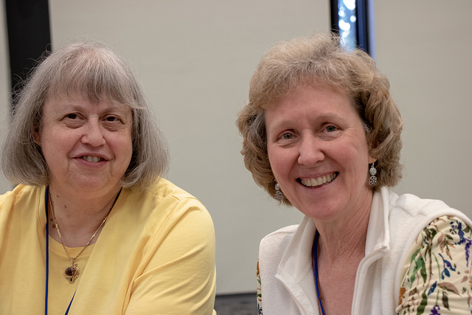
Peace and all good! Jan and Mary, in consultation with the National Executive Council.

Slide 38
National Executive Council
2015-2018
Jan Parker, Minister
Mary Bittner, Vice Minister
Jerry Rousseau, Treasurer
Jane DeRose-Bamman, Secretary
Mary Frances Charsky, Councilor
Willie Guadalupe, Councilor
Joan Geiger, Councilor
Mary Stronach, International Councilor
Br. Alexander Escalera OFM Cap., CNSA President-in-Turn

