Slide 1
The Franciscan Charism
Joint Committee on Franciscan Unity
Saturday, April 22, 2023

Slide 2
Welcome
Andrew Chavanak, n/OLF
Co-Convener, Joint Committee on Franciscan Unity
Notes:
Masud

Slide 3
A Brief History of the Joint Committee
Initial ecumenical meeting held in 2002, hosted by Ecumenical Commission of the Secular Franciscan Order (OFS)
Formed in 2004 with adoption of mission statement and organizing principles
Elements of Franciscan Unity adopted in 2005
Annual conferences held in various locations until 2020 (COVID-19), with in-person conferences resuming in fall 2021

Slide 4
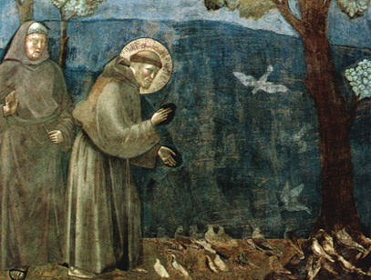
Mission Statement
For the sake of creation, we are called to bear witness to the essential unity of the church, the Body of Christ, by working towards Franciscan unity in all of its expressions.
We will achieve this through dialogue and collaboration among the Orders which follow Christ in the traditions of Francis and Clare.

Slide 5
The Elements of Franciscan Unity
Baptism
Vocation
Charism
Christ-Centeredness
Prophetic Voice

Slide 6
Charism – Elements of Franciscan Unity
As Franciscans, we see in the life of St. Francis of Assisi these gifts of the Holy Spirit: Holy Poverty (humility), love and joy. Through our Rules and through the individual and collective work of our Orders, we seek to manifest these gifts.
In our unified emulation of Francis, we seek to express a life that witnesses to poverty, love and joy.

Slide 7
Secular Franciscan Order [Roman Catholic] (OFS)
Order of Ecumenical Franciscans (OEF)
Third Order, Society of St. Francis [Episcopal/Anglican] (TSSF)
Order of Lutheran Franciscans [ELCA] (OLF)

Slide 8
The Franciscan Charism
Andrew Chavanak, n/OLF (adapted from a presentation by Beverly Hosea, TSSF)

Slide 9
The 3 Notes of the Order
Humility
Love
Joy

Slide 10
Humility, Love, and Joy
Humility, love and joy are the three notes that mark the lives of Tertiaries.
When these characteristics are evident throughout the Order, its work will be fruitful.
Without them all that it attempts will be in vain.

Slide 11
Poverty
1. Absolute Poverty

Slide 12
Poverty
1. Absolute Poverty
2. Relative Poverty

Slide 13
Poverty
1. Absolute Poverty
2. Relative Poverty
3. Jesus Poverty

Slide 14
Humility
We always keep before us the example of Christ, who emptied himself, taking the form of a servant, and who, on the last night of his life, humbly washed his disciples’ feet.
We likewise seek to serve one another with humility.

Slide 15
Humility : : : : : : : : : : : : : : : Poverty
Humility confesses that we have nothing that we have not received and admits the fact of our insufficiency and our dependence upon God.
It is the basis of all Christian virtues.

Slide 16
Worms

Slide 17
Joy
This joy is a divine gift, coming from union with God in Christ. It is still there even in times of darkness and difficulty, giving cheerful courage in the face of disappointment, and an inward serenity and confidence through sickness and suffering. Those who possess it can rejoice in weakness, insults, hardships, and persecutions for Christ’s sake; for when we are weak, then we are strong.

Slide 18
Love
Jesus said, ‘I give you a new commandment, that you love one another. Just as I have loved you, you also should love one another. By this everyone will know that you are my disciples, if you have love for one another.’ (John 13.34-35)
LOVE is the distinguishing feature of all true disciples of Christ who wish to dedicate themselves to him as his servants.

Slide 19
Bearing Witness for the Sake of Creation

Slide 20
Following in the Footsteps of Francis and Clare
Marie Bianca, OFS

Slide 21
Characteristics of the Franciscan Life
An intense Eucharistic spirituality or self-emptying kenosis
Fraternal communion and mutual equality
Simplicity
Love of poverty
Humility
A genuine sense of “minority” or “littleness”
A complete, active abandonment to God, demonstrated by obedience to the Church

Slide 22
Eucharistic Spirituality (Self-Emptying Kenosis)

Slide 23
Fraternal Communion & Mutual Equality

Slide 24
Simplicity

Slide 25
Love of Poverty

Slide 26
Humility

Slide 27
Seeking to Serve the Lord – A Sense of “Minority”

Slide 28
Abandonment to God, Obedience to the Church

Slide 29
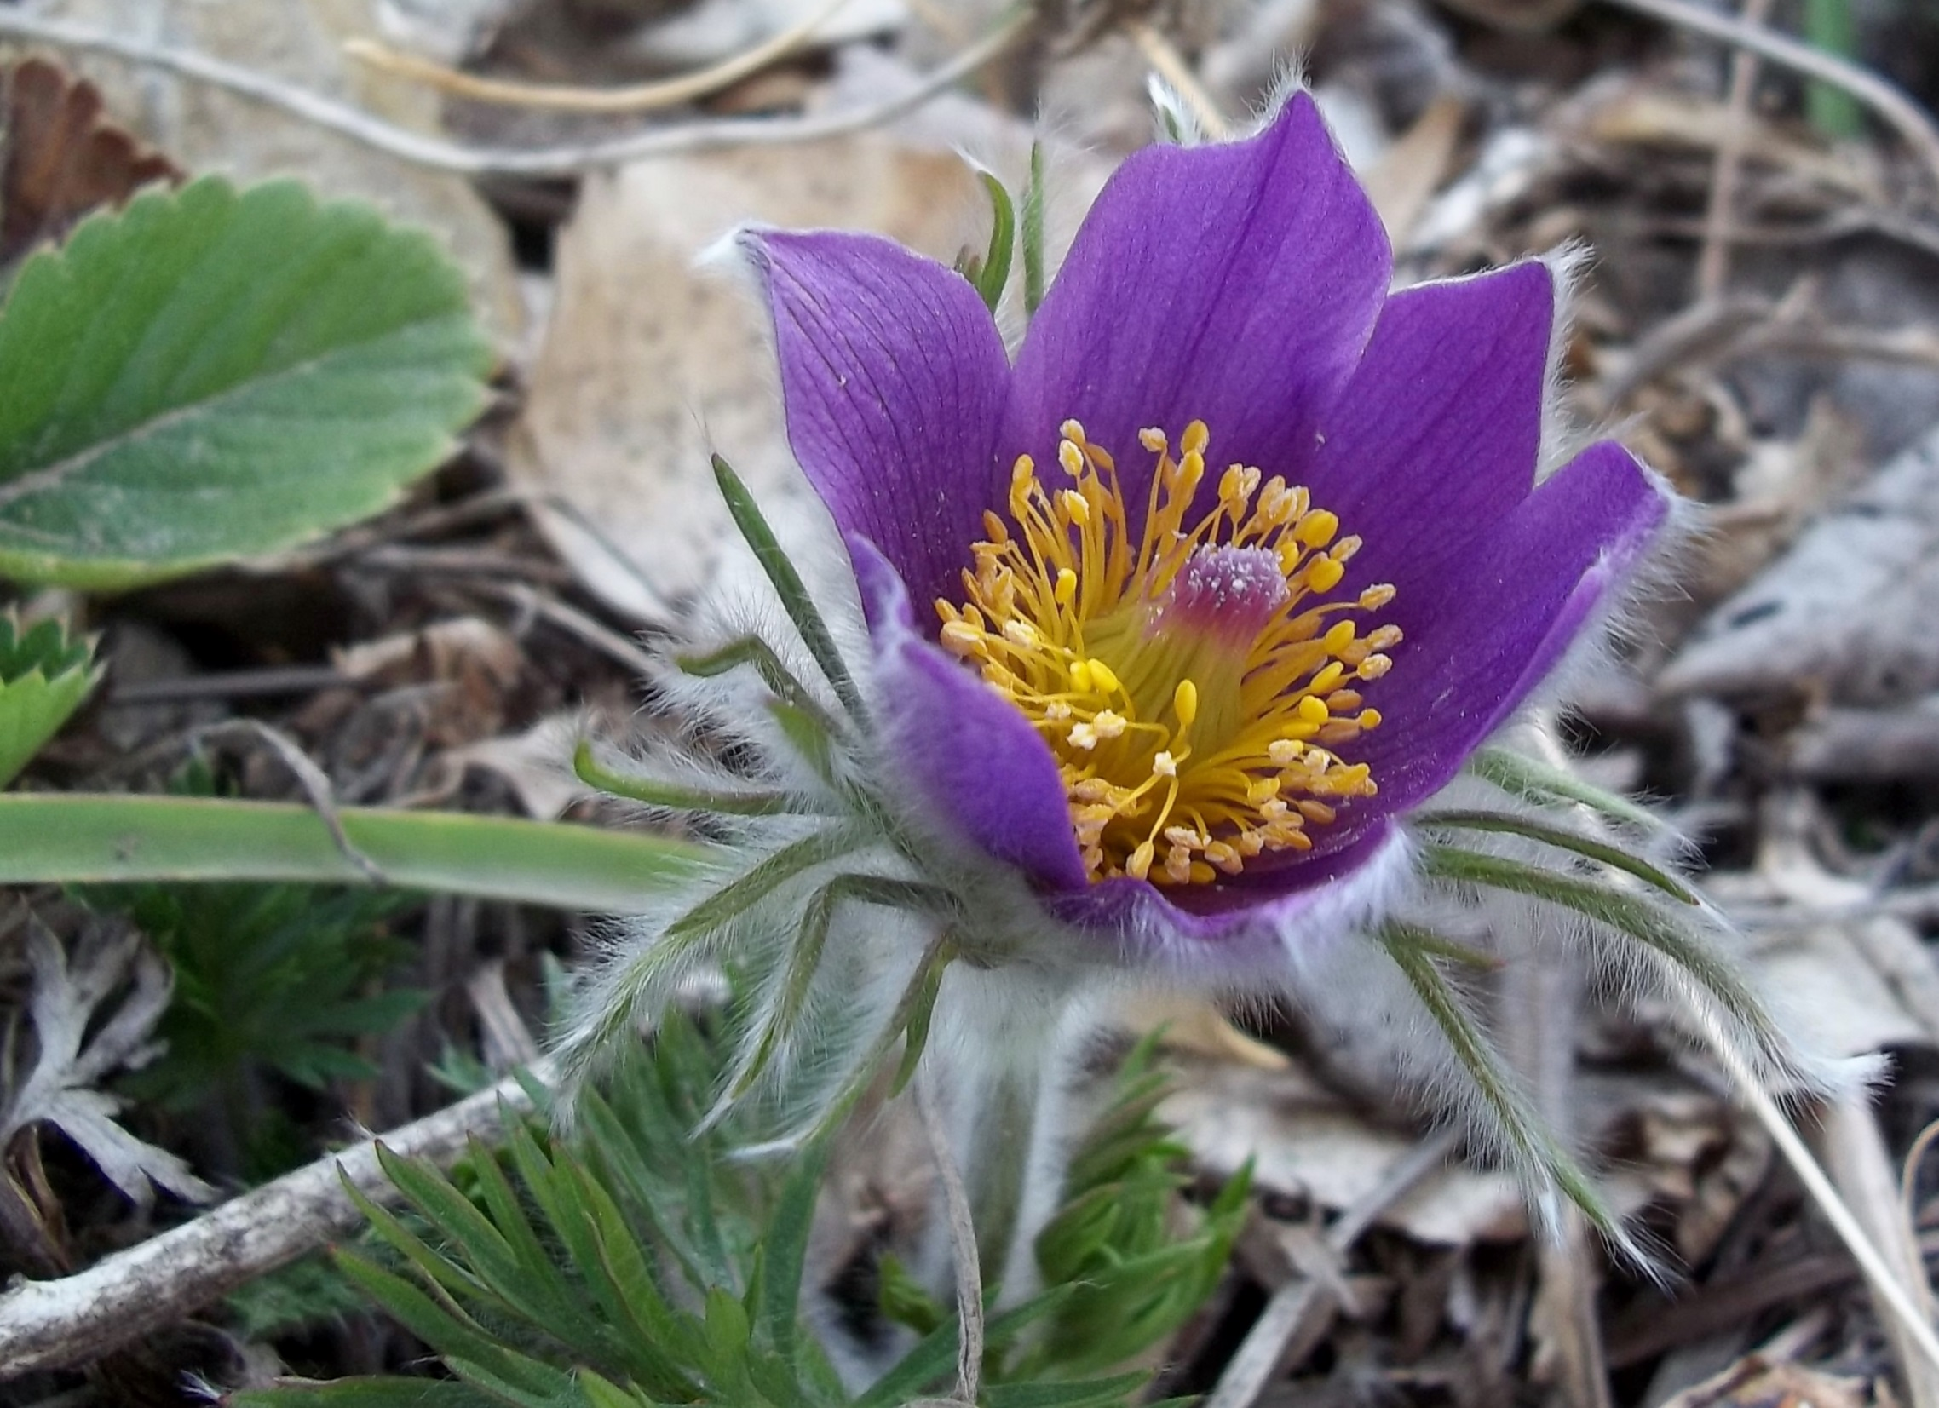
The Charism of St Francis as Expressed by the Order of Ecumenical Franciscans
Ron Nuss-Warren, OEF

Slide 30
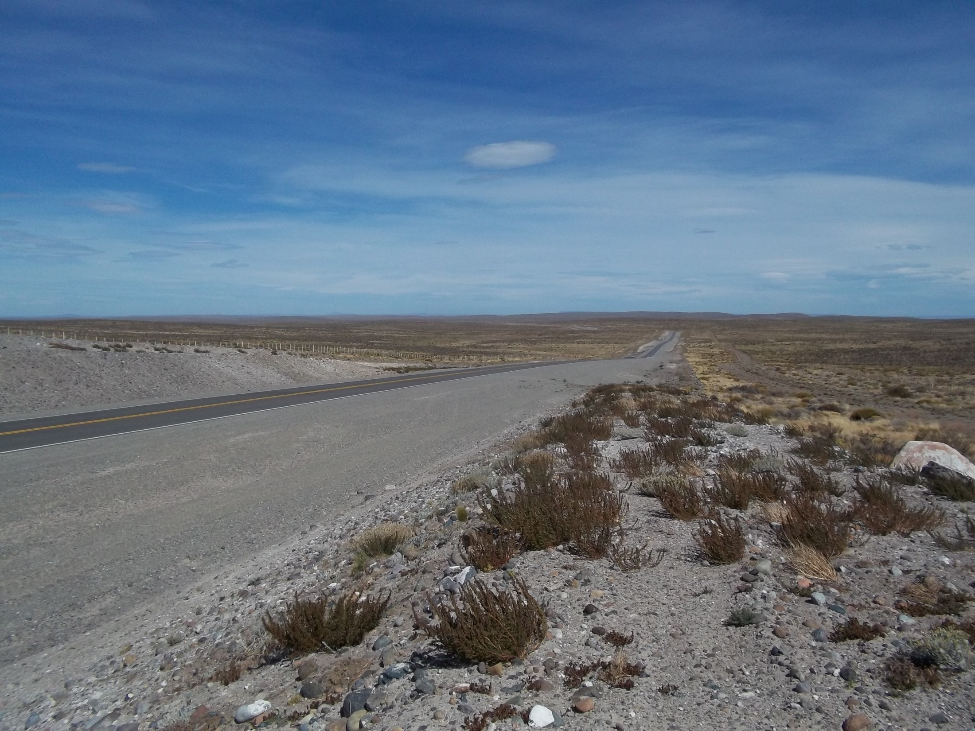
“A radical embrace of the evangelical counsels of
Poverty, Chastity and Obedience”

Slide 31
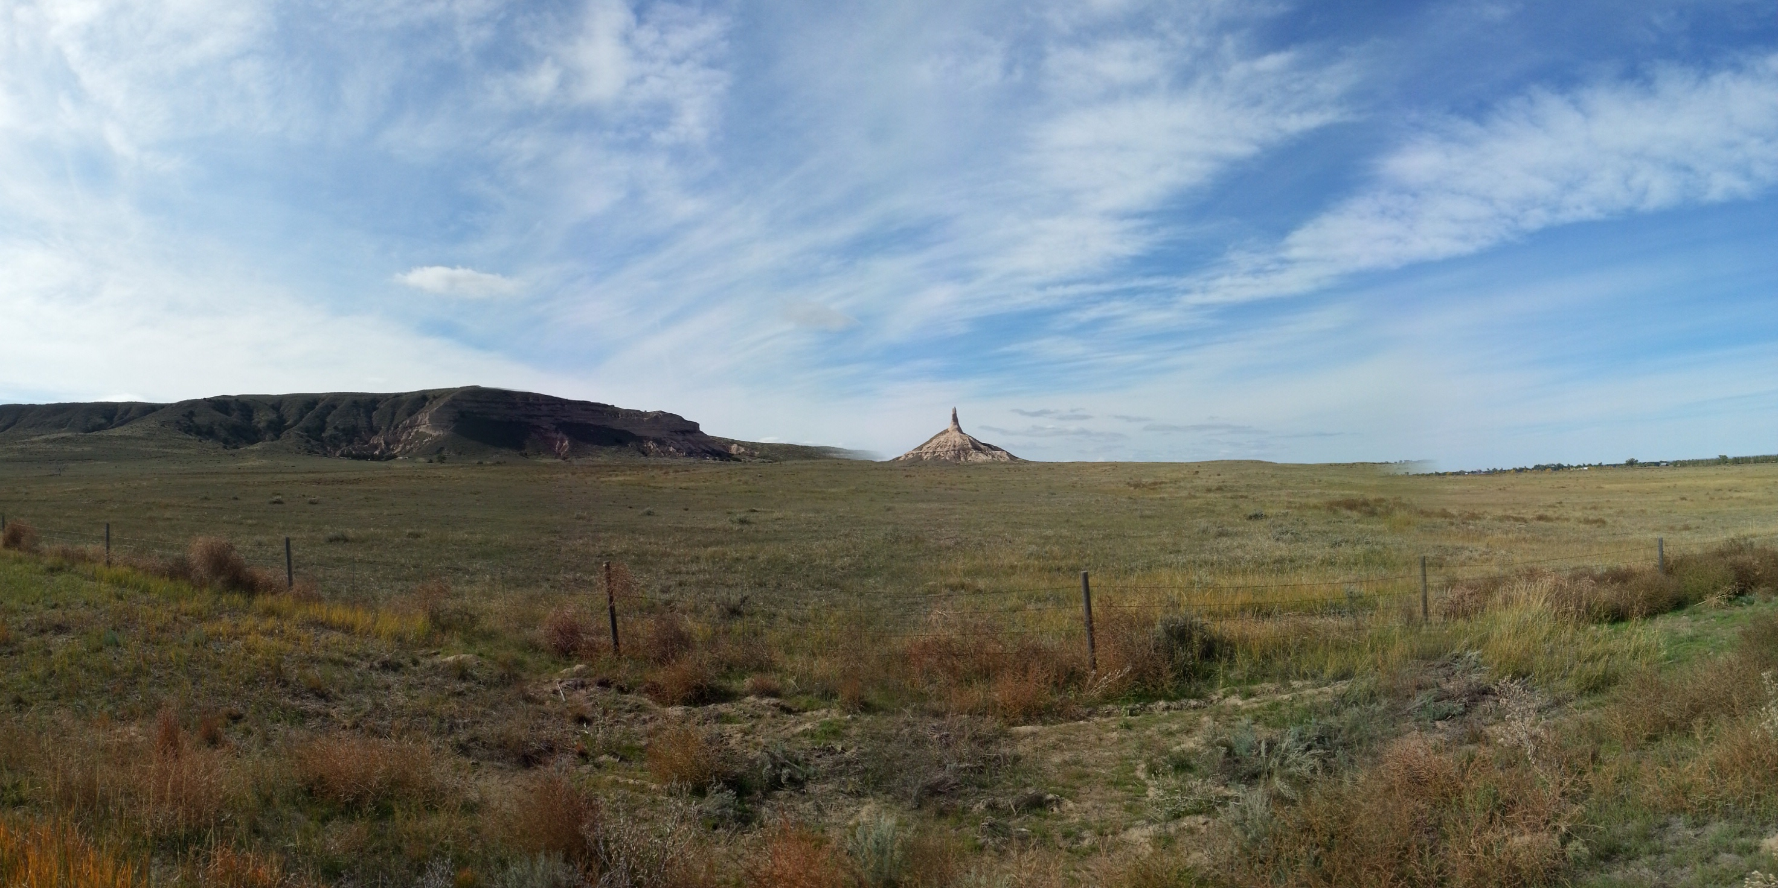
Poverty

Slide 32
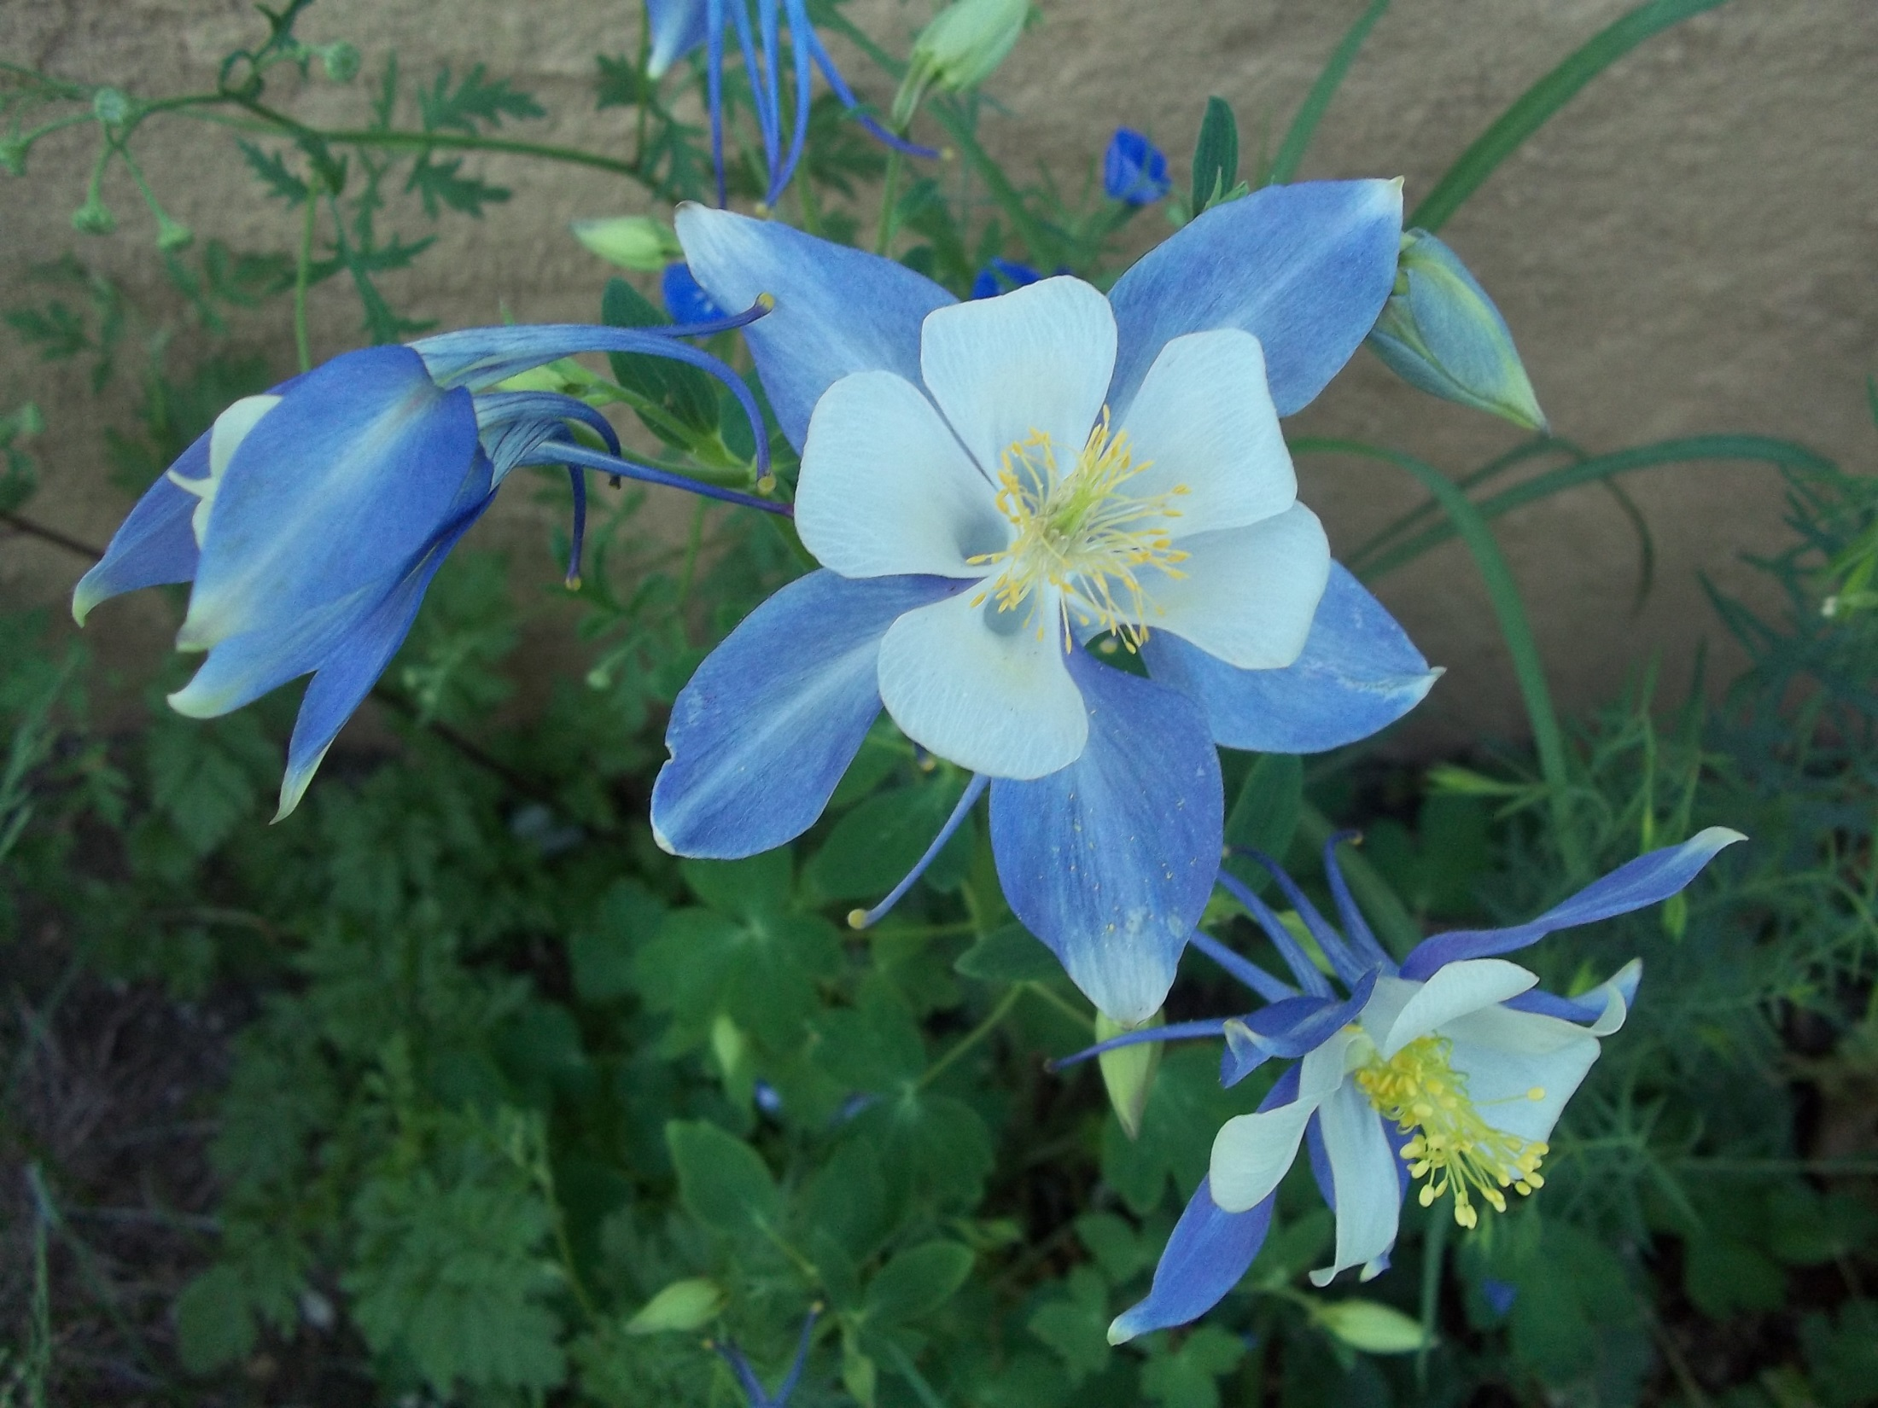
Generosity

Slide 33
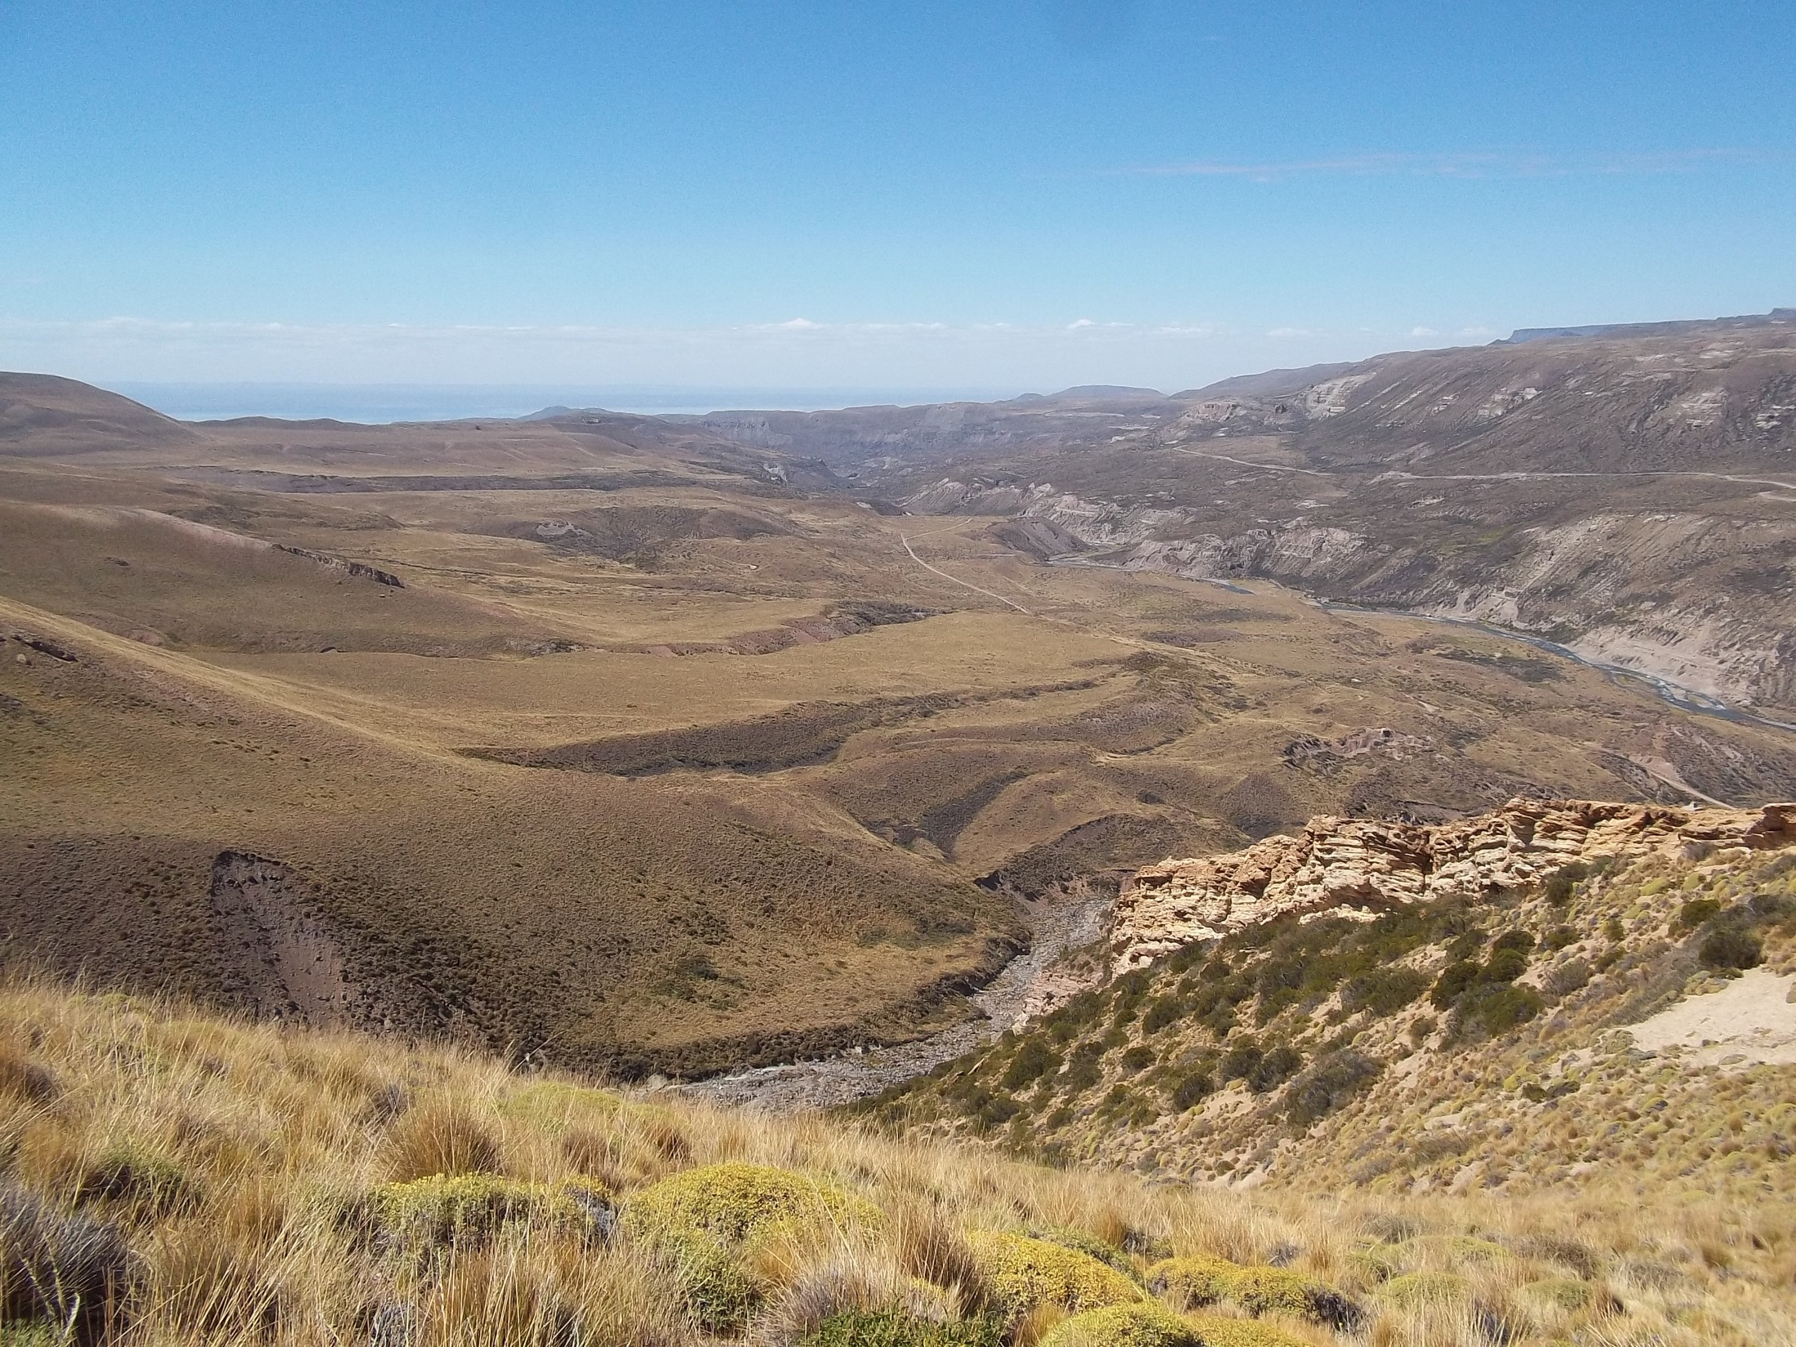
Chastity

Slide 34
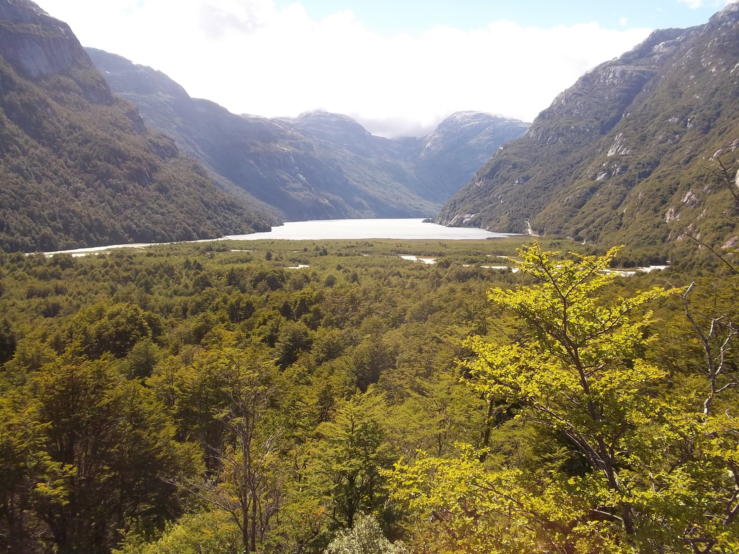
Respect for all of God’s handiwork

Slide 35
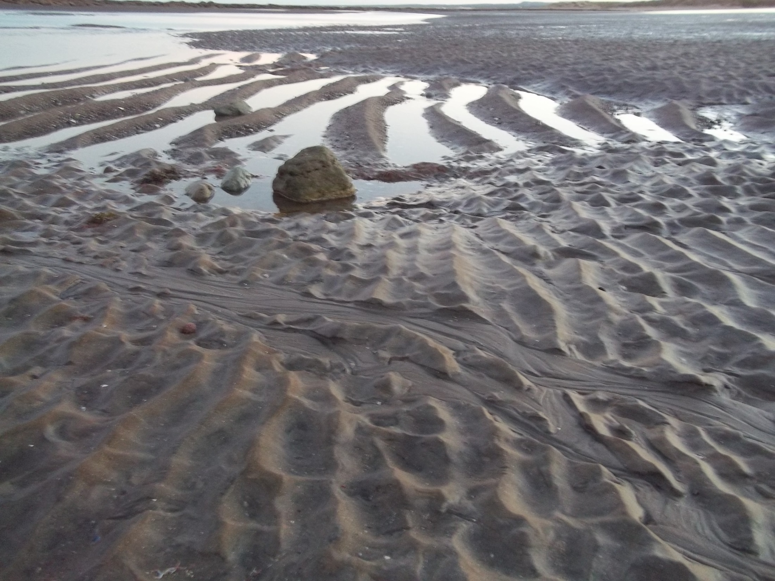
Obedience

Slide 36
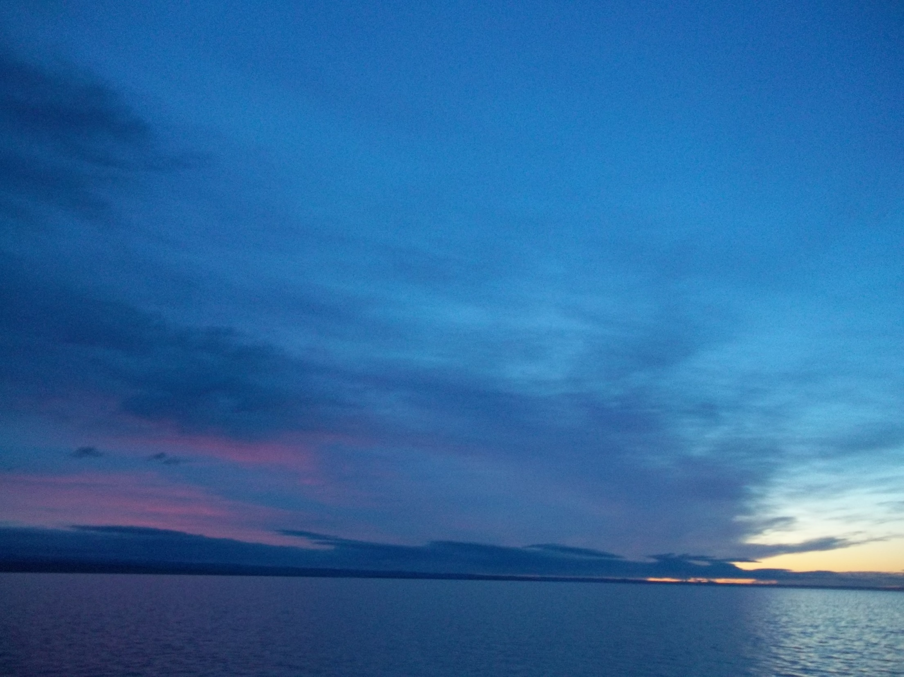
Respect, love, awe and tenderness
rebuild the church

Slide 37
The walk of daily conversion

Slide 38
The Soulspark

Slide 39
Questions for Breakout Groups
As we from our four Orders connect, what can we share with each other that illuminates poverty/humility, love and joy that will help us be effective witnesses and examples in creative ways to this hurting world we live in?

Slide 40
Agape Feast Liturgy
Joint Committee on Franciscan Unity
Saturday, April 22, 2023

Slide 41
A Note on the Liturgy
This liturgy is specifically intended for use by Franciscans from different orders and different communions who wish to share a “virtual common table”. The Agape Feast can be used as a stand-alone liturgy or it can be used at the beginning or end of a shared “virtual meal”, or interspersed with an order of worship. The liturgy is adapted from the Iona Abbey Worship Book.

Slide 42
Welcome
As Franciscans, we come from different traditions to follow the journey of Francis and Clare. We come as different people to serve One God, who calls us to unity as the family of God.

Slide 43
Call to the Feast
Andrew: Out of darkness came light,
Ron L.: and the power of God was revealed
Andrew: in the running wave and the flowing air,
Ron L.: in the quiet earth and the shining stars.

Slide 44
Call to the Feast (continued)
Andrew: Out of the dust came life,
Ron L.: and the image of God was revealed
Andrew: in the human face and the gentle heart,
Ron L.: in the warmth of flesh and the depth of soul.

Slide 45
Call to the Feast (continued)
Andrew: Out of justice came freedom
Ron L.: and the wisdom of God was revealed
Andrew: in the need to grow and the will to love,
Ron L.: in the chance to know and the power to choose.

Slide 46
Call to the Feast (continued)
Andrew: And God looked at the creation,
Ron L.: And behold, it was very good.

Slide 47
Psalm 116:12-19 (Marie)
How shall I repay the LORD
for all the good things God has done for me?
I will lift the cup of salvation
and call on the name of the LORD.
I will fulfill my vows to the LORD
in the presence of all God’s people.
Precious in your sight, O LORD,
is the death of your servants.

Slide 48
Psalm 116:12-19 (Continued)
O LORD, truly I am your servant;
I am your servant, the child of your handmaid; you have freed me from my bonds.
I will offer you the sacrifice of thanksgiving
and call upon the name of the LORD.
I will fulfill my vows to the LORD
in the presence of all God’s people,
in the courts of the LORD’s house,
in the midst of you, O Jerusalem. Hallelujah!

Slide 49
Pause for reflection.

Slide 50
Introduction to Prayer of Adoration (Andrew)
I will keep on thanking God
with constant words of prayer.
I will glory in the living God;
the humble will hear and be glad.

Slide 51
Prayer of Adoration (Ron N.)
Let us pray.
Living God, our loving parent: you cherish your creation, and we praise you.
With earth, air, water, fire: in our element as your children, we praise you.

Slide 52
Prayer of Adoration (continued)
With our lips, with our lives: in all our diversity, each one made in your image, we praise you.
Because, in Jesus, you came to share our human lives: our sorrow and our joy, we praise you.
Because your Spirit is at work today: encouraging, enabling, surprising us, we praise you.

Slide 53
Prayer of Adoration (continued)
Poor as we are, you give us hope: Salt of the earth, you give us meaning and purpose, and we praise you.
Amen.

Slide 54
Mark 9:50 (Marie)
Salt is good; but if salt has lost its saltiness,
how can you season it? Have salt in yourselves,
and be at peace with one another.

Slide 55
Pause for reflection.

Slide 56
Prayer of Confession
Andrew: Salt is good, but if salt has lost its saltiness, how can you season with it?
Ron L.: Giving God, you blessed us with saltiness, but we became bland.
Marie: You trusted us with your Word, but we did not keep it.

Slide 57
Prayer of Confession
Ron N.: You lit a flame in our midst, but we hid it under formality, smothered it with our fears.
Andrew: God, in your mercy, forgive us.

Slide 58
Pause for reflection.

Slide 59
Giving Thanks for Our Time Together
All are invited to speak forth a single word or a brief phrase of thanks for something that happened during our time together. A simple response may be used such as, “Generous God, we thank you.”

Slide 60
Psalm 34:8 (Marie)
Taste and see that the Lord is good;
happy are they who trust in him!

Slide 61
Pause for reflection.

Slide 62
Introduction to Sharing the Feast (Andrew)
Although separated by geography, we are all invited to share a common table as followers of Jesus, Francis, and Clare – a Franciscan Agape Feast. At this table we come as beloved siblings in the Holy Family of God. Taste and see that God is good.

Slide 63
Sharing the Feast
Each participant, having present a portion of bread (or festive bun, oatcake, or sweet bread) and a cup or glass of a fruit beverage, now partakes of both, giving thanks to God for the fellowship being shared in this gathering and the Presence of the Lord which we have experienced during our time together.
After two minutes or so, Andrew continues with the following prayer.

Slide 64
Prayer of Thanksgiving (Andrew)
As we share this bread, we thank you, God, for our daily bread, for the food which delights and nourishes us, and for the companionship that sustains us as Franciscans.
We thank you, too, for this beverage to quench our thirst, and for the Living Water with which you surprise and enrich and transform our lives.

Slide 65
Prayer of Thanksgiving (Andrew)
We give thanks for this feast at which all Franciscans can share a foretaste of the Holy Realm.
All: Amen.

Slide 66
The Lord’s Prayer
Andrew: Gathered into one by the Holy Spirit, let us pray as Jesus taught us, using the words that are closest to each of our hearts:
All: ___________________

Slide 67
A Prayer of Blessing (Ron L.)
Giving God, bless all whom you have gathered in this time and space. May we be aware of your presence and of each other at every meal and in all our sharing.
All: Amen.

Slide 68
Passing the Peace
Andrew, with hands clasped in a sign of reverence, bows towards the participants on the screen, offering the sign of peace “May Peace and All Good be with you” or “Pace e Bene”
In response, participants, with hands clasped in a sign of reverence, bow towards those on the screen offering the same sign and statement of peace.

Slide 69
Prayer for Peace
Brother E. Louis Canter, OEF
God, give us peace in our hearts,
in our families, in our church,
in our communities, in our world, this day.
Help me to be an instrument of peace today,
so that your love and mercy is understood and lived. Amen.

Slide 70
Dismissal (Ron N.)
Let us go forth with the love of Christ!
All: Thanks be to God!

