Slide 1
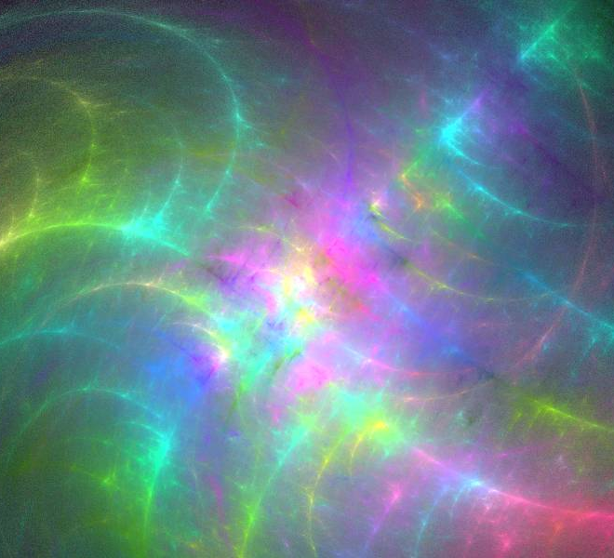
People of God: A Sacred Prism
Joint Committee on Franciscan Unity
Special Recognition to Roots & Branches: Programs for Spiritual Growth Founder- The Reverend Masud Ibn Syedullah for Developing this Program
This Photo by Unknown Author is licensed under CC BY-SA

Slide 2
The Creator’s Prism is like no other. The intensity and wonder create in our hearts can only be expressed by love.
Light pours through the prism of life to be dispersed in every shade of color. Rich in depth and each layer, a unique expression of the One. All necessary, to the great painting of life.

Slide 3
Muslim, Jewish, Christian , Traditions searching for united wisdom and understanding of our Creators plan for us.
Wells dug deep in the ground, harnessing the river of Light: Compassion, Love, Peace, Joy, Patience, Kindness, Faithfulness, Gentleness and Forgiveness.

Slide 4
Love is at the Center
We are called to live the Word. May it be from The Koran, The Torah, the Old or New Testament of our respective traditions. We are challenged to bring living life to the words, written of old; breathing the Spirit that unites us.

Slide 5
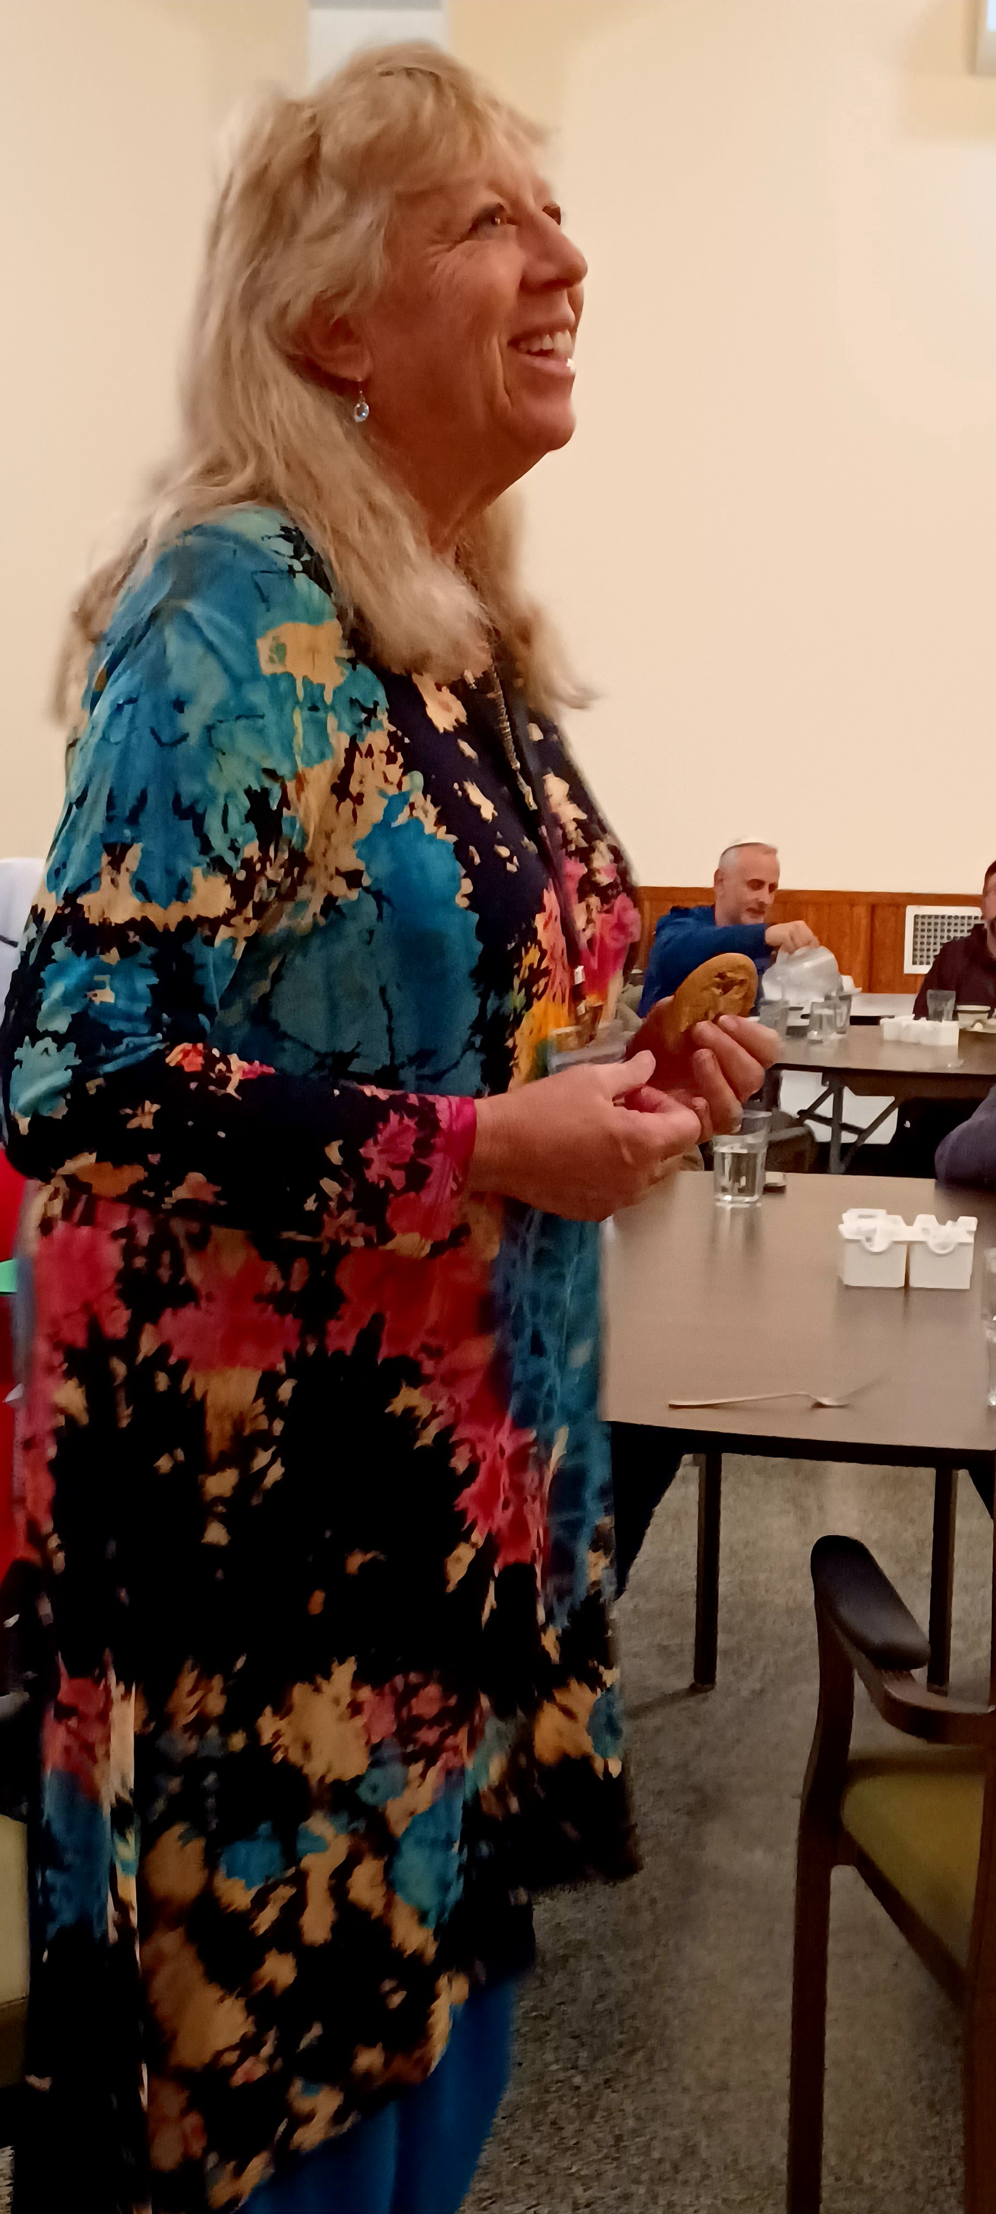
“Can I receive the Divine Kiss in the color of the sky?
In this breath?
With This step?
Can I open to the gift that God is giving me in “this”?
Rabbi Shefa Gold’s Curriculum on the
Song of Song Reflection in Love

Slide 6
“One alone so luminous in her mother’s heart.” (S of S)
“Can I install a constant remembrance of One Alone / Unity consciousness, even as I engage with multiplicity, the vast variety of myriad experience?”

Slide 7
“Opening to God’s Love and Unity”
“Listen God-wrestlers, there is only One. And you shall love that One with all your heart, with all your soul and with all your might.”
“Grant us peace, goodness, grace, love and compassion!”

Slide 8
“Things That Make for Peace.”
“Sit with the Lord of Peace,
The Source of Peace,
The Originator of Peace,
The Spring of Peace,
The Reservoir of Peace,
Opening your heart to the gentle whisperings of His Love

Slide 9
“Oh Allah,
You are the Peace, Peace from you and Peace comes back to you,
So, grant us, Oh Allah, with Your Peace and admit us to the home of Peace.” (Prophet Mohamad)

Slide 10
“The Beautiful & Powerful Names of Allah”
“Ya Rahman (The Compassionate) Ya Allah
Ya Rahim (The Merciful) Ya Allah
Ya Hay (The Ever-Living) Ya Allah
Ya Qayoum (The Self-Existing) Ya Allah
Ya Malik (The King) Ya Allah
Ya Shafi (The Healer) Ya Allah
Ya Quddus (The Holy) Ya Allah
Ya Salam The Peace) Ya Allah
Ya Mu’min (The Granter of Security) Ya Allah
Ya Muhaymin (The Controller) Ya Allah
Ya Aziz (The Powerful) Ya Allah

Slide 11
Walking Meditation
“Ner Adonay Nishmat adam Chofays kol-chadray-vaten.
My Soul is the flame of God that searches the inner chambers. (Proverbs 20:27)

Slide 12
Faith Community to Build Outreach - Weaving Relationships- The Rev. Stephen Holton
“You can not just Pray for Peace, you must act to build relationships of unity.
Once you are connected with God, and you offer Him your service, it is no longer you who acts- but God through you.
May we become Feral Mystics!
“That which you have had healed, we need to take it out to others.” The Rev. Stephon Holton

Slide 13
“What Gift do you bring to the Table?”

Slide 14
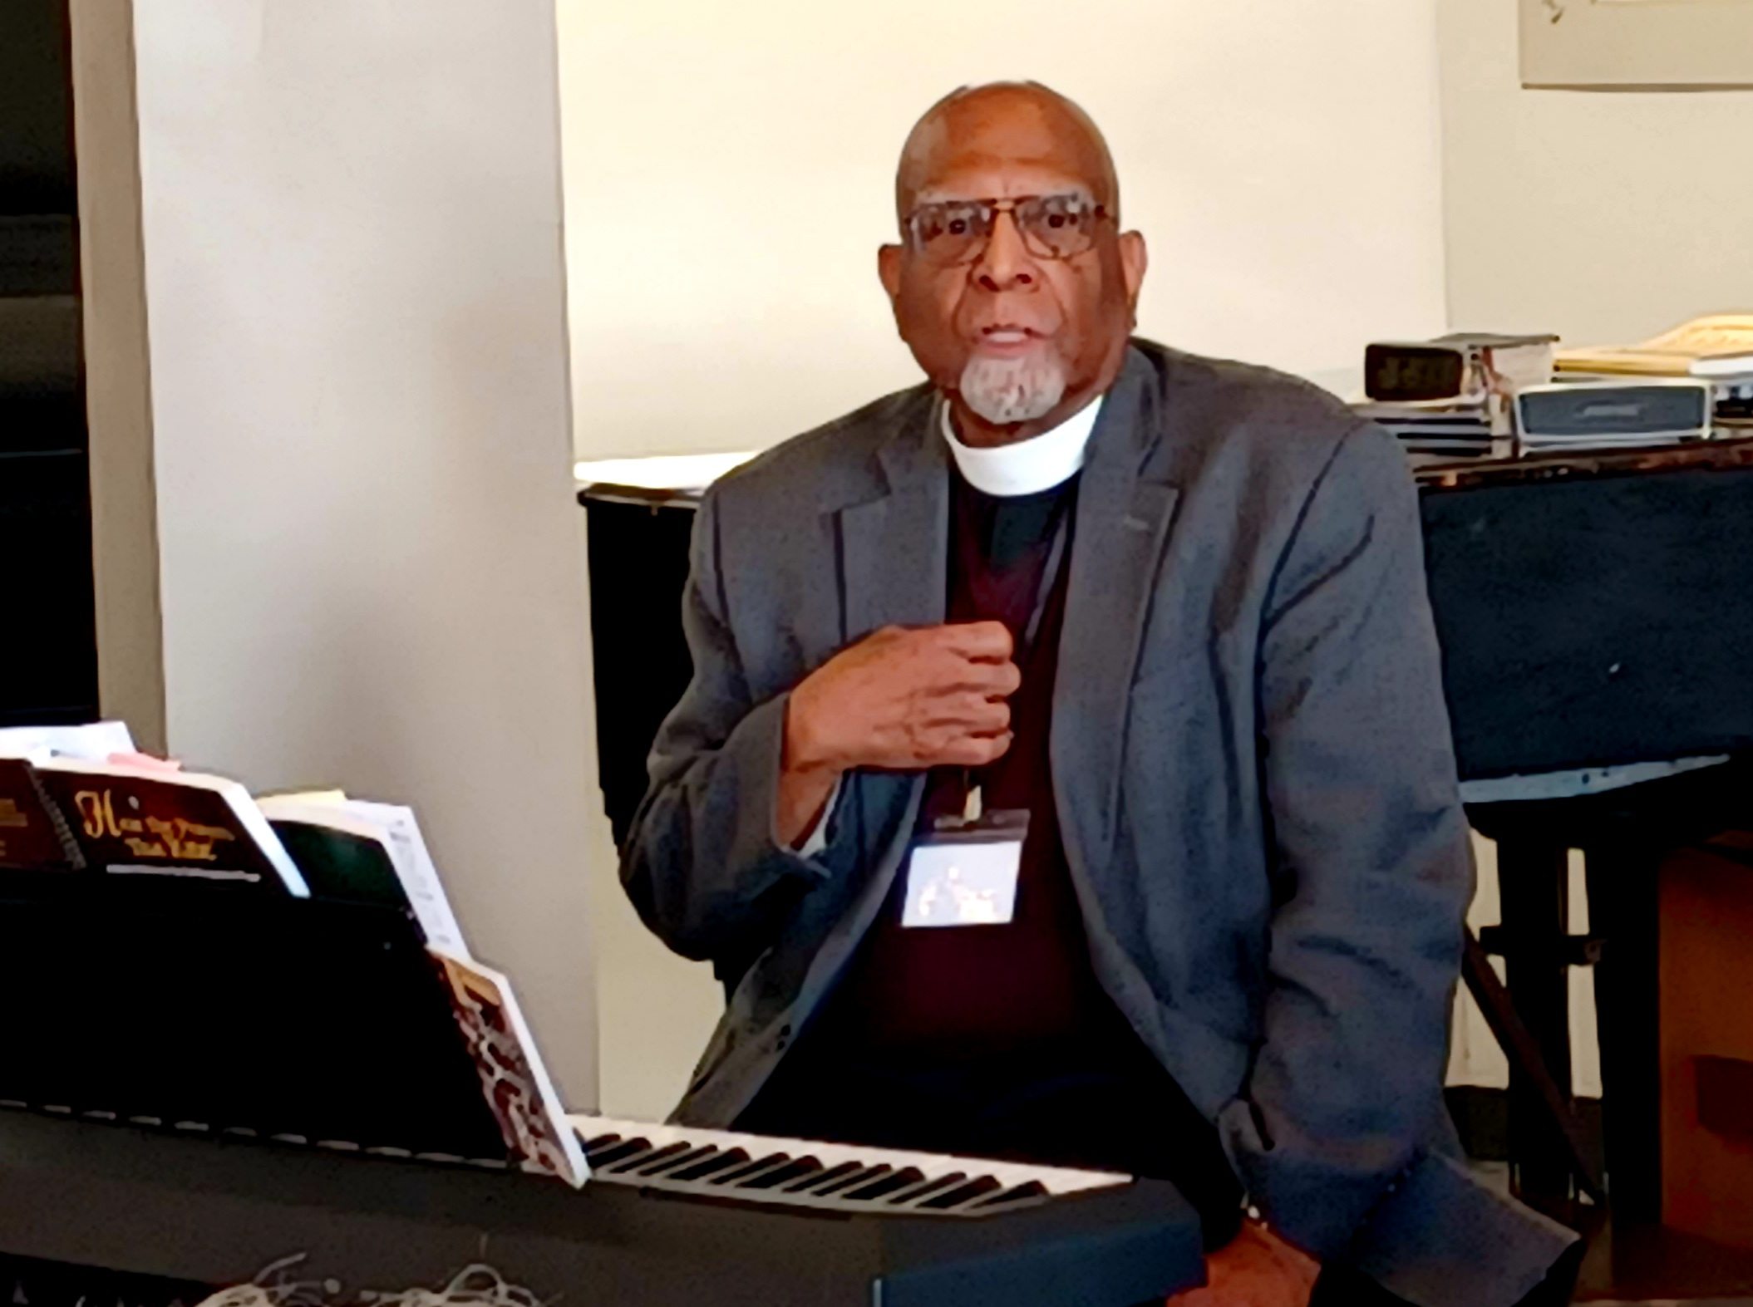
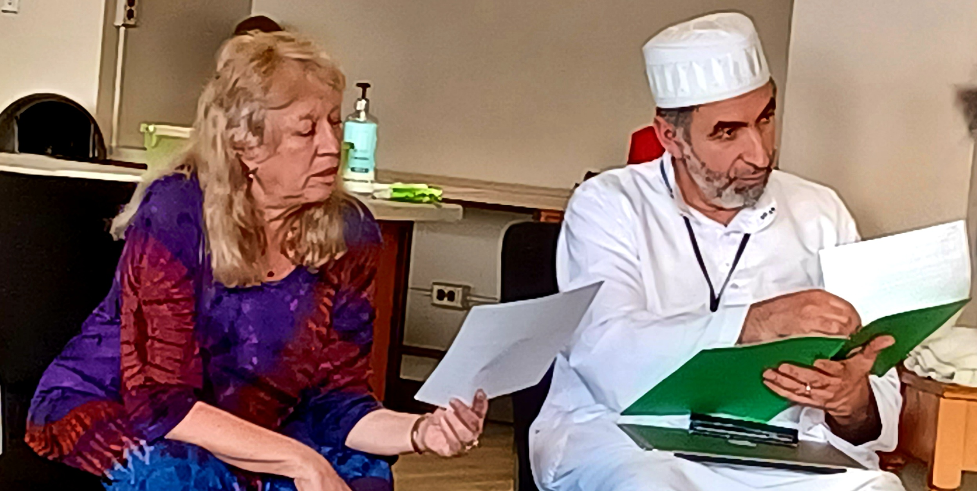
Light as a symbol in the Abrahamic Traditions

Slide 15
Taize’Chant- Offering our hearts is meditative chant
“Bless the Lord, My Soul, and bless God’s holy name.
Bless the Lord, my soul, who leads me to life.” (Psalm 103:1)

Slide 16
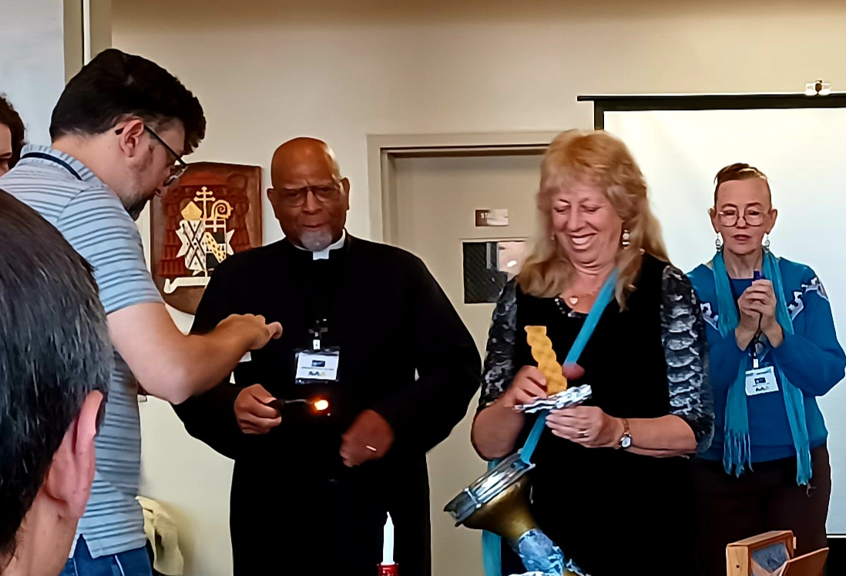
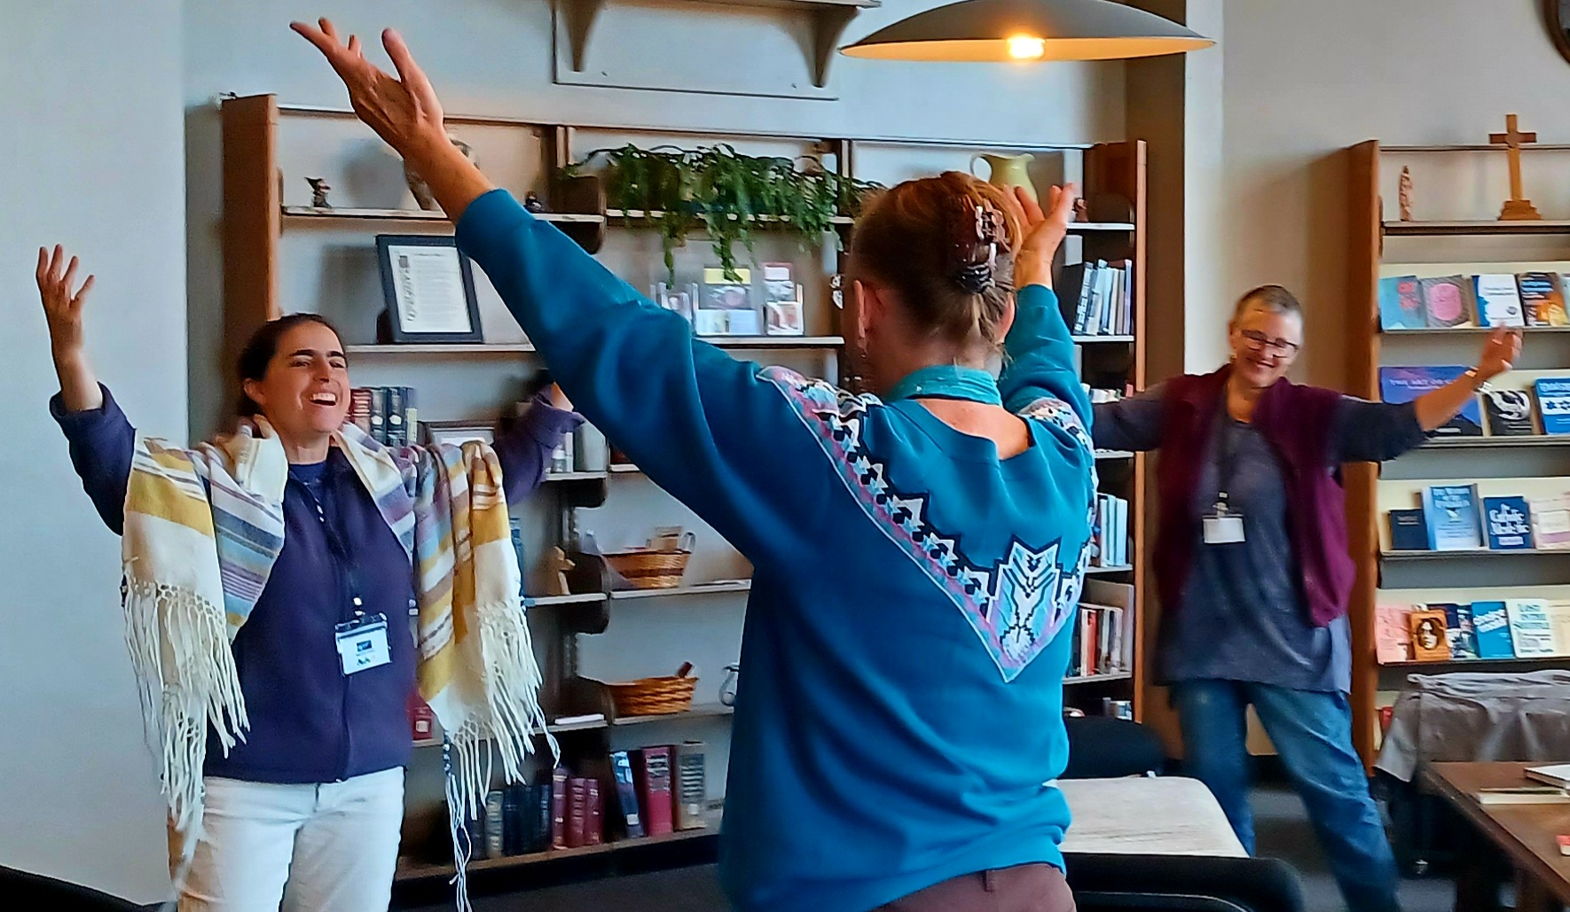
Havdalah and Commissioning

Slide 17
Take your Light out into the world.

Slide 18
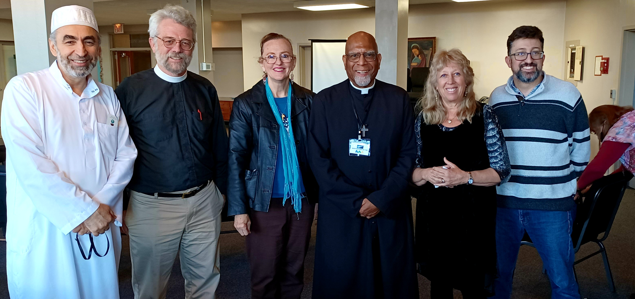
Joint Committee Members and Presenters

Slide 19
Thanks to all who have made this a beautiful reflection of Unity and Creators Love: Rev Masud Ibn Syedullah TSSF, Rev Steven Holton, Rabbi Sefa Gold, Imam Mohamad Bashar Arafat. Each has given of their heart and words do not express the depth of Gratitude; The Joint Committee of Franciscan Unity, Graymore Retreat Center, and all others who have made this a momentous gathering of Unity. Go Light the World.

Slide 20
Additional Resources: The Rev. Masud Ibn Syedullah https://rootsandbranchesprograms.org Love at the Center www.RabbiShefaGold.com Civilizations Exchange & Cooperation Foundation Imam Mohamad Bashar Arafat www.cecf-net.org Cadeio.org Creation. Online Ecumenical and Interfaith GuideBook USCCB.org www.CatholicClimateCovenant.org Ofsusaecumenicalinterfaith.org https://www.vatican.va/content/vatican/en/search.html?q=ecuminism+and+interfaith+relations&from=&to=&in=all&sorting=relevance

