Slide 1
VISIONING SEEKING GOD’S VISION FOR FORMATION
“Throw open the windows of the [Secular Franciscan Order] and let the fresh air of the spirit blow through.”
~ Pope John XXIII ~

Slide 2
COMMENTARY ON
Gather the Wisdom, Weave a Dream: Transformative Visioning as a Refounding Process
(Ted Dunn, Ph.D. in Human Development)
But first, let me tell you a story.
Note: Story of the Great White Rabbit from the book
“In Pursuit of the Great White Rabbit” by Edward Hays pp. 10, 11

Slide 3
TRANSFORMATIVE VISIONING IS . . .
A communal faith journey.
The power of the journey lies in how we walk it.
WHY
Because the journey will test our willingness to step out in faith and leave behind that which no longer has meaning, and
Ideally, if we commit to the process and see it through to completion, eventually we will develop a prophetic vision, which is --
God’s path for the future of formation.

Slide 4
TRANSFORMATIVE VISIONING IS . . .
A process of deciding and choosing the appropriate course of action to pursue in our relationship to the will of God.
If we are willing to be open and receptive to the Holy Spirit, God will reveal His will through special graces and insights.

Slide 5
Ted Dunn says we are to:
Gather wisdom.
Weave a powerful dream that awakens our collective souls.
Provide our sisters and brothers with a dream that will bring forth deep and radical change,
SO THAT
NEW LIFE CAN EMERGE.

Slide 6
Ted Warns Us of Pitfalls:
Less than All-out Effort – Maintenance vs What can be
Insufficient Depth – Commitment to the shoreline or the depths of the ocean
Limited Ownership – Commitment by a few or by the OFS as a body
Resistance – Another word for it is Conflict – the choice to avoid resolution or encounter it in dialogue.
Glorification of the Past – Calls for a both/and approach

Slide 7
SIMPLY ANNE’S THOUGHTS
ON VISIONING

Slide 8
I BELIEVE VISIONING IS . . .
The exercise of the gift of Wisdom by which the Holy Spirit enables us to see things from God’s point of view.
Using the gift of Counsel, the Holy Spirit inspires us to know God’s will.
Wisdom and Counsel work together; pray for these gifts.

Slide 9
IN ADDITION, I BELIEVE VISIONING CAN BE. . .
The process by which we discover the dream God has for us in regard to formation.
If,
the essential components of the formative process are present, primarily the spirit and essence of the Rule, I believe there is substantial assurance that this is God’s will for our Order.

Slide 10
SUGGESTED VISIONING TOOLS
Primary: Pray for guidance.
Having studied your homework, reflect on the relevant data provided.
Be aware of your own preconceived ideas and agendas. They could distract you.
Listen to others’ points of view.
Finally: Choose options that are in accord with the Gospel and our Holy Rule

Slide 11
I DO BELIEVE THAT
Visioning is NOT easy and there will be some uncertainty.
All that can be expected of us is to use whatever gifts we have to arrive at a degree of consensus and then be willing to share what we believe God is saying to us as a visioning body.
And I do believe, the Spirit of Truth is available to all and our trust in God is sufficient for us to be at peace without having to have all the pieces in place.

Slide 12
FINALLY, IN EVALUATING THE VISION, IT SHOULD …
Reflect love
Express truth
Promote unity
Reflect harmony and goodness

Slide 13
BLAST FROM THE PAST 15th Congress—Newark, Delaware—1997
The theme was Now is the Time - The Kingdom of God is at Hand. Secular Franciscans, friars and religious gathered together to face the upcoming millennium with a strategy of leadership, an authentic experience of community, and a vision to build a world based on Christ's values. It was a challenge to Secular Franciscans to return to the excitement of its founding story.
Sr. Brenda Hermann, MSBT,
facilitated sessions on Refounding.

Slide 14
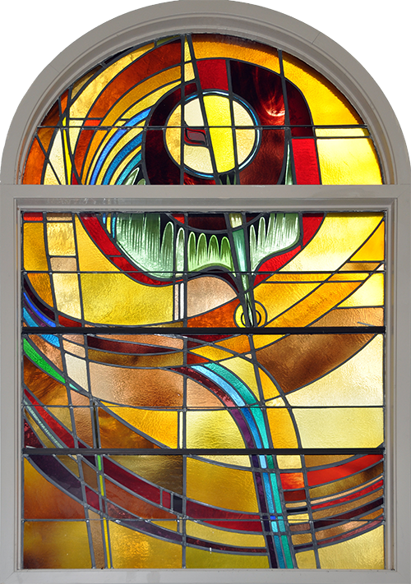
Let us END with just a moment
of quiet reflection.
Let us close our minds to the distractions and reflect on God’s presence,

