Slide 1


Come and See
1
Notes:
1

Slide 2
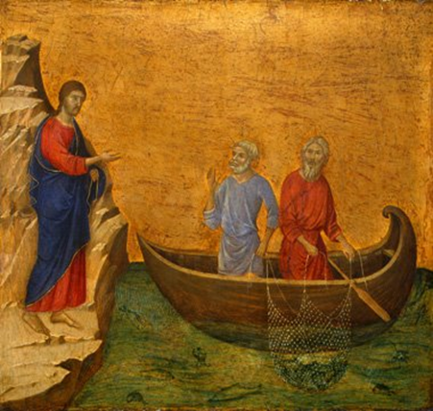
“Come, follow me…”
1
Notes:
1

Slide 3
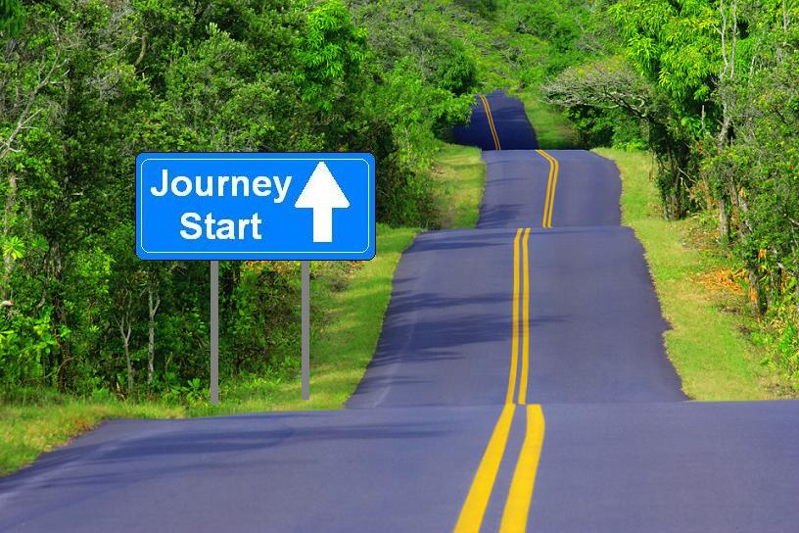
1
Notes:
Each of us is on a spiritual journey….
1

Slide 4
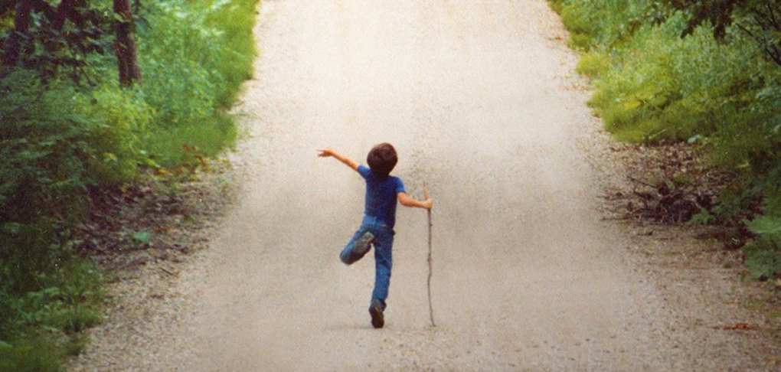
1
Notes:
For Franciscans it’s a journey of JOY!
1

Slide 5
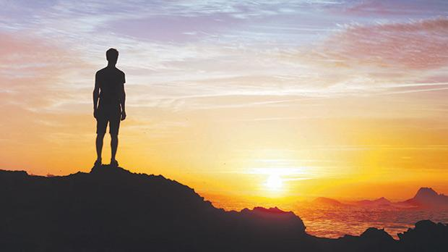
1
Notes:
Maybe you are here today because you are seeking something more on your spiritual journey.
1

Slide 6
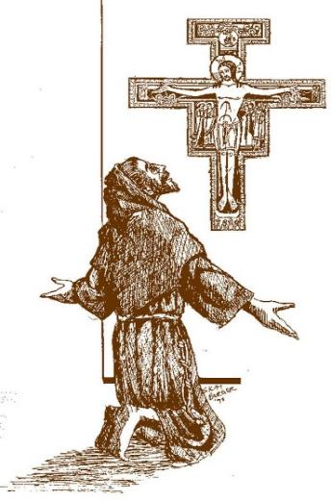
1
Notes:
Francis of Assisi was seeking as well.
He heard the Lord call to him, “Go and rebuild my church.”
1

Slide 7
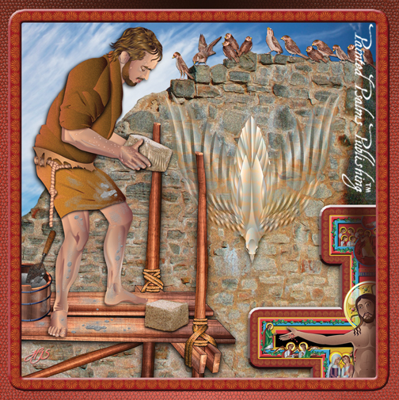
1
Notes:
And so that's what Francis did. He set about rebuilding the church of San Damiano, little by little, stone by stone.
As he continued to listen to Christ’s call, he embraced a new way of life.
1

Slide 8

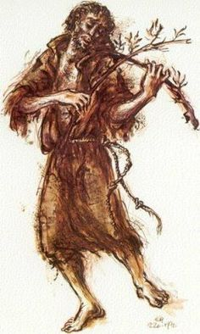
1
Notes:
Francis lived his new life passionately.
And he was filled with joy!
1

Slide 9
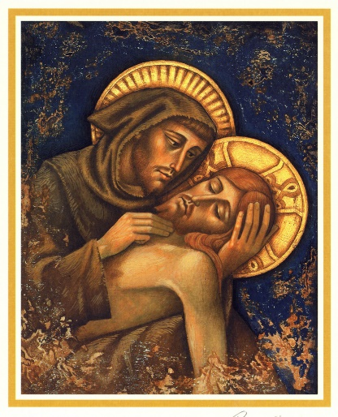
1
Notes:
He embraced poverty, humility & simplicity.
He embraced a life of prayer.
He desired to conform his life to the life of Christ.
1

Slide 10
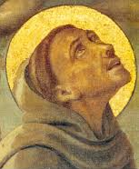
1
Notes:
Francis’s heart burned with love for Christ - but that love was not to remain in his heart alone.
What God planted in Francis’s heart was meant to be shared.
1

Slide 11
1
Notes:
Soon others hearts were stirred - and awakened to their own call to follow Christ in the way of St. Francis.
One in particular was a young girl of Assisi named Clare.
Francis could see that she, too, had been called by God. Their hearts shared the same gift. They were filled with the joy of the Gospel and the love of Christ.
Clare embraced this new life. Other women followed her. This was the beginning of the Order we know today as the Poor Clares.
1

Slide 12
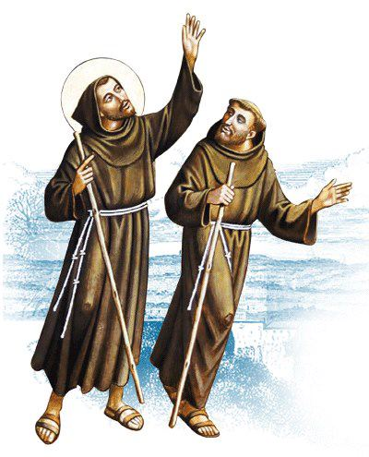
1
Notes:
Young men in Assisi were drawn to live the life that Francis had embraced.
How amazed Francis must have been that others wanted to follow him! As Francis himself tells us, “the Lord gave me brothers.”
1

Slide 13
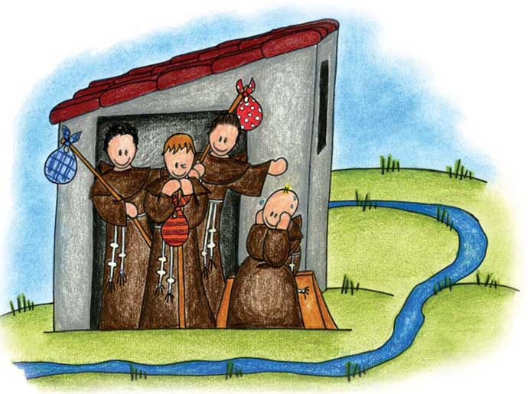
1
Notes:
Francis saw that the Lord was calling him to live the Gospel life together with others - in fraternity.
These were the first Franciscans brothers. At that time they were known as the “lesser brothers” or the Friars Minor.
1

Slide 14
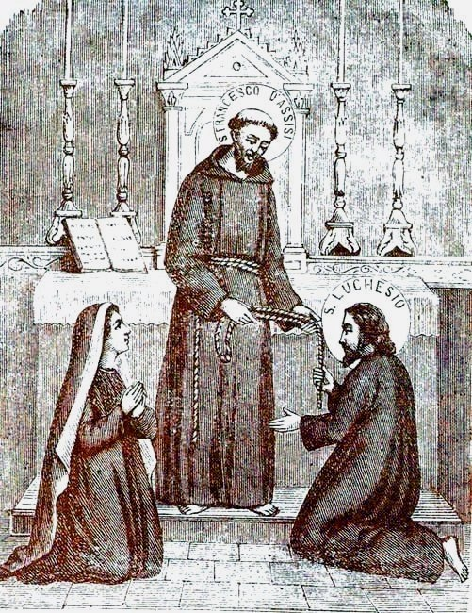
1
Notes:
Married men and women also came to Francis and wished to join him. Francis, inspired by the Holy Spirit, wrote a Rule of Life for lay persons – a Rule for those living in the world who heard the call to live the Gospel.
These men and women were the first Secular Franciscans.
At that time they were known as “brothers and sisters of penance.”
1

Slide 15
First Order – Brothers
Second Order - Poor Clares
Third Order - Secular
1
Notes:
And so the structure of our Franciscan Family is threefold:
First Order – Brothers
Second Order- the Poor Clares
Third Order – Secular
1

Slide 16
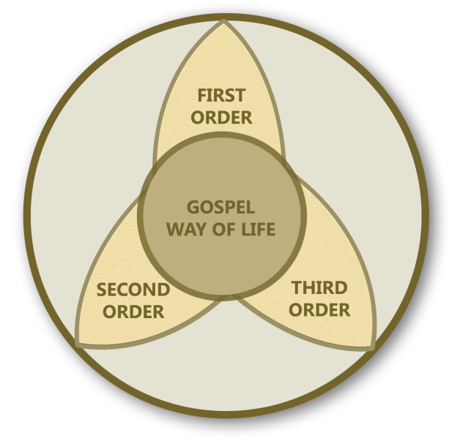
1
Notes:
Within the Franciscan Family the Secular Franciscan Order holds a special place. It is a true Order within the Catholic Church - one of three distinct Orders – 1st, 2nd and 3rd - all part of the Franciscan Family – all following the Gospel way of life.
1

Slide 17
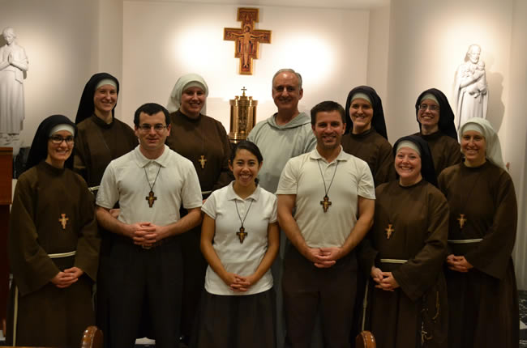
1
Notes:
We have a beautiful family.
And what began in just one heart, is now in many hearts beating as one. How our family has grown over the years!
1

Slide 18
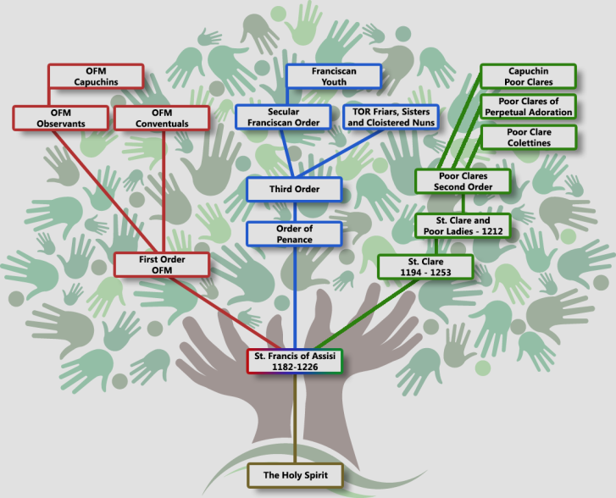
1
Notes:
The seed that God had planted in Francis grew like a mustard seed into a large tree. Here you can see our full family tree.
There are three main branches. Each branch has developed throughout the years – but as you can see it all started with the Holy Spirit, and St. Francis’s response of “Yes, this is what I want!”
(You might explain the different branches.)
1

Slide 19
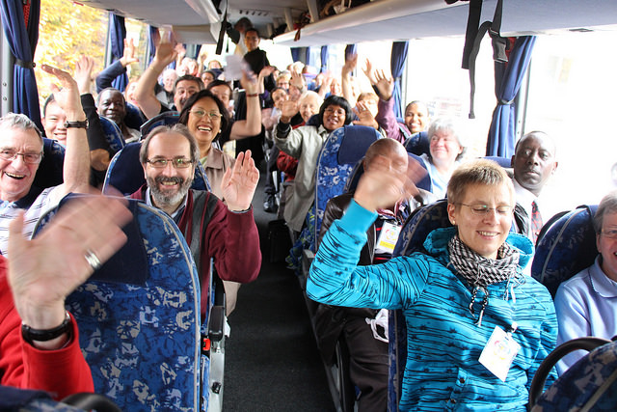
1
Notes:
Just as a biological family passes along certain traits, so it is with the Franciscan family – there is a living transmission. What better way to preserve and pass along this treasure!
Here is a photo of our international Secular Franciscan family. This photo was taken in 2014 when Seculars from over 100 countries gathered in Assisi for the General Chapter.
1

Slide 20
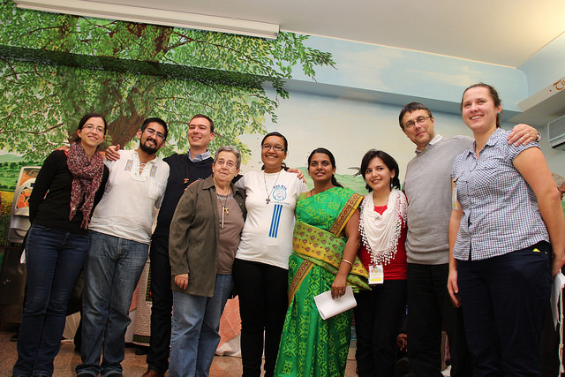
1
Notes:
We are blessed to belong to an Order that unites us with brothers and sisters all over the world.
Here is another photo from the 2014 General Chapter.
The Secular Franciscan Order has over 350,000 members worldwide.
1

Slide 21
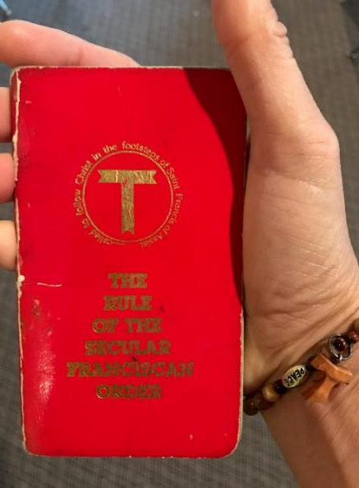
1
Notes:
Secular Franciscans follow a Rule based on living the Gospel of Jesus Christ – going from Gospel to life, and life to the Gospel.
1

Slide 22
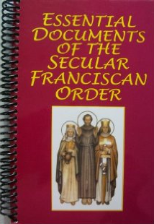
1
Notes:
As the Franciscan Order grew it was clear that some guidelines would be needed. We have Constitutions that help us apply the Rule to our daily lives, and Statutes that outline our organization and structure. We call these our “Essential Documents”.
Optional text:
Our documents unify us, and help us organize ourselves. I appreciate that the word organize is derived from the word “organic”. So to me, to organize is a way to maintain the life of our Order.
1

Slide 23
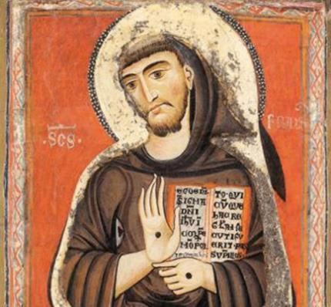
“At every step in following the Franciscan Way, from Inquiry to Ongoing Formation, in prayer, one should journey with Sacred Scriptures in one hand and the Secular Franciscan Rule and General Constitutions in the other hand, and with both eyes, as clearly as possible, focused on Christ and Francis.”
Deacon Tom Bello, OFS
Former National Minister
1
Notes:
Here former National Minister Tom Bello tells us about the place of these documents in our lives…
(Read from slide)
We journey in prayer…
“Let prayer and contemplation be the soul of all they are and do.” (OFS Rule, Article 8)
1

Slide 24
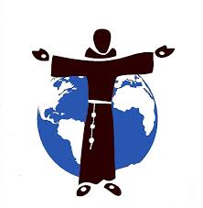
1
Notes:
Since the Secular Franciscan Order is worldwide, let’s look a bit at the structure of the Order…
1

Slide 25
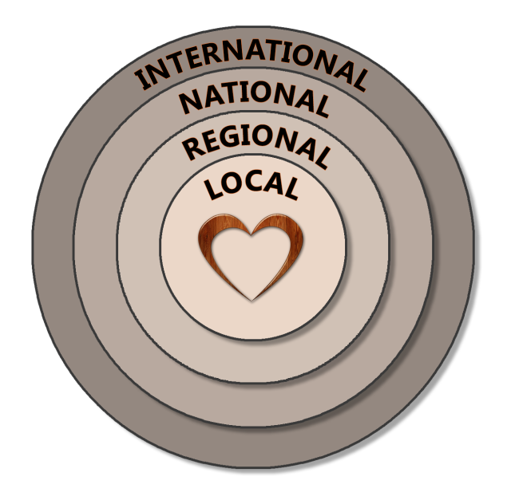
1
Notes:
At the heart of the Order is the Local Fraternity.
Surrounding the local fraternity are the other levels of fraternity – regional, national and international. Each level in turn exists to animate, guide and support the level within it.
All Secular Franciscans belong to all four levels of fraternity.
Local fraternities are grouped geographically into Regions.
Our National Fraternity has 30 Regions. All the National Fraternities in the world – over 100 countries – form the International Fraternity.
1

Slide 26
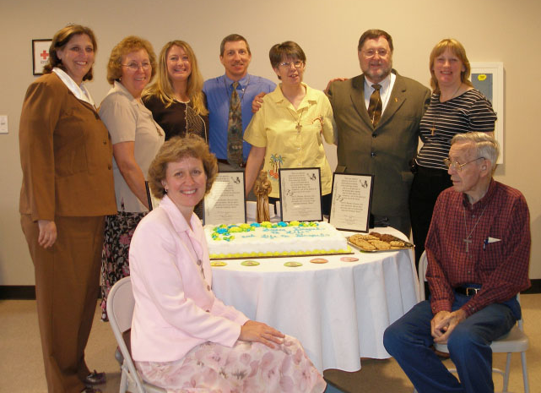
1
Notes:
The Local fraternity is the place of our Franciscan birth. It is a place where we are nourished and formed. In our local fraternity we share experiences and encourage each other. Here is where we celebrate our love for God and our love for each other. It is a school of holiness – a place of formation.
This is a photo of our own local Fraternity.
(You might insert your own photo.)
1

Slide 27
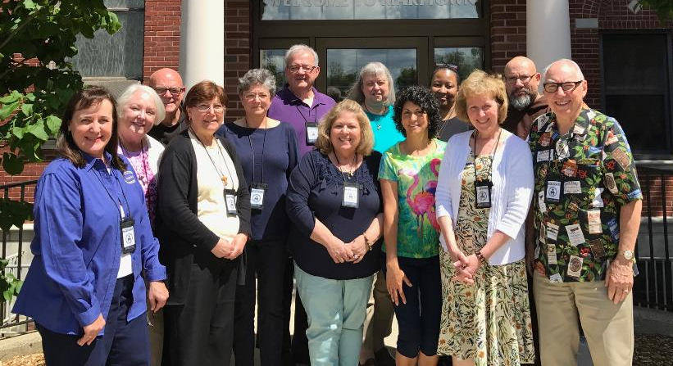
National Executive Council of the Secular Franciscan Order
(NEC)
1
Notes:
Within each fraternity, at every level, there is a Council and a Minister. The Council and Minister serve together to animate and guide the fraternity. As Franciscans we embrace “Servant Leadership”.
Each fraternity is accompanied by Spiritual Assistants from the First Order and Third Order Regular. We journey with our brother Friars who help us stay true to the Franciscan charism.
This is a photo of our National Executive Council taken in 2017.
From L to R:
Councilor: Mary Frances Charsky
Councilor: Joan Geiger
Spiritual Assistant: Br. Bob Brady OFM
International Councilor: Mary Stronach
Formation Commission Chair: Mary Anne Lenzi
Spiritual Assistant: Fr. Christopher Panagoplos TOR
Councilor: Willie Guadalupe
Vice-Minister: Mary Bittner
Secretary: Jane DeRose-Bamman
JPIC Commission Chair: Carolyn Townes
Minister: Jan Parker
Spiritual Assistant: Br. Alexander Escalera OFM Cap.
Treasurer: Jerry Rousseau
1

Slide 28
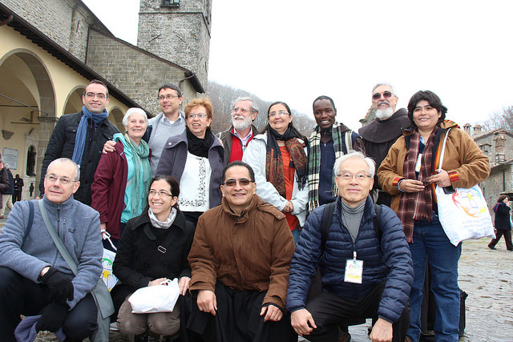
International Council of the Secular Franciscan Order
(CIOFS)
1
Notes:
Here is our International Council (from 2014)
The bonds we share with our International Secular Franciscan Family are strong and getting stronger.
The fact that we are a worldwide order is a strength that we have only begun to tap into.
1

Slide 29
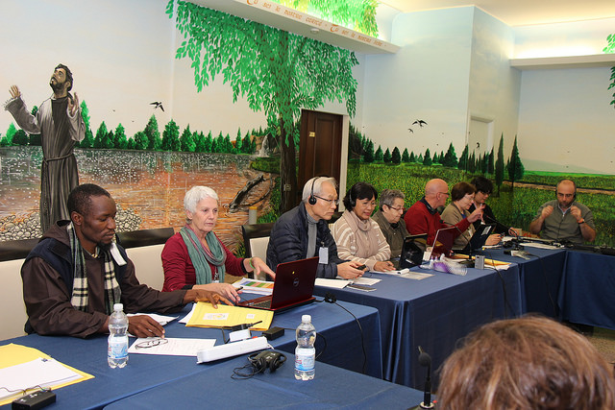
1
Notes:
Here is the international council at work. (Note the translation equipment!)
1

Slide 30
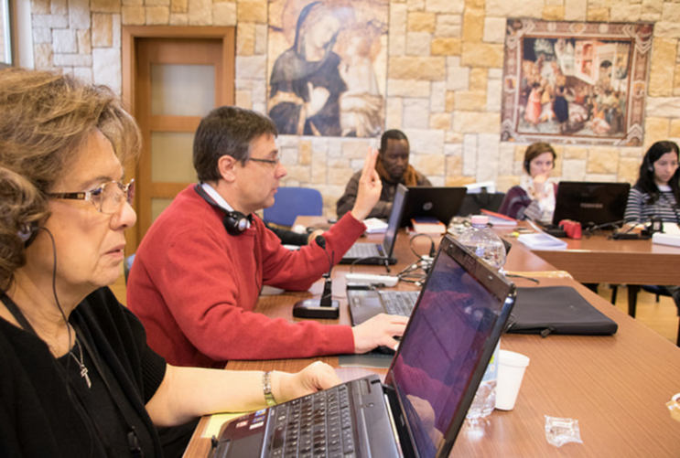
1
Notes:
Another photo of the international council at work.
1

Slide 31
1
Notes:
The local fraternity that you are visiting today is named “San Damiano Fraternity” (Insert your own fraternity name.)
Along with 10 other local fraternities we make up “St. Clare Region”
(Insert your own Region’s name.)
Our Region is part of the “National Fraternity of the Secular Franciscan Order – USA “ OR “OFS-USA” for short.
1

Slide 32
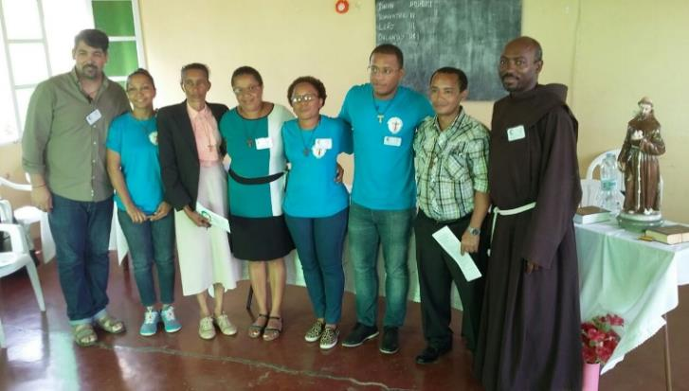
1
Notes:
Together…. with fraternities from all over the world….
1

Slide 33

“Come to Him, a living stone…
Chosen and precious in the sight of God..
To be built into a spiritual temple..”
1 Peter 2:5
1
Notes:
…we are the living stones – living stones in the Church that St. Francis was called to rebuild.
1

Slide 34
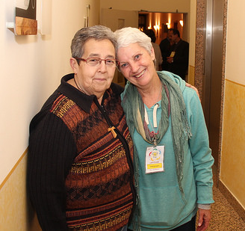
1
Notes:
God has chosen us for a purpose. And he has united us in a beautiful worldwide Order.
I am thrilled, time after time, in speaking to one Franciscan sister or brother after another, to find that our hearts are so similar.
1

Slide 35
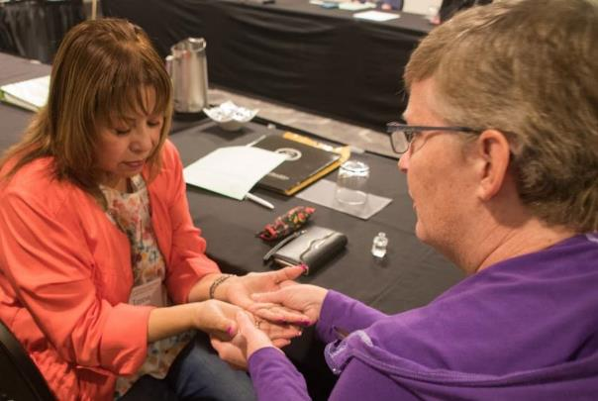
1
Notes:
We are there for each other – there to help each other live what we have professed – joy, peace, hope, simplicity, conversion, conformity to Christ. Together we journey to holiness.
Franciscans are bearers of peace. We seek ways of unity and harmony through dialogue, trusting in the divine seed in all people, and in the transforming power of love and pardon. (OFS Rule, Art. 19)
1

Slide 36

1
Notes:
Along with our love for all people is our love and care for all creation. St. Francis felt a kinship with all creation because all of us were created by the same Father… and all creation bears the imprint of the Most High.
(OFS Rule, Art. 18)
Francis would sing of Brother Sun, Sister Moon, Sister Mother Earth, Brother Wind, Sister Water, Brother Turtle, Sister Sparrow, etc.
1

Slide 37

1
Notes:
We are called to serve and promote justice. We serve in many ways in our daily lives at work and at home – and in many different ministries, both individually and in our fraternities.
We run soup kitchens and shelters. We have established airport chapels and assist refugees. We help impoverished families in India and in the Amazon. And in many places we work side-by-side with the Friars and Sisters.
(Of course it would be good to name your own ministries…)
1

Slide 38
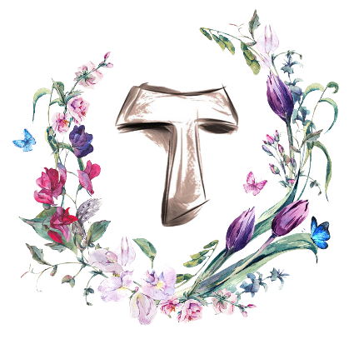
1
Notes:
The TAU cross is our habit … a sign that we are Franciscans, on an amazing journey…
1

Slide 39
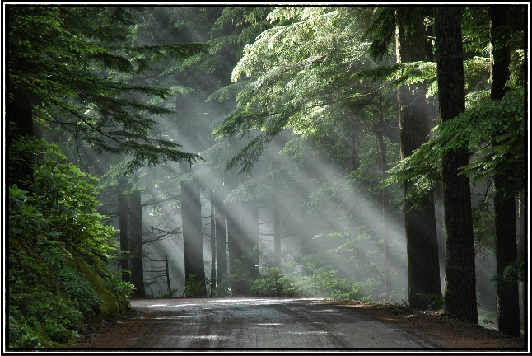
1
Notes:
…and all of us would like to share with you what a beautiful journey it's been!
We invite you to walk with us. Come and see if, perhaps, this Franciscan life is something you are called to live.
Optional text: We will take a few moments now to answer any questions, and then N. (insert name) will tell you about the Pathway you might take, if you would like to look into this a little further…
(After this presentation another member of the fraternity comes forward to explain the Pathway to Profession.)
1

Slide 40
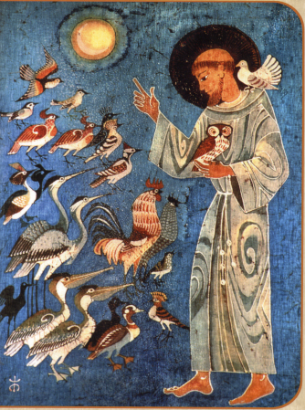
The Lord give you peace!
1
Notes:
The Lord give you peace!
<number>

